Slide 1

Plant Reactome
Technical Overview

Slide 2
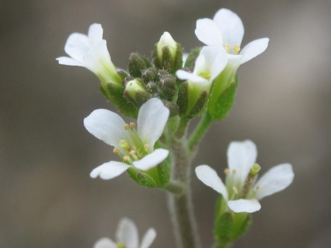

Project Focus
Take Reactome’s successful model for curating, representing, and analyzing human pathways (and projections to other species), and apply it to plants by:
  Converting -Cyc pathway data for plants to Reactome’s data struture
  Building “Plant Reactome” database(s) and web interfaces based on the existing Reactome software platform

Slide 3
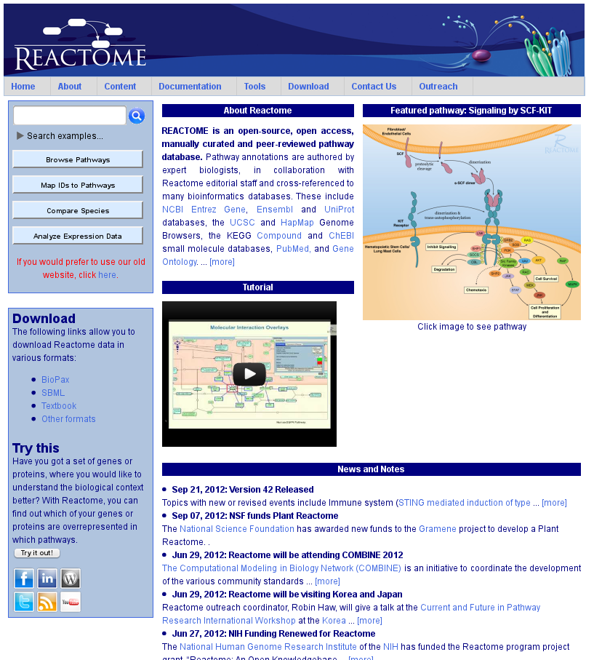
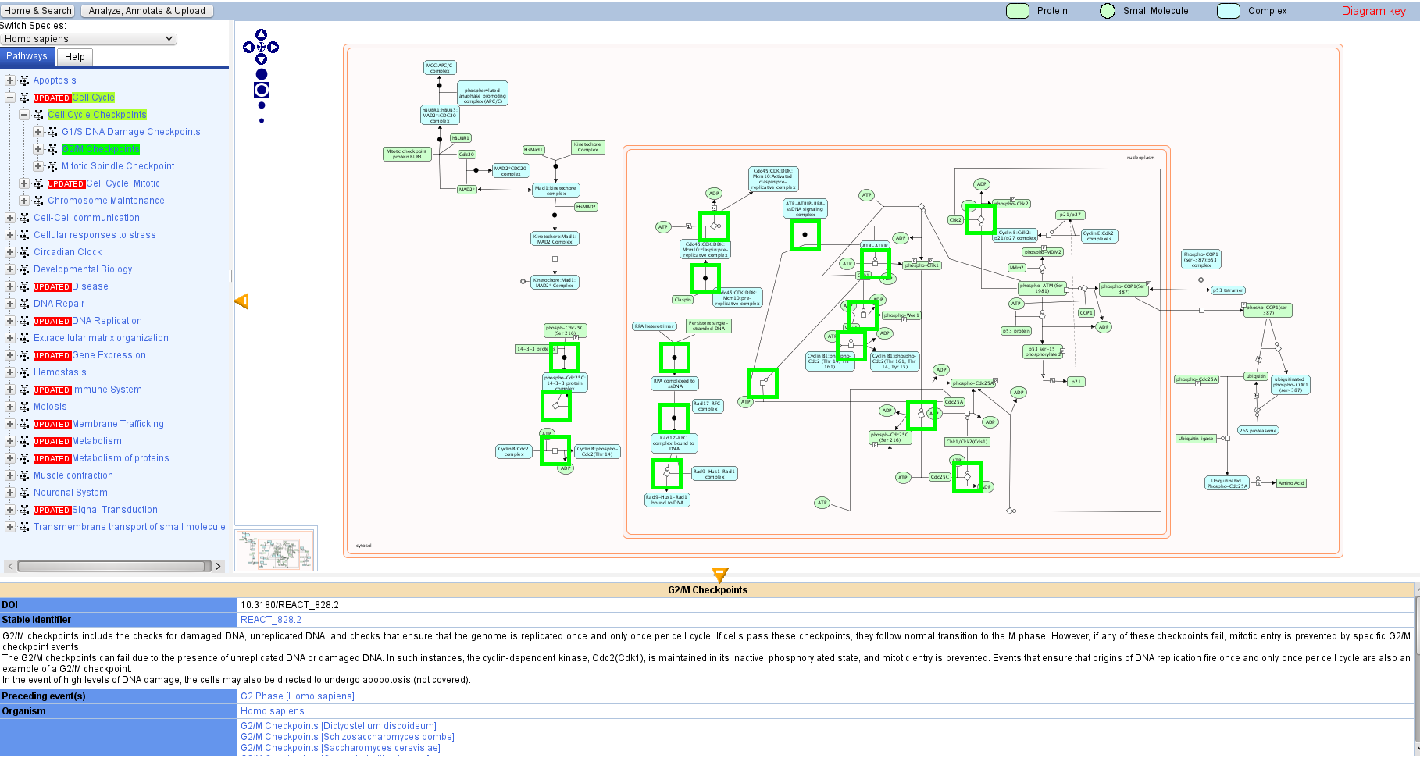
What is Reactome?
Well, most importantly, it’s a pathway database.
Most people interact with that database via the Reactome web site.
Pathway Browser
Notes:
Screenshots of the Reactome web site, curator tool

Slide 4
Data Conversion
We converted RiceCyc and AraCyc data to the Reactome data schema using PathwayExchange (Java).
- Exported –Cyc data in Biopax format (OWL/XML)
- Ran PathwayExchange and associated conversion utilities (i.e. mapping ChEBI identifiers to reference molecules)
- Output format: a Reactome project file (XML)
- Project file was loaded into a curator’s database (MySQL) on Reactome’s development server
Notes:
** We = Guanming Wu and I
Also mention converted Arabidopsis pathways taken from ArabidopsisReactome.org (older site) and a few manually curated Arabidopsis pathways sitting in the Human Reactome db

Slide 5
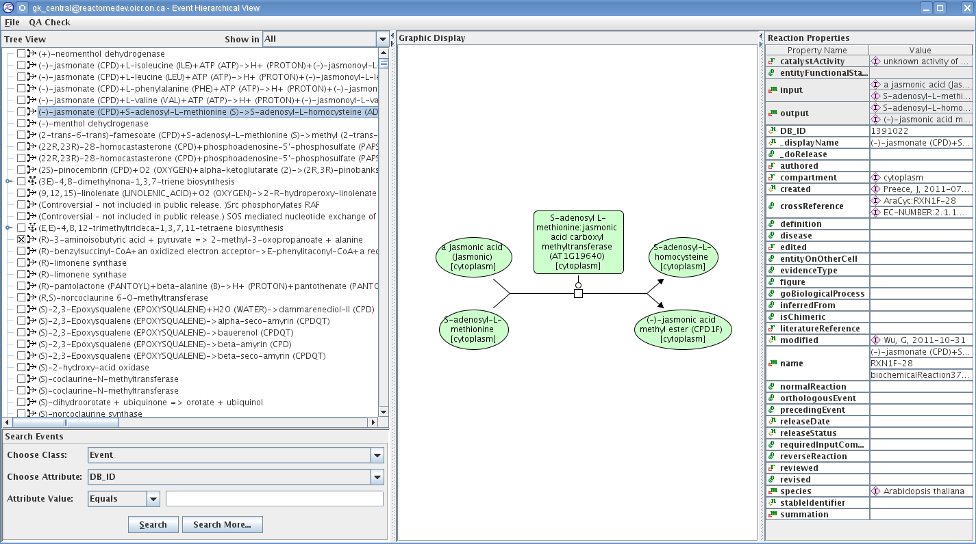
Curation
Vindhya, Palitha, and student workers have been manually curating these converted rice pathways using the Reactome Curator Tool

Slide 6
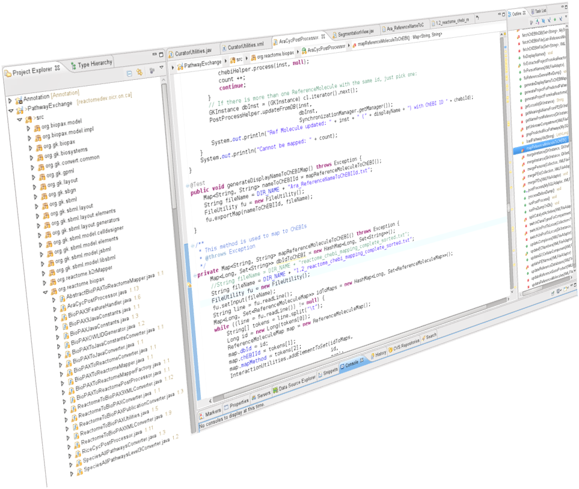
Building Data Management Utilities
Making the curator’s job easier with a little Java…
Automating the import of UniProt data for reference gene products
Cleaning up duplicate UniProt mappings (working w/ EBI)
Changing the cellular location of certain reference molecules
Refining species references for sub-species
Mapping Gramene ID’s to Reactome data

Slide 7
Building the Plant Reactome
Web Application
Hosting: Development is taking place on OSU and newly-installed virtual OICR servers.
Code-base: We are sharing and extending the existing Reactome source code within their CVS project – coordinating enhancements and contributing back to the Reactome project as needed – instead of forking the code.
Data Flow: We will "slice" finished, curated rice pathways from gk_central on ReactomeDev to generate our test data. Rice will act as the designated reference species.
Configuration: Superficially “re-skin" the site as Plant Reactome.

Slide 8
Plant Reactome
Architecture
(Dev & Live: OICR)
Development
Production
Plant Reactome Dev (OICR)
Debian
Apache
Tomcat
MySQL
Perl
Reactome (OICR)
Debian
Apache
Tomcat
MySQL
Perl
Plant Reactome
plants.reactome.org
(completely separate web instance;
initial reference species: Oryza sativa)
Development Web Site
plantreactomedev.oicr.on.ca
Deploy
plant_gk_current
(new db; similar function to gk_current)
plant_gk_current
(new dev db; similar function to gk_current)
Curation
ReactomeDev
MySQL
gk_central
(existing curator db)
Extract rice “slice”; no orthology projections for now

Slide 9
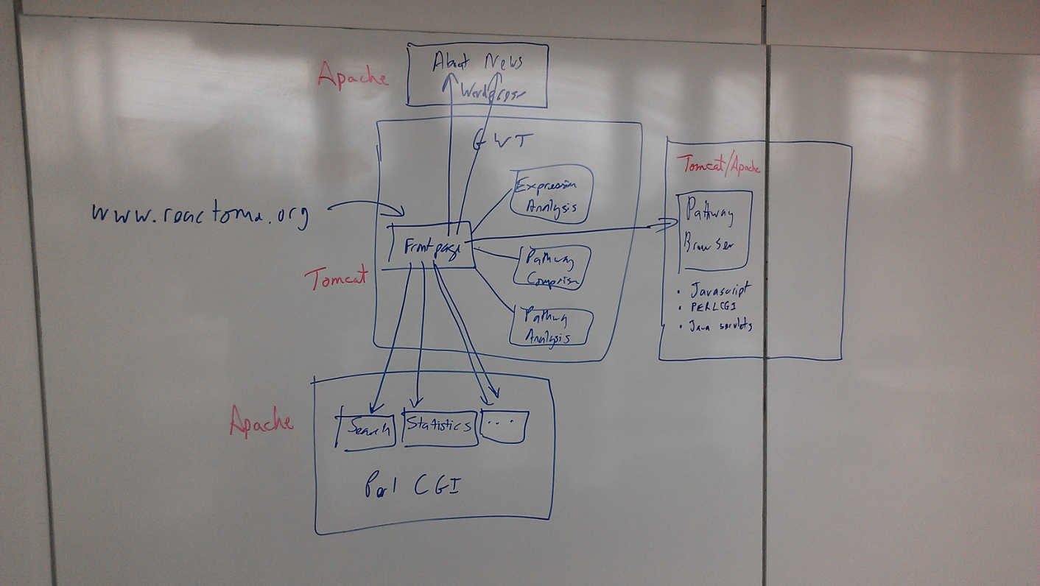
Working with our colleagues at
EBI and OICR
Robin Haw: server mgmt (OICR)
David Croft: Reactome software developer (EBI)
Guanming Wu: Reactome software developer (OICR)
Ahhh, whiteboard.
My old friend…
Notes:
Whiteboarding session at EBI with David Croft

