Slide 1
Gramene Genetic Diversity www.gramene.org/diversity poster: P835
Genevieve DeClerck
Gramene Database Curator
Cornell University
Ithaca, NY
Notes:
I work on the Genetic Diversity module, which focuses on genotype-phenotype and the kinds of datasets that groups in the Rice SNP Consortium is and will be producing
I’d like to give you a brief overview of the Gramene Genetic Diversity module and what kind of role it will play here.

Slide 2
Gramene Genetic Diversity
Data types
Genotype (allele calls, markers)
Phenotype (trait measurements, trait ontology)
Germplasm (passports, stocks)
Species
Rice
Maize
Arabidopsis
Discovery of associations between genetic variation (alleles) and observable traits within populations of rice, maize, and Arabidopsis
Notes:
Our mission is to
-Facilitate the study the genetics of variation within populations of rice, maize and Arabidopsis
- and how this relates to quantitative and observable traits
Allele data, trait measurements and germplasm in rice, maize and arabidopsis are our concentration

Slide 3
Gramene Genetic Diversity
Data
Rice
Currently
  OryzaSNP: 160K SNPs x 20 rice varieties
  15 rice small-scale diversity studies (SSR, QTL)
Upcoming
  ricediversity.org SNP chip data
    1536 SNP x 400 lines
    44K SNP chip
Long term
  ricesnp.org SNP chip data
    600K SNP chip
    “breeders mini-chips” (384 markers)
    Phenotype data (flowering time, and many more)
Notes:
- I wanted to give you an overview of whats in the database now and where we’re heading…
- Our latest rice data addition is data produced by the OryzaSNP project and was discussed in the McNally
et al publication which came out this summer, which comprises about 160,000 SNP calls by 20 diverse rice vars
In the short term we plan on integrating 1536
In the long term, we will be adding resequencing data, results from 600K and 384 mini-chip projects

Slide 4
Gramene Genetic Diversity data
Maize
Short term:
  Maize HapMap 1.5M SNPs x 27 NAM founder lines
  Phenotype data for flowering time and other traits from NAM population
Long term:
  30M SNPs x 27 NAM* founder lines
  2M SNPs x 2200 inbred lines
  Additional phenotype data
NAM=Nested Association Mapping
Notes:
Just a short look at what we have planned for maize. We do coordinate closely with Panzea.org. On our plate currently is getting in results from the Maize Hapmap project

Slide 5
Gramene Genetic Diversity data
Arabidopsis
Currently:
  “2010 Project” 216K SNPs x 931 accessions (250K chip)
Short term:
  Allele calls for 300 more accessions from “2010”
  Phenotype data for flowering time
Long term:
  Additional phenotype data
  1001 Genomes Project re-sequencing data

Slide 6
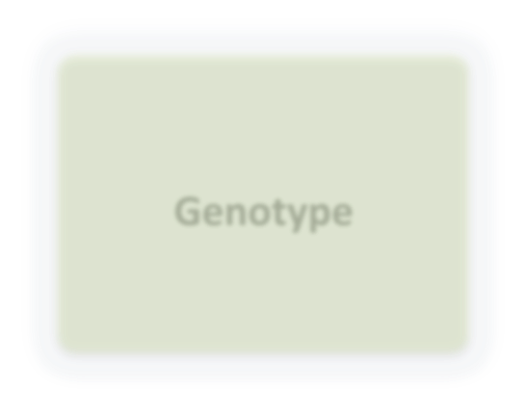
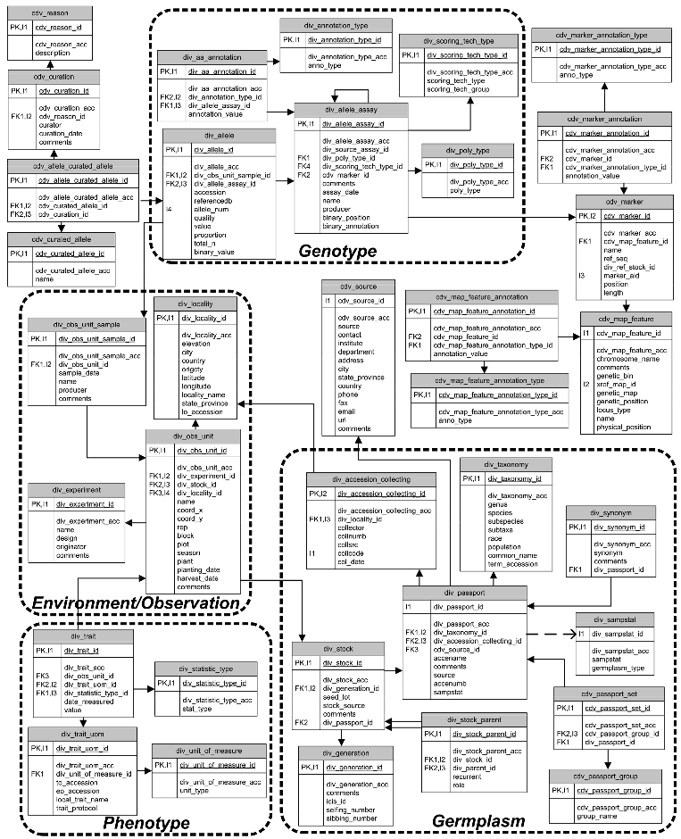
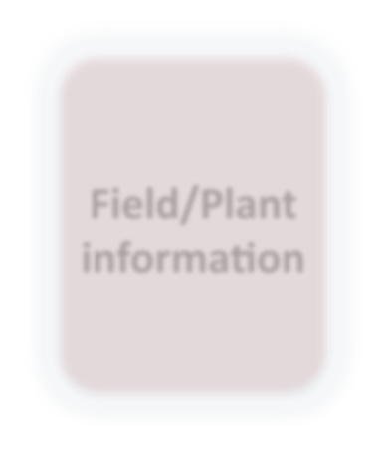

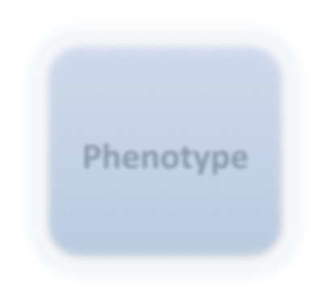
Gramene Diversity Database Schema
(GDPDM)
Genotype
Links genotype, phenotype, germplasm, and field information
GDPDM v 4.0 optimized for efficient handling of large scale SNP data
GDPDM = Genomic Diversity and Phenotype Data Model
Field/Plant information
Germplasm
Phenotype
Notes:
Here is an overview of the database schema that Diversity uses for data storage. GDPDM has been optimized for handling large scale snp and resequenving data. This schema’s greatest feature of course is that it links genotype, phenotype and germplasm under one roof, which will faciliatate sophisticaled data mining.

Slide 7
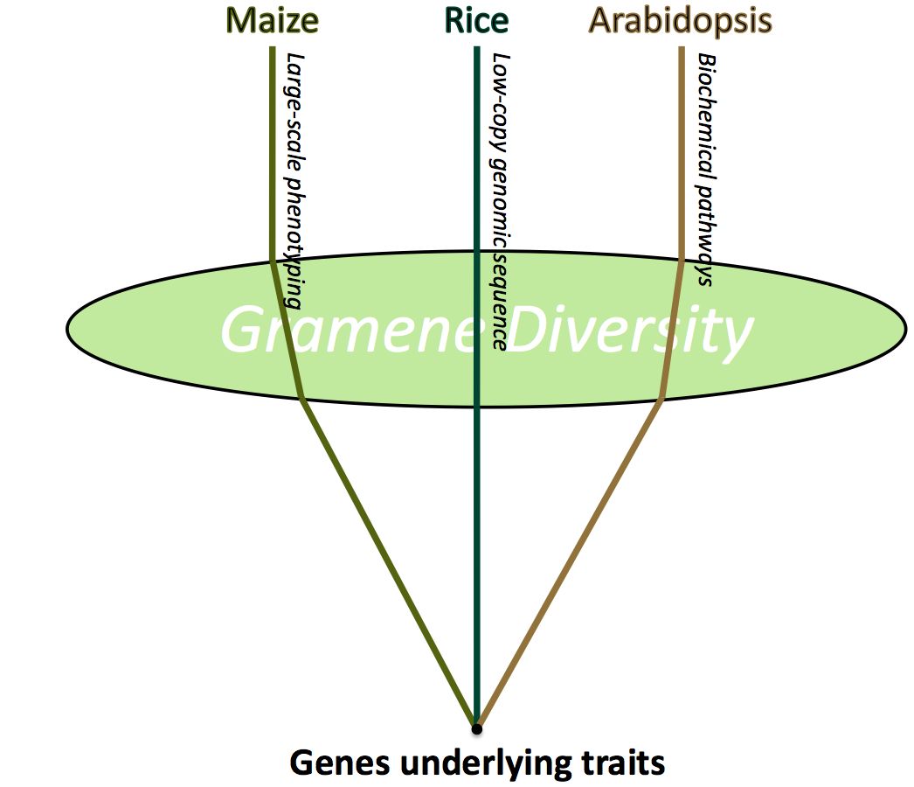
Cross-species model for gene discovery
Charles Chen (PAG Poster #817)
Notes:
Here is a schematic that illustrates why we’re focusing on rice, maize and arabidopsis.. Diversity aims to be “A lens for discovery…..” Each species brings complimentary strengths..
Maize’s large scale phenotyping, rice low-copy genomic sequence and arabi’s rich biochemical pathway library. The end goal being to uncover genes underlying traits. This will involve applying novel statistical filters, which are currently beign developed… this work is headed up by Charles Chen, who is is the room. Poster.
Pooling allelic data and phenotypic observations will facilitate association modeling within and between these three important plant systems

Slide 8
Basic query and navigation www.gramene.org/diversity
  Example #1: Search for allele profile of
  “Bonnet 73”
  Example #2: View all rice germplasm records related to a particular trait
Notes:
Bioinformatics
is the application of information technology to the field of molecular biology

Slide 9
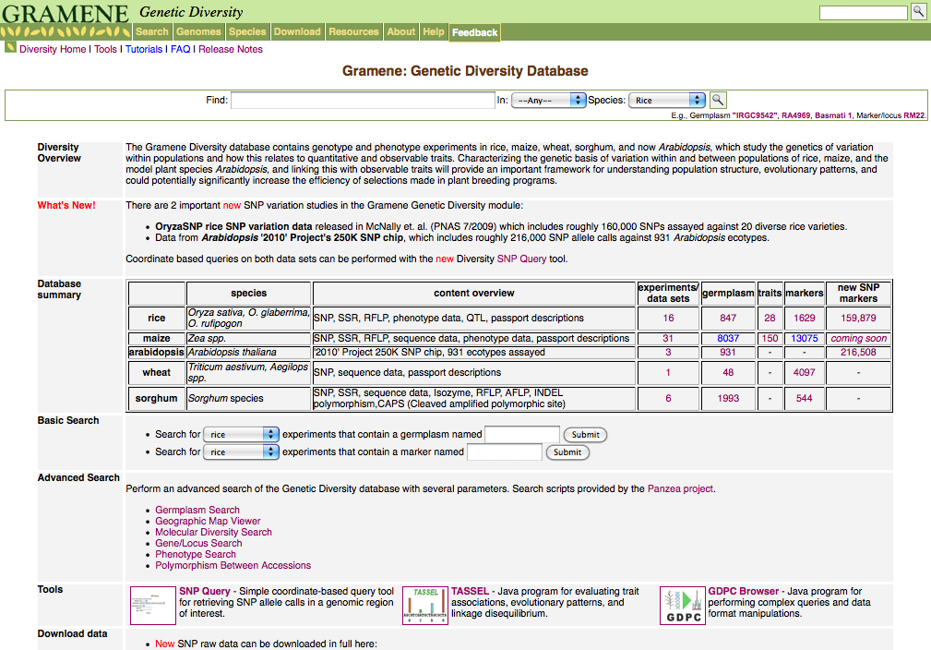
Notes:
Data summary table.

Slide 10
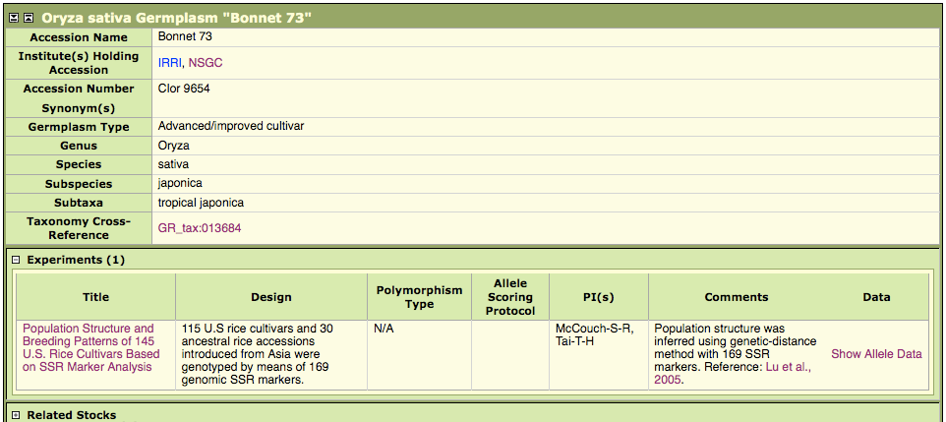
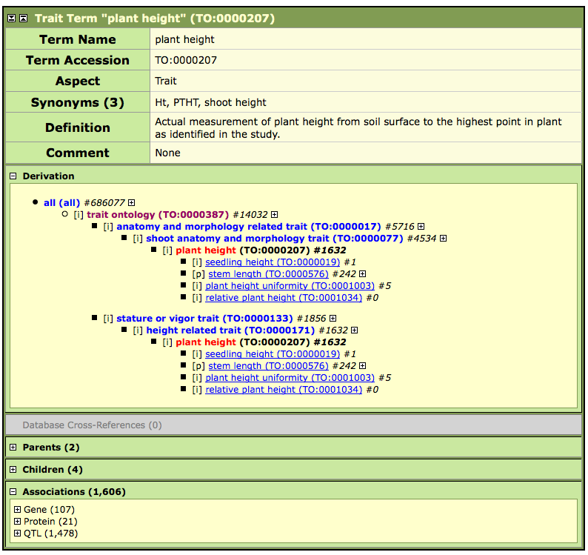
Diversity example #1
Search for allele profile of Bonnet 73
Germplasm record
for “Bonnet 73”

Slide 11
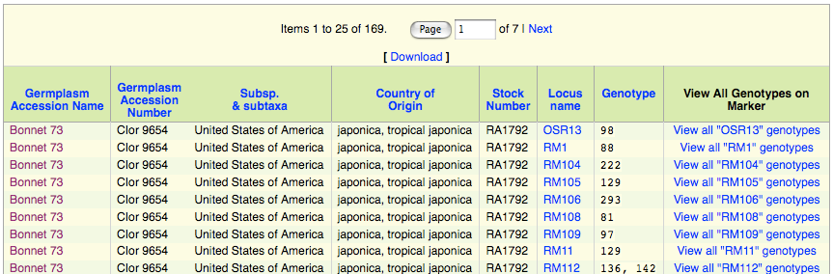
Diversity example #1
169 Bonnet 73 alleles found

Slide 12
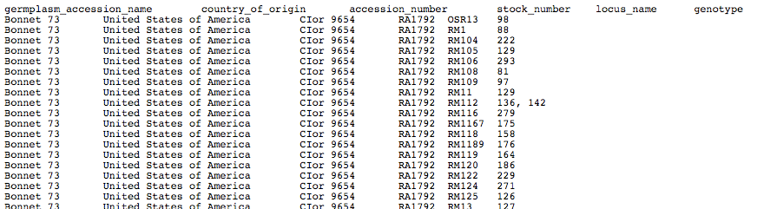
Diversity example #1
169 Bonnet 73 alleles found
Text data dump of
all 169 genotype
measurements

Slide 13
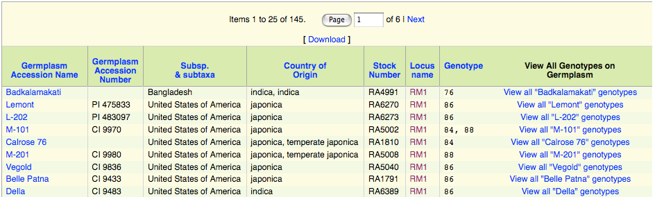
Diversity example #1
All genotypes of marker ‘RM1’

Slide 14
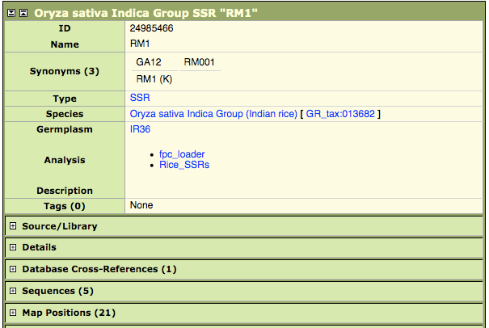
Diversity example #1
All genotypes of marker ‘RM1’
Gramene Marker
record for RM1

Slide 15
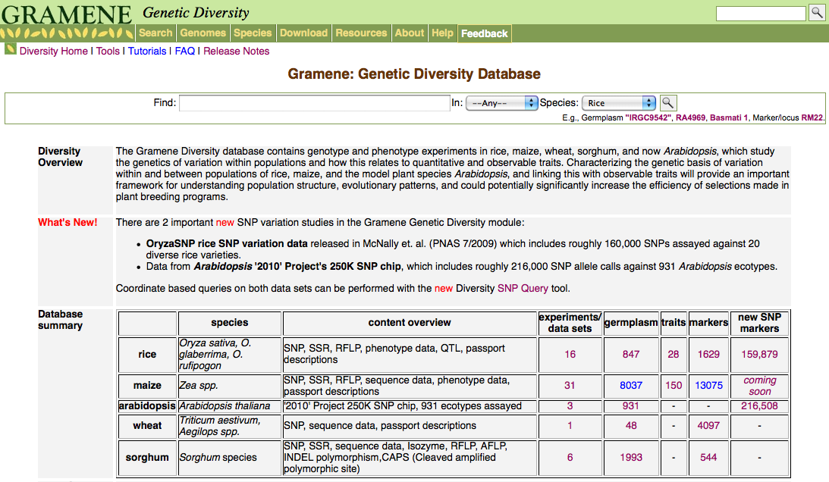
Diversity example #2
View all rice germplasm records related to a particular trait
Click on the trait
number hyperlink
for rice

Slide 16
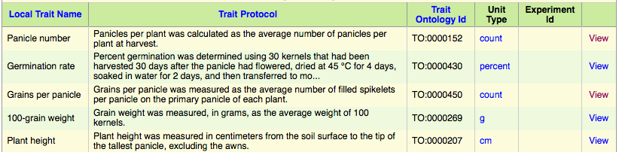
Diversity example #2
View all rice germplasm records related to a particular trait
View trait details for
“Panicle” number

Slide 17
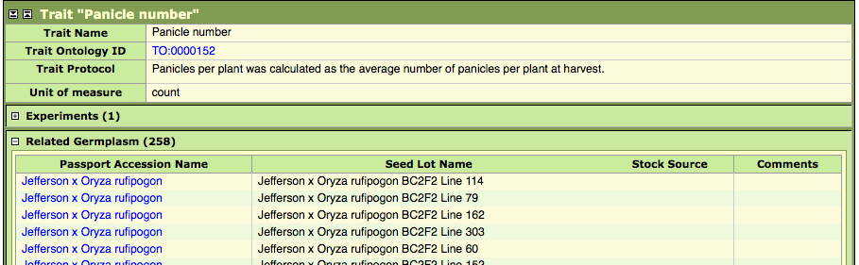
Diversity example #2
View all rice germplasm records related to a particular trait
258 germplasm stock records found related to “Panicle number”

Slide 18
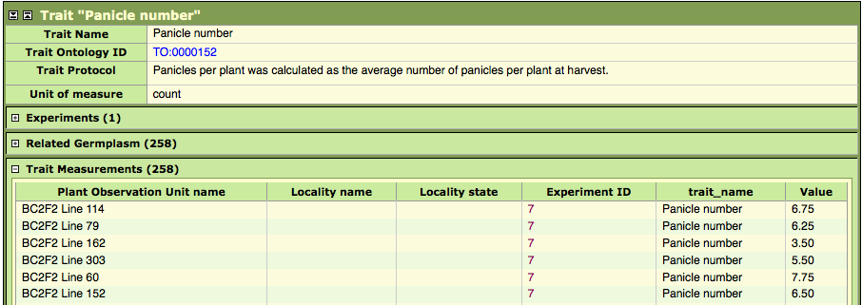
Diversity example #2
View all rice germplasm records related to a particular trait
…and display the trait measurement data
Access trait measurements for each stock

Slide 19
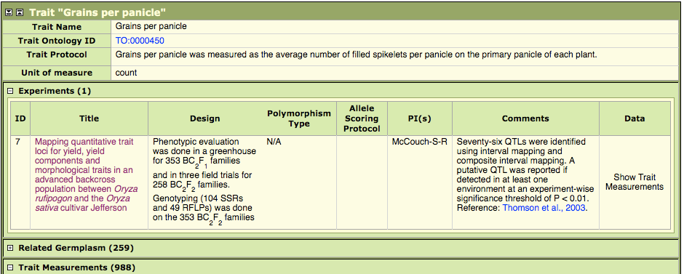
Diversity example #2
View all rice germplasm records related to a particular trait
…and display the related experiments
Display all associated experiments within Diversity with “Panicle number” trait measurements. There is only 1 related experiment in this case

Slide 20
Next-gen data
SNP
resequencing
Notes:
At this point Gramene Diversity offers tools for analysis and visualization. TASSEL is a sophisticated statistical analysis package, Flapjack is a nice tool to viz. Both of these tools are Java clients and run on your desktop, but both are capable of connecting directly to a database.
SNP query is a basic searching tool we recently developed to allow for genome coordinate based searching.
The Ensembl people who we collaborate with on theGramen Genome Browser are developing new features that will allow GWAS and SNP data to be displayed.

Slide 21
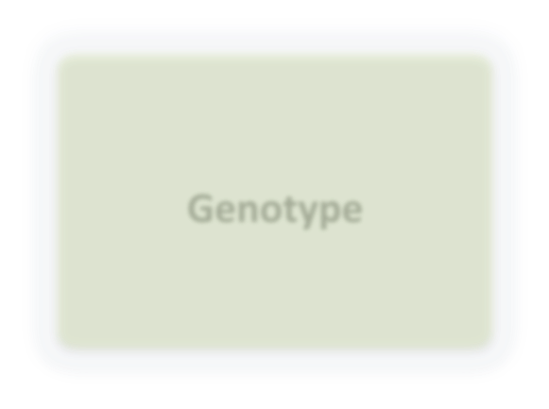
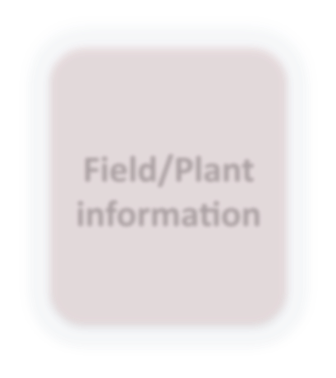

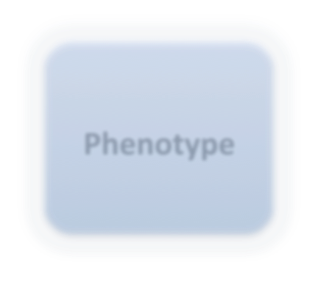
Genotype
GDPDM 4.0
Stores genotype
data as BLOBS
(Binary Large Objects)
div_allele.binary_value
div_allele_assay.binary_position
Field/Plant information
DB
Germplasm
pack/unpack
Phenotype
User
interface
Notes:
Here is an overview of the database schema that Diversity uses for data storage. GDPDM has been optimized for handling large scale snp and resequenving data. This schema’s greatest feature of course is that it links genotype, phenotype and germplasm under one roof, which will faciliatate sophisticaled data mining.

Slide 22
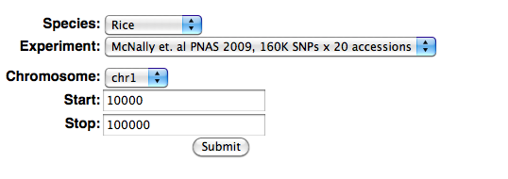
SNP Query www.gramene.org/db/diversity/snp_query
Notes:
Here is an overview of the database schema that Diversity uses for data storage. GDPDM has been optimized for handling large scale snp and resequenving data. This schema’s greatest feature of course is that it links genotype, phenotype and germplasm under one roof, which will faciliatate sophisticaled data mining.

Slide 23
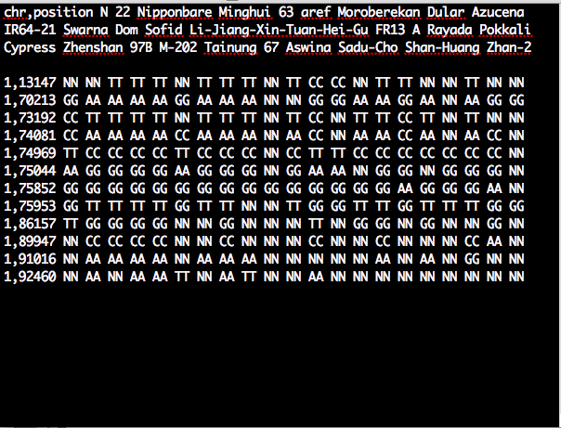
SNP Query www.gramene.org/db/diversity/snp_query
Notes:
Here is an overview of the database schema that Diversity uses for data storage. GDPDM has been optimized for handling large scale snp and resequenving data. This schema’s greatest feature of course is that it links genotype, phenotype and germplasm under one roof, which will faciliatate sophisticaled data mining.

Slide 24
Tools for analysis and visualization www.gramene.org/diversity/tools.html
TASSEL (maizegenetics.net/tassel)
  Statistical analysis
Flapjack (SCRI)
  Visualization of SNPs in genomic context
Gramene Genomes/Ensembl Genome Browser
  Variation tracks
Notes:
At this point Gramene Diversity offers tools for analysis and visualization. TASSEL is a sophisticated statistical analysis package, Flapjack is a nice tool to viz. Both of these tools are Java clients and run on your desktop, but both are capable of connecting directly to a database.
SNP query is a basic searching tool we recently developed to allow for genome coordinate based searching.
The Ensembl people who we collaborate with on theGramen Genome Browser are developing new features that will allow GWAS and SNP data to be displayed.

Slide 25
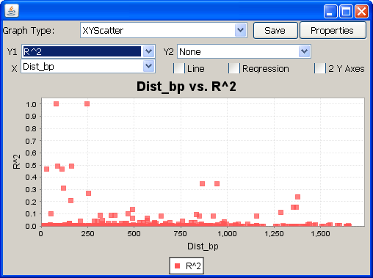
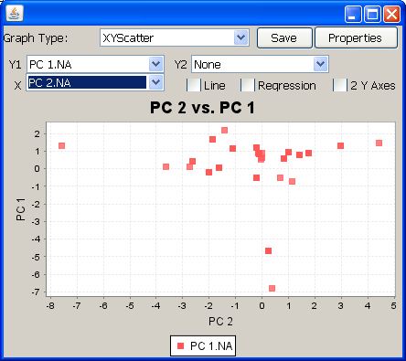
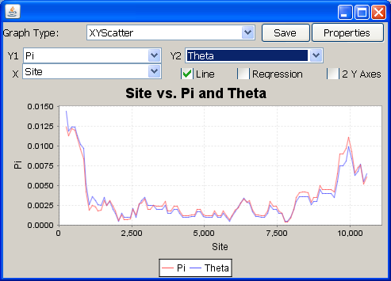
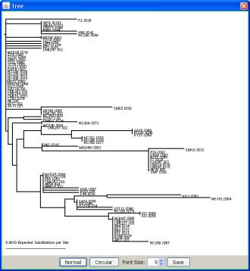
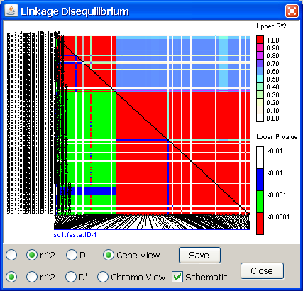
TASSEL analysis
LD v Distance
PCA of genotypes
Diversity sliding window
Phylogeny
LD

Slide 26
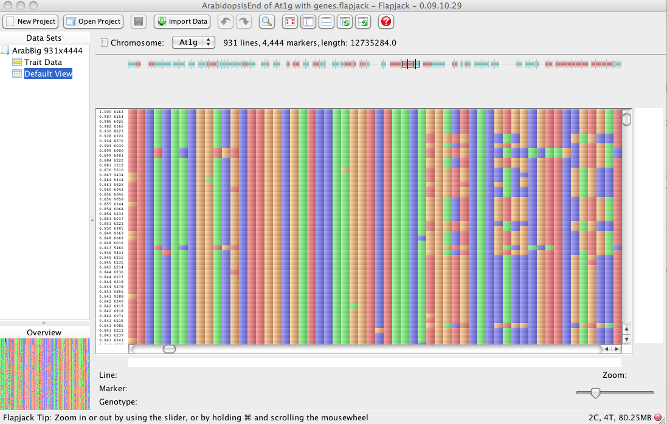
Flapjack for viz
Genome annotation
SNP markers
Plants

Slide 27
Germplasm module www.gramene.org/db/germplasm
  Close connectivity to Diversity
  Link out to GRIN/GRIN-Global, NSGC, IRIS, …
  Currently, just rice

Slide 28
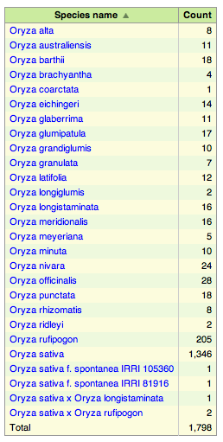
Germplasm module www.gramene.org/db/germplasm

Slide 29

Germplasm module www.gramene.org/db/germplasm

Slide 30

Germplasm module www.gramene.org/db/germplasm

Slide 31
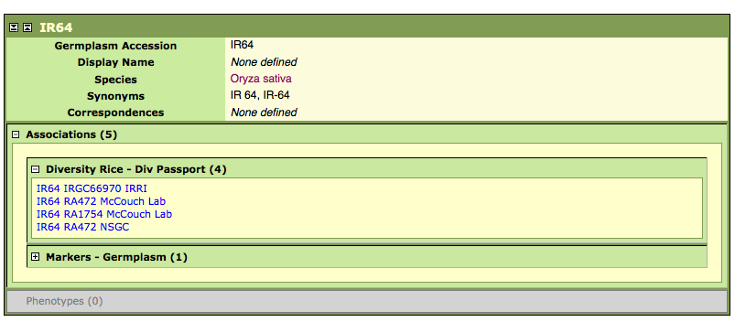
Germplasm module www.gramene.org/db/germplasm

Slide 32
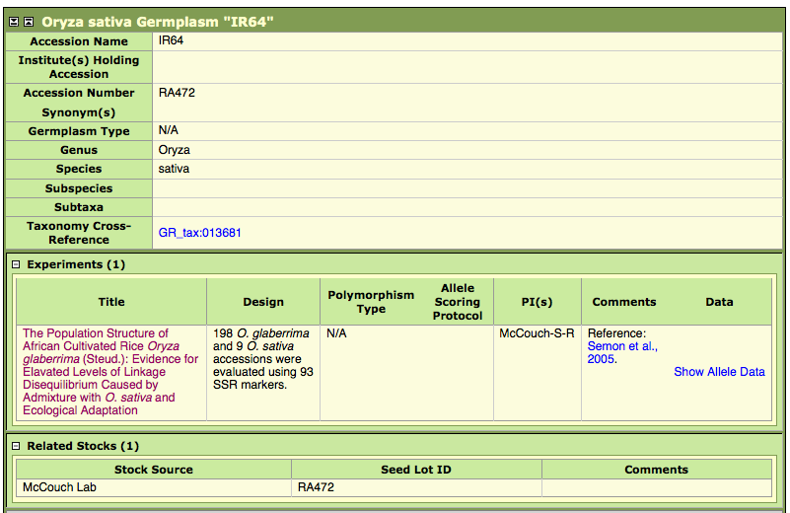
Germplasm module www.gramene.org/db/germplasm

