Slide 1
DIVERSITY IN THE GENOME BROWSER

Slide 2
Get Diversity Data Out the Door
Concepts
  Power user just download the whole dataset
  For many user current query tools are too complicated or outside their world view
  Use Ensembl as the main query tool (most queries by location – chromosome level down to specified positions
  Simplify the choices on germplasm with predefined sets (maize - domesticated, wild, all; rice – indica, japonica, rufipogon, all)

Slide 3
DAS Design
The DAS Server accepts queries for features on a chromosome within a physical position range. For example… Chromosome 10: 6,120,976 - 6,121,273
The DAS Server returns SNPs within the given range on the specified chromosome.

Slide 4
Potential DAS Tracks
SNP positions (ticks below 200Kb size, diversity line graph for larger scales)
Coverage line graph
Indel positions(same as above)
Fst line graph - show differentiation between two groups of lines (e.g.. tropical versus non-tropical)
Recombination rate line graph
Domestication sweep line graph

Slide 5
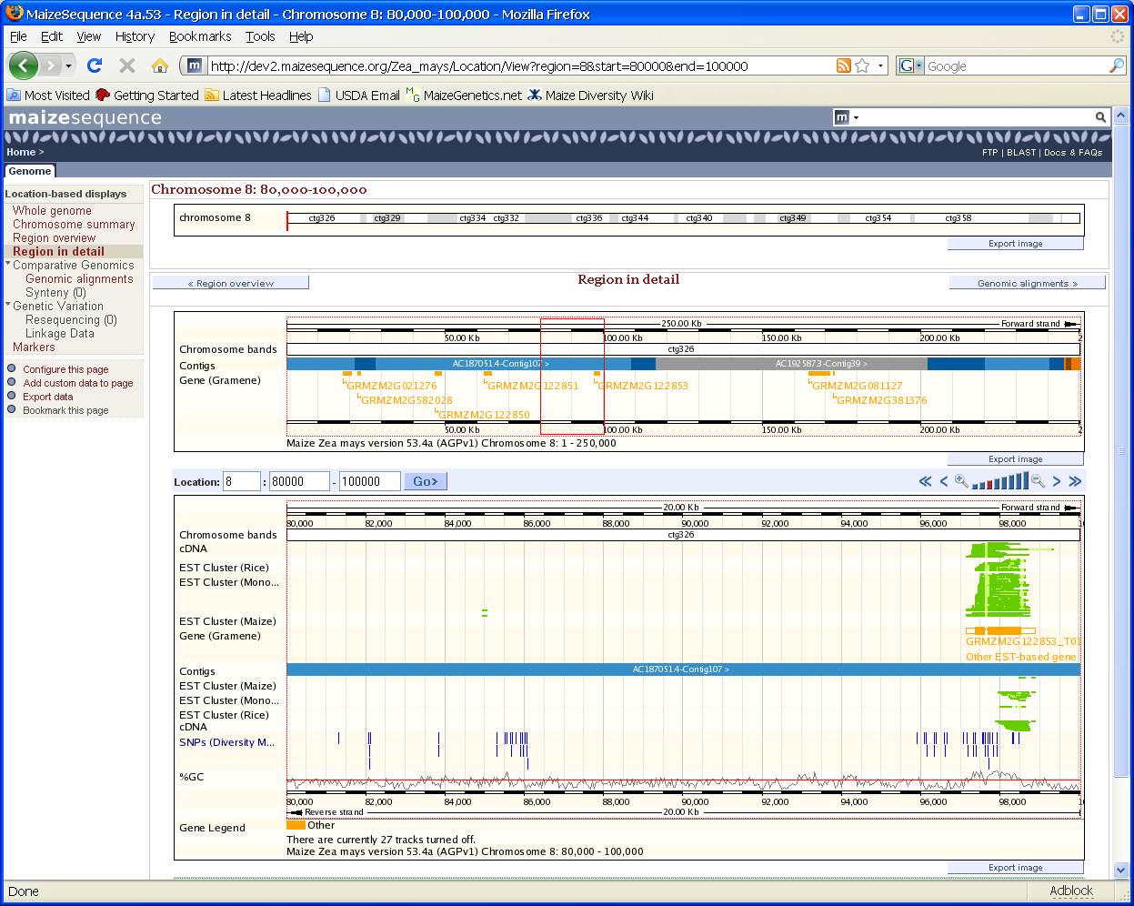
Export Diversity
SNP File (txt.zip)
View In TASSEL
Diversity
Coverage

Slide 6
Needed to Accomplish DAS Tracks
Database with SNPs, computed linegraph values, etc. (Software tools (i.e. Tassel) needed to generate).
DAS Servers
Support from knowledgeable Ensembl folks to integrate tracks into Gramene Ensembl and maizesequence.org.

Slide 7
Ensembl to Diversity Applications
(More later in diversity section)
In Ensembl, Navigate to Desired Range on Chromosome.
From SNP DAS Track, select “Tassel” menu option.
Tassel starts preloaded with SNPs from range shown in Ensembl.

Slide 8
DIVERSITY GOALS

Slide 9
Get Diversity Data Out the Door
Concepts
  Power user just download the whole dataset
  For many user current query tools are too complicated or outside their world view
  Use Ensembl as the main query tool (most queries by location – chromosome level down to specified positions
  Simplify the choices on germplasm with predefined sets

Slide 10
Query Avenues
Position – Use Ensembl
Germplasm – Diversity module already does this, output needs to be more useful.
Pathway – Later phase but same concepts

Slide 11
Result Sets
Genotypic information
  Locations
  Coverage
  Fst
  Diversity
  Relative diversity (crop/wild)
Phenotype-Genotype Associations
Breeding Values

Slide 12
Release 30
Curation of major genotypic datasets
  Rice, Maize, Arabidopsis
Genotypic integration with Ensembl
  SNPs, diversity, Fst, coverage, etc.
Major Genotypes in useful packets
  Flat file format
  Display and analyze automatically in TASSEL
  One click from current location

Slide 13
Release 31
Curation of major Phenotypic datasets
  Rice, Maize, Arabidopsis
Association integration with Ensembl
Major Association Results in useful packets
  Flat file format
  Display and analyze automatically in TASSEL
  One click from current location

Slide 14
SCHEMA CHANGES

Slide 15
Future of Genetic Data
15 million SNPs for 7000 maize lines (1.05e11 data values)
Current database schemas can not handle these numbers.
Solution: GDPDM version 4.0 (Haplotype Packing Design)

Slide 16
GDPDM Version 4.0
Haplotype Packing Design
This design uses SQL Blob data types to store identified lists of SNPs/Indels for a given chromosome.
Corresponding physical positions for SNPs are stored.
Lengths for Indels are stored.
http://www.maizegenetics.net/gdpdm

Slide 17
GDPDM Version 4.0
Memory Efficiency
Old schema… 1 million SNPs * ~100 bytes for each div_allele record. (100 Mb)
GDPDM version 4.0… 1 million SNPs * ½ byte. (½ Mb)
~200 Fold Improvement.

Slide 18
GDPDM Version 4.0
Advantages
Packing many SNPs/Indels into a single database entry reduces memory consumption.
Using Physical Positions instead of Genetic Positions is the preferred design going forward.
Bitwise parsing improves performance.

Slide 19
GDPDM Version 4.0
Value Field
Byte 1-3: Bit 1-24: Version of the compression algorithm (3 bytes) (ASCII). This version: 001
Byte 4: Bit 25-32: Blob Type (1 byte) (ASCII). This blob: 1
Byte 5-8: Bit 33-64: Number of Sites (SNP/Indel positions) (4 bytes)
Byte 9-18: Bit 65-144: Genome Version (10 byte) (ASCII)
Byte 19-43: Bit 145-344: Chromosome Name (25 byte) (ASCII)
Byte 44-47: Bit 345-376: Start Position (4 bytes). Smallest Absolute Physical Position.
Byte 48-51: Bit 377-408: End Position (4 bytes). Largest Absolute Physical Position
Byte 52-76: Accession Name (25 bytes) (ASCII)
Remaining bytes through byte 1024 are unused for unknown header information.
Byte 1025 - end: Each SNP/Indel genotyping value uses 4 Bits, represented by IUPAC nucleotide code. Code ‘-’ represents Indels. Code ‘N’ will be unknown. Values are smallest physical position to largest.

Slide 20
CURATION

Slide 21
Diversity data
-rice-
Currently: 21 experiments
  841 germplasm, 28 traits, 1617 markers
Pending: 5 QTL experiments
  still curating: assigning TO ids; validating new germplasm against existing germplasm in diversity_rice
Projected for Build 30:
  26 experiments (21 + 5 QTL)
  44K rice chip, ~400 lines – genotype and phenotype data
  Additional QTL experiments?
Projected for Build 31:
  600K rice chip!
  ?

Slide 22
Diversity data
-arabidopsis-
Currently: 2 experiments (250K chip)
  362 germplasm, 0 traits, 1,126,177 SNP markers (248,584 on chip)
Projected for Build 30:
  Genotype data for additional lines? (1300 lines expected)
  Flowering time data for 250K chip?
Projected for Build 31:
  1001 Genomes Project (complete sequences for 1300 above lines) -- ??

Slide 23
Diversity data
-maize-
Currently: 31 experiments
  8037 germplasm, 150 traits, 13075 markers
Projected for Build 30:
  3 Million SNPs on 28 lines
  more NAM trait data
Projected for Build 31:
  15 Millions SNPs on 50 lines
  Projected SNPs on 7000 lines

Slide 24
Diversity data
-wheat and sorghum-
Currently:
  wheat: 481 germplasm, 0 traits, 4097 markers
  Sorghum: 1993 germplasm, 0 traits, 544 markers
Projected for future builds:
  wheat: ?
  Sorghum: Diversity data from Kresovich et. al.?

Slide 25
DIVERSITY INTERFACES

Slide 26
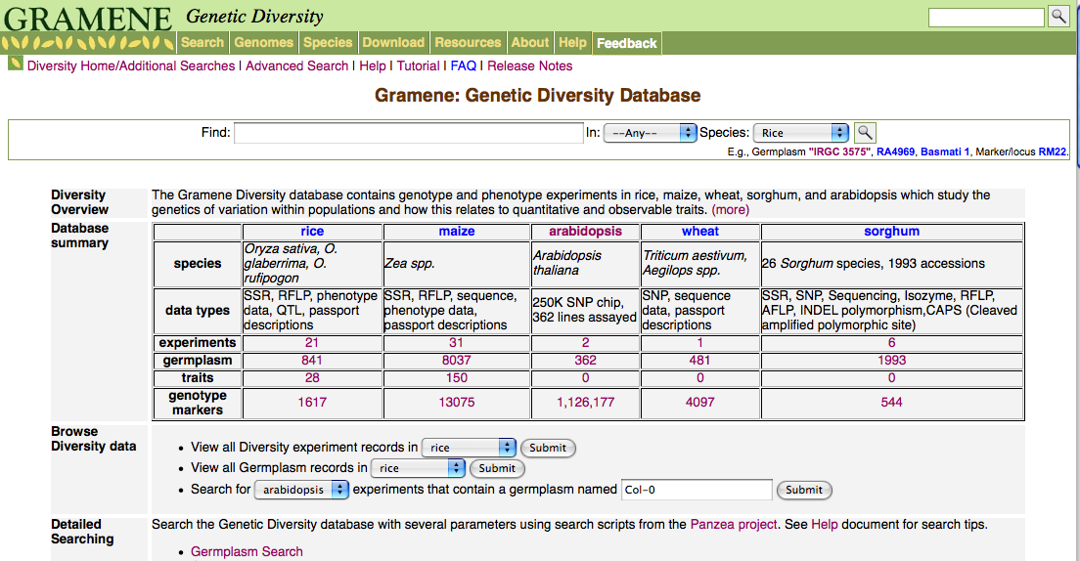
Diversity module
New Diversity home page in development:
http://dev.gramene.org/db/diversity/diversity_view
  Increases Diversity transparency and browsability
  Will provide more options for how search the db
  “Database summary” table provides easy access to all the diversity db’s primary data.
  To do: links to Ensemble tracks;

Slide 27
Export Diversity
SNP File (txt.zip)
View In TASSEL
Diversity
Coverage

Slide 28
From Single Click
Server produces diversity file from GDPDM that has been subsetted for the appropriate range.
Delivery - .txt that is zipped.
  OR
TASSEL is Web Started with an the URL of the compressed file.
  190K SNPs from the 216Mbp Maize Chromosome 5 on 28 lines can passed as 1.1Mb file.
  TASSEL runs basic analyses on the fly during startup
  User can refine analyses

Slide 29
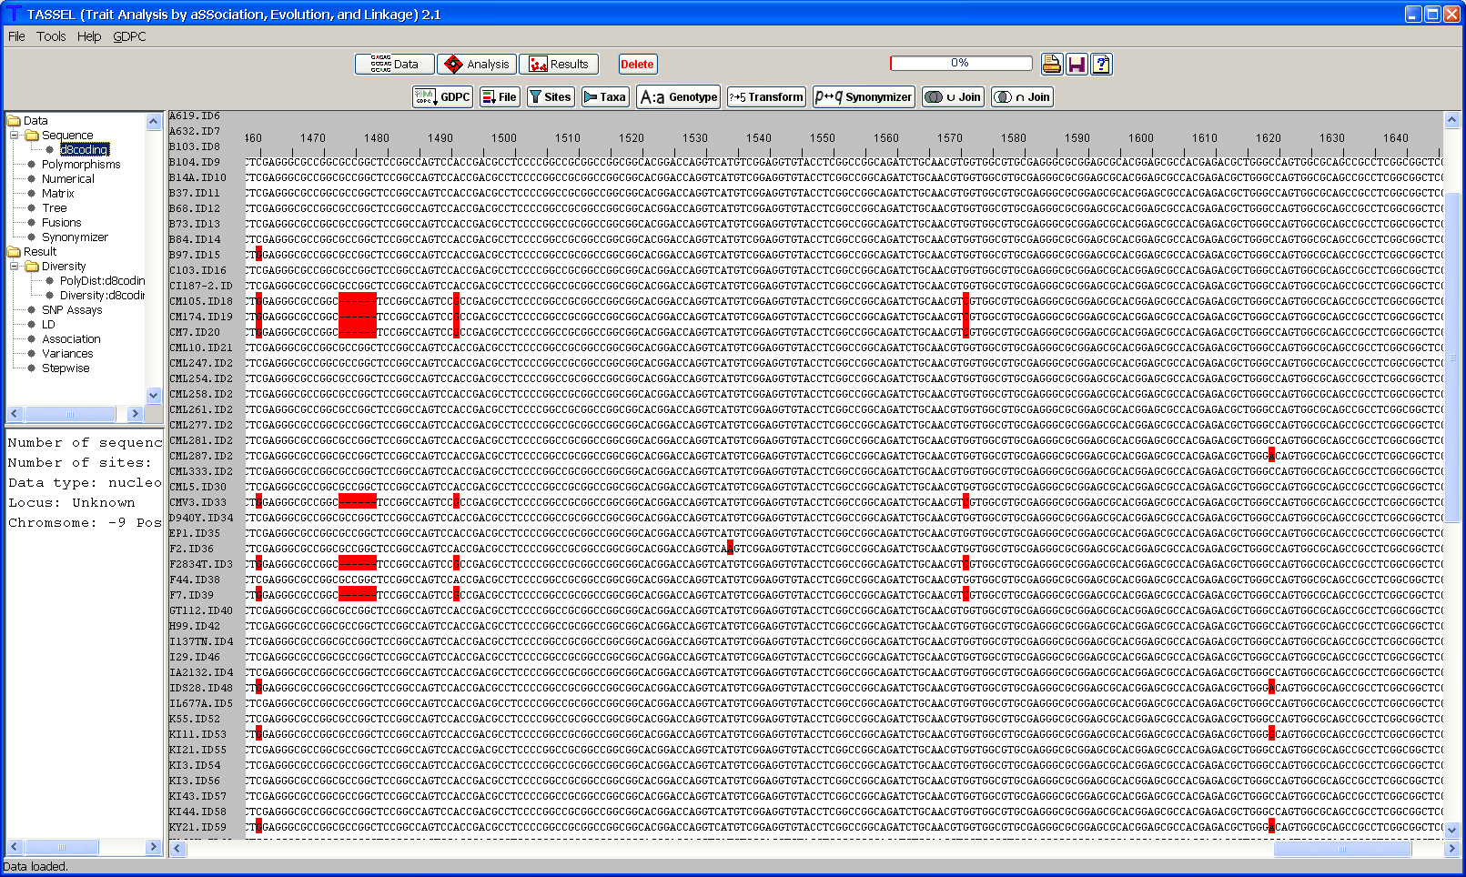
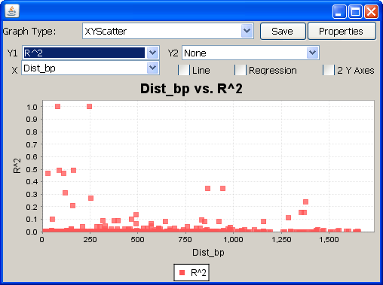
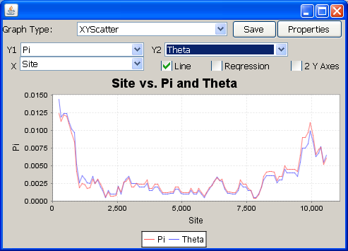
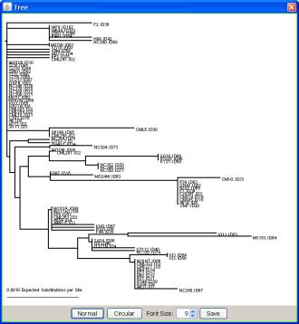
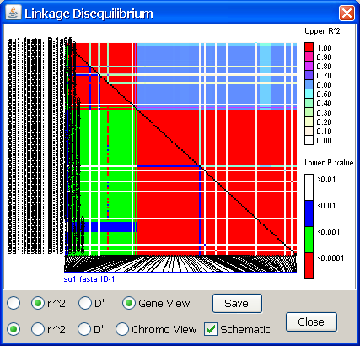
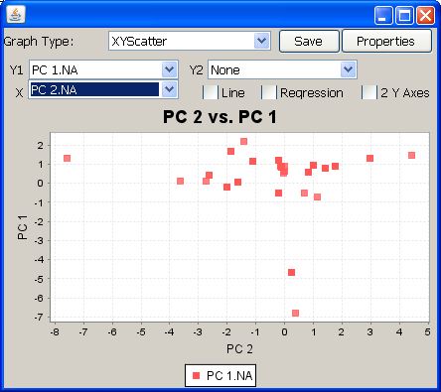
TASSEL immediately after startup
(all these features already exist)
Genotypic Data
Diversity sliding window
Phylogeny
LD
LD v Distance
PCA of genotypes

Slide 30
To Add to TASSEL
Auto Startup with data and series of start analyses
Sliding window of bin of sites frequencies (basic frequency is already there) or Pie Chart
Pass basic taxonomy to TASSEL
  For Fst
  Divergence from outgroup
  Diversity Ratio – domestication test
Pass site classification (Syn, nonsyn)
  Sliding window Dn/Ds
  Pie Charts
Icon of genotypes and current window location

Slide 31
Association Results (Release 31)
Manhattan plots for Ensembl and/or ticks for significant sites
Single click download of association results for window
  Table flat file
  Autoload into TASSEL
    Used GlazedList (knobs for site type, frequency, P, etc).
    Pie charts and plots of various classes along genome
Phenotype (& Residuals) and genotype available

