Slide 1

Introduction to Gramene Website, build 40
Ken Youens-Clark
Cold Spring Harbor Lab
14 January 2014

Slide 2


Funding
NSF Award 1127112

Slide 3


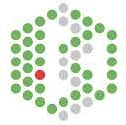
Acknowledgements
Doreen Ware, PhD (PI, USDA ARS)
Marcela Karey, PhD (Project Manager)
Jim Thomason, Sharon Wei, Andrew Olson, Ken Youens-Clark
Pankaj Jaiswal, PhD (Co-PI)
Palitha Dharmawardhana, PhD; Vindhya Amarasinghe, PhD; Sushma Naithani, PhD; Justin Preece
Paul Kersey, PhD
Dan Bolser, PhD; Dan Staines; Arnaud Kerhornou

Slide 4
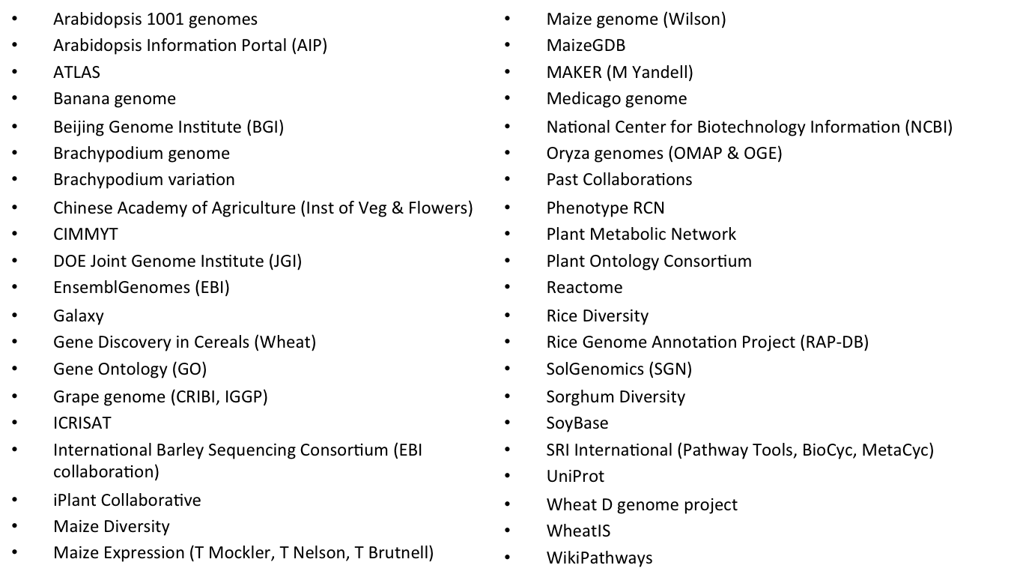
Collaborators

Slide 5
More than a sum of it’s parts…
Drupal CMS, blog
Custom search
Ensembl web browser (v74), BLAST
BioMart
Pathway tools Cyc browser (v17)
Reactome pathways tools
Public MySQL server
Visualizations, public REST APIs (coming soon)

Slide 6
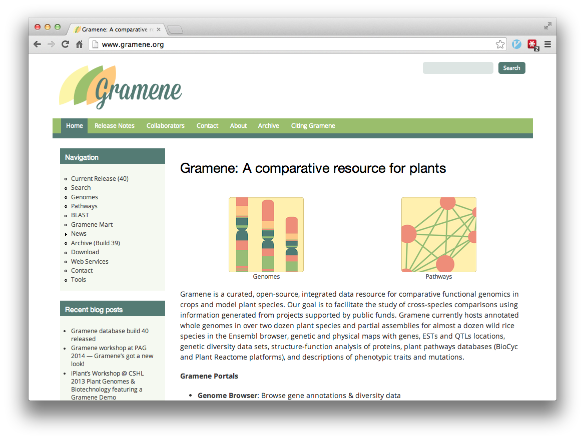

Slide 7
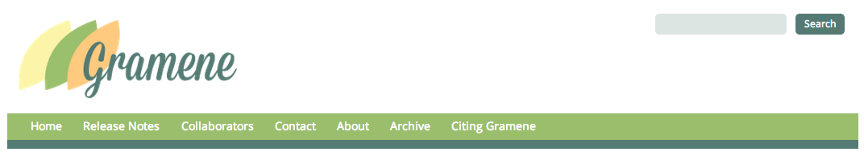
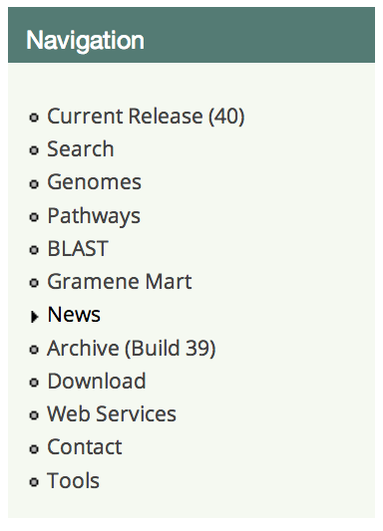
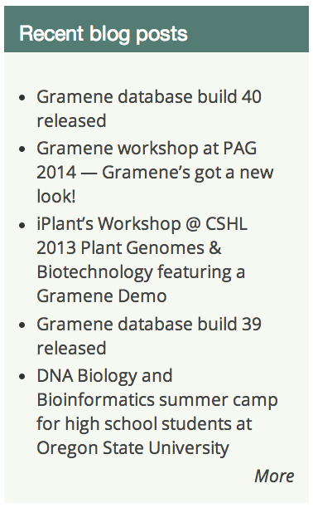

Slide 8
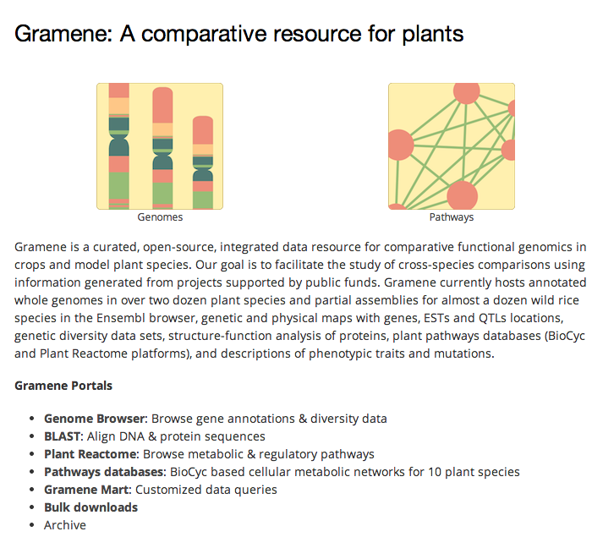

Slide 9
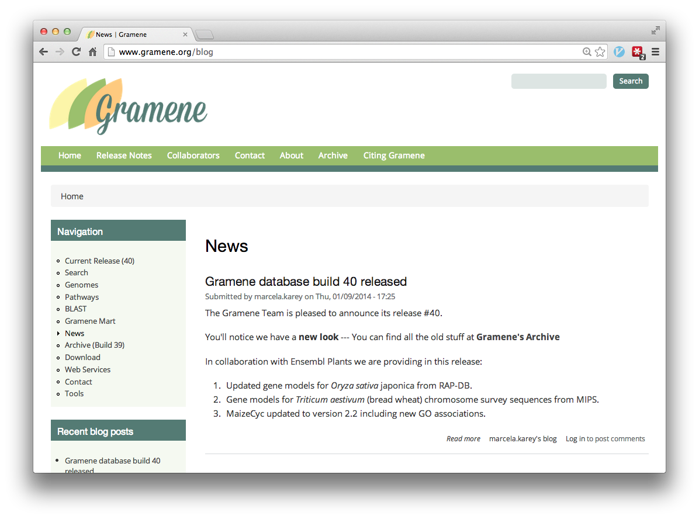

Slide 10
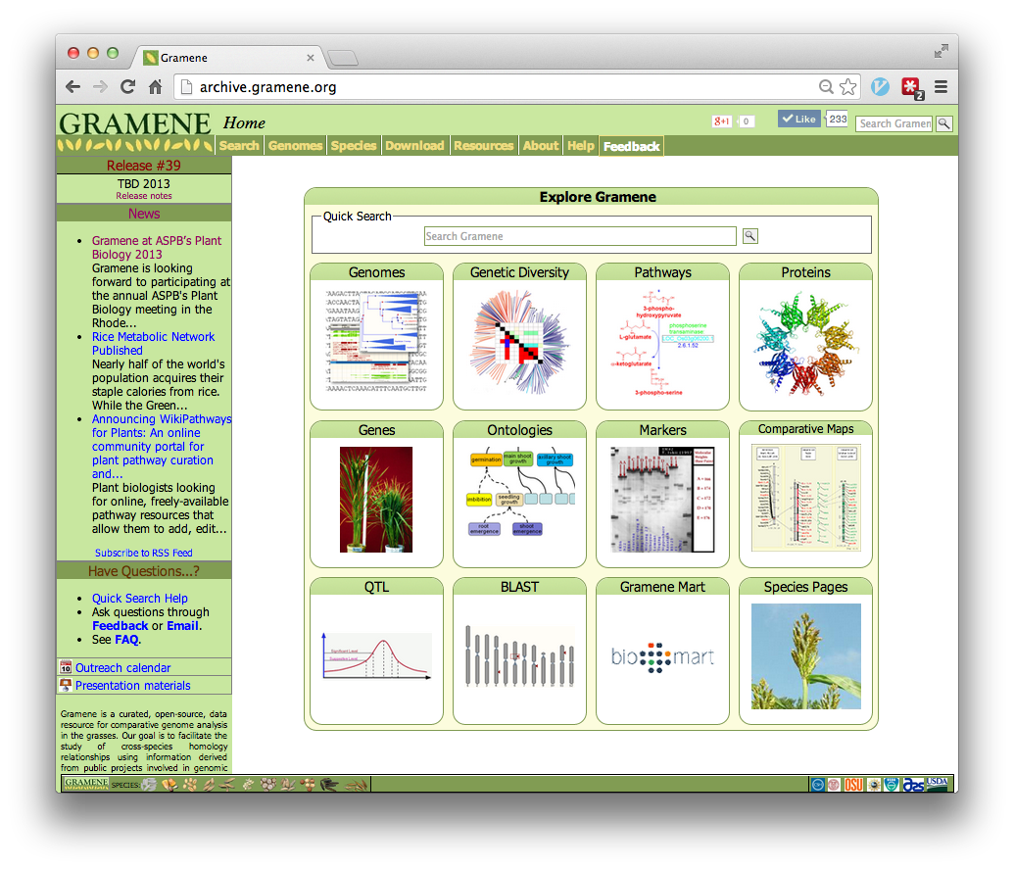

Slide 11
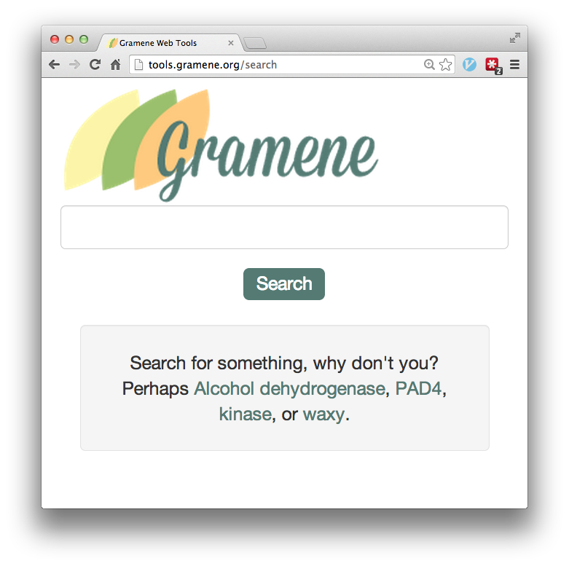

Bootstrap +
Try it on a mobile device!

Slide 12
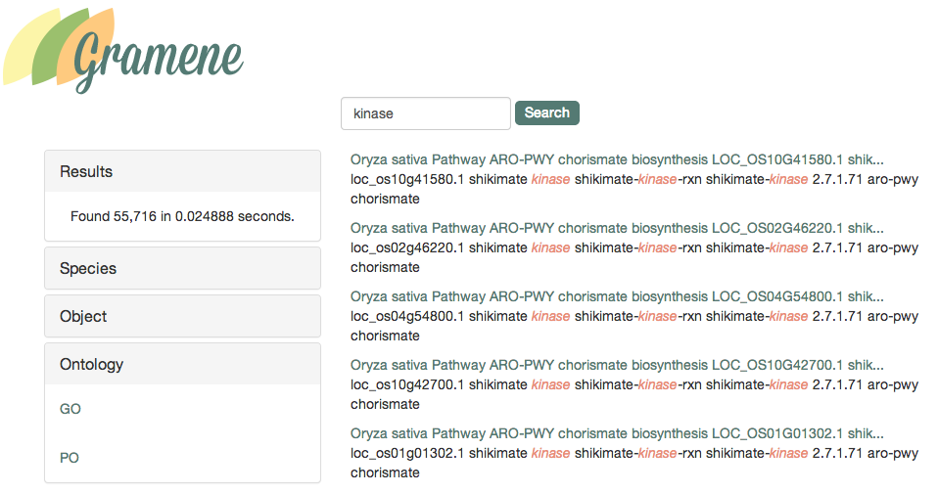
Search Results for “kinase”

Slide 13
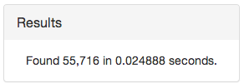
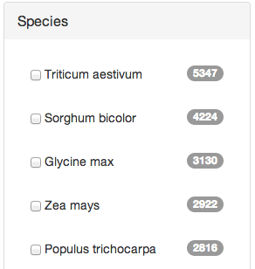
Drill Down (Facets)

Slide 14
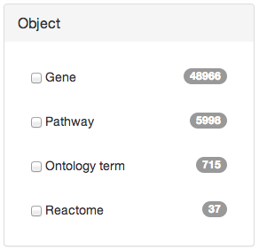
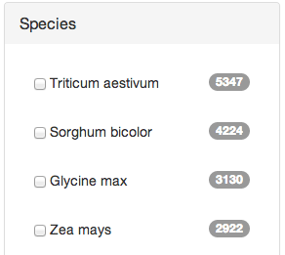
Facets

Slide 15
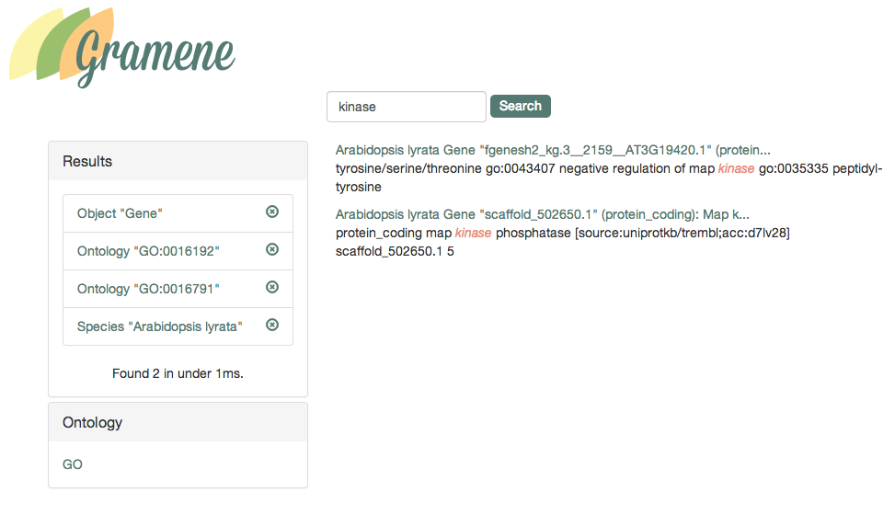
Facets

Slide 16
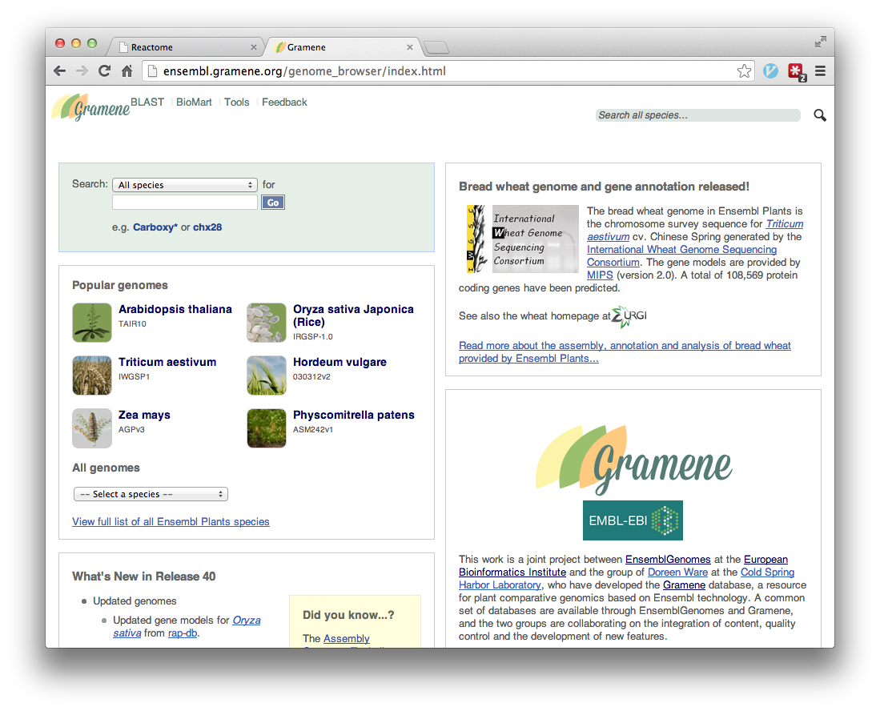

Slide 17
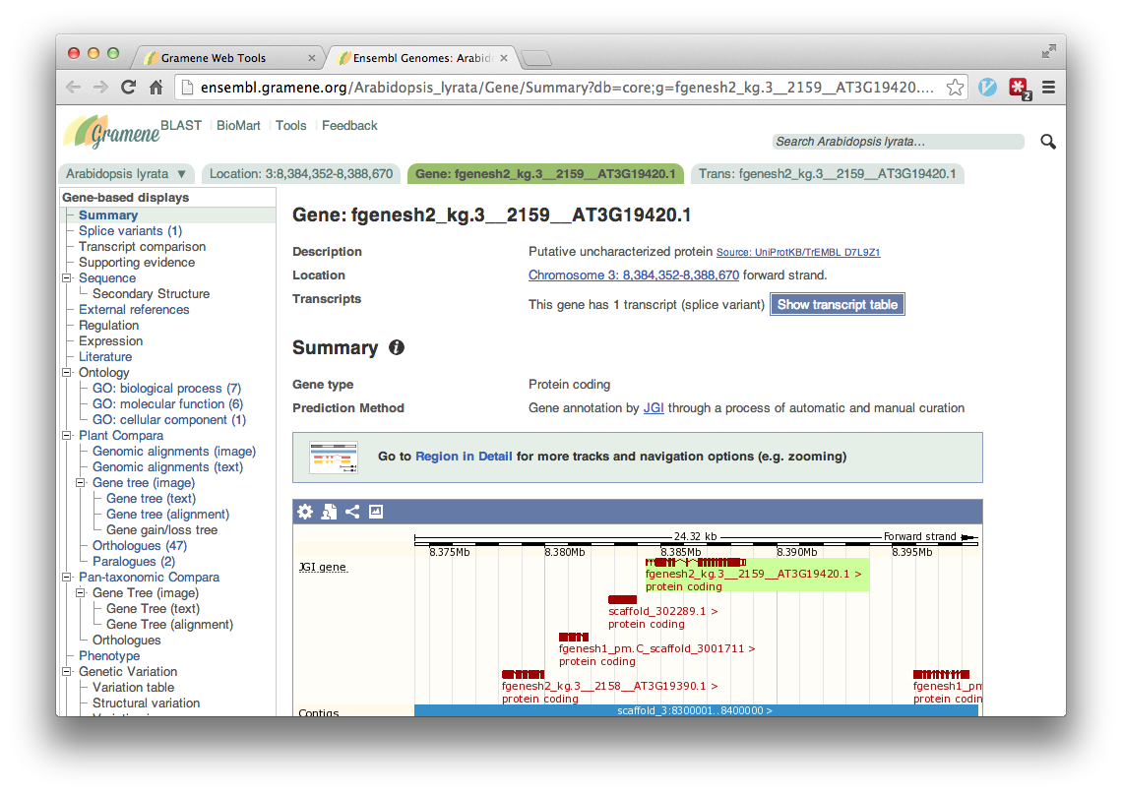

Slide 18
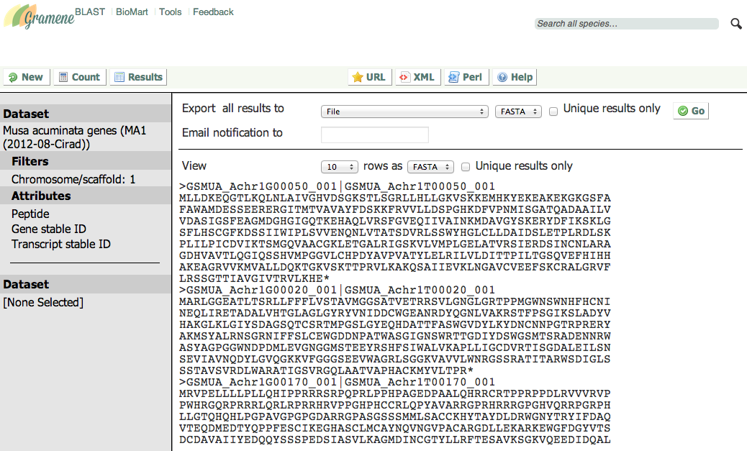
Mart

Slide 19
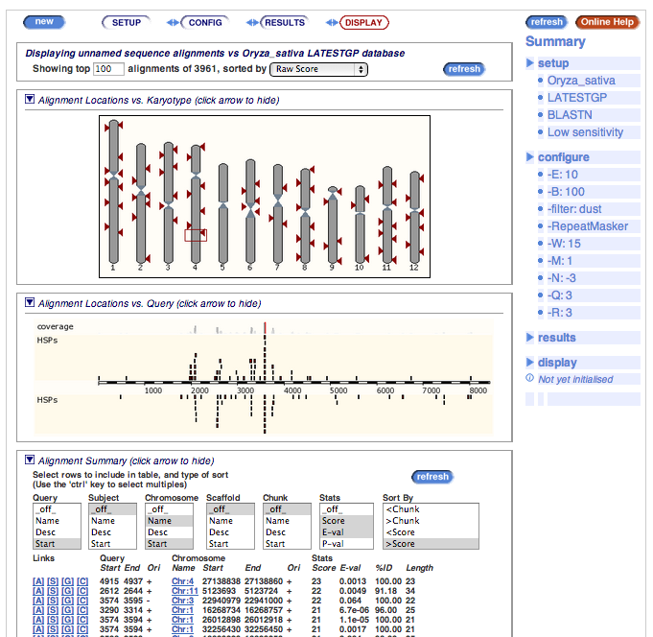
BLAST

Slide 20
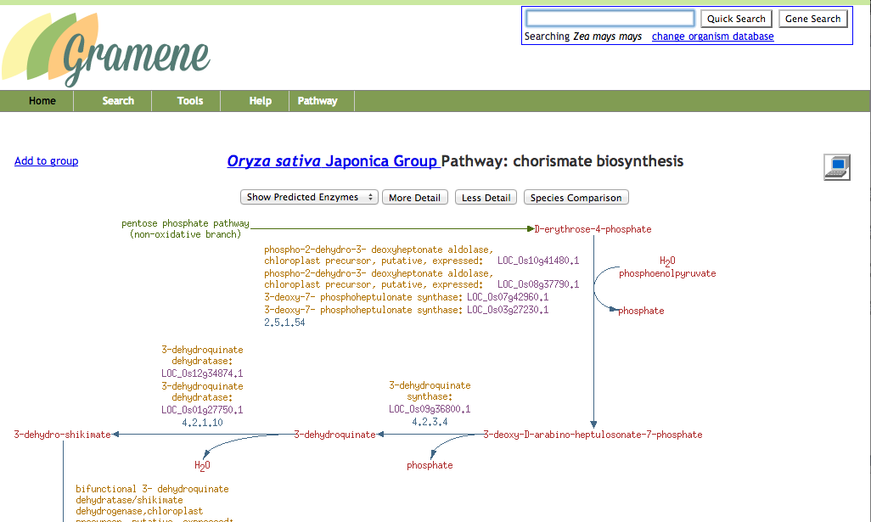
Pathways

Slide 21
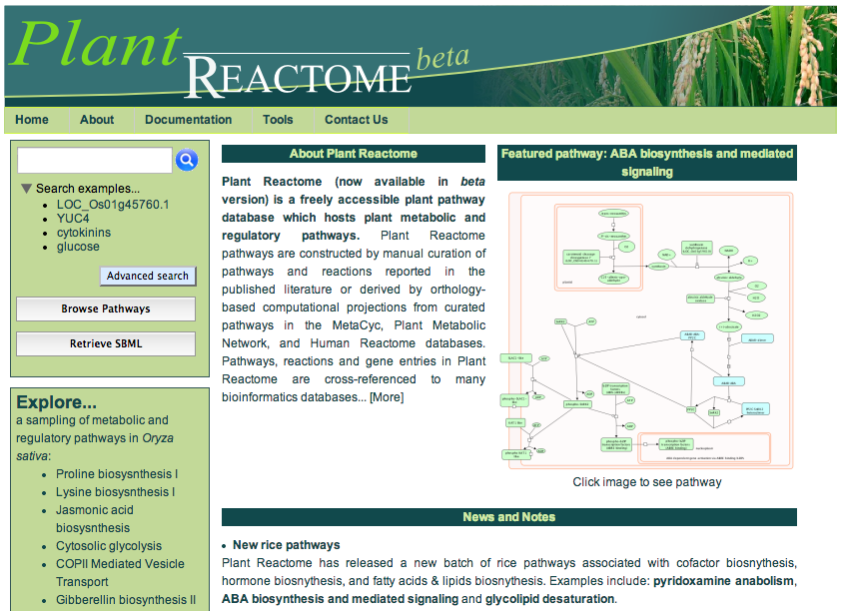

Slide 22
Coming soon
Public REST API
Custom visualizations (GWAS, maps, etc.)
Amigo 2 ontology tools
New search facets
Downstream analysis of search results & integration with Mart, Galaxy, iPlant, etc.
Virtual Machines at iPlant, AWS

