Slide 1

Introduction to Gramene Website, build 40
Ken Youens-Clark
Cold Spring Harbor Lab
14 January 2014

Slide 2




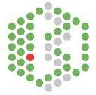


Acknowledgements
Funded by the National Science Foundation’s
Plant Genome Research Program award #1127112
Doreen Ware, PhD (PI, USDA ARS)
Marcela Karey, PhD (Project Manager)
Yinping Jiao; Sunita Kumari, PhD; Jim Thomason; Joshua Stein, PhD; Andrew Olson; Bo Wang; Sharon Wei; Ken Youens-Clark
Pankaj Jaiswal, PhD (Co-PI)
Palitha Dharmawardhana, PhD; Vindhya Amarasinghe, PhD; Sushma Naithani, PhD; Justin Preece
Paul Kersey, PhD, Helen Parkinson, PhD
Dan Bolser, PhD; Dan Staines; Arnaud Kerhornou, Maria Keays, Nuno Fonseca, Robert Petrysk
Lincoln Stein, PhD
Peter D’Eustachio, PhD; Guanming Wu; Robin Haw; David Croft; Joel Weisner
Crispin Taylor, PhD
Patti Lockhardt

Slide 3
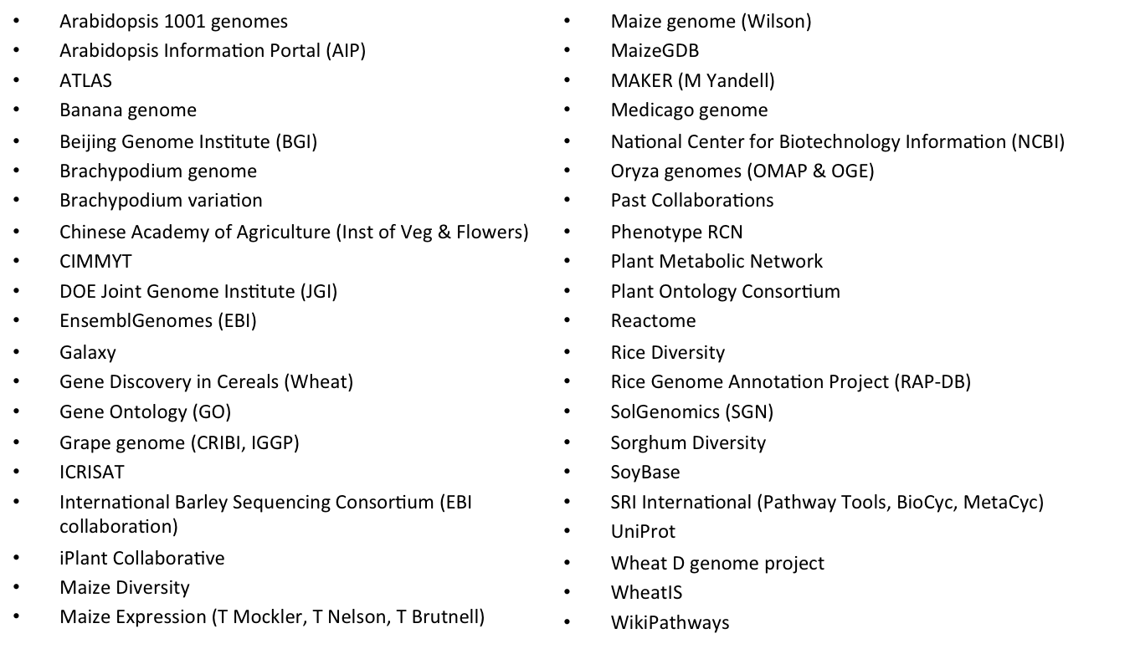
Collaborators

Slide 4
More than a sum of it’s parts…
Drupal CMS, blog
Custom search
Ensembl web browser (v74), BLAST
BioMart
Pathway tools Cyc browser (v17)
Reactome pathways tools
Public MySQL server
Visualizations, public REST APIs (coming soon)

Slide 5
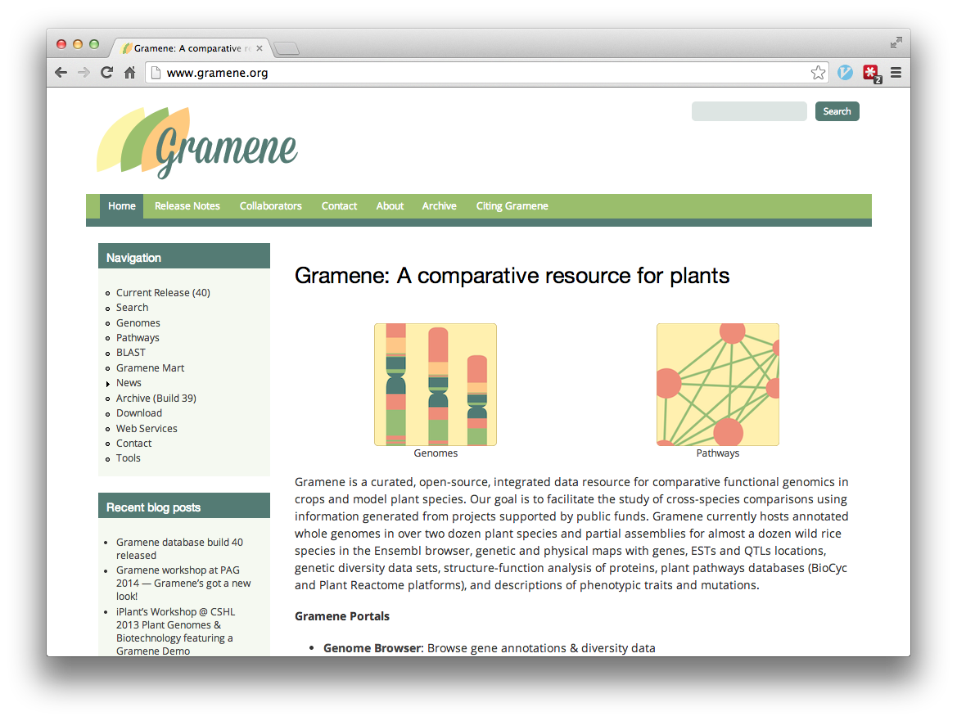

Slide 6
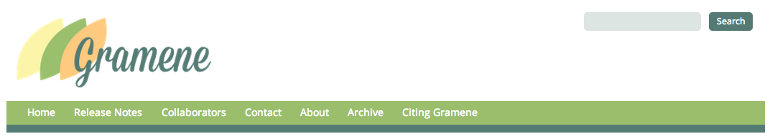
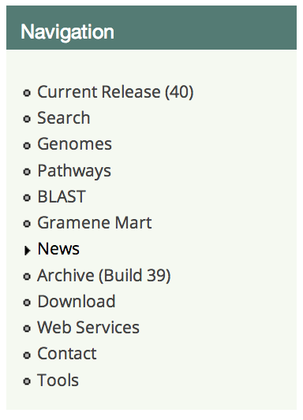
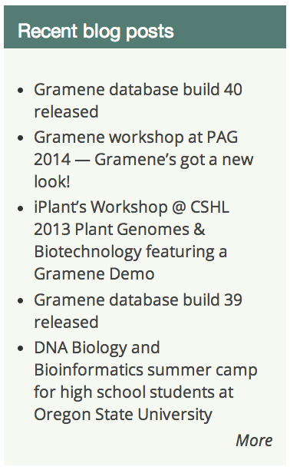

Slide 7
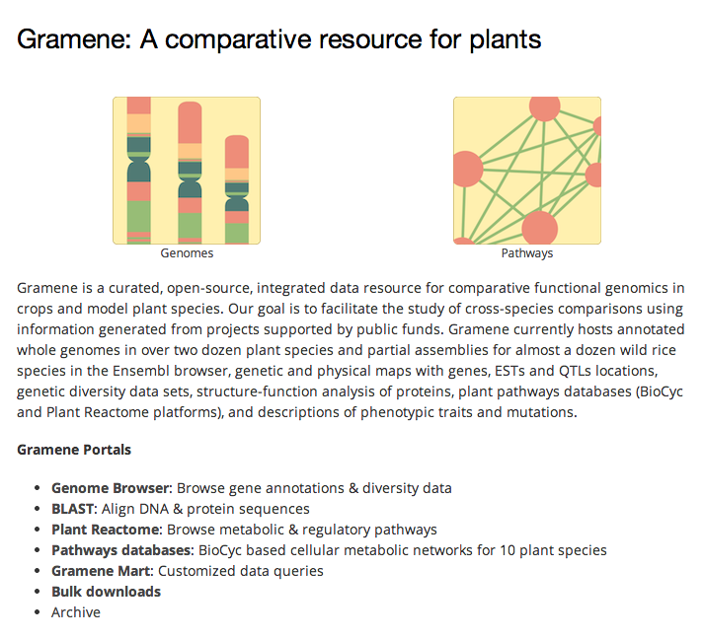

Slide 8
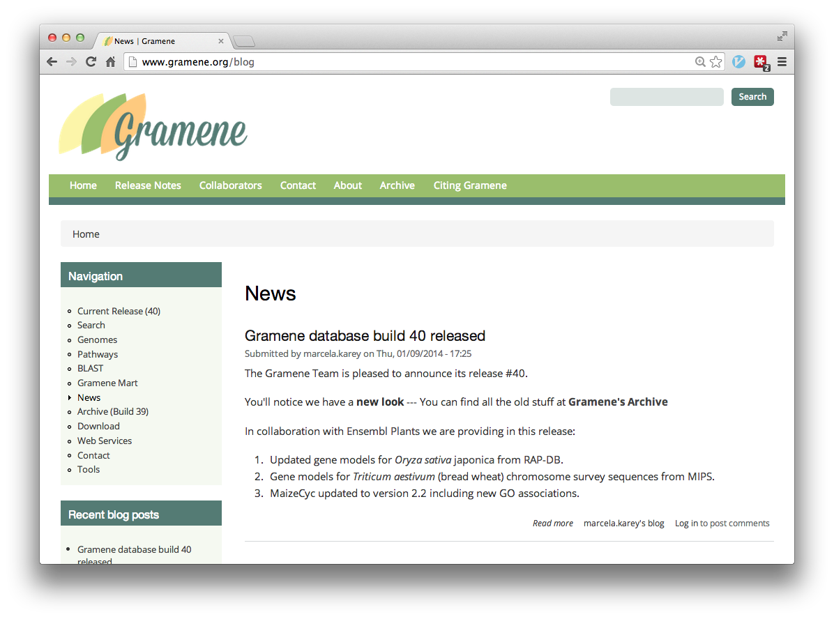

Slide 9
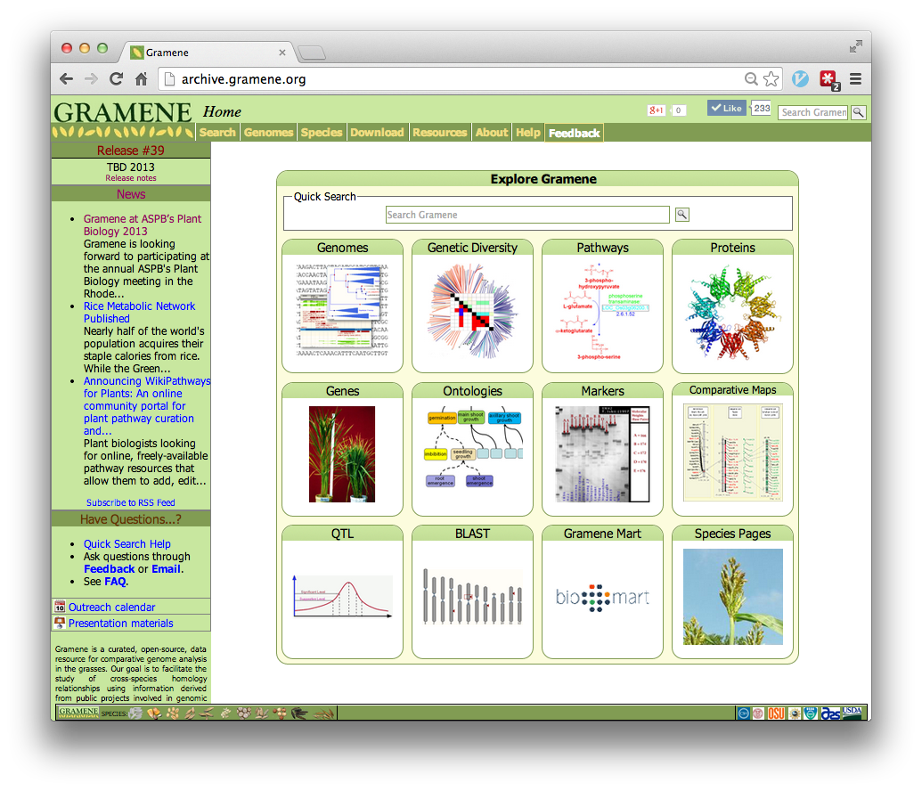

Slide 10
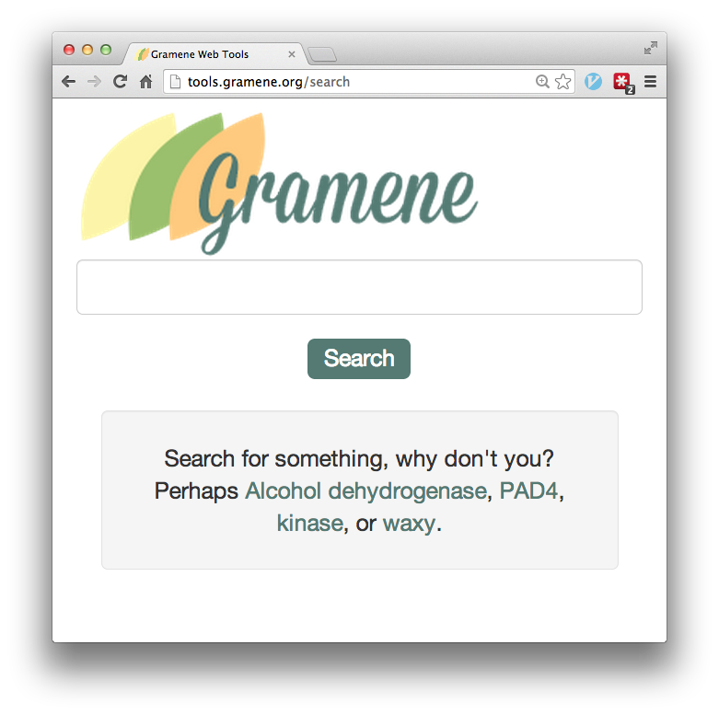

Bootstrap +
Try it on a mobile device!

Slide 11
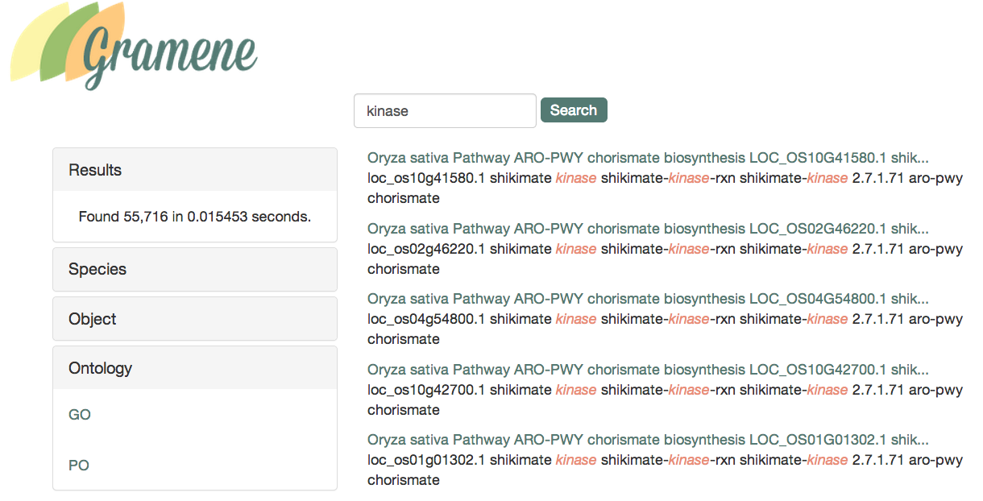
Search Results for “kinase”

Slide 12
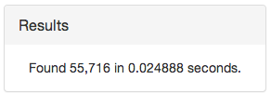
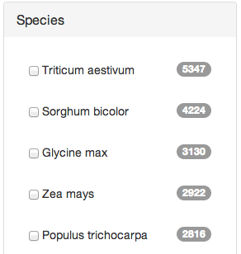
Drill Down (Facets)

Slide 13
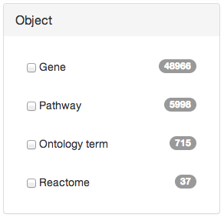
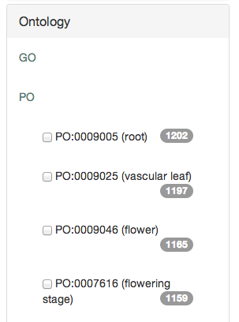
Facets

Slide 14
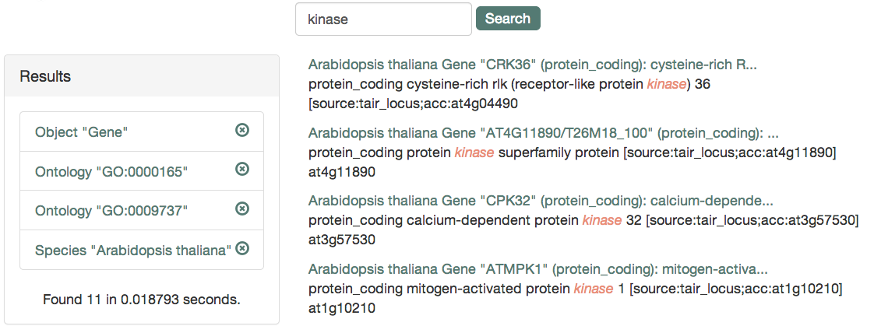
Facets
11 genes associated with response to ABA
in the A. thaliana MAP-K cascade/pathway

Slide 15
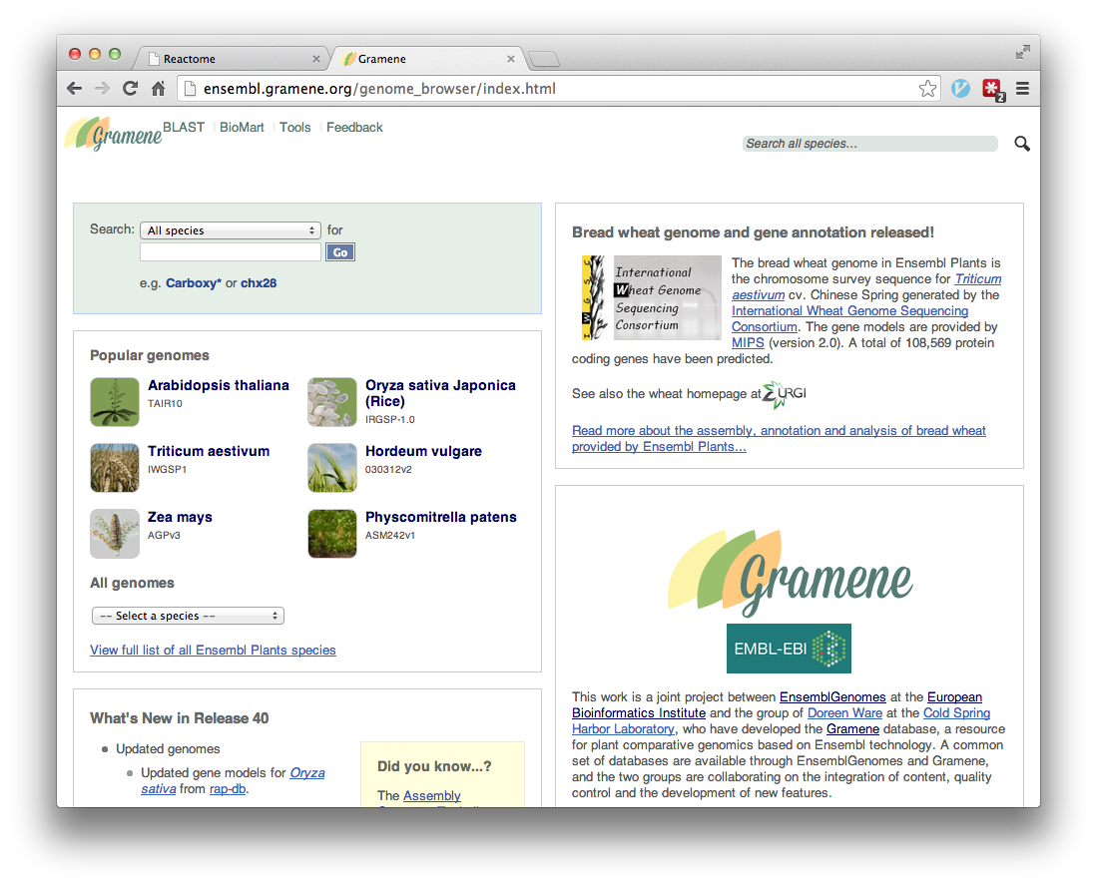

Slide 16
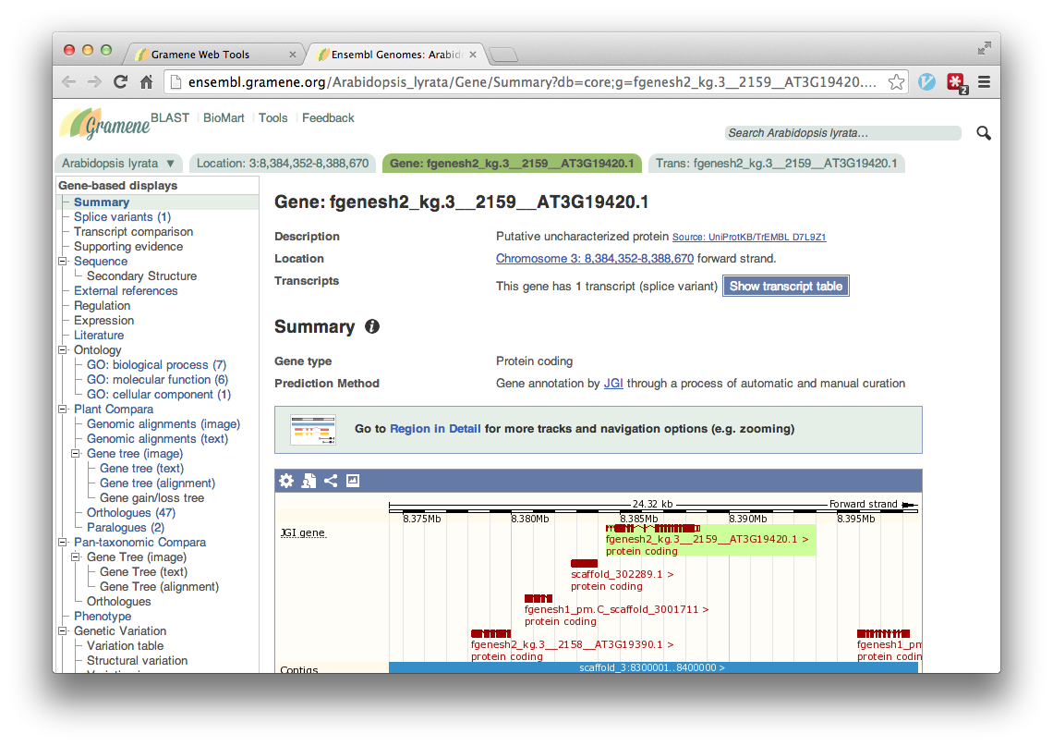

Slide 17
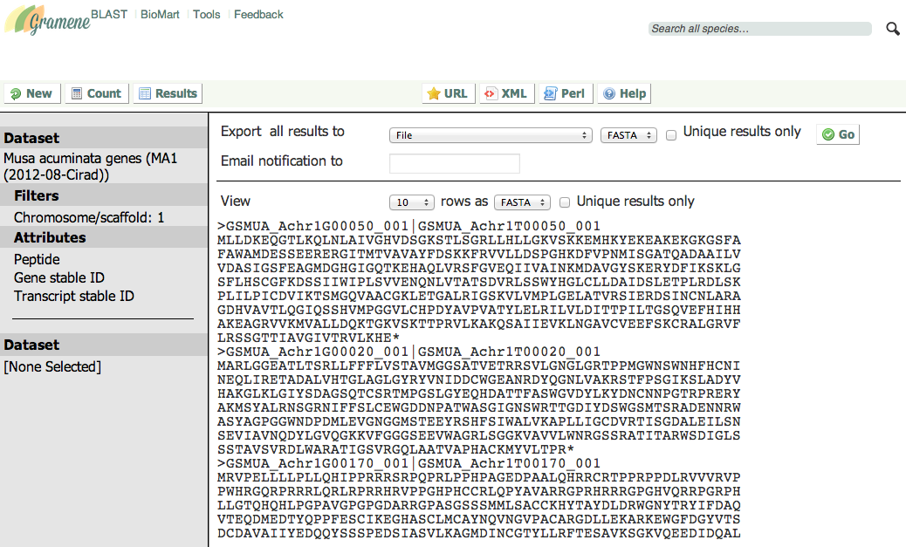
Mart

Slide 18
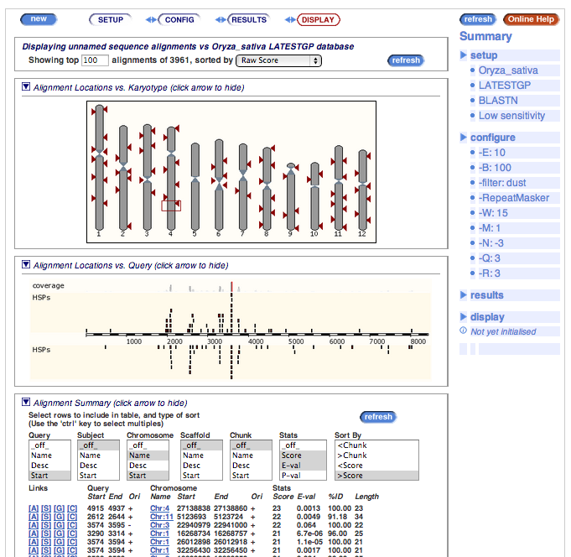
BLAST

Slide 19
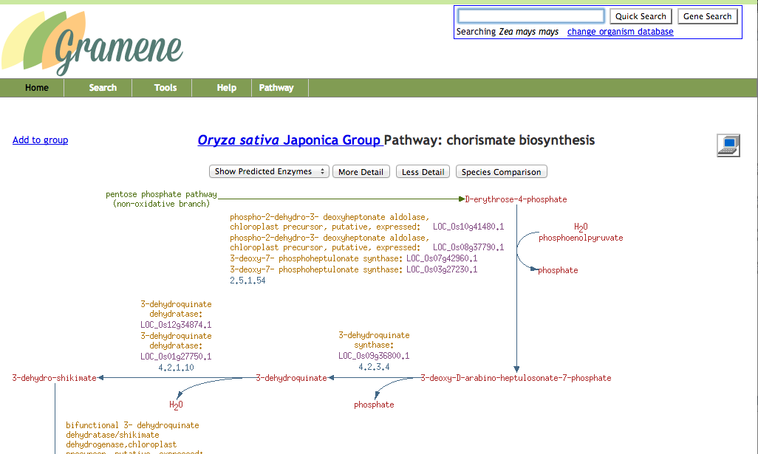
Pathways

Slide 20
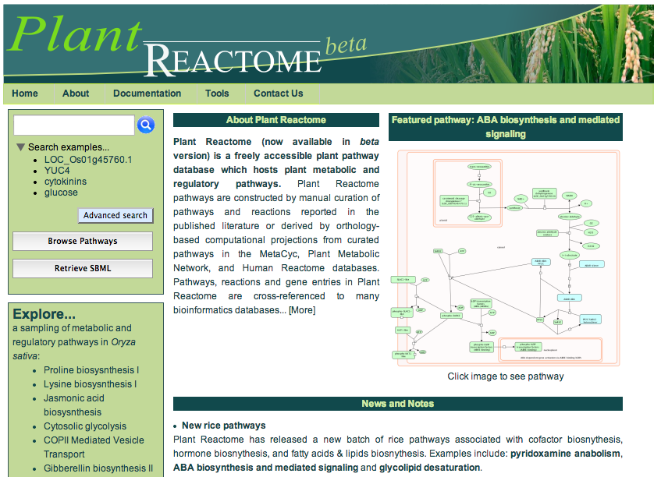

Slide 21
Coming soon
Public REST API
Custom visualizations (GWAS, maps, etc.)
Amigo 2 ontology tools
New search facets
Downstream analysis of search results & integration with Mart, Galaxy, iPlant, etc.
Virtual Machines at iPlant, AWS

Slide 22

