Slide 1
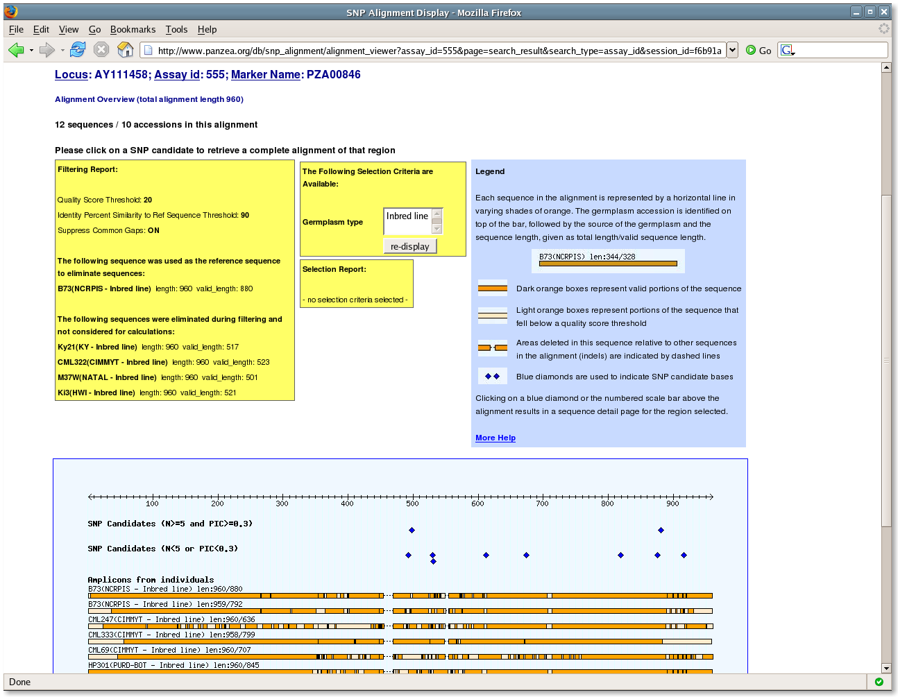
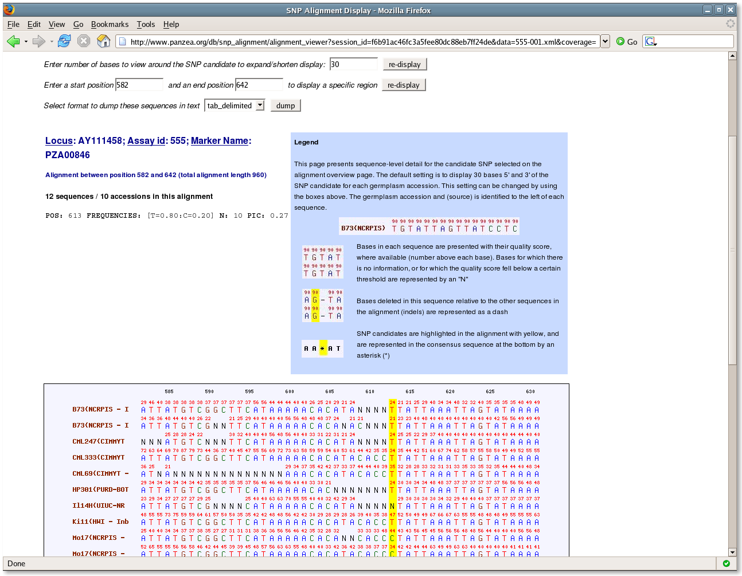
Alignment Viewer

Slide 2
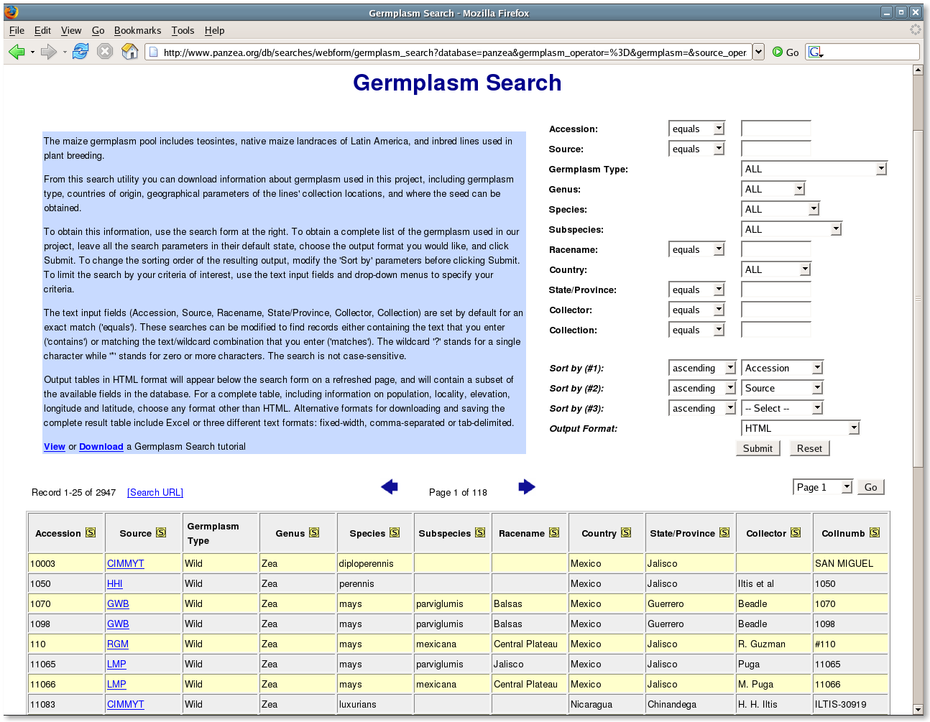
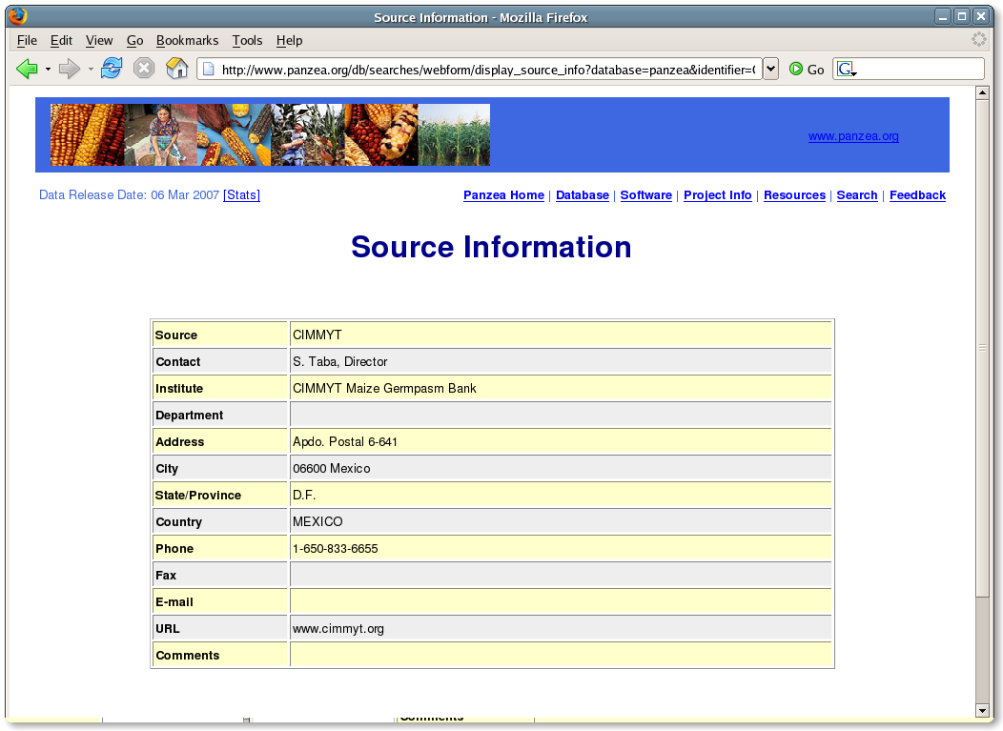
Search Pages

Slide 3
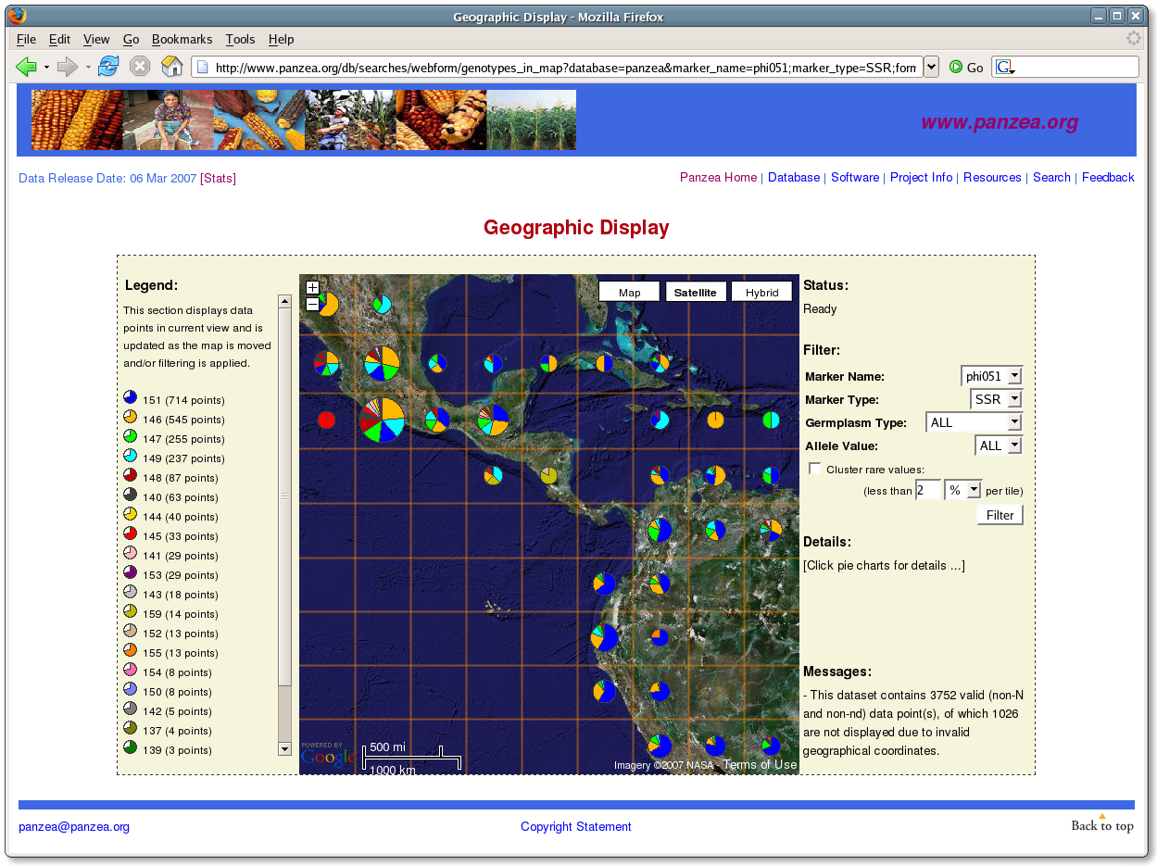
Geographic Display

Slide 4
Software Packages
Search Page Framework (HTML::SearchPage)
Panzea Search Pages
Geographic Display (HTML::GMap, GD::Icons)
Look-Align Alignment Viewer

