Slide 1

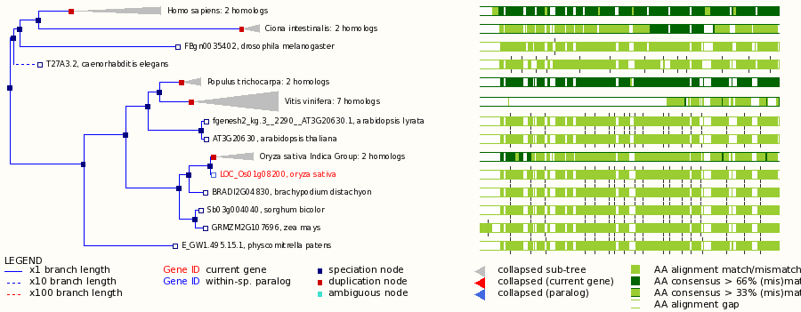
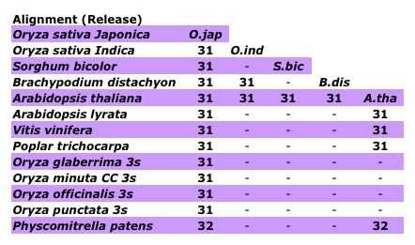
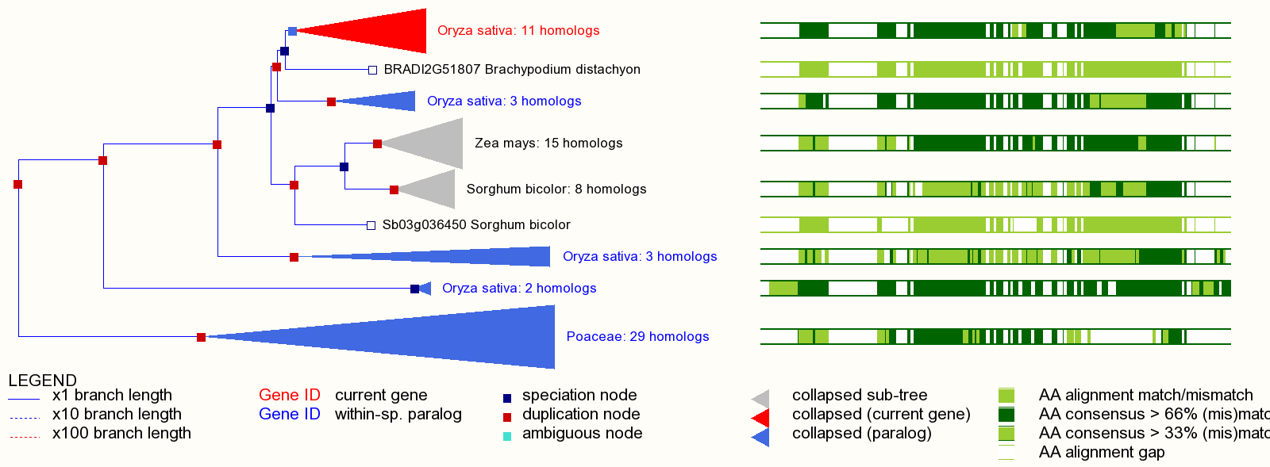
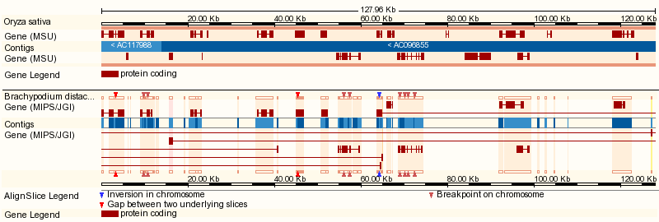
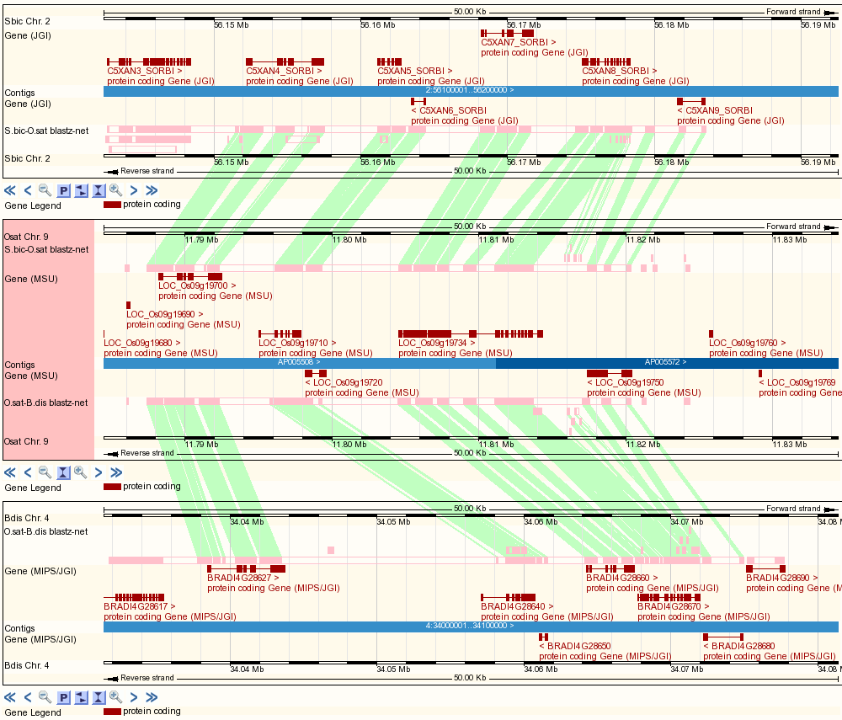
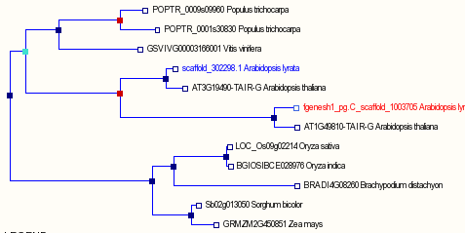
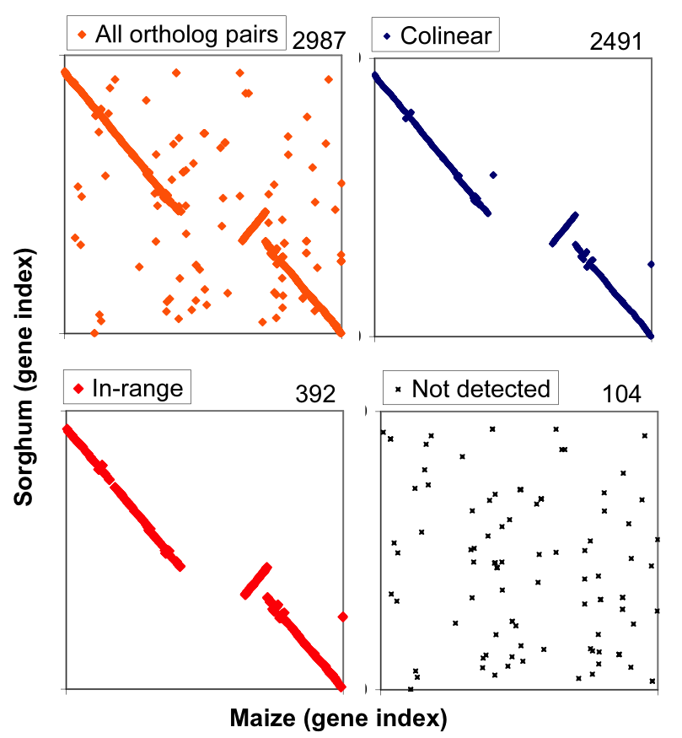
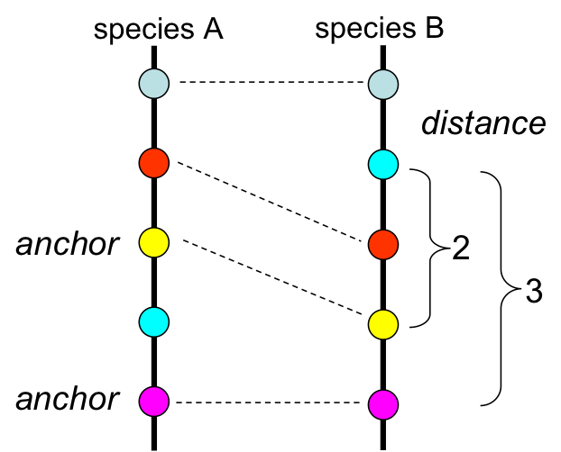
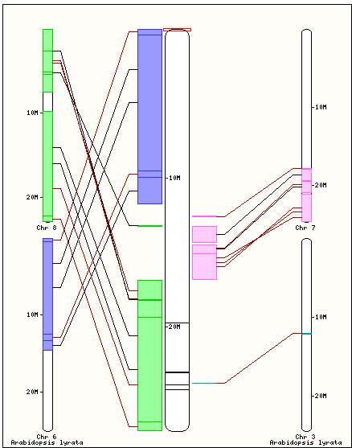
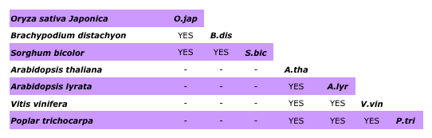
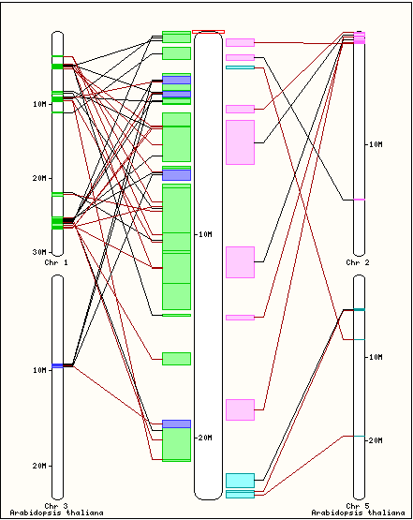
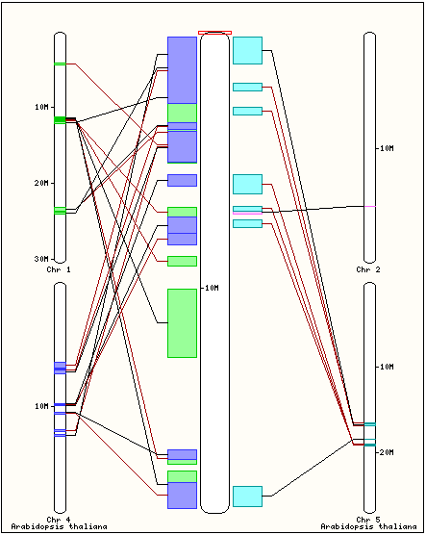
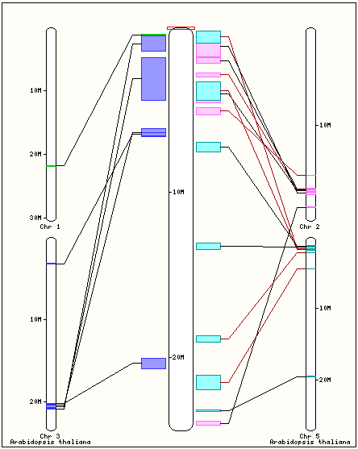
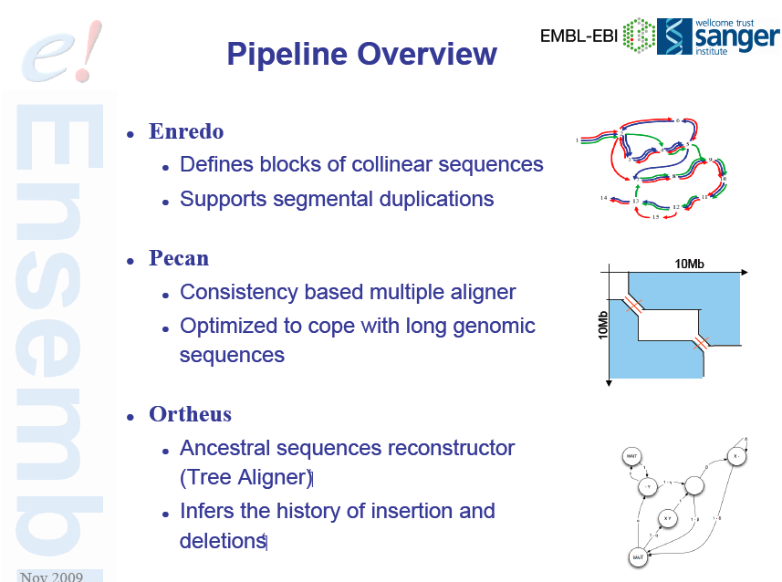
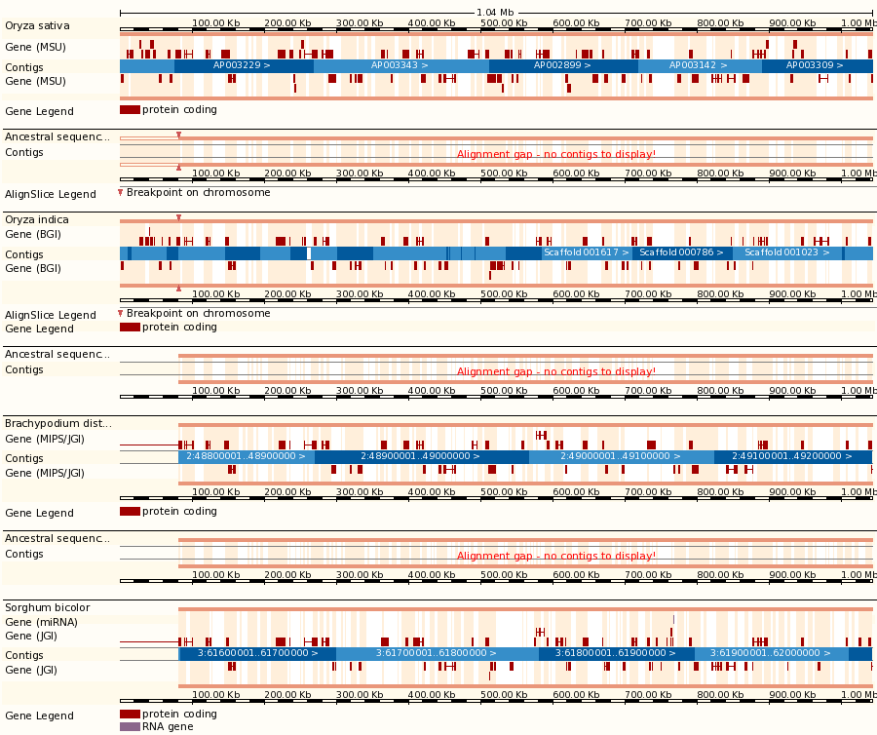
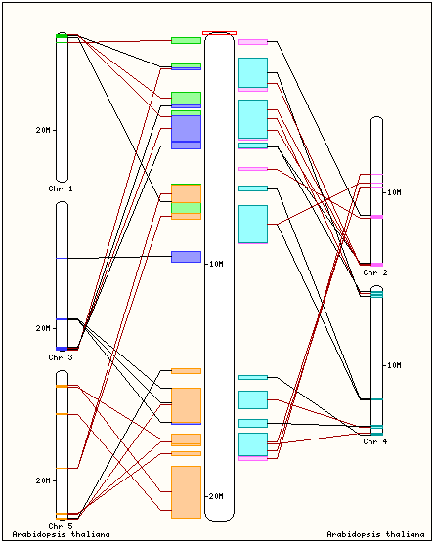
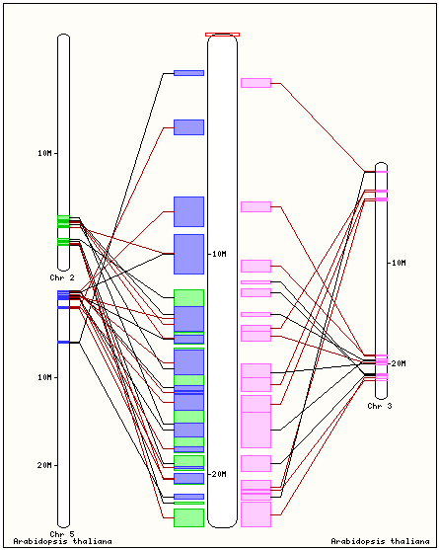
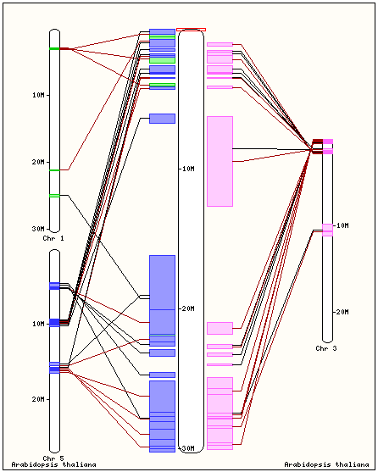
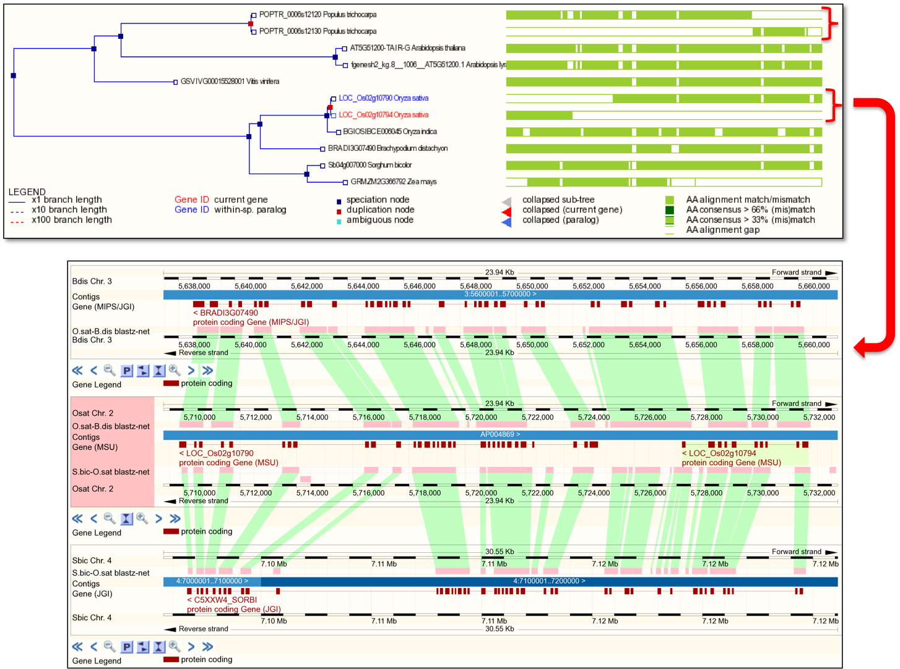
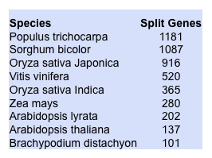




Gramene Comparative & Phylogenomics Resources for Plants
Joshua C. Stein¹, William Spooner¹, Sharon Wei¹, Liya Ren¹, Doreen Ware^{1,2}
¹Cold Spring Harbor Laboratory, Cold Spring Harbor, NY 11724
²USDA-ARS NAA Plant, Soil & Nutrition Laboratory Research Unit, Ithaca, NY 14853
ABSTRACT: The integration of genome annotation with evolutionary analysis, often referred to as phylogenomics, is a powerful strategy in the study of gene structure and function, and is a compelling motivation for acquiring complete genome sequences. The Gramene Project (www.gramene.org) provides a comprehensive platform for comparative genomics in plants, utilizing the Ensembl Compara pipeline and database structure. The site offers data and visualizations of whole genome alignments, synteny analysis, phylogenetic trees, and ortholog/paralog designations. Release 32 includes the whole genomes of five monocots (rice japonica, rice indica, sorghum, Brachypodium, and maize), four dicots (Arabidopsis, A. lyrata, grape, and poplar), the moss Physcomitrella, and partial genomes of several wild rice species. New features include multi-species views, synteny maps based on phylogenetically-determined orthologs, and multiple genome alignments and ancestor reconstruction using the Enredo/Pecan/Ortheus pipeline. These data are fully integrated with other Gramene resources, including gene and protein-level annotations, GO ontology, genome browsers, diversity data, and pathways. We describe details of this resource and demonstrate its use in multiple applications, including the definition of duplication events, large and small-scale rearrangements, annotation inconsistencies, and comparison of gene-family diversity across species. The availability of this platform provides unique opportunities to elucidate the evolutionary history of flowering plants.
Patterns of evolution revealed by Compara gene trees
Whole Genome Alignments
BLASTZ-CHAIN-NET between 20 pairs of species
Top: A ubiquitin specific protease has remained low-copy throughout eukaryotes. Bottom: Species-specific expansion of a grass-specific family of NB-ARC domain disease-resistance genes in rice, maize, sorghum, but not in Brachypodium.
Whole Genome Alignments Displayed in Multi-species View
Gene-Centered Synteny Build
Compara Orthologs
Collinear mappings (DAGchainer)
“in-range” mappings near collinear anchors
Map
Ensembl Compara Gene Tree Pipeline¹
Load genes and longest translations for all species in Gramene
Stack any number of genomes aligned to a common reference by BLASTZ
Browse & zoom along any genome independently
1
All versus all BLASTP
Duplicated Regions in Arabidopsis and Poplar Revealed by Co-synteny with Grape
EPO Multiple Alignment & Ancestor Reconstruction
2
  Rice japonica, indica, Brachypodium, sorghum, Arabidopsis, A. lyrata, grape, poplar
Build a graph of protein relations based on Best Reciprocal Hits or Blast Score Ratio
3
Extract the connected components using single linkage clustering with the groups of peptides
4
Generate a protein alignment for each cluster using TCoffee²
Paten et al (2008) Genome Research 18:1814
Paten et al (2008) Genome Research 18:1829
5
Comparative Annotation:
Automated detection of putative split gene models
Build a gene tree and reconcile with species tree using TreeBeST³
Special class of “paralog” since Ensembl 58
6
Contiguous split paralog: Non-overlapping, nearby (<1 Mb), same strand
Putative split paralog: Non-overlapping, different regions (e.g. scaffolds)
Funding
Infer the orthology and paralogy relationships for every pair of genes in the gene tree
This work was initially supported (2001-2004) by the USDA Initiative for Future Agriculture and Food Systems (IFAFS) (grant no. 00-52100-9622) and a Cooperative State Research and Education Service (CSREES) agreement through the USDA Agricultural Research Service (grant no. 58-1907-0-041). For the years 2004-2007 this work was supported by the National Science Foundation (NSF) PGI grant award #0321685. Current work is being supported by the NSF Plant Genome Research Resource grant award #0703908.
7
Notes:
http://www.gramene.org/Oryza_sativa/Component/Location/Web/ViewBottom?_rmd=1138;r=1:1-49999;update_panel=1;export=png
http://www.gramene.org/db/qtl/qtl_display?qtl_id=7555
http://www.gramene.org/Oryza_sativa/Location/Multi?db=core;h=LOC_Os09g19734%20%281-9758%29;r=9:11784449-11834448;r1=2:56142482-56192481:1;s1=Sorghum_bicolor
http://www.gramene.org/Oryza_sativa/Location/Synteny?otherspecies=Sorghum_bicolor&h=LOC_Os09g19734+%281-9758%29&r=9%3A11784449-11834448&db=core
http://pathway.gramene.org/RICE/NEW-IMAGE?type=PATHWAY&object=PWY-5027
http://www.gramene.org/Oryza_sativa/Component/Gene/Web/GeneSNPImage?_rmd=aebd;db=core;g=LOC_Os09g19734;h=LOC_Os09g19734%20%281-9758%29;r=9:11804570-11814327;export=png
http://www.gramene.org/db/diversity/diversity_view
http://www.gramene.org/Arabidopsis_thaliana/Component/Gene/Web/ComparaTree?_rmd=0c2d;collapse=;db=core;g=AT4G33150-TAIR-G;r=4:15985189-15991538;export=png
http://www.gramene.org/Oryza_sativa/Component/Gene/Web/GeneSNPImage?_rmd=aebd;db=core;g=LOC_Os09g19734;h=LOC_Os09g19734%20%281-9758%29;r=9:11804570-11814327;export=png-2
http://www.gramene.org/db/cmap/viewer?dotplot=0&eliminate_orphans=0&mapMenu=&featureMenu=1&corrMenu=1&displayMenu=1&advancedMenu=&slot_min_corrs_1=0&slot_min_corrs_2=100&stack_maps=1&map_start_0_raj2003a9=24.8&map_start_1_grjp2009a-9=1&map_start_2_mzfpc0806-ctg11=0.00&map_start_2_mzfpc0806-ctg44=0.00&map_start_2_mzfpc0806-ctg91=0.00&map_start_2_mzfpc0806-ctg164=0.00&map_start_2_mzfpc0806-ctg309=0.00&map_start_2_mzfpc0806-ctg318=0.00&map_start_2_mzfpc0806-ctg320=0.00&map_start_2_mzfpc0806-ctg325=0.00&map_start_2_mzfpc0806-ctg438=0.00&map_stop_0_raj2003a9=84&map_stop_1_grjp2009a-9=23011239.00&map_stop_2_mzfpc0806-ctg11=3165.00&map_stop_2_mzfpc0806-ctg44=2895.00&map_stop_2_mzfpc0806-ctg91=4353.00&map_stop_2_mzfpc0806-ctg164=3481.00&map_stop_2_mzfpc0806-ctg309=2007.00&map_stop_2_mzfpc0806-ctg318=1683.00&map_stop_2_mzfpc0806-ctg320=2260.00&map_stop_2_mzfpc0806-ctg325=2652.00&map_stop_2_mzfpc0806-ctg438=347.00&map_mag_0_raj2003a9=1&map_mag_1_grjp2009a-9=1&map_mag_2_mzfpc0806-ctg11=1&map_mag_2_mzfpc0806-ctg44=1&map_mag_2_mzfpc0806-ctg91=1&map_mag_2_mzfpc0806-ctg164=1&map_mag_2_mzfpc0806-ctg309=1&map_mag_2_mzfpc0806-ctg318=1&map_mag_2_mzfpc0806-ctg320=1&map_mag_2_mzfpc0806-ctg325=1&map_mag_2_mzfpc0806-ctg438=1&map_in_menu_0_raj2003a9=1&map_in_menu_1_grjp2009a-9=1&map_in_menu_2_mzfpc0806-ctg11=1&map_in_menu_2_mzfpc0806-ctg44=1&map_in_menu_2_mzfpc0806-ctg91=1&map_in_menu_2_mzfpc0806-ctg164=1&map_in_menu_2_mzfpc0806-ctg309=1&map_in_menu_2_mzfpc0806-ctg318=1&map_in_menu_2_mzfpc0806-ctg320=1&map_in_menu_2_mzfpc0806-ctg325=1&map_in_menu_2_mzfpc0806-ctg438=1&sub=Redraw&highlight=%22CQAX26%22&ft_clone=1&ft_est=1&ft_est-cluster=1&ft_fpc=1&ft_gene=1&ft_gene-prediction=1&ft_genomic-dna=1&ft_gss=1&ft_marker=1&ft_mrna=1&ft_overgo=1&ft_qtl=1&ft_rflp=1&ft_ssr=1&ft_sts=1&ft_DEFAULT=1&label_features=landmarks&collapse_features=1&evidence_type_ID=1&ets_ID=0&evidence_type_bin_marker=1&ets_bin_marker=0&evidence_type_colocalized_qtl_marker=1&ets_colocalized_qtl_marker=0&evidence_type_curated_gene_to_qtl=1&ets_curated_gene_to_qtl=0&evidence_type_dbest_poaceae=1&ets_dbest_poaceae=0&evidence_type_est-cluster-membership=1&ets_est-cluster-membership=0&evidence_type_export-genes-to-mdb=1&ets_export-genes-to-mdb=0&evidence_type_fix-genbank-accs=1&ets_fix-genbank-accs=0&evidence_type_fix-overgo-correspondences=1&ets_fix-overgo-correspondences=0&evidence_type_fpc_loader=1&ets_fpc_loader=0&evidence_type_gene_model=1&ets_gene_model=0&evidence_type_gss_poaceae=1&ets_gss_poaceae=0&evidence_type_load-mmp-est-clusters=1&ets_load-mmp-est-clusters=0&evidence_type_load-plant-transcripts=1&ets_load-plant-transcripts=0&evidence_type_load-plantgdb-est-clusters=1&ets_load-plantgdb-est-clusters=0&evidence_type_load-tgi-est-clusters=1&ets_load-tgi-est-clusters=0&evidence_type_load-unigene-est-clusters=1&ets_load-unigene-est-clusters=0&evidence_type_maize_cytomap=1&ets_maize_cytomap=0&evidence_type_neighboring_qtl_marker=1&ets_neighboring_qtl_marker=0&evidence_type_omap2indica_synteny_pipeline=1&ets_omap2indica_synteny_pipeline=0&evidence_type_omap2irgspv4_synteny_pipeline=1&ets_omap2irgspv4_synteny_pipeline=0&evidence_type_omap2tigrv4_synteny_pipeline=1&ets_omap2tigrv4_synteny_pipeline=0&evidence_type_other_dna_poaceae=1&ets_other_dna_poaceae=0&evidence_type_rflp_sequence=1&ets_rflp_sequence=0&evidence_type_rice_ssrs=1&ets_rice_ssrs=0&evidence_type_set-clone-associations=1&ets_set-clone-associations=0&evidence_type_sog_overgo=1&ets_sog_overgo=0&evidence_type_synteny=1&ets_synteny=0&evidence_type_unknown=1&ets_unknown=0&evidence_type_wheat-est-bi=1&ets_wheat-est-bi=0&evidence_type_yac_mate_pair=1&ets_yac_mate_pair=0&aggregate=0&corrs_to_map=1&show_intraslot_corr=0&split_agg_ev=0&phrb=300&pixel_height=300&font_size=small&image_type=png&clean_view=0&hide_legend=0&dotplot_ps=1&scale_maps=1&omit_area_boxes=0&comp_menu_order=display_order&ignore_image_map_sanity=0&session_id=2c9c89a29d530cd6e7e2348e7c2b5d0a&step=10&session_mod=&ref_map_set_acc=raj2003a&ref_map_accs=raj2003a9&ref_species_acc=1&flip=&data_source=Build31

