Slide 1
Esembl Compara Overview
Comparative genomics:
  Whole genome alignments
  Synteny regions
Comparative proteomics:
  Orthologue predictions
  Paralogue predictions
  Protein family clusters
Sources:
  http://pre.ensembl.org/info/data/compara/homology_method.html

Slide 2
Homologue Relationships
Orthologues :
any gene pairwise relation where the ancestor node is a speciation event
Paralogues :
any gene pairwise relation where the ancestor node is a duplication event

Slide 3
Homologue Relationships
time
A
Ancestor
Duplication
A 1
Inparalogues
A 2
Speciation
Inparalogues
H 2
Duplication
M 1
H 1
Orthologues
Outparalogues
M 2
M 2’
Inparalogues

Slide 4
Orthologue / Paralogue Prediction Algorithm
(1) Load the longest translation of each gene from all species used in Ensembl.
(2) Run WUBLASTp+SmithWaterman of every gene against every other (both self and non-self species) in a genome-wise manner.
(3) Build a graph of gene relations based on Best Reciprocal Hits (BRH) and Blast Score Ratio (BSR) values.
(4) Extract the connected components (=single linkage clusters), each cluster representing a gene family.
(5) For each cluster, build a multiple alignment based on the protein sequences using MUSCLE.
(6) Build tree and infer duplications/losses using NJTREE (reconciles gene tree w/ species tree).
(7) From each gene tree, infer gene pairwise relations of orthology and paralogy types.

Slide 5
Some Details
1 BRH: Best Reciprocal Hit. When a query gene translation has an unambiguous 'best' hit to a target translation, and that particular target translation has an unambiguous 'best' hit back to the starting query translation. The discrimination function for 'best' is a simple sort of blastp >score, %identity, >%positivity.
2 BSR: Blast Score Ratio. When 2 proteins P1 and P2 are compared, BSR=scoreP1P2/max(self-scoreP1 or self-scoreP2). The default threshold used in the initial clustering step is 0.33.
3 Edgar RC "MUSCLE: a multiple sequence alignment method with reduced time and space complexity" BMC Bioinformatics 2004 Aug 19;5:113.
4 Li H et al. NJTREE: http://treesoft.sourceforge.net/njtree.shtml. Manuscript in preparation.

Slide 6
Orthologue and Paralogue Types
ortholog_one2one
ortholog_one2many
ortholog_many2many
apparent_ortholog_one2one
within_species_paralog
between_species_paralog

Slide 7
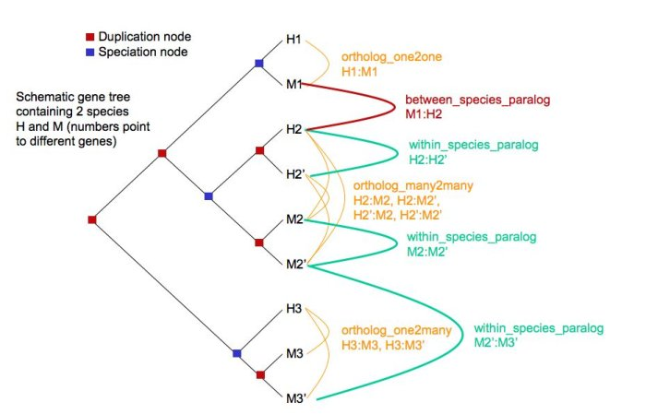
Orthologue and Paralogue Types

Slide 8
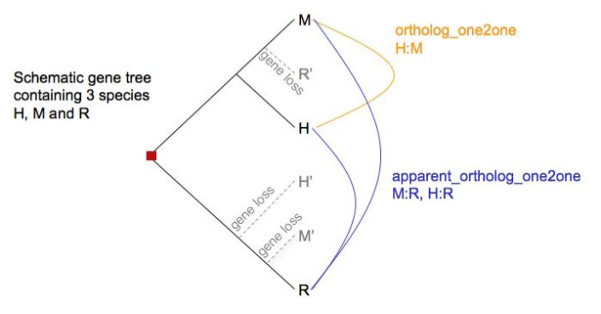
Orthologue and Paralogue types

