Slide 1
Introducing CACHEfx
Scalable Caching Appliances
October 2007

Slide 2
Current Trends Creating I/O Bottlenecks
Shared I/O going mainstream
Clustered / technical computing
Virtualization
Web-scale applications
Video on demand
Server growth creating
shared I/O bottleneck
Traditional solutions are no longer effective
  Disk over provisioning
  Server or subsystem caching

Slide 3
A New Approach: Centralized Storage Caching
  Dramatically increase performance
    IOPS, low latency, throughput
  Reduce over-provisioning
    Less power, space, cooling
  Guarantee service levels
  Install transparently
    Maintain storage processes (snapshots, mirroring, archive)
  Scale as a shared network resource
Gear6
Scalable Caching Appliance
Clustered File System
Cached data served
10-50x faster from RAM

Slide 4
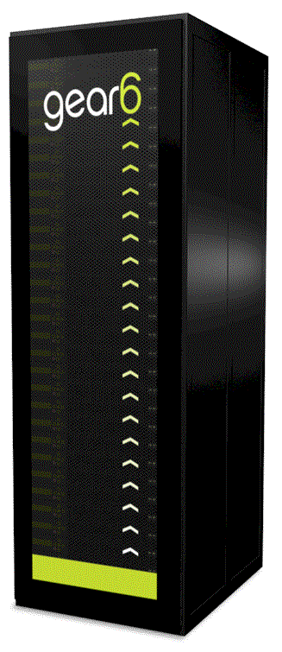
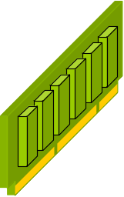
Introducing CACHEfx Scalable Caching Appliances
Use high-speed RAM to overcome performance limitations of traditional disk-based storage
Accelerate data center systems and applications by transparently eliminating I/O bottlenecks
Fit existing infrastructure
  Initial focus on NAS/NFS
  Support clustered file systems
Deliver true performance
  Low latency
  High IOPS
  and high throughput
Support thousands of clients
Scale to multiple terabytes
Close the performance gap
CACHEfx™
Appliance

Slide 5
Positive Impact of Centralized Storage Caching
Broad Market Applicability
Consistent Benefits
Databases
Electronic design
Financial analytics
Energy and exploration
Media delivery
Biotechnology
Animation
Performance and acceleration
Reduce over-provisioning
Quality of Service
Investment protection
Pervasive Data Center Trends
Large data sets
Random access
Concurrent clients
Transaction intensive
Peak loads with SLAs
Shared I/O

Slide 6
CACHEfx Appliance and Reflex OS
Reflex OS™
  Coherent memory aggregation
  Parallel I/O and real time response for scalable I/O bandwidth
  Intelligent cache services
Appliance Performance
  From 250,000 to millions of IOPS
  Microsecond response time
  Scales linearly
Network
  2 to 16 Gb/s
  10 Gigabit Ethernet connectivity
Capacity
  Starting at ¼ TB. More capacity via real time compression. Scale to 5TB
Supported Protocols
  NFS and clustered file systems
  Other protocols planned
Reflex OS
Cache Services
Performance
Virtualization

Slide 7
Deployment Use Cases
Problems
  I/O constraints
  Poor utilization
  Varied service levels
Solutions
  Application acceleration
  Efficient performance
  Guaranteed storage quality of service
Benefits
  Shorten processing times
  Simplify configurations
  Easily manage peak loads
  No infrastructure change
  Supercharge all NAS/NFS and clustered file systems
Performance and Acceleration
Reduce Over-provisioning
Quality of Service
NFS
Clients
Application
and Database
Servers
Direct data path available anytime
Ethernet/IP
Network
CACHEfx™
NFS
Servers/Storage
(clustered file
systems)

Slide 8
Key Points to Remember
Performance gap is real and growing
Centralized storage caching represents
a unique and innovative solution
Industry’s first scalable caching
appliance
  Delivers instant data access
  Enhances existing infrastructure
Suits broad range of
applications and segments
Accelerating storage for real time application performance
<number> : Gear6 Confidential

