Slide 1
BAC sequence improvement

Slide 2
Data sources
Existing BAC contigs in Genbank
~100X illumina BAC resequencing in pools
Fosmid sequences
40000 nt insert size 4000 nt insert stdev
FLcDNA sequences
simulated reads for scaffolding
WGS 454 sequences

Slide 3
Strategy
Order and orient contigs with fosmid, cDNA, and possibly other data (tbd)
Local meta assembly of illumina reads within BAC pools using soapdenovo and abyss
Anchor novel contigs by genetics method
Fill gaps between contigs and improve consensus sequence with 454 and illumina reads using PAGIT tools

Slide 4
MaizeGDB and GRC tools
We are collaborating with MaizeGDB on using the GRC tools to manage updates to the assembly.
Updated versions of the BAC accessions with contigs ordered and oriented according to the RefGen_v3 AGP are being created for use in the GRC tools.

Slide 5
1. Effectiveness of fosmid sequences for ordering BAC contigs
Using blastn we find 103,404 pairs of contigs within 14,493 BAC clones that which align to fosmid mate pair reads.

Slide 6
2. Assembly and new contigs anchoring
Align reads to all the bacterial genome to detect the contamination by Bowtie2
Assembly by Soapdenovo and Abyss
Merge the two assemblies by SSPACE
Align scaffolds to the BACs and get the unmapped contigs
Anchor the unmapped contigs by Kmer-mapping
(Only use the SNP from these 90 BACs as genotype)

Slide 7
Assembly and new contigs anchoring
32.61% reads were bacterial contamination
366 new contigs
55 new contigs were anchored (P-value<=1e-6)

Slide 8
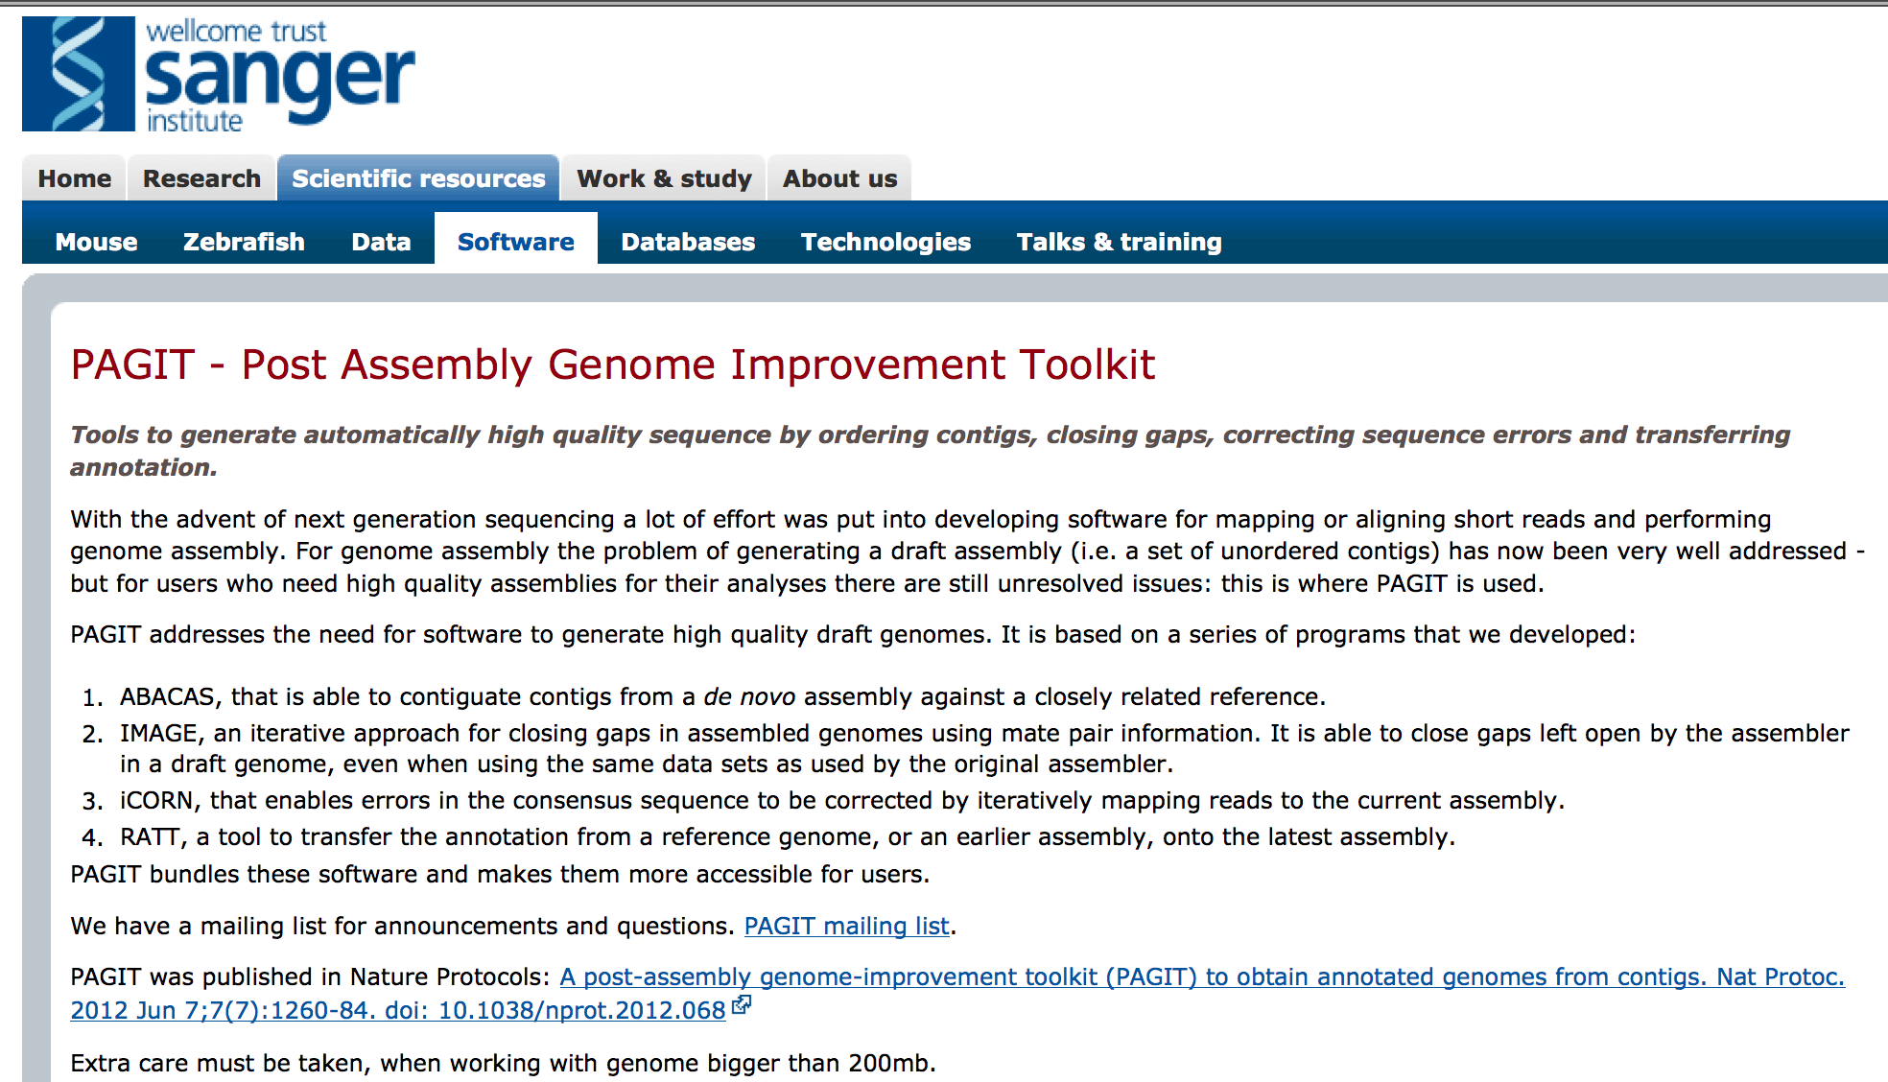
Gap closing by the BAC-pool data

Slide 9
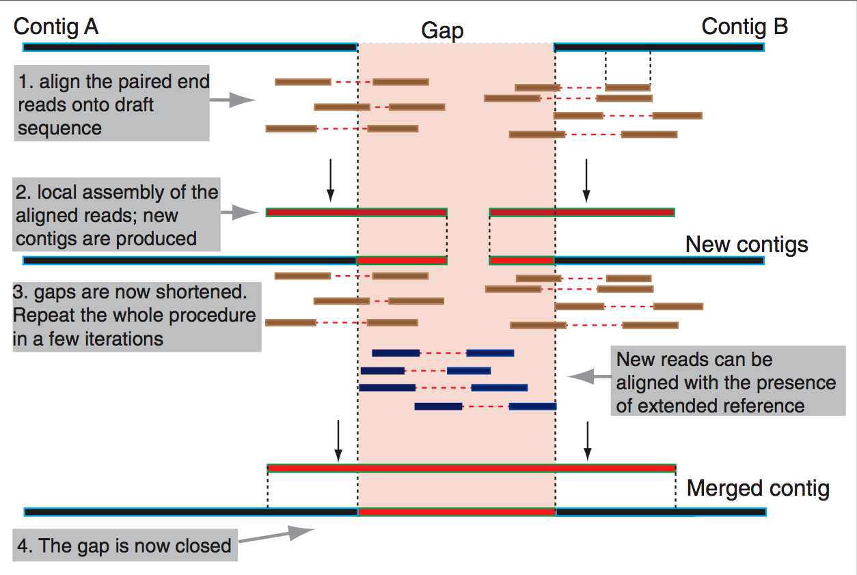
96 pooled BACs
~110kb gaps were filled for 90 BACs
iteration | Starting gaps | Gap closed | Gap extend oneside | Gap extend bothside
1 | 1012 | 32 | 336 | 41
2 | 980 | 10 | 144 | 16
3 | 970 | 4 | 104 | 11
4 | 966 | 0 | 74 | 7
5 | 966 | 3 | 48 | 7
6 | 963 | 2 | 43 | 3
7 | 961 | 1 | 38 | 0
8 | 960 | 0 | 29 | 2
9 | 960 | 0 | 26 | 0
10 | 960 | 1 | 20 | 1
11 | 959 | 0 | 15 | 1
12 | 959 | 0 | 12 | 0
13 | 959 | 0 | 12 | 0
14 | 959 | 0 | 14 | 0
15 | 959 | 0 | 13 | 0
16 | 959 | 0 | 13 | 0
17 | 959 | 1 | 9 | 0
18 | 958 | 0 | 10 | 0
19 | 958 | 0 | 9 | 0
20 | 958 | 0 | 9 | 0

Slide 10
Old BACs Updated BACs by AGP file
iteration | Starting gaps | Gap closed | Gap extend oneside | Gap extend bothside | iteration | Starting gaps | Gap closed | Gap extend oneside | Gap extend bothside
1 | 1000 | 21 | 335 | 40 | 1 | 1012 | 32 | 336 | 41
2 | 979 | 7 | 170 | 17 | 2 | 980 | 10 | 144 | 16
3 | 972 | 1 | 101 | 10 | 3 | 970 | 4 | 104 | 11
4 | 971 | 1 | 80 | 4 | 4 | 966 | 0 | 74 | 7
5 | 970 | 0 | 63 | 5 | 5 | 966 | 3 | 48 | 7
6 | 970 | 1 | 50 | 3 | 6 | 963 | 2 | 43 | 3
7 | 969 | 2 | 42 | 2 | 7 | 961 | 1 | 38 | 0
8 | 967 | 1 | 37 | 1 | 8 | 960 | 0 | 29 | 2
9 | 966 | 1 | 35 | 0 | 9 | 960 | 0 | 26 | 0
10 | 965 | 0 | 28 | 0 | 10 | 960 | 1 | 20 | 1
11 | 965 | 0 | 29 | 0 | 11 | 959 | 0 | 15 | 1
12 | 965 | 0 | 21 | 0 | 12 | 959 | 0 | 12 | 0
13 | 965 | 0 | 23 | 0 | 13 | 959 | 0 | 12 | 0
14 | 965 | 0 | 20 | 0 | 14 | 959 | 0 | 14 | 0
15 | 965 | 0 | 20 | 0 | 15 | 959 | 0 | 13 | 0
16 | 965 | 0 | 16 | 0 | 16 | 959 | 0 | 13 | 0
17 | 965 | 0 | 19 | 0 | 17 | 959 | 1 | 9 | 0
18 | 965 | 0 | 16 | 0 | 18 | 958 | 0 | 10 | 0
19 | 965 | 0 | 15 | 0 | 19 | 958 | 0 | 9 | 0
20 | 965 | 0 | 12 | 0 | 20 | 958 | 0 | 9 | 0

Slide 11
Next
Use scaffolding tools to build scaffolds among contigs using Fosmid reads and simulated mate pair reads.
Anchor novel contigs and fill gaps.
Effective scaffolding requires long insert size mate pair sequencing.
Significant gap filling requires long reads

Slide 12
Possible BAC order correction strategy
A/ Re-ordering by minimizing structural variation (SV)-looking misassemblies
1) Map paired-end and mate-pair Illumina reads from B73 to BACs
2) Filter for uniquely mapped pairs
3) Identify all unsupported contig junctions from SV detection
4) Re-ordering BAC contigs by scaffolding with Illumina mate-pairs and PacBio (SSPACE/Pbjelly)
Redo steps 1) to 3) for validation
For unresolved cases:
5) Deduce from mapping the most likely order(s) (may not be easy)
Redo steps 1) to 3) to select the best supported order (generating no or less SVs)
For unresolved cases:
6) Test all possible orders and keep the most supported one after 1 and 2
(will require a lot of computational resources)
For 4), 5) and 6), multiple mate-pair libraries with various size should help
B/ Gap filling on re-odered BACs (GapFiller, IMAGE, …)

Slide 13
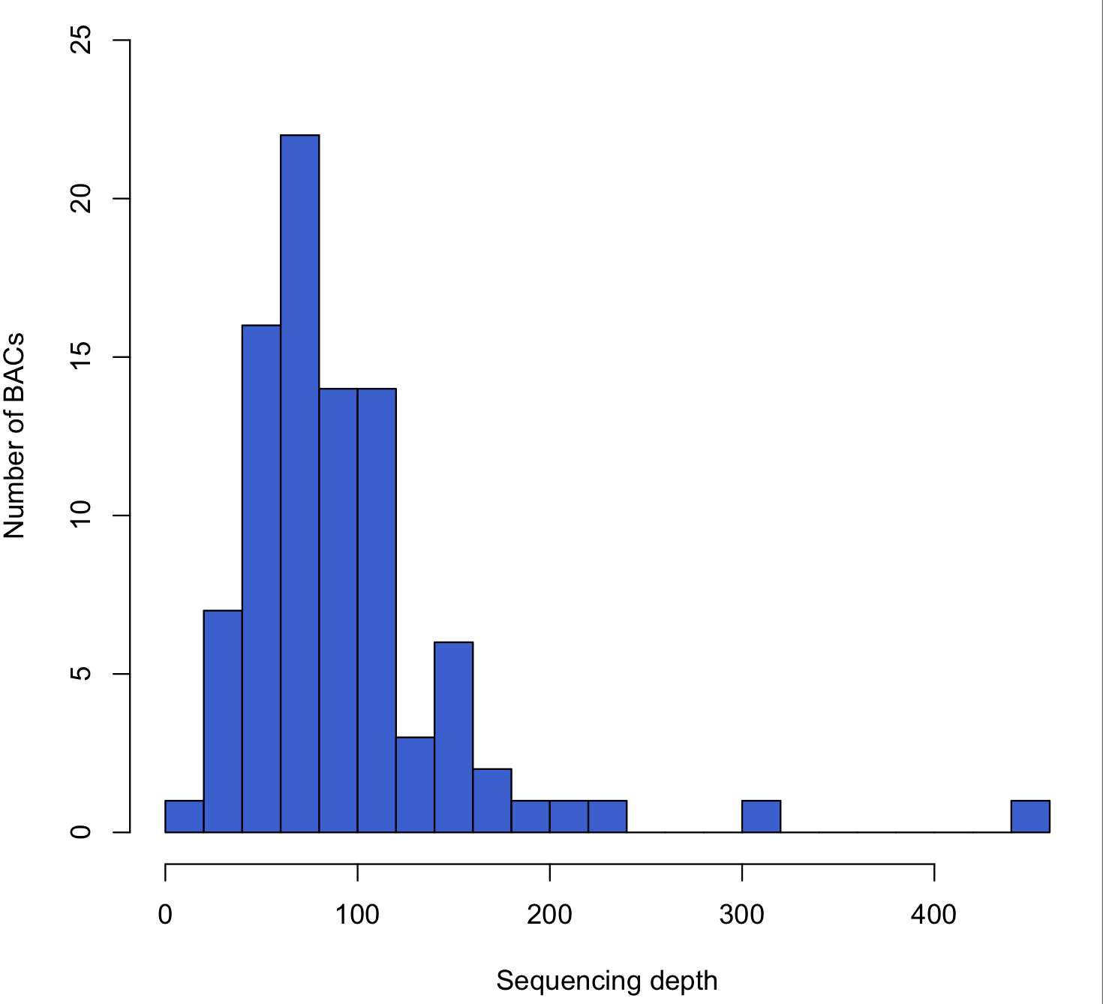
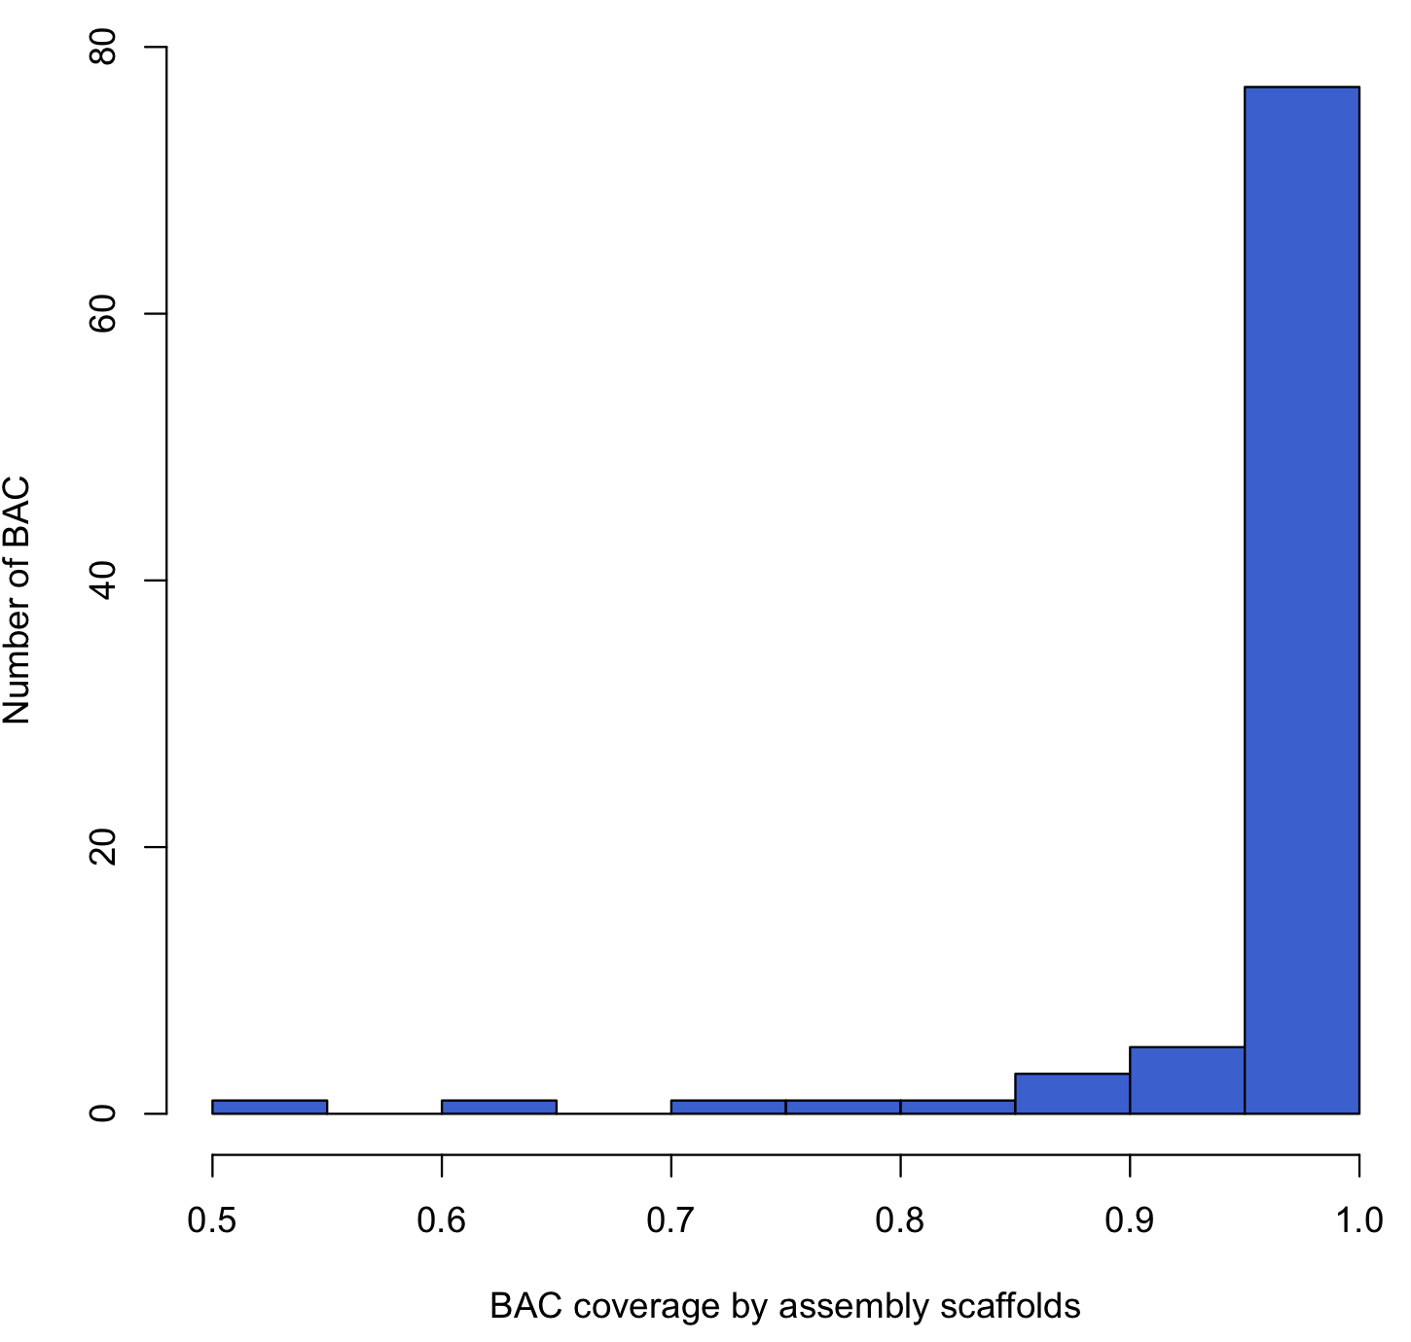
BAC reassembly strategy
Sequencing depth of each BAC
BAC coverage by assembly
Results from one pool of 90 BACs
 | Min. | 1st Qu. | Median | Mean | 3rd Qu. | Max.
N80 | 291 | 1178 | 1509 | 1952 | 2373 | 8510
N50 | 569 | 4266 | 5705 | 6400 | 7331 | 26640
N20 | 1525 | 8526 | 11200 | 14190 | 16400 | 59530
Max | 5871 | 13070 | 17250 | 19160 | 22970 | 59530
Coverage of Reference | 51.52% | 96.00% | 97.09% | 95.22% | 97.97% | 99.44%
Most BACs have excellent breadth and depth of coverage

