Slide 1
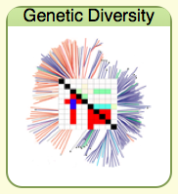
Gramene Genetic Diversity
Tools and Resources
Jon Zhang
Cornell University

Slide 2
Genetic Diversity Overview
Focus
Large scale genotype and phenotype association studies
Access to data
Tools for data analysis
Research Goal…
To associate genetic variation and observable traits across multiple species.
    [Jon Zhang, P0952]
Rice
Maize
Arabidopsis

Slide 3
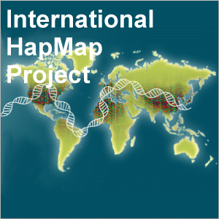
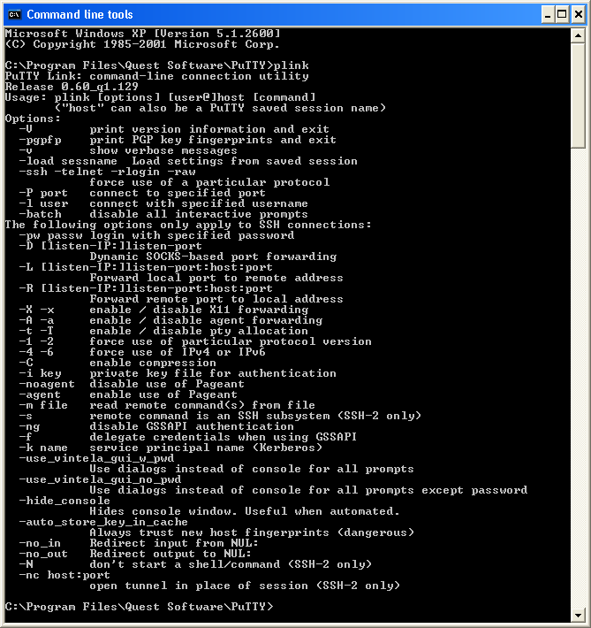
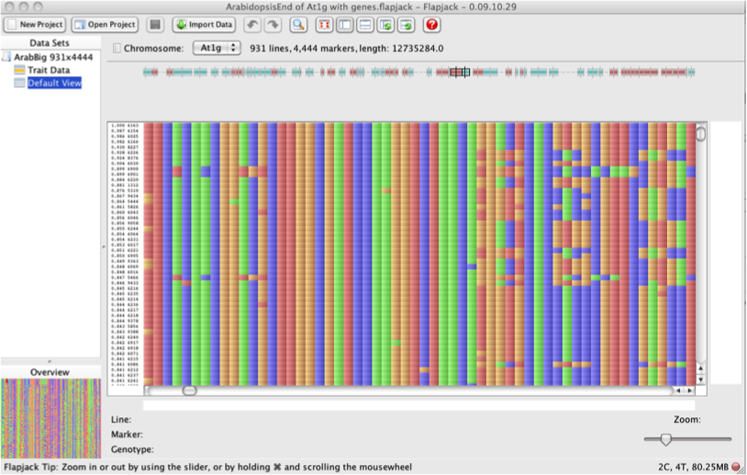
Genetic Diversity Overview
Data types
Genotype (SNPs, indels, genotype-by-sequence (GBS))
Phenotype (trait measurments, ontology, field information)
Germplasm (passports, stocks)
Data formats
Hapmap
Plink
Flapjack

Slide 4
Diversity Resources
Data Sets
Rice, Maize, Arabidopsis, Sorghum, Wheat
Species | Diversity Data Sources
Arabidopsis | Large scale SNP data from 1001 Genomes and NSF 2010 Arabidopsis Project
Maize | Molecular and Functional Diversity of the Maize Genome Project, Panzea.org
Rice | QTL and SSR based diversity studies from over 20 publications; Large scale SNP data from ricediversity.org and oryzasnp.org, NSF Rice Diversity, OryzaSNP, and Rice Haplotype Map projects
Sorghum | Sorghum Diversity Project
Wheat | Haplotype Polymorphism in Polyploid Wheats and Their Diploid Ancestors project

Slide 5
Diversity Resources
Data Storage
SQL database with the GDPDM schema
Binary Large Objects (BLOBs)
GDPDM
Able to capture data from a variety of sources: QTL mapping, association studies, SNP genotype assay studies, germplasm evaluation studies, and field data from plant breeding programs
5 sections: Genotypes, Phenotypes, Association, Germplasm, and Environment Observations

Slide 6
Diversity Resources
GDPDM Database Structure
GDPDM: www.maizegenetics.net/gdpdm
Genotypes
Uses BLOBs for storage
Supports full range of ploidy
Associations
Geno-pheno link
Largely expanded since last version
Environment Observations
Planting information
Treatment
Geographic data
Phenotypes
Quantitative or qualitative traits
Supports ontology intergration
Germplasms
Pedigree description
Seed stock information

Slide 7
Diversity Resources
BLOBs
Stores data in binary form
SNP Value, Position, SNP ID
200 fold compression of data
Low overhead, fast querying
ASCII Data
SNP1, SNP2, SNP3
CHR1, Position1
523, 7454, 8995
ACCATGGTCAACT
Binary Data
00111001101

Slide 8
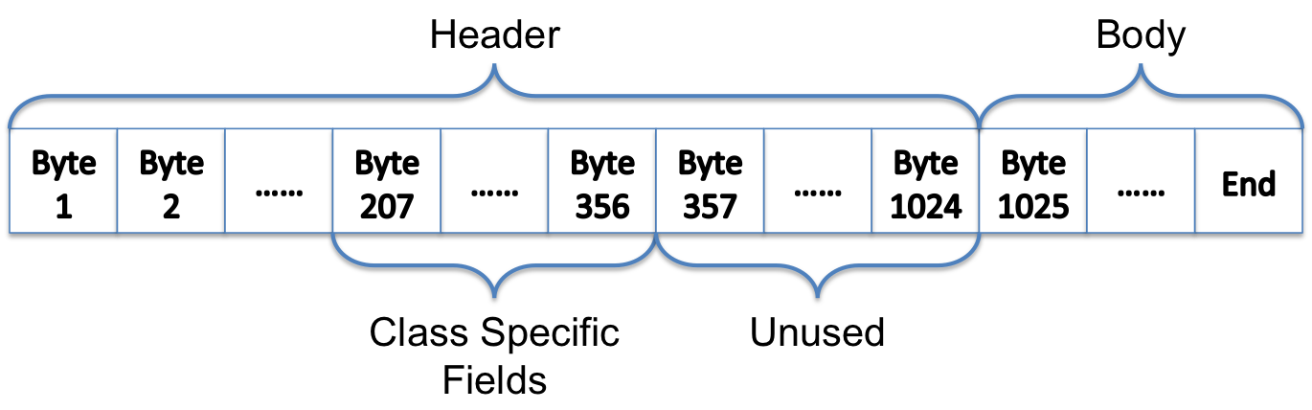
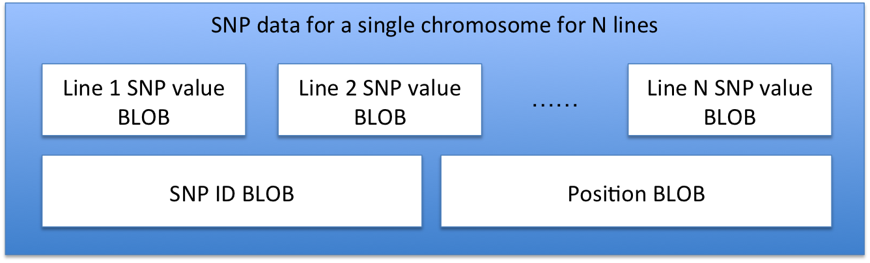
Diversity Resources
BLOB Structure
Data Structure

Slide 9

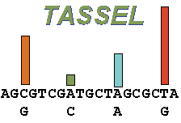
Diversity Tools
Data Availability
Bulk data downloads in various formats
Direct TASSEL web-launch
Data
Plink
Hapmap
Flapjack

Slide 10
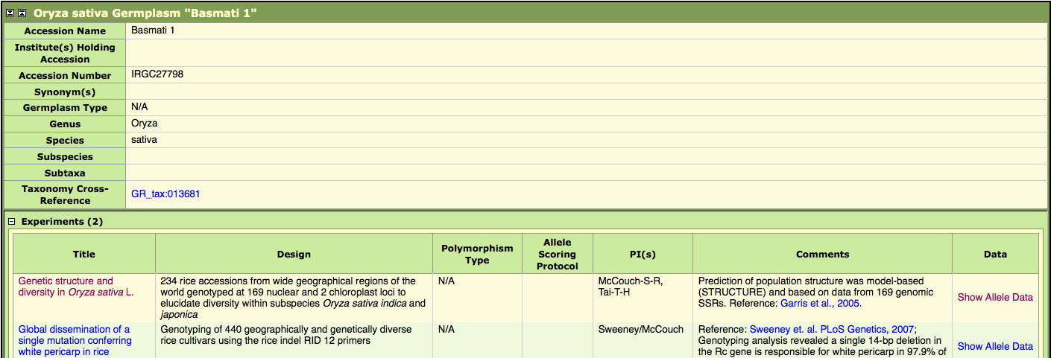
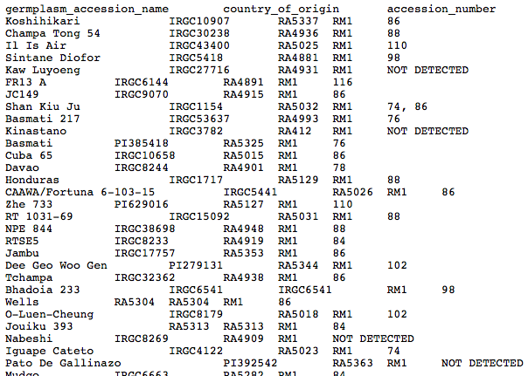
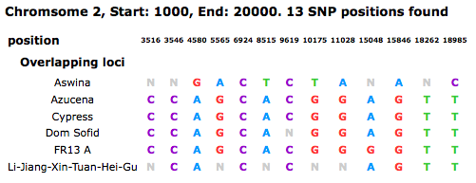
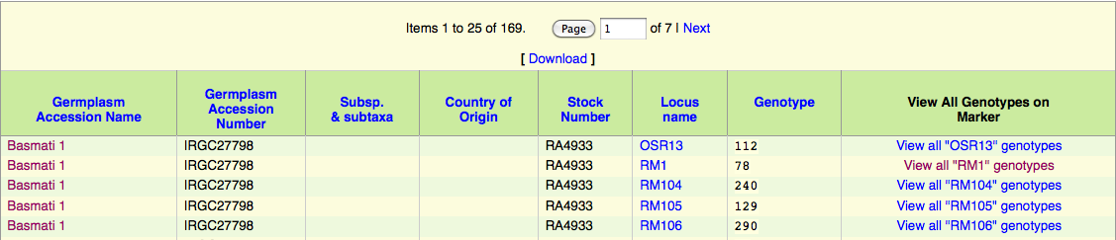
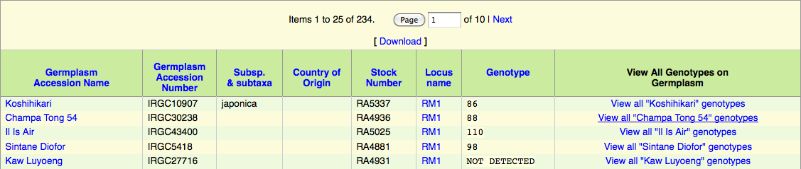
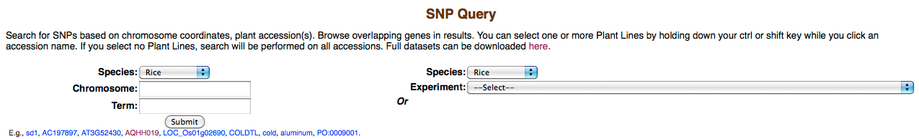
Diversity Tools
Data Availability
Quick Search
SNP Query

Slide 11
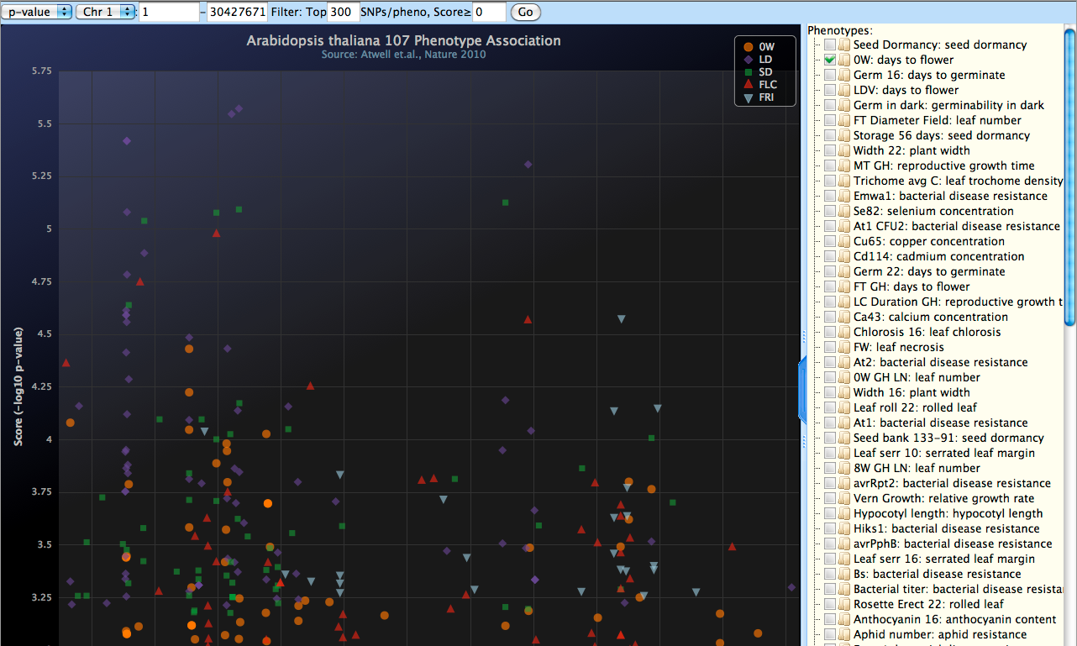
Diversity Tools
Data Analysis
Flapjack
Trait Analysis by aSSociation, Evolution, and Linkage (TASSEL)
GWAS Association Viewer

Slide 12


Diversity Tools
Flapjack
Developed by SCRI, now The James Hutton Institute
Genotype and Haplotype visualization in genotypic and phenotypic context
Collaboration with Gramene Diversity to develop connectivity between Flapjack and TASSEL

Slide 13
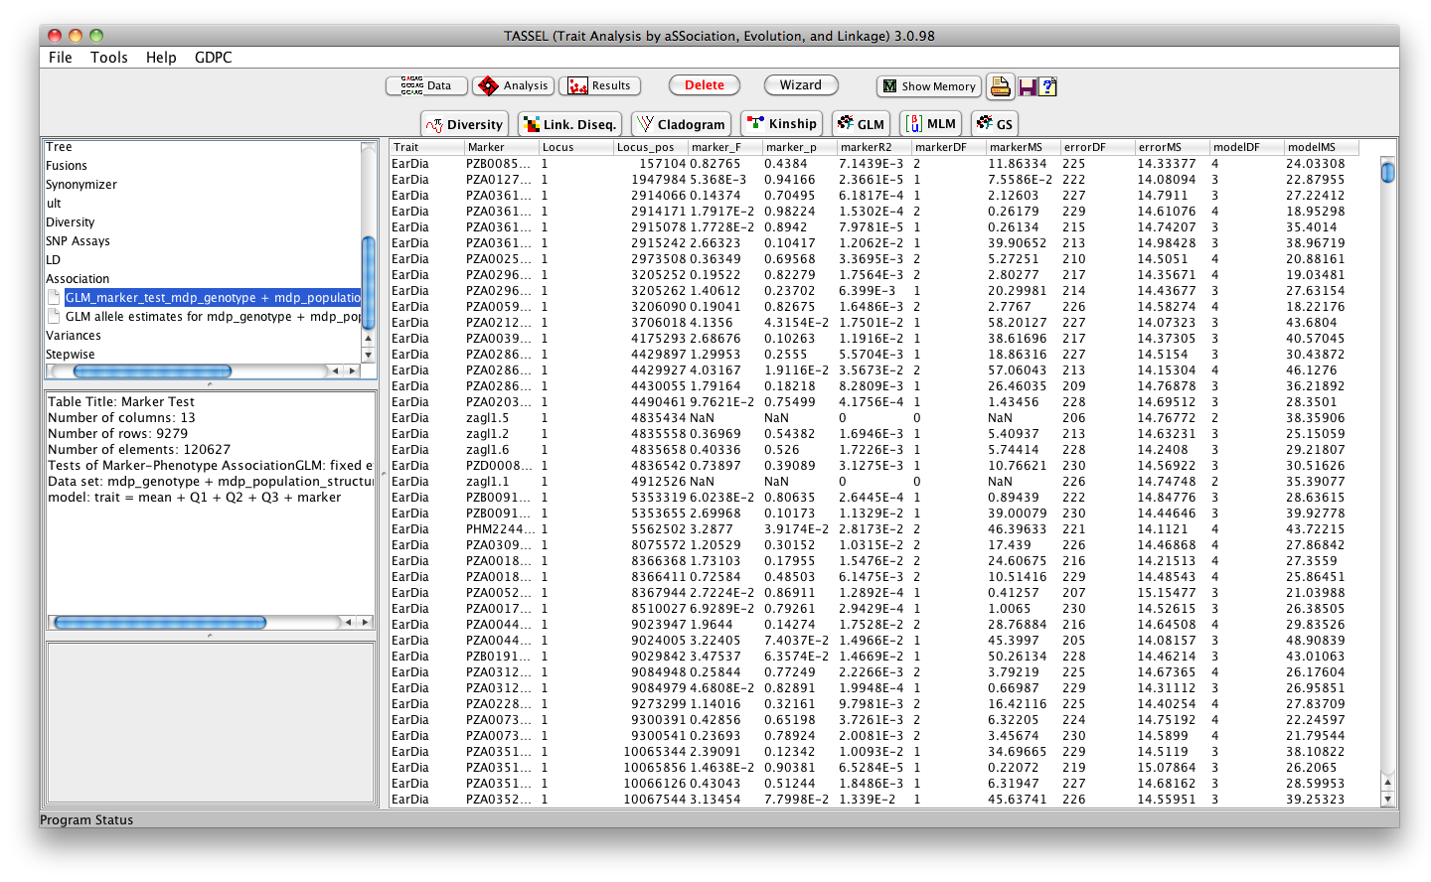
Diversity Tools
TASSEL
Evaluating trait associations, evolutionary patterns
Visualization of data
Many analysis options
  Diversity
  Cladistic Analysis
  Linkage Disequilibrium
  Extract SNPs
  Kinship
  Association Analysis

Slide 14
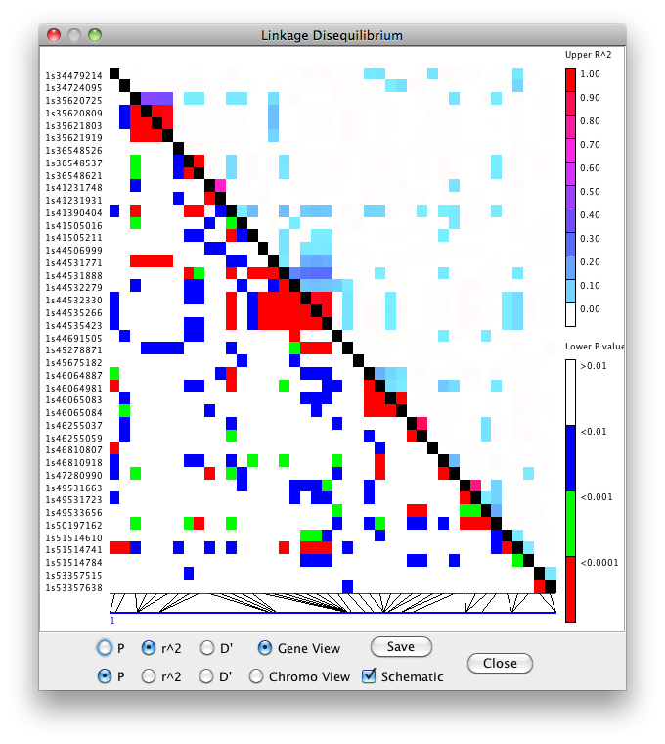
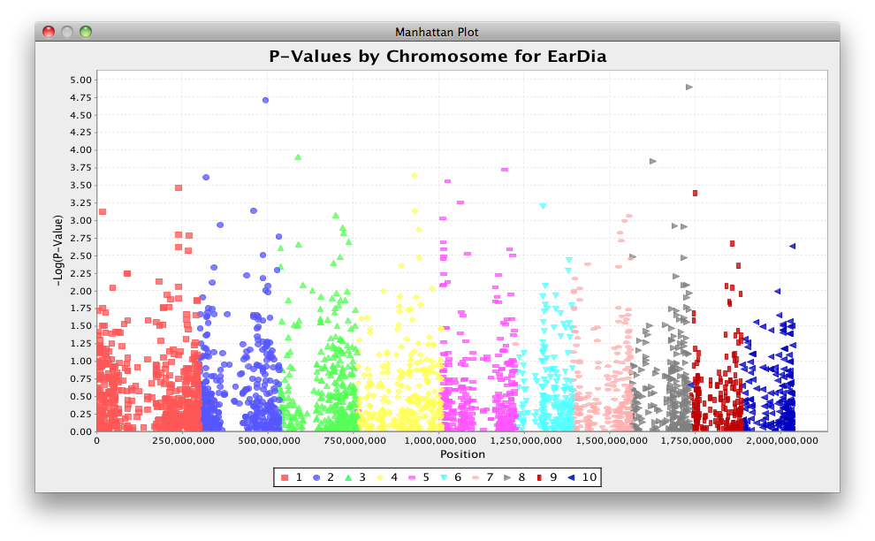
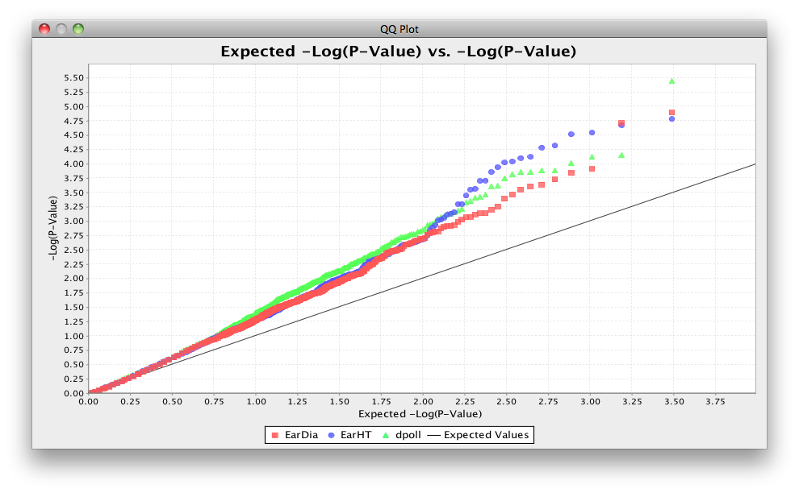
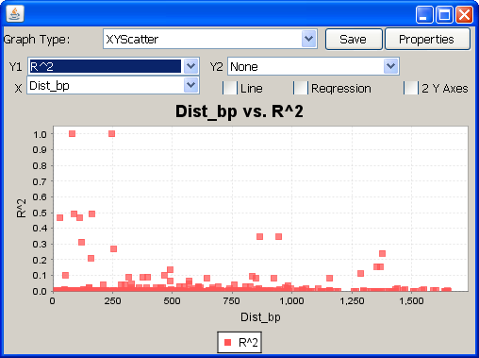
Diversity Tools
TASSEL Visualization Options
Chart utility with many options
LD plots
Cladogram
QQ plots
Manhattan plots
    [Terry Casstevens, P0993]
www.maizegenetics.net/tassel

Slide 15
Diversity Tools
GWAS Association Viewer
GWAS results in an interactive interface
Results directly populated from the database
Trait selection
Zooming
P-value cutoff selection
www.gramene.org/db/jshc2010

Slide 16
Thanks!
Visit Diversity www.gramene.org/db/diversity/diversity_view

