Slide 1
RiceCyc
RiceCyc is a web-based tool for viewing gene annotations mapped to various biochemical pathways.
Software: Pathway-tools developed from SRI
Data source:
TIGR assembly of Oryza sativa japonica cv. Nipponbare

Slide 2
RiceCyc Build
Pathway-tool builds pathway database primarily based on name or EC matching to MetaCyc
Interpro annotation of TIGR rice peptides to get GO terms and map to EC or MetaCyc
Compara analysis on TIGR rice peptide against SP-Trembl proteins from Poaceae
Compara analysis on TIGR rice peptide against arabidopsis ensembl
Curated gene functions and names from Gramene gene module

Slide 3
RiceCyc Creation
Annotated Rice Genome
RiceCyc
List of Gene Products
Pathways
List of Genes
Reactions
Pathologic Software
Integrates genome and pathway data to predict metabolic network
DNA sequence
Compounds
Reference Database MetaCyc
Gene Product
Pathways
Genes
Reactions
Compounds

Slide 4
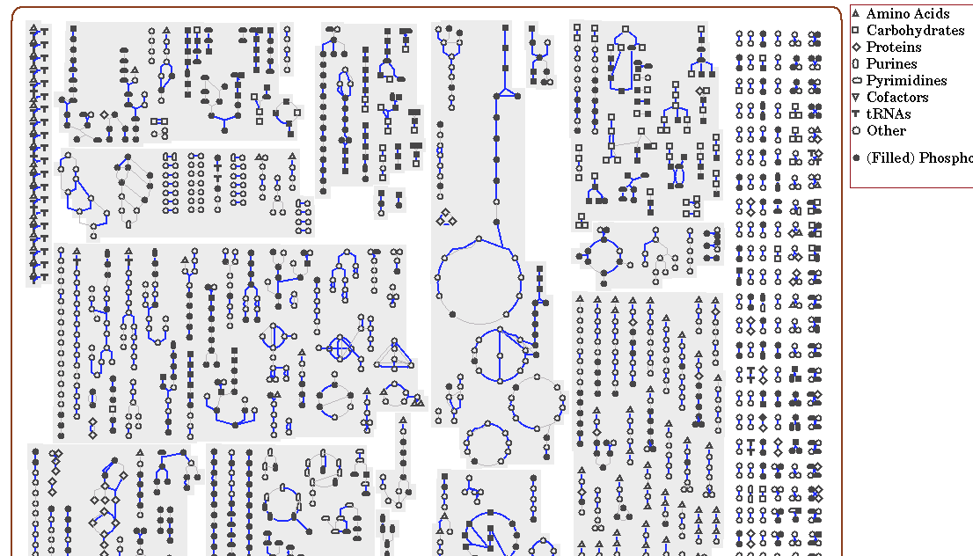
Overview of rice metabolic map
Biosynthetic pathways TCA Cycle Catabolic Orphan

Slide 5
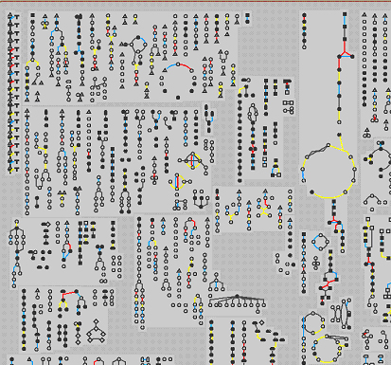
RiceCyc omics viewer
Red lines represent upregulated processes.
Blue lines represent unchanged processes.
Yellow lines represent downregulated processes.

Slide 6
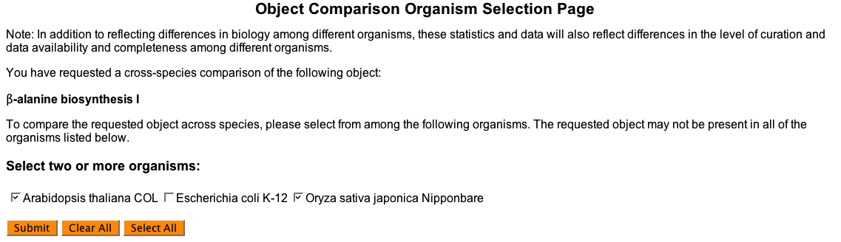
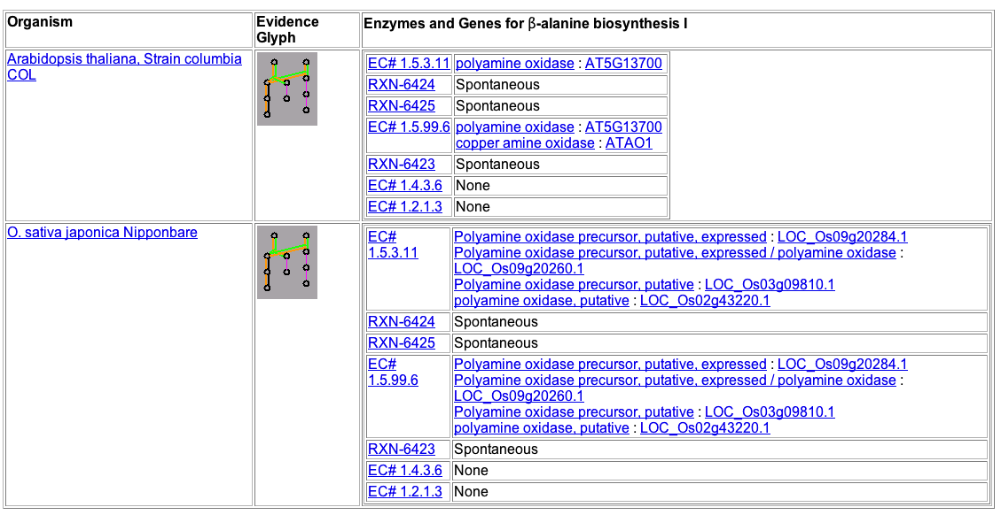
RiceCyc Comparative Analysis

Slide 7
RiceCyc Status
Following the computer generated creation of RiceCyc the dataset has undergone several rounds of manual curation with 63 pathways deleted and 16 added.
Summary:
* Pathways: 278
* Enzymatic Reactions: 1687
* Transport Reactions: 5
* Polypeptides: 43172
* Protein Complexes: 4
* Enzymes: 10387
* Compounds: 1265

Slide 8
Ontology database update
6 types of ontologies in ontology database
(TO, GO, PO, GRO, EO, GR_tax)
All gramene objects annotated by ontology terms are collected in ontology database.
Ensembl rice, maize, arabidopsis genes, proteins, curated genes, QTL, maps, marker libraries, marker species

