Slide 1
Web Usage and Stats

Slide 2
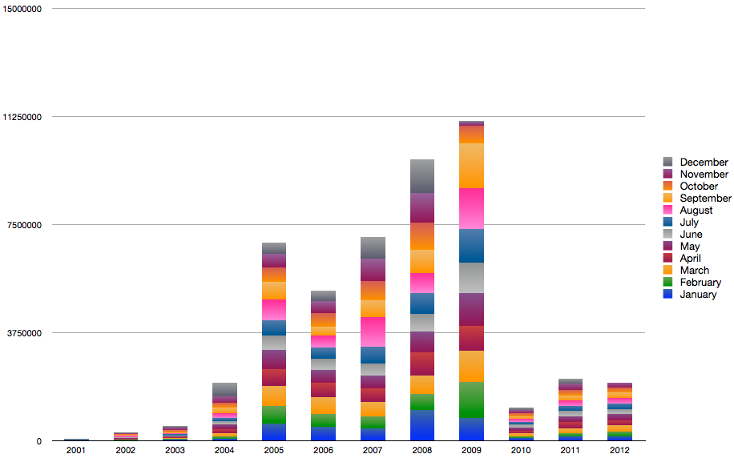
Page Requests by Year per Month
2001 - 2012
Notes:
By Analog/Google Analytics

Slide 3
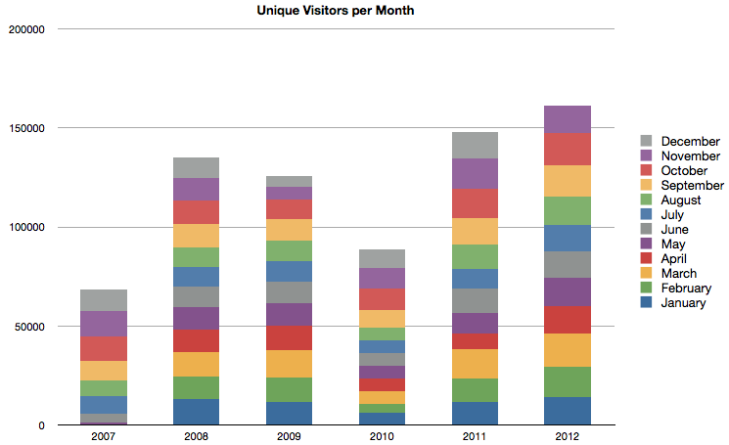
Unique Visitors by Year per Month
2007 - 2012
Notes:
By Google Analytics. Unique Visitor info only tracked back to April 2007

Slide 4
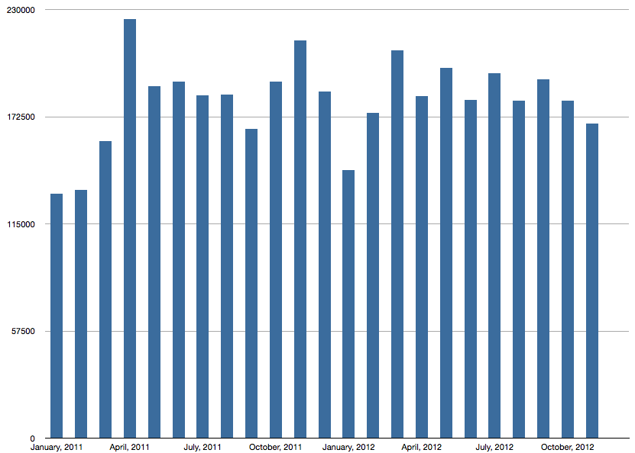
Page Requests by Month for 2011-2012
Notes:
By Analog

Slide 5
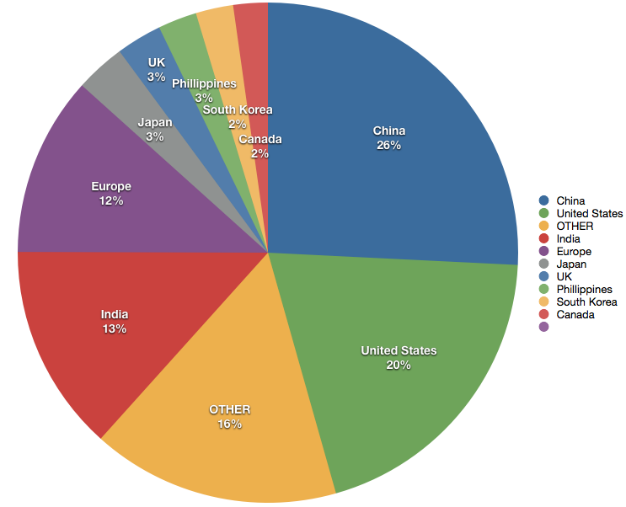
Top Countries - Visits%
January 2012 – November 2012
Notes:
By Google analytics – all EU countries extracted from the "Other" and combined with the "UK" slice

Slide 6
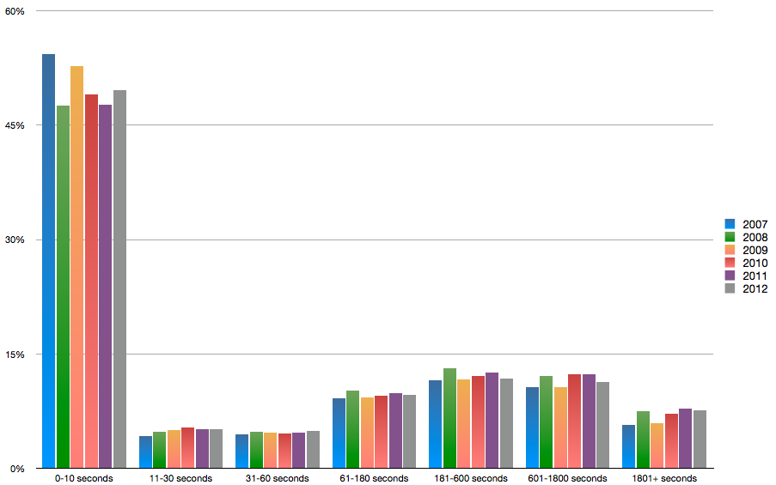
Duration of Visit

Slide 7
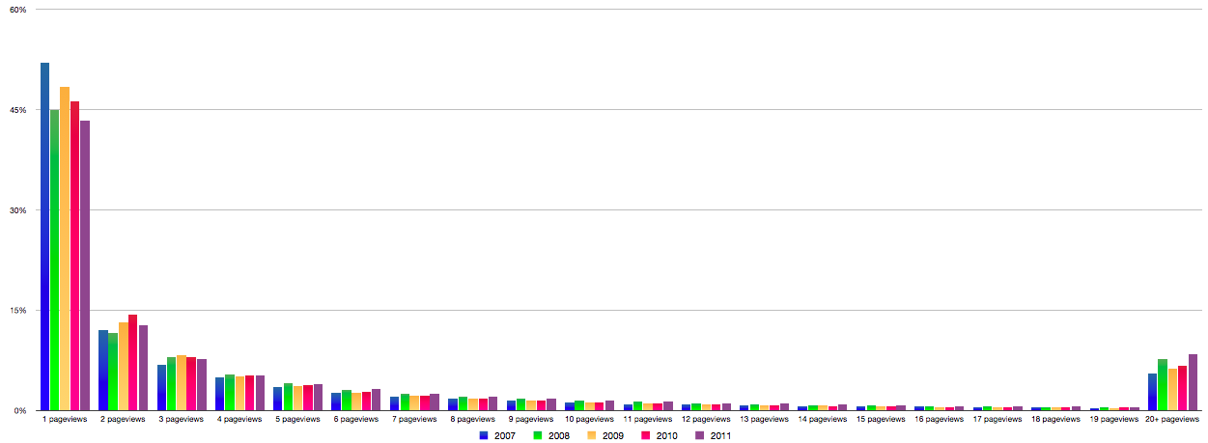
Depth of Visit
Notes:
Depth of visit shows pageviews in the visit against the percentage of visits with this many pageviews – per year.

Slide 8
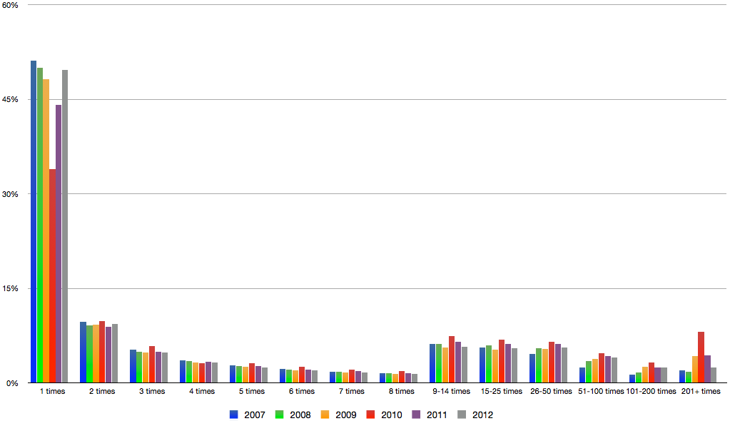
Visitor Loyalty
Notes:
From Google Analytics
You can see that the number of visitors who visited the site 50 times and up has increased along the years.

Slide 9
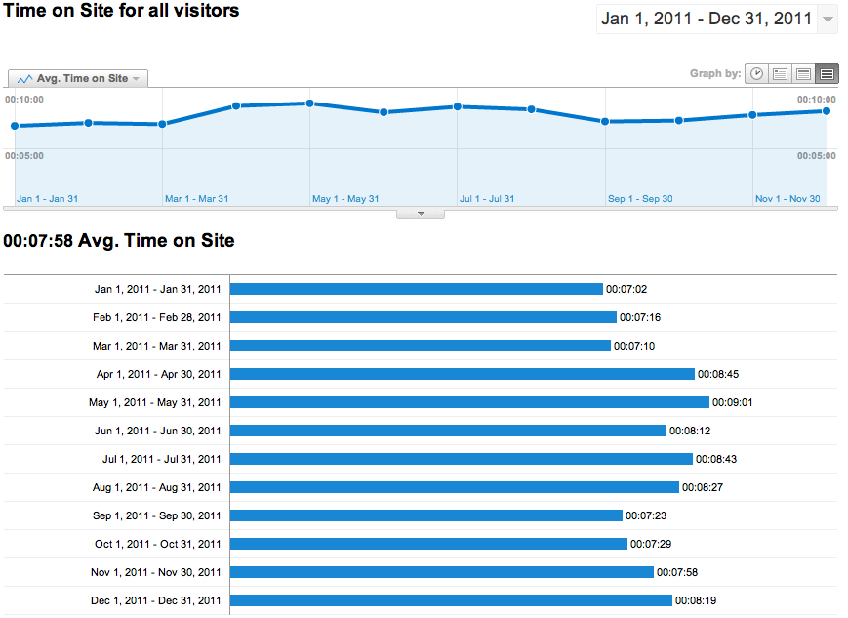
Time on Site

