Slide 1
Journal Review
5th July 2007
William Spooner
whs@ebi.ac.uk
http://www.gramene.org
Notes:
Gramene is a curated, open-source, web-accessible data resource for comparative genome analysis in the grasses,
As an information resource, the purpose of Gramene is to provide added value to the data that are initially contributed by a variety of species-specific databases and generic data repositories such as Entrez.
The genome browser component of Gramene is a flexible tool for visualising annotations on the sequenced rice genome, and increasingly for physical genome maps from species such as maize.
This talk presents some example browser views, with an outline on how 3rd party data are processed into a viewable format.

Slide 2
Key Questions
Why do genomes evolve?
How do genomes evolve?
What has been the pattern of genome evolution in the Viridiplantae lineage?
How can we use information from four sequenced genomes (rice, Arabidopsis, Sorghum, poplar) to determine this pattern?
How can the pattern of genome evolution be used to address the first two questions?

Slide 3
Chosen Paper
Striking Similarities in the Genomic Distribution of Tandemly Arrayed Genes in Arabidopsis and Rice.
  Rizzon et al (2006). PLOS Comp. Bio. 2, e115.
  Example of a whole-genome comparison between rice and Arabidopsis.,
  Combines both homology and spatial dimensions,
  Recent, published in PLOS (which is nice),
  Fits well with Josh's review.

Slide 4
Methods of Gene Duplication
Whole-genome duplication (WGD) (covered by Josh);
  ~25% duplicated Arabidopsis genes and ~50% rice genes are retained following polyploid events,
  Retained genes have non-random functional (GO) classifications.
Segmental (localised) duplication
  Causes tandemly Arrayed Genes, TAGs, which are the subject of the paper under review.

Slide 5
Tandemly Arrayed Genes, TAGs
Genes of a family that are tightly clustered on a chromosome.
Frequent in plants; 18% Arabidopsis genes, 16-29% Rice genes (number depends on identification method).
Less well-studied and understood than non-clustered duplicates.
Evolutionary pressures differ w.r.t. WGD genes. I.e. a single gene rather than genetic pathway is duplicated;
  favours fixation of genes in flexible steps or at the end of pathways

Slide 6
Origin of TAGs
Unequal crossing-over (UCO)‏
  Mis-alignment of homologous DNA between sister chromatids during mitosis and chromosomes during meiosis.
  Associated with increased concentration of repeats.
Transposition
  Retrotransposition can produce processed retrogenes by inserting DNA copies of mRNAs into the genome.
  DNA transposons can carry copies of genes with them when they transpose.
  Transposition may interact with UCO via ectopic (illegitimate) recombination. This bit is beyond me!

Slide 7
Concerted Evolution
Non-independent evolution of copy members in a multigene family.
  For TAGs, CE is increased due to gene conversion;
  CE Violates assumptions of the molecular clock; tends to increase gene similarity (reduce Ks), and therefore overestimate gene duplication rate.
Mother
Gene-A
Gene-A'
Meiosis
Recombination
Missmatch repair
Offspring
Gene-A
Gene-A'

Slide 8
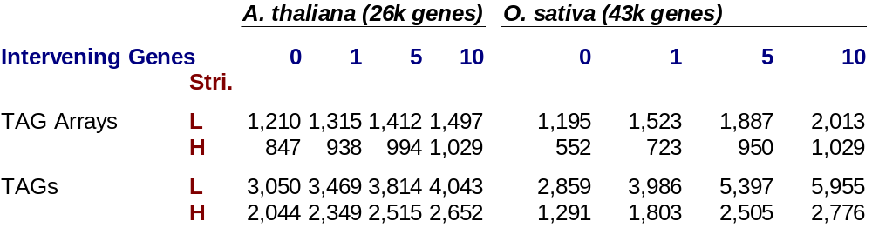
Genome Content of TAGs
Homologous
  Low stringency; >30% identity over >70% length,
  High stringency; >50% identity over >90% length.
Co-location
  Four levels; <=0, <=1, <=5 or <=10 intervening genes.

Slide 9
TAG Distributions
TAGs are under represented in centromeres in both species.
TAGs are positively correlated with recombination rate in both species (weakly in rice), but correlation dependent on classification criteria for TAGs.

Slide 10
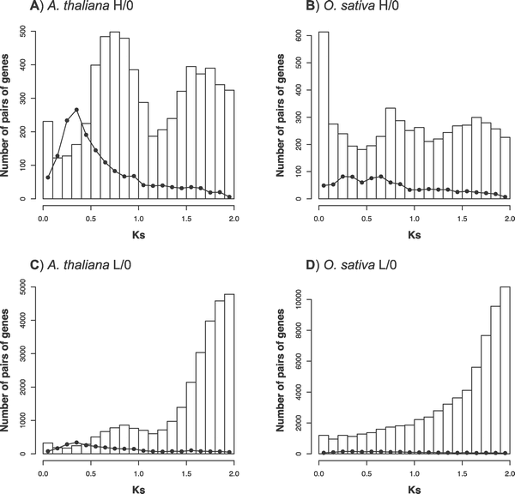
Distribution of Ks
Bars = non-TAG duplicate genes
Line = TAGs
Red observations made by authors
Polyploid events
???
Even distribution
CE
Artefacts

Slide 11
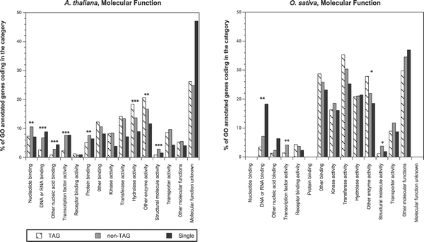
Classification by GO

Slide 12
Questions for the Plant Group Data
Can we repeat the TAG experiments using gene tree data rather than simple homology scores?
What are the characteristics of TAGs within outparalog (duplicated before arab/rice speciation) and inparalog (duplicated after speciation) classes?
Can TAGs be correlated in any way with transposon distribution?
What are the patterns of TAG distribution in poplar/Sorghum?

Slide 13
Bibliography
Hancock J.M. 2005: Gene factories, microfunctionalization and the evolution of gene families. Trends in Genetics 21, 591-595.
Gao, L., and Innan, H., 2004. Very Low Gene Duplication Rate in the Yeast Genome. Science 306, 1367-1370.

