Slide 1
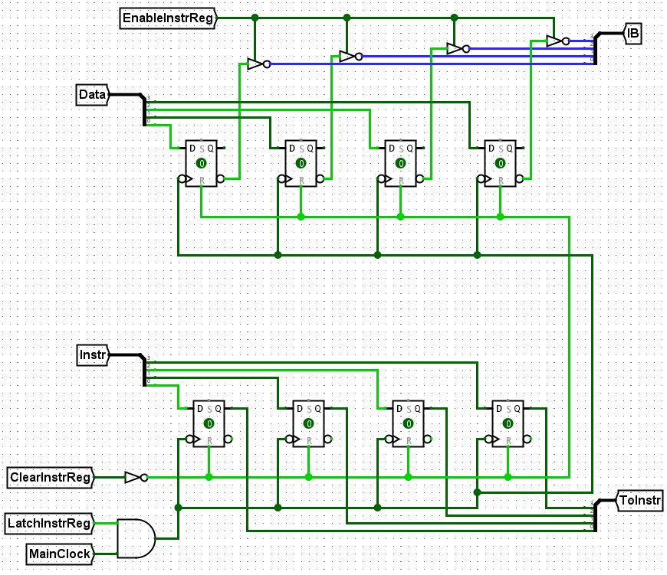
Instruction Register
Matthew Murray

Slide 2
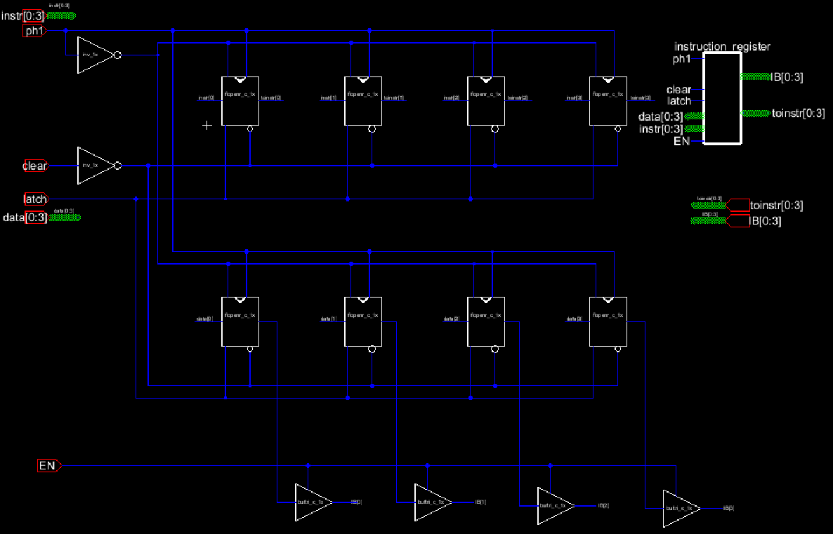

Slide 3
Clock inverter
Instruction reg
Data reg
Data output buffers

Slide 4
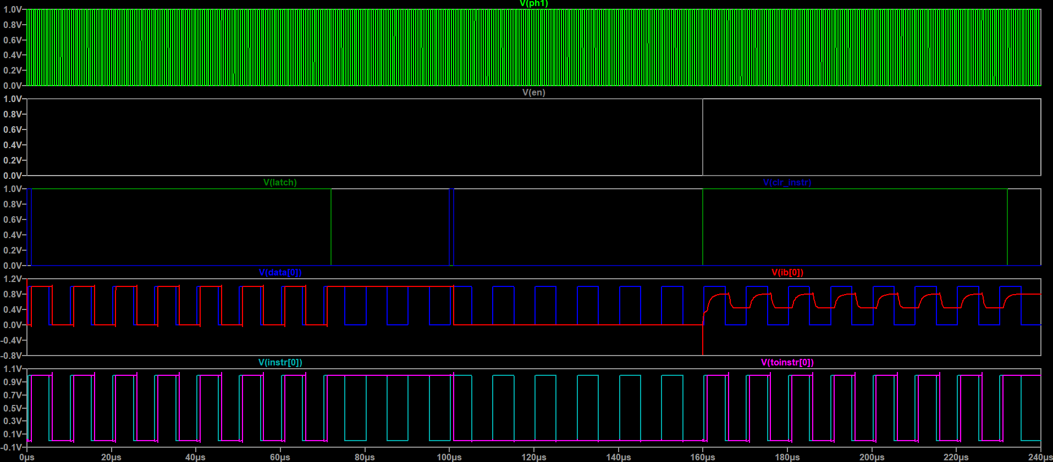

Latch active
Data enable active
Latch inactive
Clear pulse t=100$μs$
Latch active
Data enable inactive
Clear pulse
Inputs change at clock falling edge – outputs change at the next rising edge
Holds previous state with latch inactive
Output zero after clear
Drive strength reduced with output disabled

Slide 5
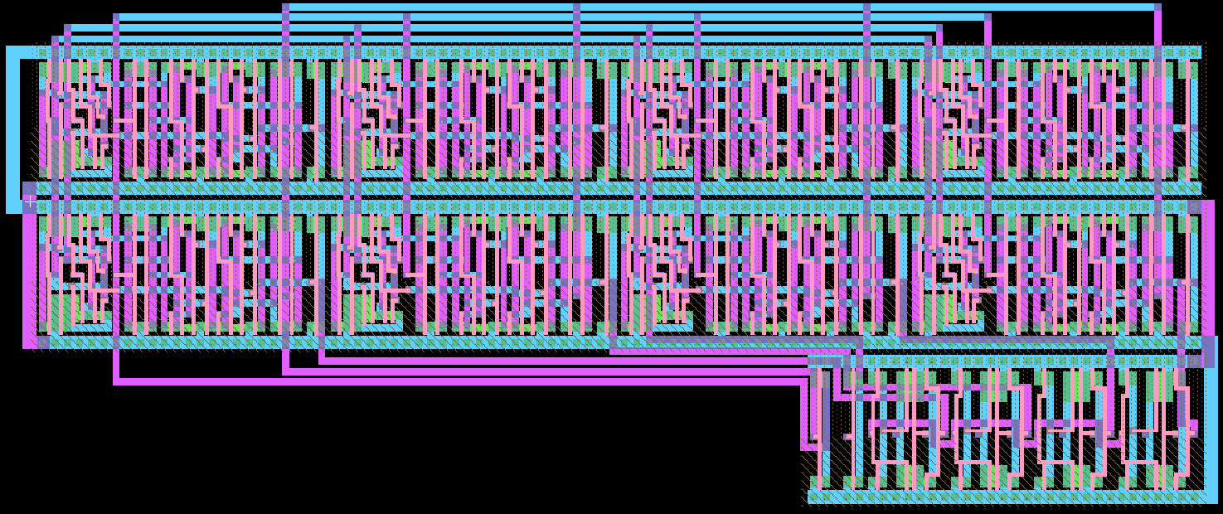
Flip flops
Inverters
Output Buffers

