Slide 1
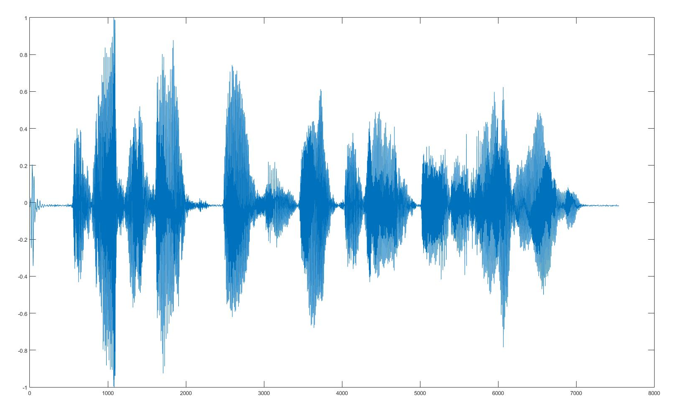

Isolated Word Recognition Techniques in Bengali A comparative analysis of the effects of data augmentation on HMM and ANN based acoustic models
Presenters: Warida Rashid & Mohi Reza
Supervisor: Mr. Moin Mostakim Co-supervisors: Mr. Matin Saad Abdullah & Md. Shamsul Kaonain
August 21, 2017

Slide 2
Methods
Feature Extraction
Hidden Markov Model with Gaussian Emissions
Deep Neural Network with Feed-forward Network and Back-propagation

Slide 3
Feature Extraction
Divide the signal into short frames.
For each frame calculate Fast Fourier Transform (FFT)
Apply the mel filter bank to the power spectra, sum the energy in each filter.
Calculate the logarithm of all filter bank energies.
Take the DCT of the log filter bank energies.
Keep the lower 13 DCT coefficients, discard the rest.

Slide 4
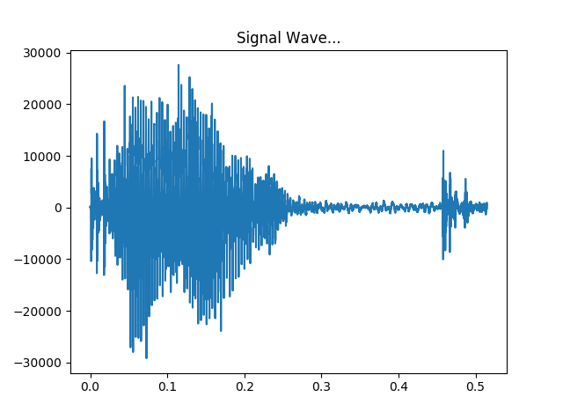
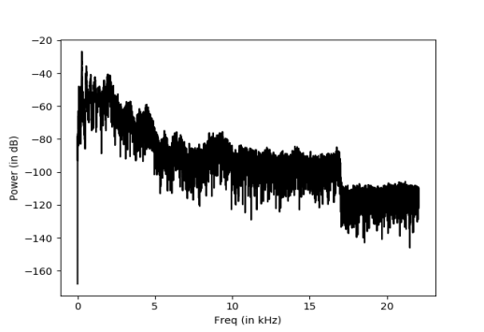
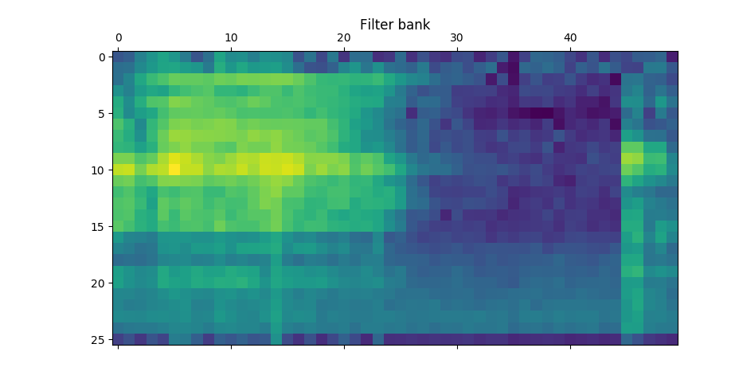
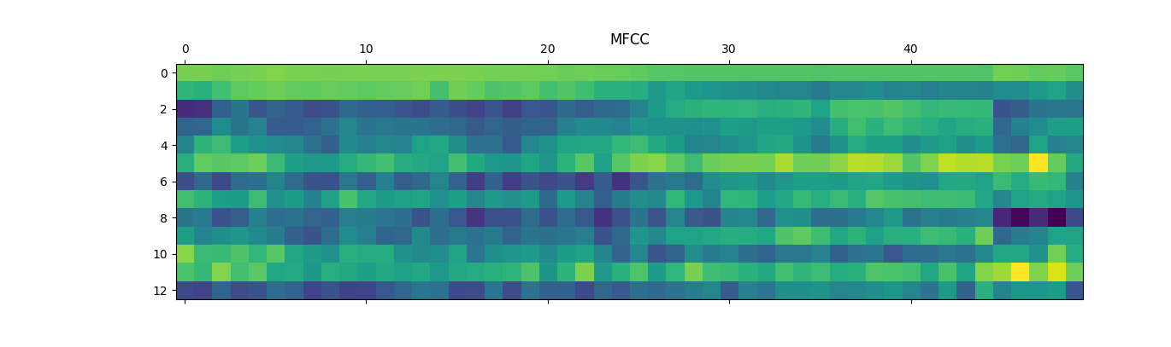
Feature Extraction
Fig.1 Original waveform
Fig.2 FFT
Fig.3 Log Filter Bank
Fig.3 MFCC

Slide 5
Hidden Markov Model with Gaussian Emissions
Two problems associated with model construction:
Estimating the parameters given the observation sequence of training data to maximize output. Solution: Baum-Welch algorithm.
Estimating the optimal state sequence given the model parameters and observation sequence. Solution: Viterbi algorithm.
Number of components used: 5

Slide 6
Deep Neural Network
Feed-forward network with backpropagation
Optimization: Adam Optimizer
Cost function: Softmax cross entropy with logits
Number of layers: 5 including the input and output layer.
1500 nodes per layer.

Slide 7
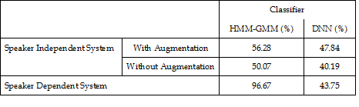
Results
Average Percentage Accuracy Levels

Slide 8
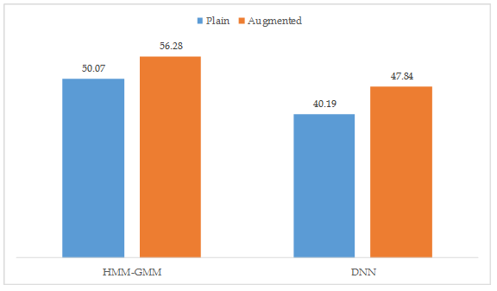
Results
Effects of Augmentation on Accuracy Level

Slide 9
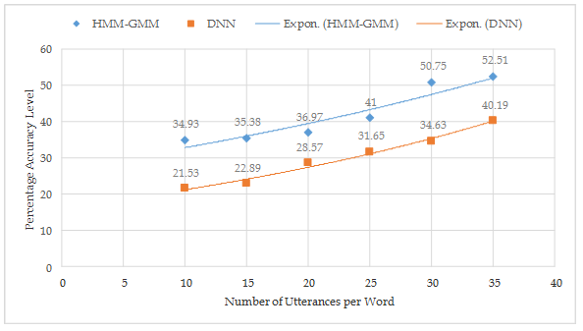
Results
Effects of Augmentation on Accuracy Level

Slide 10
Suggestions
The HMM model and the dataset can be used for speaker dependent isolated word recognition.
Accuracy can be improved by increasing the number of data and data augmentation.

Slide 11
ReferencesI
34/32

