Slide 1
Data, Vectors, and the Geometry of Least Squares
Session 02 · Lecture, first half Thierry Warin

Slide 2
Why is the most-used estimator in economics a right-angle triangle?

Slide 3
Outline
1 | Where we are, and what this adds
2 | The model in matrix form
3 | Route 1 — calculus
4 | Route 2 — geometry (the one worth remembering)
5 | Leverage, and $R^{2}$ as an angle
6 | Frisch–Waugh–Lovell
7 | Never invert $X^{⊤}X$
8 | Key takeaways

Slide 4
Learning objectives
Derive the normal equations twice — by calculus and by projection — and see they are one statement
Read the hat matrix $H$: fitted values, residuals, degrees of freedom, leverage
Explain $R^{2}$ as a squared cosine, and say what it therefore cannot tell you
State Frisch–Waugh–Lovell and use it to say what “controlling for” means
Say why you should never compute ${\left(X^{⊤}X\right)}^{−1}$, and what to do instead
Full derivations: 01-lecture/README.md §2.1–2.5. These slides are the same argument, drawn.

Slide 5
1 · What this adds

Slide 6
Where we are
Session 01 set up the machine and asked what a scenario is. No mathematics.
This is the first method in the course, and everything after it is a variation. Sessions 03–11 add assumptions to this estimator, relax them, or replace it — but the geometry drawn today recurs in every one.

Slide 7
What today buys you
A way to fit a line to anything | and to know exactly what it optimises
The meaning of “controlling for” | as a projection, not a hand-wave
The reason collinearity hurts | before we meet the cure in Session 05
The identity behind causal ML | FWL returns in Session 10, unchanged

Slide 8
Learn the picture once and you re-use it nine times.

Slide 9
2 · The model

Slide 10
Stack the data
$y∈R^{n}$, $X∈R^{n×p}$ with a leading column of ones:
$$y=Xβ+ε$$
We want the $\hat{β}$ minimising the residual sum of squares
$$S\left(β\right)=∥y−Xβ∥_{2}^{2}={\left(y−Xβ\right)}^{⊤}\left(y−Xβ\right)$$
Everything today follows from that one line. There are two routes to the minimum, and they turn out to be the same statement.

Slide 11
3 · Route 1 — calculus

Slide 12
Expand, differentiate, solve
$$S\left(β\right)=y^{⊤}y−2β^{⊤}X^{⊤}y+β^{⊤}X^{⊤}Xβ$$
$$\frac{∂S}{∂β}=−2X^{⊤}y+2X^{⊤}Xβ \overset{!}{=} 0$$
giving the normal equations
$$\boxed{ X^{⊤}X\hat{β}=X^{⊤}y }$$

Slide 13
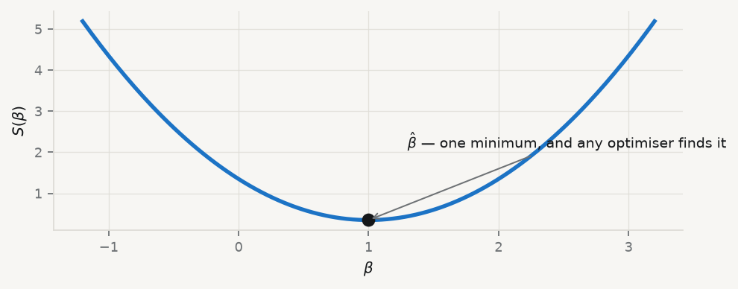
And it is a minimum
If $X$ has full column rank, $\hat{β}={\left(X^{⊤}X\right)}^{−1}X^{⊤}y$. The Hessian is $2X^{⊤}X≽0$, so the stationary point is a global minimum and $S$ is convex.

Slide 14
Convexity is why there is one answer. Session 07 gives it up, and pays for it.

Slide 15
4 · Route 2 — geometry

Slide 16
The question, restated
$Xβ$ can only reach points in $C\left(X\right)$ — a $p$-dimensional subspace of $R^{n}$.
So minimising $∥y−Xβ∥$ asks:
which point of that subspace is closest to $y$?

Slide 17
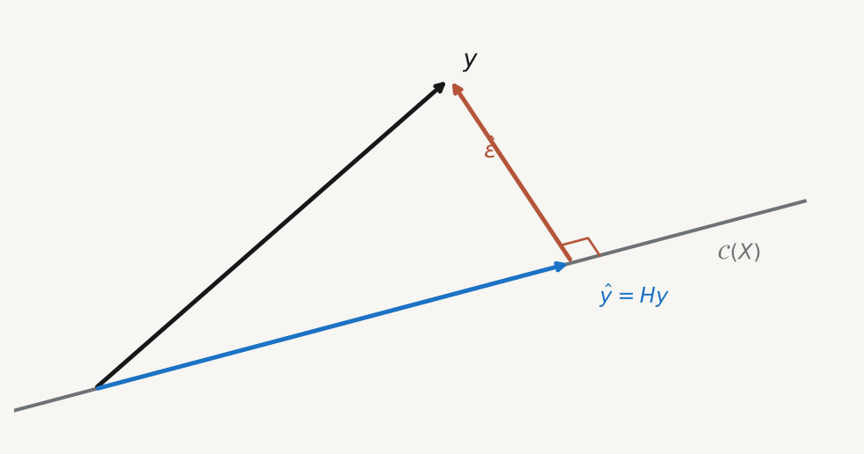
The answer is a right angle

Slide 18
The closest point is the orthogonal projection, so the residual is perpendicular to the subspace: $X^{⊤}\left(y−X\hat{β}\right)=0$ — which is the normal equations again.

Slide 19
The hat matrix
$$H=X{\left(X^{⊤}X\right)}^{−1}X^{⊤}$$
$$\hat{y}=Hy, \hat{ε}=\left(I−H\right)y, H\left(I−H\right)=0$$
$tr\left(H\right)=p$ — the projection spends exactly $p$ degrees of freedom
$h_{ii}∈\left[0,1\right]$ is observation $i$’s leverage
$∥y∥^{2}=∥\hat{y}∥^{2}+∥\hat{ε}∥^{2}$ — Pythagoras
That last identity says fitted values and residuals share no information. It is the whole reason a residual plot is informative.

Slide 20
5 · Leverage and $R^{2}$

Slide 21
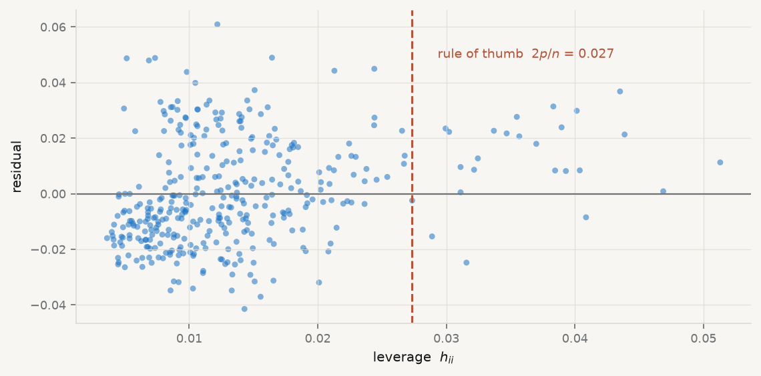
Who is pulling the line?

Slide 22
High leverage is not an error. It means that observation has unusual regressors, so it moves ${\hat{y}}_{i}$ a lot. High leverage and a large residual is what deserves a look.

Slide 23
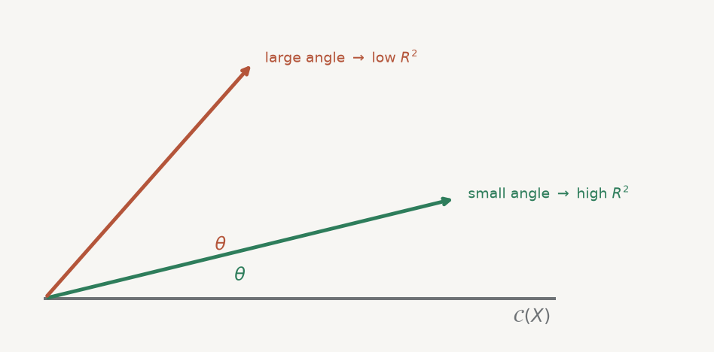
$R^{2}$ is a squared cosine

Slide 24
$$R^{2}=\frac{∥\hat{y}∥^{2}}{∥y∥^{2}}=\cos^{2}θ$$
That is all $R^{2}$ is: a statement about an angle. Not whether the model is right, not whether anything causes anything, and not whether it holds next year.

Slide 25
6 · Frisch–Waugh–Lovell

Slide 26
The theorem
Partition $X=\left[X_{1} X_{2}\right]$. Then ${\hat{β}}_{2}$ from the full regression equals the coefficient from regressing $M_{1}y$ on $M_{1}X_{2}$, where
$$M_{1}=I−X_{1}{\left(X_{1}^{⊤}X_{1}\right)}^{−1}X_{1}^{⊤}$$
$M_{1}$ is the residual-maker: it strips out everything $X_{1}$ can explain.

Slide 27
In words
A multiple-regression coefficient is a simple regression coefficient on the part of the variable that is orthogonal to everything else.
This is what “controlling for” means — not “holding constant” as a figure of speech, but projecting out, literally.

Slide 28
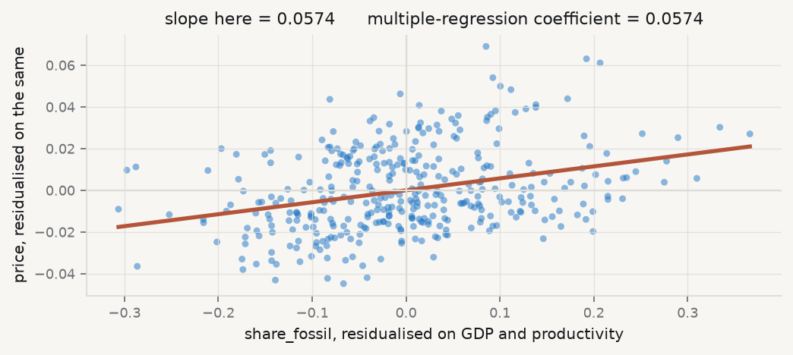
See it happen

Slide 29
Two routes, one number. That identity is what the theorem asserts — and you verify it yourself in the practice session.

Slide 30
7 · Never invert $X^{⊤}X$

Slide 31
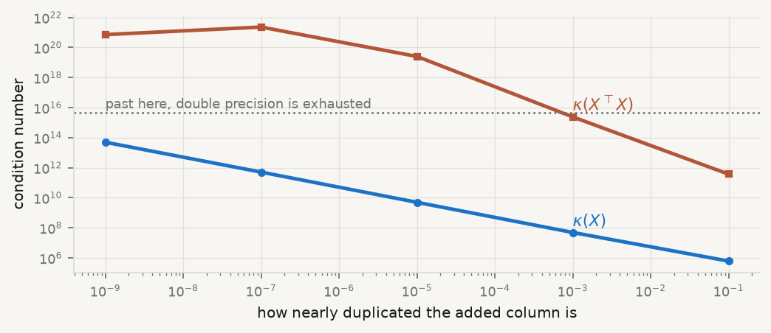
Forming it squares the conditioning
$$κ\left(X^{⊤}X\right)=κ{\left(X\right)}^{2}$$
so you lose roughly twice as many digits of precision.

Slide 32
Use QR instead
Write $X=QR$ with $Q^{⊤}Q=I$ and $R$ upper triangular; then
$$R\hat{β}=Q^{⊤}y$$
is solved by back-substitution.
This is what numpy.linalg.lstsq and statsmodels do internally. The formula on slide 3 is how you state the estimator, not how you compute it.
In the practice session you add a near-duplicate column and watch the explicit-inverse route fail while QR survives.

Slide 33
8 · Key takeaways

Slide 34
What to carry out of this session
Least squares is a projection. Calculus and geometry give one answer; the geometry is the one to remember.
$H$ is the whole story: $\hat{y}$, residuals, $tr\left(H\right)=p$, leverage, Pythagoras.
$R^{2}$ is $\cos^{2}θ$ — an angle, and nothing more.
“Controlling for” is projecting out. That is FWL, and it returns in Session 10.
Never invert $X^{⊤}X$. State it that way; compute it with QR.

Slide 35
What loses marks reliably
All three energy shares plus an intercept | exact collinearity — $X^{⊤}X$ is singular
A coefficient with no stated omitted category | the number has no referent
$R^{2}$ reported alone | give the error in the outcome’s units too
“Fossil generation raises prices by $X$” | an association in a 30-country panel, not an effect

Slide 36
In the practice session
Implement ols_normal_equations and ols_qr; compare both to statsmodels
Compute the hat diagonal; plot leverage against residual
Verify Pythagoras numerically, then drop the intercept and watch it break
Break it — add a near-duplicate column; see which route survives
FWL check — residualise, re-regress, confirm the coefficients match
Brief: 02-practice/README.md · derivations: 01-lecture/README.md

