Slide 1
Linear Regression: Inference, Diagnostics, Interpretation
Session 03 · Lecture, first half Thierry Warin

Slide 2
Your coefficient has a standard error. When does it mean anything?

Slide 3
Outline
1 | Where we are, and what this adds
2 | The sampling distribution of $\hat{β}$
3 | Gauss–Markov, and its caveat
4 | When homoskedasticity fails
5 | Three standard errors, one coefficient
6 | Omitted variable bias — signed in advance
7 | What a coefficient identifies
8 | Key takeaways

Slide 4
Learning objectives
Decompose $\hat{β}$ into truth plus noise, and see what each assumption buys
Read the four levers in the variance of a single coefficient
State Gauss–Markov and say precisely where it stops applying
Compute classical, HC1 and cluster-robust standard errors, and choose between them
Sign an omitted-variable bias before estimating, then check the prediction

Slide 5
1 · What this adds

Slide 6
Session 02 gave you a number
You can now fit a line and say exactly what it optimises.
What you cannot yet say is whether that number would survive a different sample — and therefore whether it means anything at all.

Slide 7
What today adds
Session 02 | Session 03
$\hat{β}$ | a standard error that is actually correct
The projection | the sampling distribution of the projection
“Controlling for” as geometry | what happens when you control for the wrong things
One dataset | the thought experiment of many datasets

Slide 8
Session 02 was deterministic linear algebra. Session 03 is where randomness enters — and almost everything that goes wrong in applied work goes wrong here.

Slide 9
2 · The sampling distribution

Slide 10
The decomposition that is all of inference
Substitute $y=Xβ+ε$ into $\hat{β}={\left(X^{⊤}X\right)}^{−1}X^{⊤}y$:
$$\hat{β}=β+{\left(X^{⊤}X\right)}^{−1}X^{⊤}ε$$
Truth, plus a term that is pure noise. Everything that follows depends only on what you are willing to assume about $ε$.

Slide 11
Unbiasedness is cheap
$$E\left[\hat{β}∣X\right]=β+{\left(X^{⊤}X\right)}^{−1}X^{⊤}E\left[ε∣X\right]=β$$
using only strict exogeneity.
Note what is not needed: no homoskedasticity, no normality, no independence. Unbiasedness is a weak requirement — which is why it is a weak reassurance.

Slide 12
The variance, and its four levers
Under homoskedasticity, for one coefficient:
$$Var\left({\hat{β}}_{j}\right)=\frac{σ^{2}}{n⋅Var\left(x_{j}\right)⋅\left(1−R_{j}^{2}\right)}$$
$σ^{2}$ — noise you cannot reduce
$n$ — sample size
$Var\left(x_{j}\right)$ — variation in the regressor: no variation, no estimate
$1/\left(1−R_{j}^{2}\right)$ — redundancy, the variance inflation factor

Slide 13
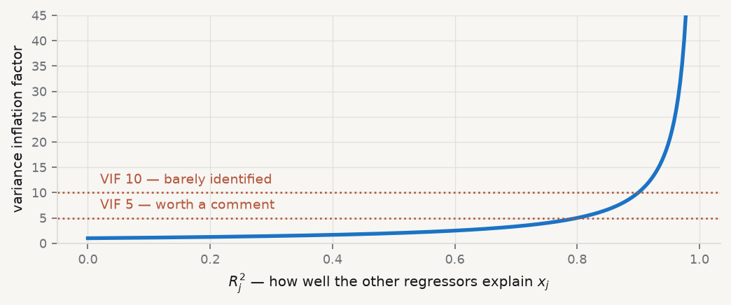
What redundancy costs

Slide 14
This is the price of collinearity — and exactly what regularisation in Session 05 proposes to pay differently.

Slide 15
3 · Gauss–Markov

Slide 16
The theorem
Under assumptions 1–4, ${\hat{β}}_{OLS}$ has the smallest variance among linear unbiased estimators.
Sketch. Any linear unbiased $\tilde{β}=Cy$ has $C={\left(X^{⊤}X\right)}^{−1}X^{⊤}+D$ with $DX=0$; then $Var\left(\tilde{β}\right)=σ^{2}\left[{\left(X^{⊤}X\right)}^{−1}+DD^{⊤}\right]≽Var\left(\hat{β}\right)$. $◼$

Slide 17
Read the middle word
Best Linear Unbiased Estimator.
The guarantee holds only within the class of unbiased estimators. Sessions 04 and 05 show that accepting bias deliberately can lower total error. Gauss–Markov does not forbid that — it simply does not apply.

Slide 18
4 · When assumption 4 fails

Slide 19
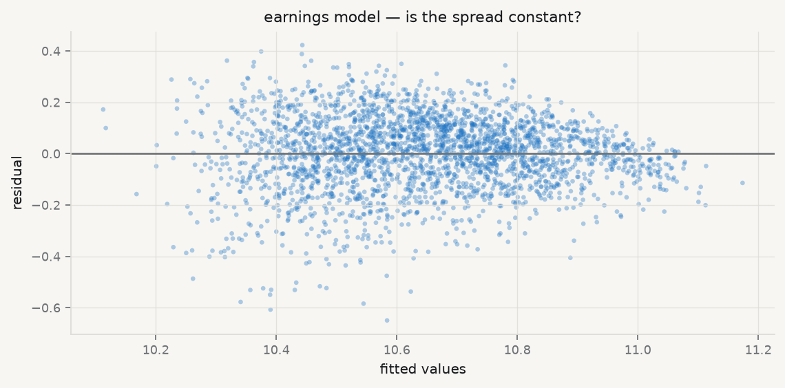
Look at the residuals first

Slide 20
You are looking for a shape, not running a test. In this panel the error variance scales with country size.

Slide 21
The sandwich is always correct
Guess at $Ω$ | When
$σ^{2}I$ — classical | essentially never with a real panel
$diag\left({\hat{ε}}_{i}^{2}\right)$ — HC1 | variance differs across units
g​εgεg⊤ — cluster | errors correlated within a unit
$$Var\left(\hat{β}∣X\right)={\left(X^{⊤}X\right)}^{−1}\left(X^{⊤}ΩX\right){\left(X^{⊤}X\right)}^{−1}, Ω=Var\left(ε∣X\right)$$

Slide 22
$\hat{β}$ never changes. Only your claimed precision does.

Slide 23
5 · Three standard errors

Slide 24
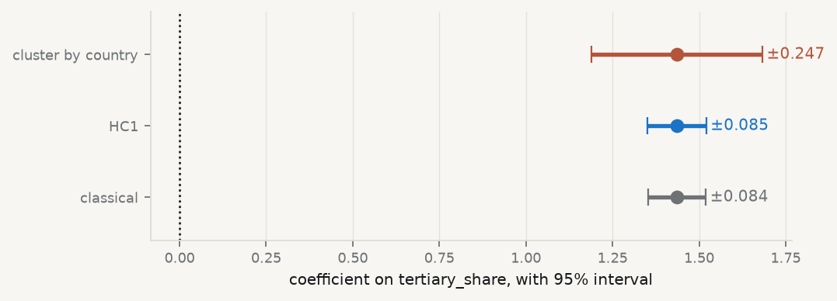
The same coefficient, three intervals

Slide 25
classical 0.0426 HC1 0.0433 cluster 0.1259 → cluster/classical = 2.95x
The clustered interval is about 3× wider. A $t$-statistic of 6 was really a $t$ of 2.

Slide 26
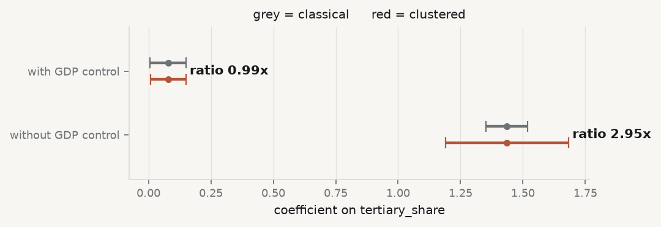
Now watch it disappear
Add one country-level control — $log$ GDP per capita:

Slide 27
Why it disappeared
$log\left(\text{GDP per capita}\right)$ varies at the country-year level, so including it absorbs the common shock that was making residuals correlate within a country.
Clustering matters when a shared, unmodelled shock sits in the residual
Model that shock explicitly and the correction shrinks
Neither route is cheating — the same fact, handled in two places
Do not conclude “clustering never matters, just add controls”. A control that absorbs the shock may also absorb the variation you wanted to study.

Slide 28
Which one do you report?
Cluster at the level at which treatment varies and shocks are shared — here, geo
Report the number of clusters alongside $n$: 3,150 rows, 30 countries
Below roughly 40 clusters, cluster-robust inference is itself unreliable
“Robust standard errors” in a table note, with no cluster level named, tells the reader nothing.

Slide 29
6 · Omitted variable bias

Slide 30
The formula
True model $y=X_{1}β_{1}+X_{2}β_{2}+u$, estimated on $X_{1}$ alone. With $δ$ from regressing $X_{2}$ on $X_{1}$:
$$E\left[{\hat{β}}_{1}\right]=β_{1}+δβ_{2}$$

Slide 31
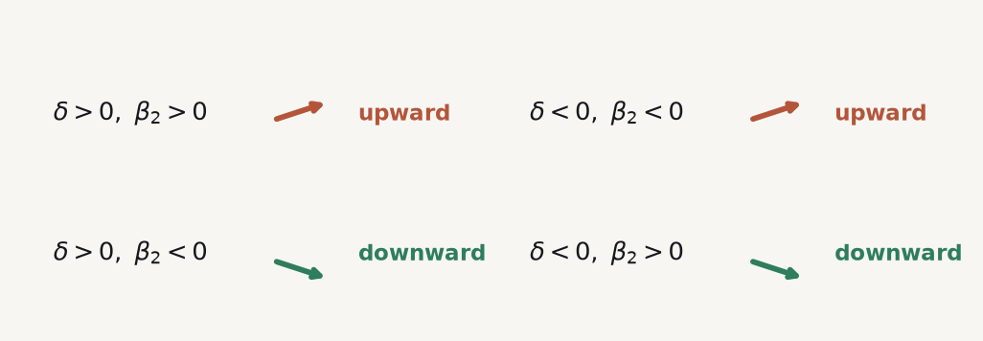
Sign it with two questions

Slide 32
Same sign in both → upward bias. Answer both questions in writing before estimating. It costs nothing, and it is the most useful discipline in applied work.

Slide 33
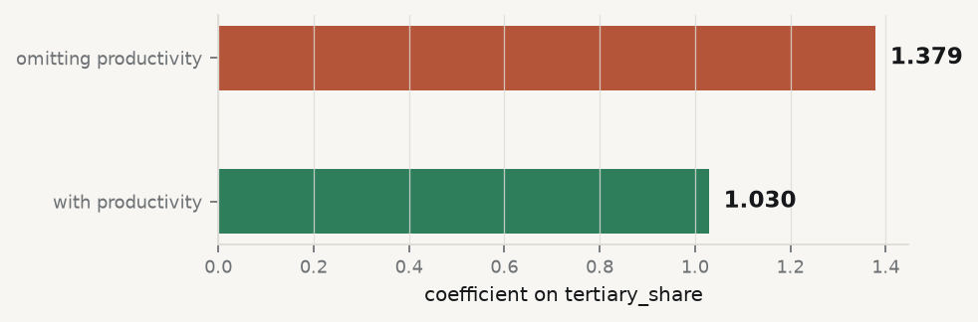
Then test the prediction

Slide 34
Productive countries have higher earnings ($β_{2}>0$) and higher tertiary shares ($δ>0$), so the bias should be upward — the short coefficient should exceed the long one. It does.

Slide 35
7 · What it identifies

Slide 36
The Mincer example
$$logw_{i}=α+ρS_{i}+γ_{1}X_{i}+γ_{2}X_{i}^{2}+ε_{i}$$
$ρ$ is often read as “the return to a year of schooling”. Strictly, it is
the mean log-wage difference associated with an additional year of schooling among people otherwise identical on the included covariates.
Unobserved ability, selection into schooling and measurement error each break the causal reading. Session 10 supplies tools that take this seriously.
Today the discipline is simply to say precisely what you have estimated.

Slide 37
8 · Key takeaways

Slide 38
What to carry out of this session
$\hat{β}=β+{\left(X^{⊤}X\right)}^{−1}X^{⊤}ε$ — everything follows from the second term
Unbiasedness is cheap; precision is where the assumptions bite
The sandwich is always right; classical, HC1 and cluster are three guesses at $Ω$
Cluster where treatment varies, name the level, report the cluster count
Sign the omitted-variable bias before estimating, then check
A $p$-value answers “how surprising under the null” — not “how large”, not “is the model right”

Slide 39
What loses marks reliably
Default standard errors on panel data | intervals far too narrow
“Robust SEs” with no cluster level named | unreproducible
Reading significance off $n=3,150$ | you have 30 independent units
Controlling for everything | post-treatment bias; uninterpretable coefficients
A $p$-value reported as an effect size | give the magnitude, in units

Slide 40
In the practice session
Fit the specification; inspect residuals against fitted values
Compute classical, HC1 and cluster-robust standard errors side by side
Name a confounder, sign its bias, then test the prediction
Report the coefficient with the cluster level and the cluster count
Brief: 02-practice/README.md · derivations: 01-lecture/README.md §3.1–3.5

