Slide 1
Bias–Variance, Overfitting, Cross-Validation
Session 04 · Lecture, first half Thierry Warin

Slide 2
Your model fits the past perfectly. Why is that bad news?

Slide 3
Outline
1 | Where we are, and what this adds
2 | The decomposition
3 | Seeing it happen
4 | How optimistic is training error?
5 | Cross-validation
6 | Three ways to get it wrong
7 | What it costs on this panel
8 | Key takeaways

Slide 4
Learning objectives
Derive the bias–variance–noise decomposition and name what each term is
Explain why training error is optimistic, and by exactly how much
Choose a CV scheme that matches the claim you intend to make
Recognise the three leakages: preprocessing, selection, dependence
Quantify, on real data, what the wrong split costs you

Slide 5
1 · What this adds

Slide 6
This is the hinge of the course
Session | The claim it let you make
02 | “Here is the least-squares fit, and here is what it optimises”
03 | “Here is an honest interval around it”

Slide 7
Both are statements about the data you have.
Neither says anything about data you have not seen. And every use of a model — forecasting, targeting, deciding — is about data you have not seen.

Slide 8
What today adds
After today, in-sample fit stops being evidence.
A vocabulary for why a flexible model can be worse: bias, variance, irreducible noise
A number for how much training error flatters you
A procedure — cross-validation — and the three ways it is routinely botched
Everything from Session 05 onward is a way of sitting at the bias–variance optimum on purpose rather than by accident.

Slide 9
2 · The decomposition

Slide 10
Expected squared error at a test point
$$E\left[{\left(y_{0}−\hat{f}\left(x_{0}\right)\right)}^{2}\right]=\underset{\text{variance}}{\underset{⏟}{Var\left(\hat{f}\left(x_{0}\right)\right)}}+\underset{{\text{bias}}^{2}}{\underset{⏟}{(E\left[\hat{f}\left(x_{0}\right)\right]−f\left(x_{0}\right))^{2}}}+\underset{\text{irreducible}}{\underset{⏟}{σ^{2}}}$$
Write $y_{0}=f\left(x_{0}\right)+ε_{0}$, add and subtract $E\left[\hat{f}\left(x_{0}\right)\right]$ inside the square, and three cross terms vanish. Derivation in the notes, §4.1.

Slide 11
What each term means
Term | In words | Falls when you…
Bias² | the structure you imposed is wrong | add flexibility
Variance | the fit chases this particular sample | remove flexibility
$σ^{2}$ | what the predictors do not observe | never

Slide 12
$σ^{2}$ is not a defect of your method. Reporting a validation error below it means you have leaked, not learned.

Slide 13
3 · Seeing it happen

Slide 14
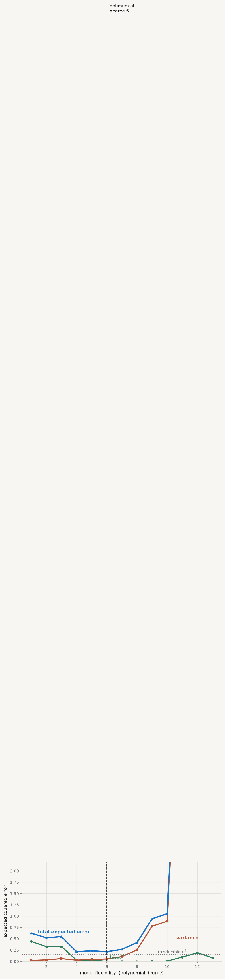
The three curves

Slide 15
Bias falls monotonically. Variance rises. Their sum has an interior minimum — and that minimum is what every method after today is trying to find.

Slide 16
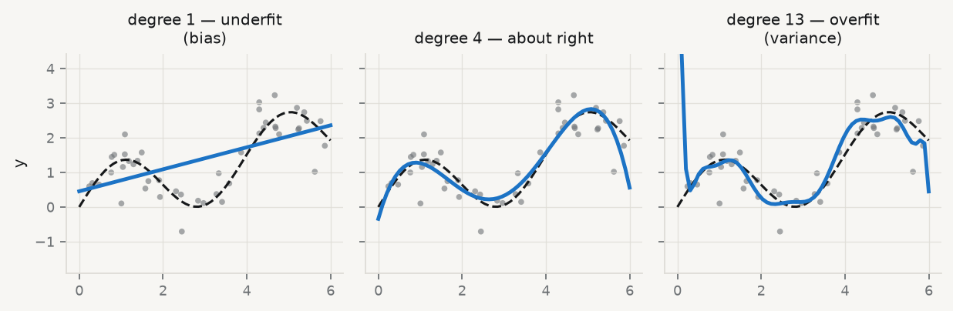
The same thing, as fits

Slide 17
Dashed line: the truth. Blue: the fit. The right-hand panel passes closer to every training point and is further from the truth almost everywhere.

Slide 18
4 · Optimism

Slide 19
Training error is biased, and by a known amount
With $err$ the training error and ${Err}_{\text{in}}$ the error on new outcomes at the same $x_{i}$:
$$E\left[{Err}_{\text{in}}\right]−E\left[err\right]=\frac{2}{n}\sum_{i=1}^{n}{Cov}\left({\hat{y}}_{i},y_{i}\right)$$
The optimism is twice the average covariance between a fitted value and its own outcome — the degree to which the model chases its own labels.

Slide 20
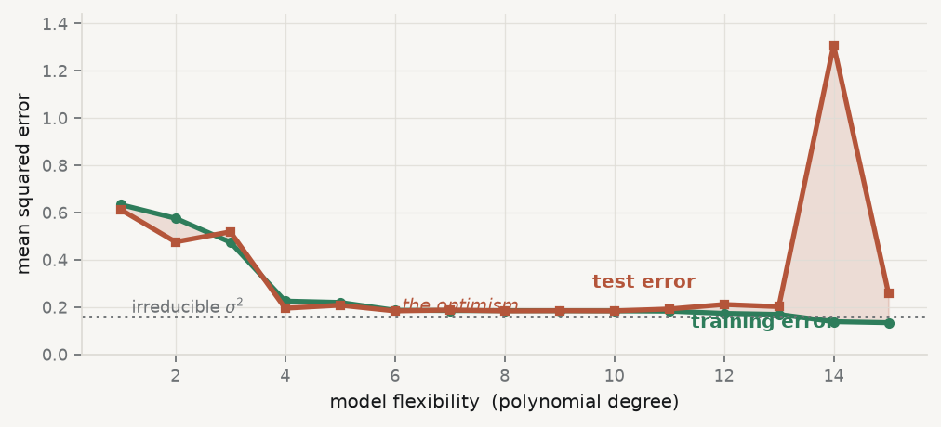
See the gap open

Slide 21
Training error falls below the irreducible noise floor. Any number under that dotted line is a report of how hard the model chased its own labels.

Slide 22
Which gives the classical criteria
For a linear fit with $p$ parameters that covariance sum is $pσ^{2}$, so the optimism is $2pσ^{2}/n$, motivating
$$C_{p}=err+\frac{2p{\hat{σ}}^{2}}{n}, AIC=−\frac{2}{n}logL+\frac{2p}{n}, BIC=−2logL+plogn$$
BIC penalises harder once $n>e^{2}≈7.4$. It is consistent for model selection; AIC is efficient for prediction. Different questions.

Slide 23
Effective degrees of freedom
dff=1σ2i​Covyi,yi
This generalises “number of parameters” to methods where counting them is meaningless — which is exactly what we need from Session 05, where a penalty makes $p$ a fiction.

Slide 24
5 · Cross-validation

Slide 25
The estimator
CVK=1nk=1Ki∈Fk​Lyi,f−kxi
Fit on the complement of each fold; predict the fold you left out.

Slide 26
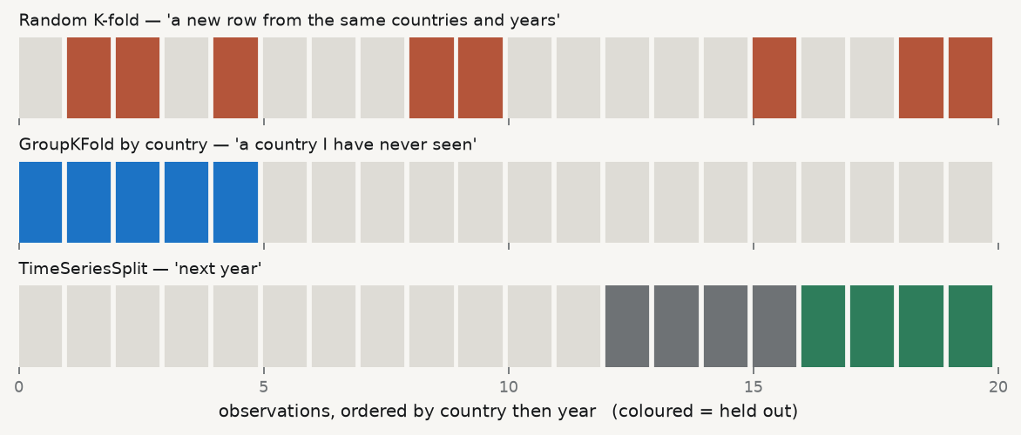
Three schemes, three questions

Slide 27
Choose the split that matches the sentence you intend to write in your conclusion. Then say which you used.

Slide 28
Choosing $K$
$K=5$ or $10$ — the standard compromise: some upward bias, much lower variance
$K=n$ (LOOCV) — nearly unbiased, high variance, expensive
For a linear smoother LOOCV is free once you have the hat matrix:
CVn=1ni​yi−yi1−hii2
$h_{ii}$ is Session 02’s leverage. The pieces accumulate.

Slide 29
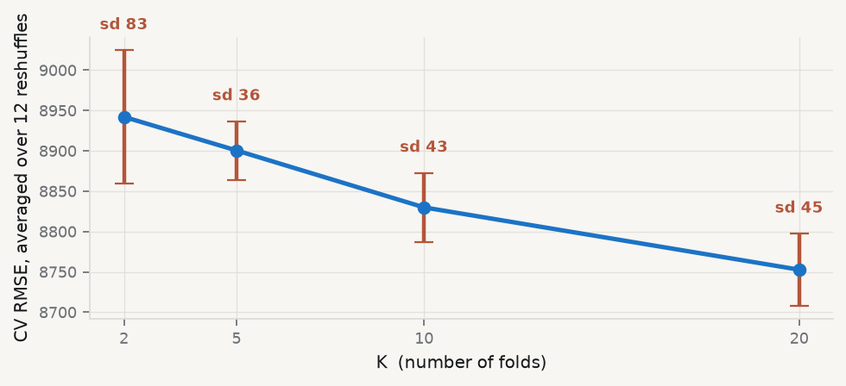
How much does the choice matter?

Slide 30
Bars are the spread across twelve different random fold assignments. $K=2$ is twice as variable as $K=5$ or $K=10$, which are hard to tell apart — which is why 5 and 10 became the convention.

Slide 31
6 · Three ways to get it wrong

Slide 32
1 · Leakage through preprocessing
Any step that learns from the data — scaling, imputation, feature selection, target encoding — must be fitted inside each training fold.
# WRONG — the scaler has already seen the test fold X_scaled = StandardScaler().fit_transform(X) cross_val_score(model, X_scaled, y, cv=cv) # RIGHT — every step re-fits inside each fold pipe = make_pipeline(StandardScaler(), model) cross_val_score(pipe, X, y, cv=cv)
The single most common serious error in applied machine learning papers. It always flatters you.

Slide 33
2 · Leakage through selection
Choosing a model by CV and then reporting that same CV error as its performance is optimistic.
outer loop → evaluation
inner loop → tuning
Reporting the best inner-loop score is the same error as reporting training error, one level up.

Slide 34
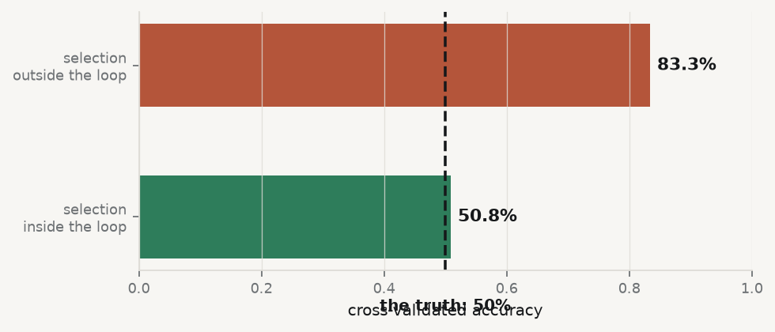
How bad is it? Try it on pure noise

Slide 35
There is no signal in that data. Selecting the 20 best of 4,000 predictors before the split manufactures an 83% classifier out of a coin flip. This is the single most common serious error in applied machine learning papers.

Slide 36
3 · Ignoring dependence
Structure | Use
Time series | rolling-origin / expanding window. Never train on the future.
Panel or clustered | GroupKFold — all rows of a unit stay together
Spatial | blocked CV — neighbours are correlated
Random folds assume exchangeability. Economic data rarely are.

Slide 37
7 · What it costs here

Slide 38
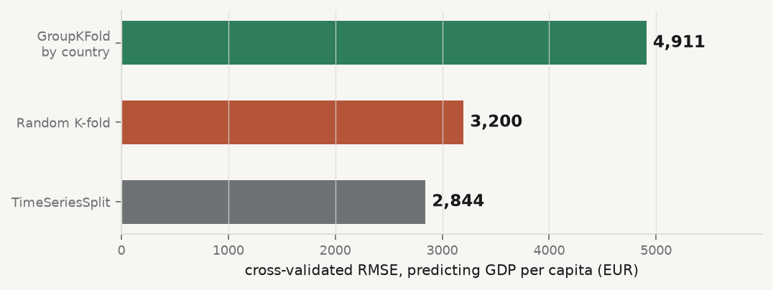
Same data, same model, three splits

Slide 39
The ratio is the whole point
grouped / random = 1.53x
Publish the random-K-fold number and you have overstated the model by that factor — without doing anything a referee would call wrong.

Slide 40
Read the gap as a diagnostic
The ratio measures how much the model leans on country identity rather than on the economics.
Random K-fold let it see Germany 2019 while predicting Germany 2020
It learned “this is Germany”, which is worthless for a country it has never seen
TimeSeriesSplit looks best of the three — and answers a third question again
Low is not the same as right. Report the split, not just the number.

Slide 41
8 · Key takeaways

Slide 42
What to carry out of this session
Error = bias² + variance + $σ^{2}$. Flexibility trades the first two; the third never moves.
Training error is optimistic by $2pσ^{2}/n$ for a linear fit — that is where AIC and $C_{p}$ come from.
Match the CV scheme to the claim. Random, grouped and time-ordered answer different questions.
Every learned step goes inside the fold. Use a Pipeline.
Tuning and evaluating on one split reports training error, one level up.
The random-vs-grouped gap is a leakage diagnostic. Report it.

Slide 43
What loses marks reliably
Random K-fold on a panel | optimistic by a wide margin
Scaling before splitting | leakage; error understated
Tuning on the test set | the test set is now training data
$R^{2}$ alone | give the error in the outcome’s units
One split, one number | no sense of variability

Slide 44
In the practice session
Reproduce the three CV schemes and tabulate the errors
Explain, in writing, why they differ in that direction
Draw the flexibility curve and mark where variance takes over
Build one deliberately leaking pipeline, fix it, report both numbers
Brief: 02-practice/README.md · derivations: 01-lecture/README.md §4.1–4.4

