Slide 1
Regularisation: Ridge, Lasso, and the Elastic Net
Session 05 · Lecture, first half Thierry Warin

Slide 2
When is a deliberately biased estimator the better one?

Slide 3
Outline
1 | Where we are, and what this adds
2 | The problem, on real data
3 | Ridge — shrink everything, a little
4 | Lasso — shrink some things to nothing
5 | Elastic net — when predictors come in families
6 | Choosing $λ$ honestly
7 | Key takeaways

Slide 4
Learning objectives
State the ridge and lasso objectives and say what each penalty buys
Explain, in the SVD basis, why ridge shrinkage is targeted rather than blunt
Derive soft-thresholding and use it to explain why the lasso produces exact zeros
Choose between lasso and elastic net by looking at the correlation structure
Report $λ$ by cross-validation, and know why the standard errors afterwards are not valid

Slide 5
1 · What this adds

Slide 6
Where we are
Session | What it gave you
02 | The least-squares fit, and the geometry that produces it
03 | An honest interval, and the diagnostics that decide which one
04 | A number for out-of-sample error, and how to get it honestly

Slide 7
Session 04 gave you a measuring instrument. It did not give you a way to improve the number it measures. Today is the first session that does.

Slide 8
The opening claim, and why it is wrong
OLS is the best linear unbiased estimator.
True. And useless, when the variance of “best unbiased” is enormous.
Session 04’s decomposition says total error is ${\text{bias}}^{2}+\text{variance}+σ^{2}$. Gauss–Markov fixes $\text{bias}=0$ and then minimises variance within that constraint.
Nobody asked whether $\text{bias}=0$ was the right constraint. Accept a little bias, buy a large reduction in variance, and total error falls. That trade is what regularisation is.

Slide 9
What today adds, in one line
A dial — $λ$ — that moves you along the bias–variance curve of Session 04 on purpose
A method that still works when $p>n$, where OLS has no unique solution at all
A method that performs variable selection as part of fitting, not as a separate ritual
Sessions 06 through 11 all reuse this dial. Penalised logistic regression, tree depth, the number of principal components, the number of clusters — every one of them is a $λ$ under another name.

Slide 10
2 · The problem, on real data

Slide 11
A situation you will actually meet
We want to explain R&D intensity (R&D as % of GDP) across European countries from digital and AI-adoption indicators.
30 countries × 11 years in the file
but the AI-use survey only exists from 2021, so those columns are two-thirds missing
15 of the columns are auxiliary series of unknown value — nobody has vetted them
This is the ordinary condition of applied macro work: a wide table, a short usable window, and no prior about which columns matter.

Slide 12
What complete-case analysis leaves you
raw = pd.read_parquet("../data/spine/angle_c_country.parquet") YCOL = "rd_pct_gdp" XCOLS = [c for c in raw.columns if c not in ("geo", "time", "flag", YCOL)] d = raw.dropna(subset=[YCOL] + XCOLS) # keep only fully observed rows print(f"usable rows n = {len(d)}, candidate predictors p = {len(XCOLS)}")
usable rows n = 37, candidate predictors p = 29
$n=37$, $p=29$. Eight degrees of freedom. This is not an exotic case — it is what happens every time a new survey wave meets an old panel.

Slide 13
Why OLS cannot cope here
print(f"condition number of the standardised design: {np.linalg.cond(Ztr):.1e}")
condition number of the standardised design: 5.0e+15
Session 02: $κ\left(X\right)$ near ${10}^{16}$ means the design is numerically singular
Session 03: the variance of ${\hat{β}}_{j}$ is $σ^{2}/\left[\left(1−R_{j}^{2}\right) {SS}_{j}\right]$ — and $R_{j}^{2}→1$ here
So the coefficients exist, but they are noise amplified
The diagnostic you learned in Session 03 does not just warn you. It tells you which tool to reach for next.

Slide 14
Four estimators, one held-out test set
def test_rmse(model): """Fit on the training split, score on the untouched 30%.""" model.fit(Xtr, ytr) return np.sqrt(mean_squared_error(yte, model.predict(Xte))) ALPHAS = np.logspace(-3, 3, 60) L1S = [0.1, 0.5, 0.7, 0.9, 0.95, 1.0] scores = { "predict the mean": np.sqrt(mean_squared_error(yte, np.full_like(yte, ytr.mean()))), "OLS": test_rmse(make_pipeline(StandardScaler(), LinearRegression())), "ridge (CV)": test_rmse(make_pipeline(StandardScaler(), RidgeCV(alphas=ALPHAS))), "lasso (CV)": test_rmse(make_pipeline(StandardScaler(), LassoCV(cv=5, random_state=0, max_iter=50_000))), "elastic net": test_rmse(make_pipeline(StandardScaler(), ElasticNetCV(l1_ratio=L1S, cv=5, random_state=0, max_iter=50_000))), }
make_pipeline(StandardScaler(), …) matters: the scaler is refitted inside each CV fold, so no test-fold information leaks into the standardisation. Session 04, leakage #1.

Slide 15
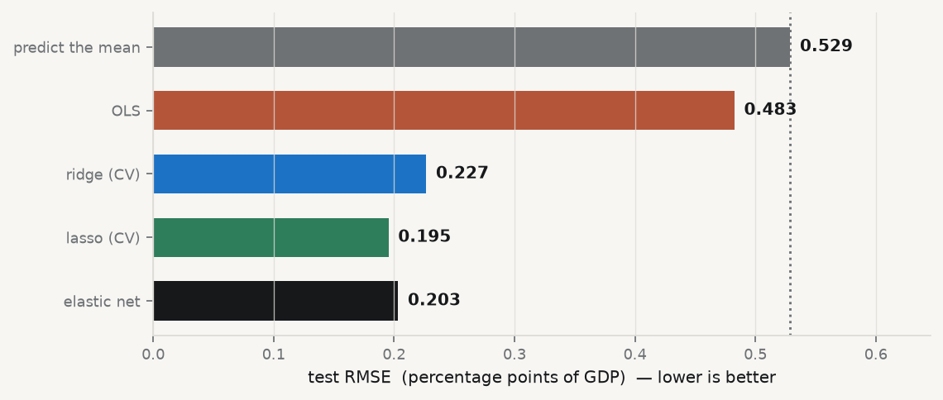
The result

Slide 16
OLS beats predicting the mean by 9%. Ridge beats it by 57%.

Slide 17
Read that again
With 29 predictors and 37 rows, OLS is worth almost nothing — it is fitting noise
The penalised fits cut the error by more than half, using the same columns
Nothing was added. Something was restrained
This is the entire argument for regularisation, and it took four lines of code to make. The rest of the session is about why it works and how to set the dial.

Slide 18
3 · Ridge

Slide 19
The estimator
$${\hat{β}}^{\text{ridge}}=arg\min_{β}\left\{∥y−Xβ∥_{2}^{2}+λ∥β∥_{2}^{2}\right\}={\left(X^{⊤}X+λI\right)}^{−1}X^{⊤}y$$
Adding $λI$ lifts every eigenvalue of $X^{⊤}X$ by $λ$. A matrix with all eigenvalues positive is invertible — for any $λ>0$, even when $p>n$.
Regularisation is not only a bias–variance device. It is what makes the problem well-posed at all. That is why it appears in every high-dimensional method you will meet.

Slide 20
Ridge in the SVD basis
With $X=UDV^{⊤}$ — Session 02’s singular value decomposition:
$${\hat{y}}^{\text{ridge}}=\sum_{j=1}^{p}{u_{j}} \frac{d_{j}^{2}}{d_{j}^{2}+λ} u_{j}^{⊤}y$$
OLS is the same sum with every factor equal to 1.
So ridge does not scale coefficients down uniformly. It multiplies the $j$-th principal direction of the design by a factor that depends on how much the data vary in that direction.

Slide 21
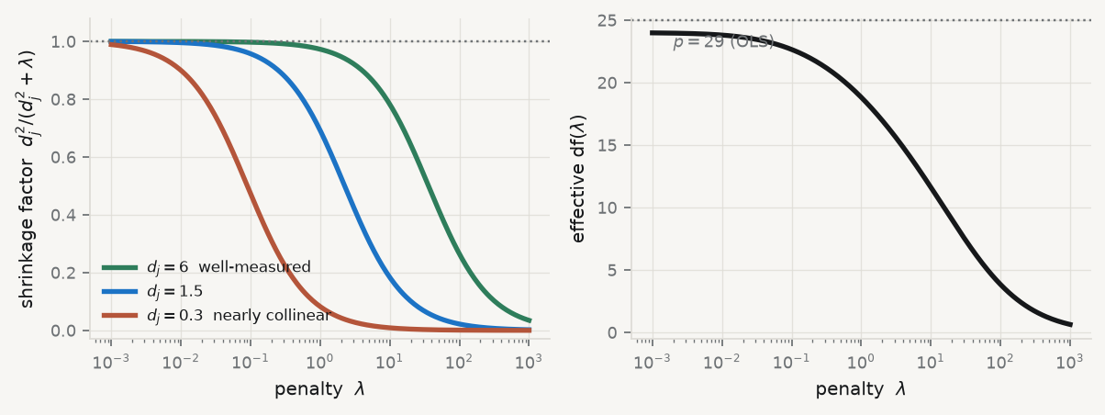
The shrinkage factor, drawn

Slide 22
Left: the same $λ$ barely touches a well-measured direction and crushes a collinear one. Right: on our actual design, effective df slides smoothly from 29 down toward 0.

Slide 23
Why that shape is the whole point
Directions where the data vary a lot carry real information — ridge leaves them alone. Directions where the data are nearly collinear are where OLS goes insane — ridge crushes them.
dfλ=j​dj2dj2+λ falls smoothly from p to 0
Ridge is a targeted damping of exactly the directions in which your data carry least information. It is not a blunt instrument, and describing it as “shrinking the coefficients” undersells it.

Slide 24
Ridge in three lines, explained
mod = make_pipeline( StandardScaler(), # 1. penalty is scale-dependent: standardise first RidgeCV(alphas=np.logspace(-3, 3, 60)) # 2. pick lambda by leave-one-out CV over a log grid ).fit(Xtr, ytr) # 3. refit on all training rows at the chosen lambda print(f"chosen lambda = {mod[-1].alpha_:.3f}") print(f"largest |coef|: OLS {np.abs(LinearRegression().fit(Ztr, ytr).coef_).max():.3f}" f" ridge {np.abs(mod[-1].coef_).max():.3f}")
chosen lambda = 23.598 largest |coef|: OLS 0.396 ridge 0.055
Line 1 is not optional. A penalty on $∥β∥_{2}^{2}$ punishes a coefficient measured in euros differently from one measured in thousands of euros. Standardise, or the penalty is arbitrary.

Slide 25
Bias–variance, explicitly
$Var\left({\hat{β}}^{\text{ridge}}\right)$ is decreasing in $λ$
${\text{Bias}}^{2}$ is increasing in $λ$
There always exists some $λ>0$ whose MSE is strictly lower than OLS
That last line is Hoerl and Kennard, 1970, and it genuinely surprised the profession. It should change how you hear the phrase “best unbiased estimator” for the rest of your career.

Slide 26
4 · Lasso

Slide 27
The estimator
$${\hat{β}}^{\text{lasso}}=arg\min_{β}\left\{1/{2n}∥y−Xβ∥_{2}^{2}+λ∥β∥_{1}\right\}$$
One change from ridge: ∥β∥1=j​βj instead of j​βj2.
No closed form. But that single change makes some coefficients exactly zero — not small, zero — and that is a qualitative difference, not a quantitative one.
To see why, look at the equivalent constrained problem: minimise RSS subject to $∥β∥_{1}≤t$.

Slide 28
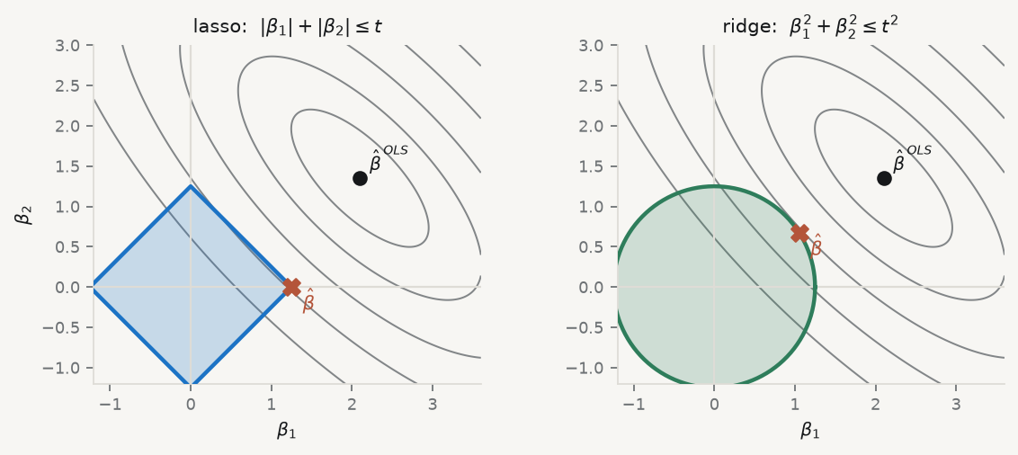
The picture that explains the zeros

Slide 29
Grey ellipses: contours of equal RSS, expanding from the OLS solution. Shaded region: what the budget $t$ allows. The estimate is where they first touch.

Slide 30
Corners produce zeros
The $ℓ_{1}$ region is a diamond: it has corners, and every corner sits on an axis, where one coordinate is exactly zero. Ellipses expanding from an arbitrary direction generically hit a corner.
The $ℓ_{2}$ region is a disc: perfectly smooth, no corners. The touch point almost never has a zero coordinate. Ridge shrinks; it never selects.
In $p$ dimensions the diamond has $2^{p}$ vertices and a whole lattice of edges and faces, each with some coordinates zero. Sparsity is not a trick — it is the shape of the constraint.

Slide 31
Where the zeros come from, algebraically
Hold every $β_{k}$, $k≠j$, fixed. With standardised columns the univariate problem is
minβj12βj−ρj2+λβj, ρj=1ni​xijyi−k≠j​xikβk
$ρ_{j}$ is just the correlation of $x_{j}$ with what the other predictors have not explained.
Convex, but not differentiable at $0$. The subgradient of $\left|β_{j}\right|$ there is the whole interval $\left[−1,1\right]$ — which is exactly what allows a flat spot at zero.

Slide 32
Soft-thresholding
$${\hat{β}}_{j}=S_{λ}\left(ρ_{j}\right)=sign\left(ρ_{j}\right)(\left|ρ_{j}\right|−λ)_{+}$$
Read it in words:
if the partial correlation of $x_{j}$ with the residual is smaller in magnitude than $λ$, set the coefficient to exactly zero; otherwise shrink it toward zero by $λ$.
Cycling this update over $j$ until convergence is coordinate descent. It is why scikit-learn fits a 200-predictor lasso path faster than you can type the command.

Slide 33
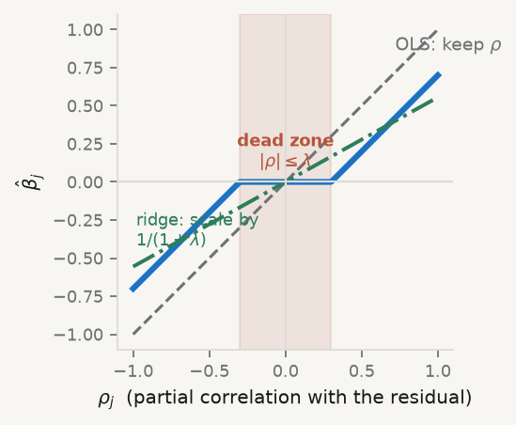
The operator, drawn

Slide 34
Ridge (dash-dot) passes through the origin with a shallower slope — it approaches zero but reaches it only when $λ=∞$. The lasso (solid) has a flat interval at zero.

Slide 35
Do it by hand, once
$ρ_{j}$ | $|ρ_{j}|−λ$ | ${\hat{β}}_{j}$
$0.42$ | $0.22$ | $0.22$
$−0.18$ | $−0.02→0$ | $0$
$0.09$ | $−0.11→0$ | $0$
$0.31$ | $0.11$ | $0.11$
Soft-threshold $ρ=\left(0.42, −0.18, 0.09, 0.31\right)$ at $λ=0.20$:

Slide 36
Two of four survive. You can compute a lasso solution with a pen — and you will be asked to on the midterm.

Slide 37
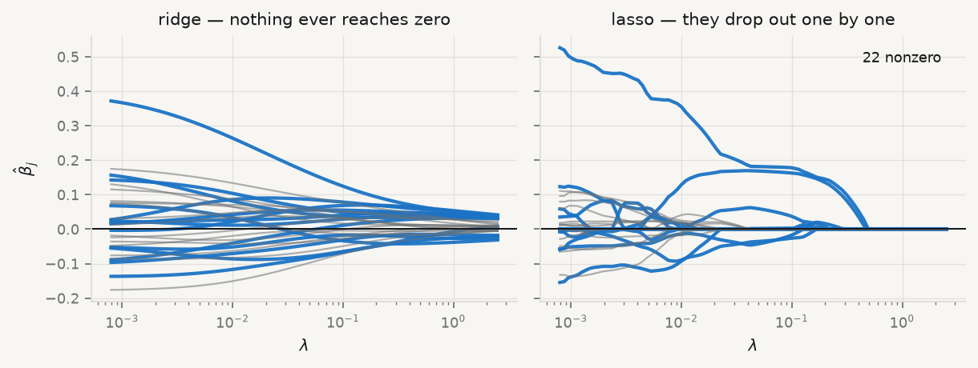
The coefficient path

Slide 38
Blue: the 14 named indicators. Grey: the 15 unvetted auxiliary series. Read right to left — increasing penalty.

Slide 39
What survived, on our data
lcv = LassoCV(cv=5, random_state=0, max_iter=50_000).fit(Ztr, ytr) kept = [(c, b) for c, b in zip(XCOLS, lcv.coef_) if abs(b) > 1e-8] print(f"lambda = {lcv.alpha_:.4f} kept {len(kept)} of {P}") for c, b in sorted(kept, key=lambda t: -abs(t[1])): print(f" {c:<20s} {b:+.3f}") print(f"auxiliary series kept: {sum(c.startswith('aux') for c, _ in kept)} of 15")
lambda = 0.0520 kept 6 of 29 ai_use_any +0.182 digital_intensity +0.168 ict_specialists +0.058 barrier_cost -0.041 barrier_legal -0.035 cloud_use +0.002 auxiliary series kept: 0 of 15
Every one of the 15 unvetted series was set to zero. The lasso did the screening you would otherwise have done by hand, by eye, and by prejudice.

Slide 40
Three limitations you must state out loud
With $p>n$, the lasso can select at most $n$ variables — a hard ceiling, not a finding
Among highly correlated predictors it picks one and zeroes the rest, near-arbitrarily
Its selected set is consistent only under strong conditions (the irrepresentable condition)
So do not present a lasso path as if it had identified the true model. It identified a set of columns that predicts well at one value of $λ$, on one sample.

Slide 41
5 · Elastic net

Slide 42
Limitation 2 is not academic
Our five AI-adoption columns are all measuring roughly the same thing:
GRP = ["ai_use_any", "ai_use_ml", "ai_use_ge3", "ai_text_mining", "ai_image_reco"] C = d[GRP].corr().to_numpy() print(f"pairwise correlations within the group: {C[np.triu_indices(5, 1)].min():.2f}" f" to {C[np.triu_indices(5, 1)].max():.2f}")
pairwise correlations within the group: 0.93 to 0.96
The lasso must choose one. So your paper says “text mining, specifically, and none of its neighbours” — a claim the data cannot support and a referee will not believe.

Slide 43
The estimator
$α$ | what you get
$1$ | the lasso
$0$ | ridge
$\left(0,1\right)$ | sparse and strictly convex
$${\hat{β}}^{\text{EN}}=arg\min_{β}\left\{1/{2n}∥y−Xβ∥_{2}^{2}+λ\left[α∥β∥_{1}+{1−α}/2∥β∥_{2}^{2}\right]\right\}$$

Slide 44
Strict convexity for any $α<1$ is what buys the grouping effect: two identical predictors receive identical coefficients, where the lasso had to pick.

Slide 45
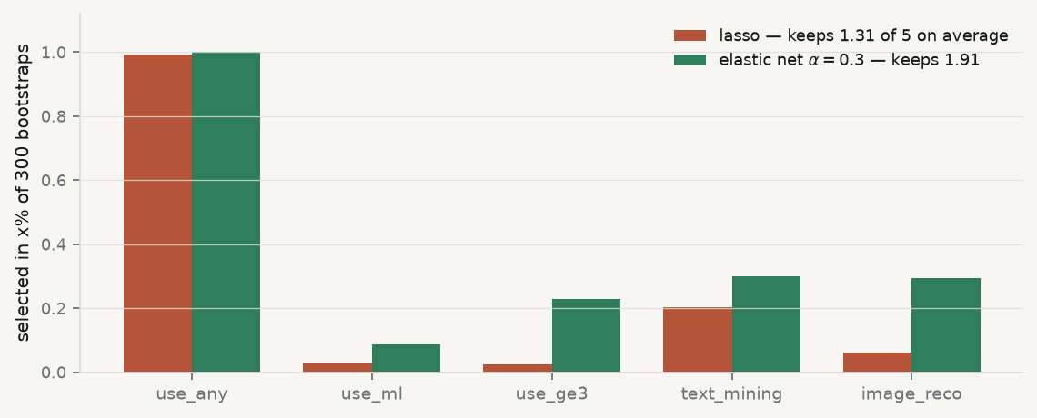
The grouping effect, measured

Slide 46
Same data, same $λ$, 300 resamples. The lasso keeps the group leader and discards its neighbours; the elastic net admits them.

Slide 47
Why this matters for a paper
For a macro panel where a dozen series measure one construct, this is the difference between a model that says “AI adoption matters” and one that says “industrial production of durable goods excluding motor vehicles, specifically.”
The coordinate update is soft-threshold, then divide:
$${\hat{β}}_{j}=\frac{S_{λα}\left(ρ_{j}\right)}{1+λ\left(1−α\right)}$$
Same worked example, $λ=0.2$, $α=0.5$: threshold at $0.10$, divide by $1.10$ → $\left(0.291, −0.073, 0, 0.191\right)$. Three survive instead of two.

Slide 48
6 · Choosing $λ$

Slide 49
The path, and where it starts
Fit over a decreasing grid from
$$λ_{max}=\max_{j}\frac{\left|x_{j}^{⊤}y\right|}{nα}$$
— the smallest penalty that still gives the null model — down to $ελ_{max}$, with warm starts (each fit begins from the previous solution).
Then cross-validate jointly over $\left(α,λ\right)$. Not sequentially: the best $λ$ depends on $α$.

Slide 50
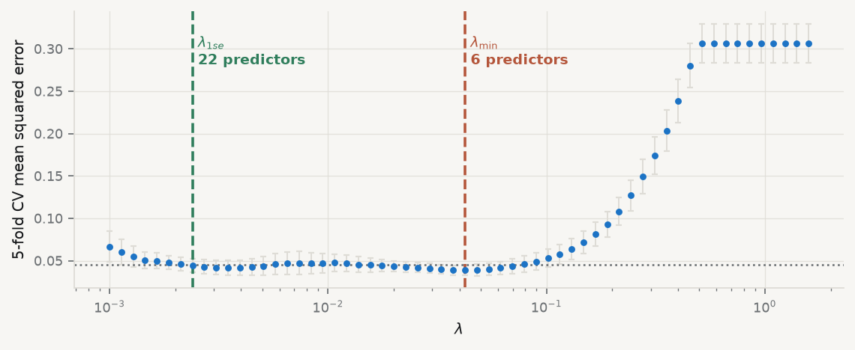
The CV curve

Slide 51
Dotted line: one standard error above the minimum. Everything below it is statistically indistinguishable from the best.

Slide 52
Two conventions, and when to use which
 | definition | use it when
$λ_{min}$ | minimises CV error | prediction is the deliverable
$λ_{1se}$ | largest $λ$ within one SE of the minimum | the model must be explained

Slide 53
$λ_{1se}$ costs you nothing detectable in accuracy and buys a much smaller model. Prefer it whenever a human has to read the coefficient table — which, in this course, is always.

Slide 54
The warning that ends the session
Standard errors and $p$-values reported after lasso selection are not valid. Selection used the same data that the inference then conditions on, so naive $p$-values are badly anti-conservative.
You may report the selected model and its out-of-sample error
You may not report summary() from an OLS refit on the selected columns as if it were an ordinary regression
Honest post-selection inference needs the debiasing machinery of Session 10

Slide 55
7 · Takeaways

Slide 56
Key takeaways
Leaving the unbiased class is a choice with a payoff — here, half the test error
Ridge damps the directions where the data are least informative; it never selects
The lasso’s zeros come from the corners of the $ℓ_{1}$ ball, and from soft-thresholding
When predictors come in families, the elastic net keeps the family; the lasso keeps a member
Choose $λ$ by CV — $λ_{1se}$ when the model must be explained
Post-selection inference is a different problem, and it is not solved by ignoring it

Slide 57
What loses marks
Penalising unstandardised predictors — the penalty is then in arbitrary units
Standardising before the CV split, so the folds see test information
Reporting the lasso’s selected set as “the variables that matter”
Reporting post-lasso $p$-values with no caveat
Choosing $λ$ on the test set, then reporting the test error

Slide 58
Now, the practice
Ninety minutes, in your groups. You will fit a full elastic-net path on a wide panel, choose $\left(α,λ\right)$ honestly, and report what survives — and what that does and does not license you to claim.
Notes: 01-lecture/README.md · practice brief: 02-practice/README.md

