Slide 1
Classification: Logistic Regression and the Decision Threshold
Session 06 · Lecture, first half Thierry Warin

Slide 2
Your classifier is 97% accurate. Should anyone be impressed?

Slide 3
Outline
1 | Where we are, and what this adds
2 | An example: Lending Club
3 | Why a straight line fails
4 | The logistic curve
5 | Reading the output
6 | Why accuracy lies
7 | The threshold is an economic choice
8 | A second example: Portugal’s red wines
9 | Key takeaways

Slide 4
Learning objectives
By the end you should be able to:
Say why a linear model cannot support a binary decision, and show it on a plot
Fit a logistic regression in Python and report an odds ratio and an average marginal effect
Explain why accuracy is the wrong metric under imbalance, and what to use instead
Derive the cost-optimal threshold, and defend the cost ratio behind it
Recognise miscalibration, and why it breaks a cost calculation

Slide 5
1 · What this adds

Slide 6
Where we have got to
Session | What you could do afterwards
02 | Fit a line, and know what “controlling for” means geometrically
03 | Attach an honest standard error to it
04 | Say whether it will hold on data you have not seen
05 | Handle more predictors than you can defend individually

Slide 7
All four assume the thing you are predicting is a number.

Slide 8
What changes today
The outcome is a yes or no, and somebody has to act on it.
That second half is new. Sessions 02–05 end with an estimate. This session ends with a decision — fund the loan or refuse it — and a decision needs something none of the earlier methods supplied: a threshold, which comes from economics, not from the data.

Slide 9
The one-sentence version
Sessions 02–05 taught you to produce a number. Session 06 is the first time the number has to become an action.
Everything awkward in this session follows from that step — and almost every applied mistake comes from taking it without noticing.

Slide 10
2 · An example

Slide 11
Lending Club
A peer-to-peer marketplace: individuals lend to individuals, and the platform prices the risk.
9,578 three-year loans funded through LendingClub.com
May 2007 – February 2010
Outcome: the loan was not fully repaid — default, or charged off
The question a lender actually has: which of these applications should I fund?

Slide 12
Get the data, once
VS Codium terminal
python scripts/fetch_teaching_data.py
import pandas as pd loans = pd.read_parquet("data/loans.parquet")
The script downloads, tidies the R-style column names (not.fully.paid → default) and caches to parquet. Run it once. Nothing else in the course touches the network.

Slide 13
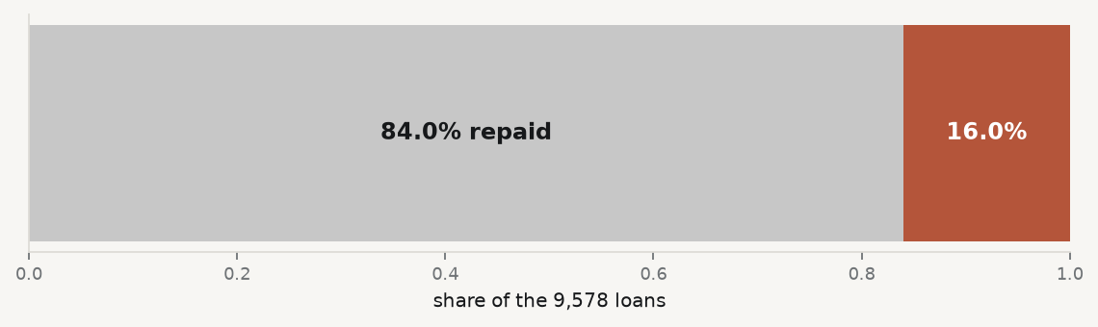
Look before you model
loans["default"].mean() # 0.160 loans["purpose"].value_counts() # 7 categories

Slide 14
16% default. Hold that number — section 6 turns on it.

Slide 15
3 · Why a straight line fails

Slide 16
Try it anyway
Regress the 0/1 outcome on FICO by ordinary least squares — the Session 02 estimator, unchanged.
import statsmodels.api as sm X = sm.add_constant(loans[["fico"]]) lpm = sm.OLS(loans["default"], X).fit()
This is the linear probability model. Economists use it, and for an average effect it is defensible.

Slide 17
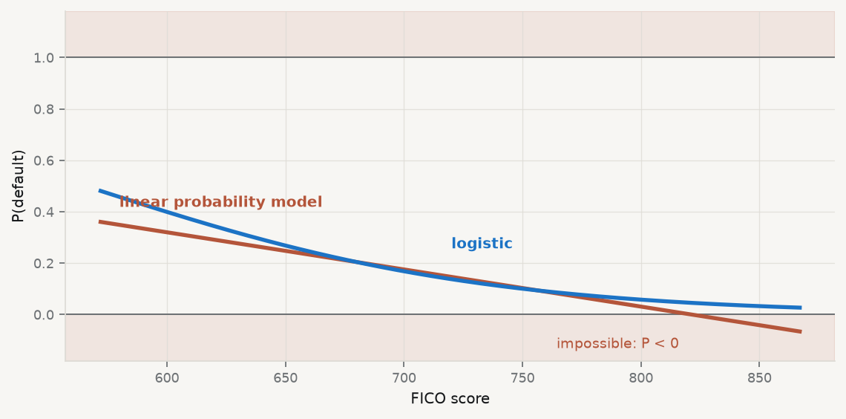
Look at what it predicts

Slide 18
The straight line crosses zero: for high-FICO applicants it predicts a negative probability of default — here as low as −0.08.

Slide 19
Why that is fatal for a decision
A probability below 0 or above 1 cannot be acted on — you cannot multiply it by a cost
The errors are heteroskedastic by construction: the variance is $p\left(1−p\right)$
The fit is dragged by points far from the boundary, where nothing is being decided
For an average effect the LPM survives. For an individual decision it does not — and this session is about decisions.

Slide 20
4 · The logistic curve

Slide 21
Bend the line into the unit interval
$$log\frac{p\left(x\right)}{1−p\left(x\right)}=x^{⊤}β ⇔ p\left(x\right)=\frac{1}{1+e^{−x^{⊤}β}}$$
The log-odds on the left is free to run from $−∞$ to $+∞$, so a linear model is safe there. The probability on the right is then squeezed into $\left(0,1\right)$ automatically.

Slide 22
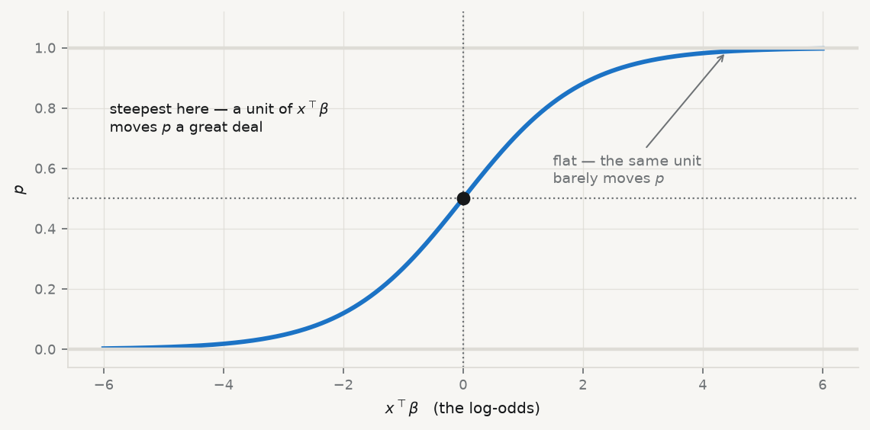
What the squeeze looks like

Slide 23
The slope is not constant. That is why one coefficient does not translate into one change in probability.

Slide 24
Three ways to report one coefficient
Quantity | Formula | Use when
Log-odds | $β_{j}$ | reporting the raw model
Odds ratio | $e^{β_{j}}$ | a credit or clinical audience
Average marginal effect | 1ni​βj pi1−pi | reporting to economists

Slide 25
The odds ratio is constant everywhere; the probability change is not. Report the average marginal effect unless you have a reason not to.

Slide 26
5 · Reading the output

Slide 27
Fit it
import numpy as np import statsmodels.formula.api as smf m = smf.logit("default ~ fico + int_rate + np.log(revol_bal + 1)", data=loans).fit() print(m.summary().tables[1])
Line by line:
smf.logit — the formula interface; default ~ ... reads “default explained by”
np.log(revol_bal + 1) — transformed inside the formula, so the transformation is part of the recorded model rather than a step you might forget
+ 1 because balances of exactly zero exist, and $log0$ is undefined

Slide 28
What it says
coef std err z P>|z| Intercept 1.6886 0.9231 1.8292 0.0674 fico -0.0064 0.0011 -5.8332 0.0000 int_rate 10.5902 1.4681 7.2138 0.0000 log(revol_bal+1) -0.0162 0.0131 -1.2314 0.2182
fico is negative — a better score lowers default risk. int_rate is strongly positive: the platform’s own pricing already encodes who is risky.

Slide 29
Make it reportable
np.exp(m.params["fico"]) # 0.9936 — odds ratio per FICO point m.get_margeff().summary() # average marginal effects
0.9936 per point sounds like nothing. Per 100 points it is ${0.9936}^{100}≈0.52$ — the odds of default roughly halve.
The model does not care about units; your sentence does. Always say per what.

Slide 30
6 · Why accuracy lies

Slide 31
The null model is already good
16% default. So the model “nobody ever defaults” — which uses no data at all — is
84% accurate.
Report 85% accuracy and you have bought one point over saying nothing. Under imbalance, accuracy measures the base rate, not skill.

Slide 32
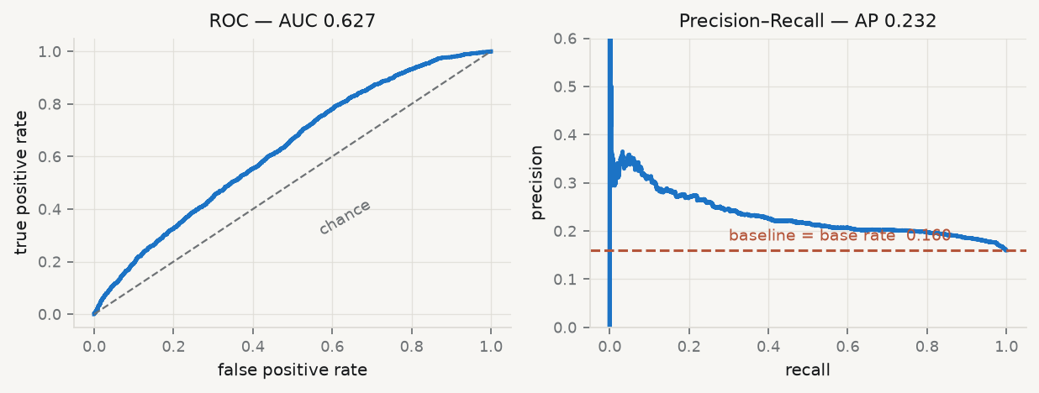
Two curves, one model

Slide 33
Read them against each other
ROC AUC 0.627 — looks like a working model. Its reference line is chance, a low bar.
PR AUC 0.232 — its reference line is the base rate, 0.160. The real gain is 0.232 against 0.160.
Under heavy imbalance, report PR with its baseline. ROC flatters, because the false-positive denominator is enormous.

Slide 34
7 · The threshold

Slide 35
0.5 is a claim, not a default
Classifying at $\hat{p}>0.5$ asserts that a false positive and a false negative cost the same.
For a lender they do not: refusing a good borrower costs a margin; funding a defaulter costs the principal.

Slide 36
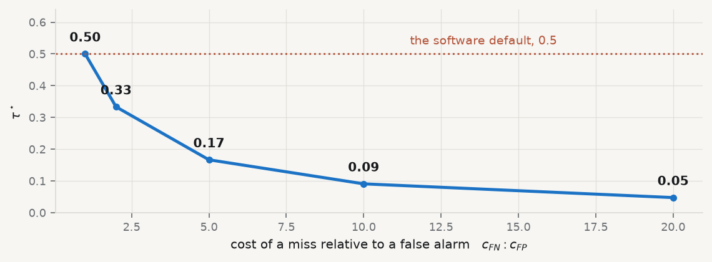
The cost-optimal threshold
$$\boxed{ τ^{⋆}=\frac{c_{FP}}{c_{FP}+c_{FN}} }$$

Slide 37
At a 5:1 cost ratio the right threshold is 0.167, not 0.5.

Slide 38
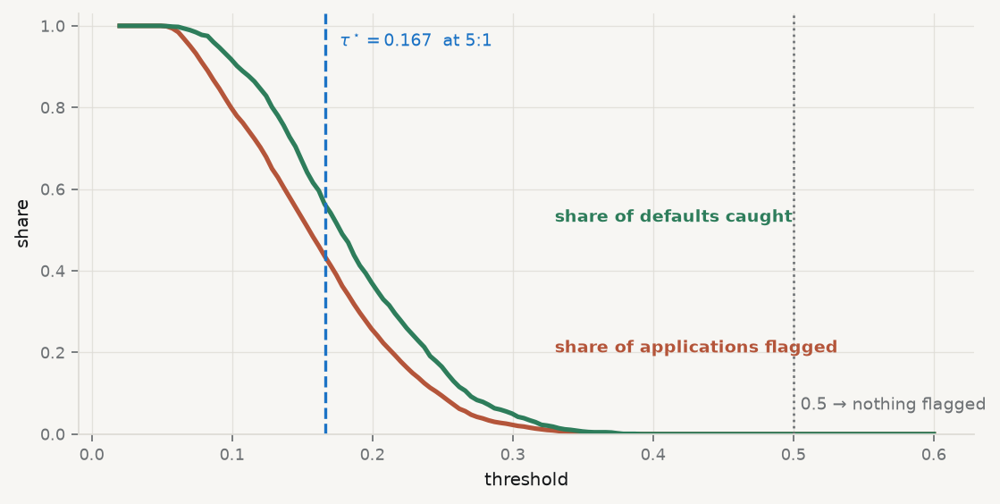
What the threshold does to the decision

Slide 39
The number that should alarm you
threshold flagged recall 0.100 7625 0.915 0.167 4134 0.560 0.200 2440 0.369 0.300 215 0.050 0.500 0 0.000
At 0.50 the model flags nothing at all. Every applicant approved, recall zero — and the software reported no error whatsoever.

Slide 40
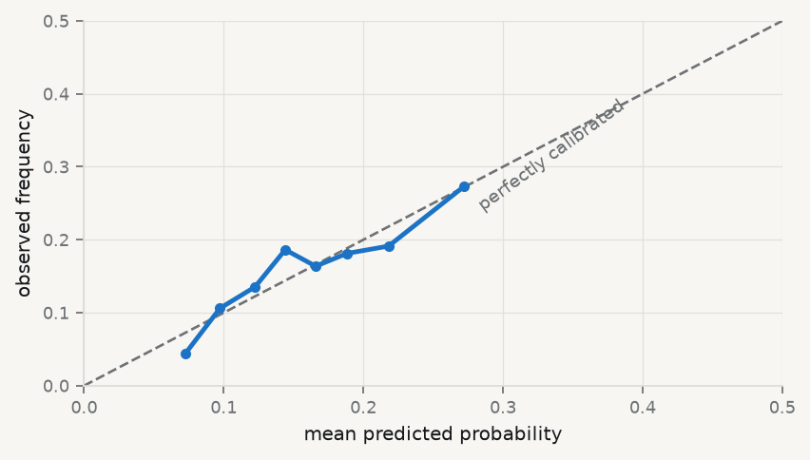
Is 0.3 really 30%?

Slide 41
Discrimination and calibration are different properties. A model can rank perfectly and still be miscalibrated — and a miscalibrated probability cannot enter a cost calculation.

Slide 42
8 · A second example

Slide 43
Portugal’s red wines
1,599 red vinho verde wines, chemically assayed, each rated by at least three blind tasters.
wine = pd.read_parquet("data/redwines.parquet") m_w = smf.logit("good ~ alcohol + volatile_acidity + sulphates", data=wine).fit() np.exp(m_w.params["alcohol"]) # 2.74
An odds ratio of 2.74: each extra percentage point of alcohol nearly triples the odds a taster calls the wine good.

Slide 44
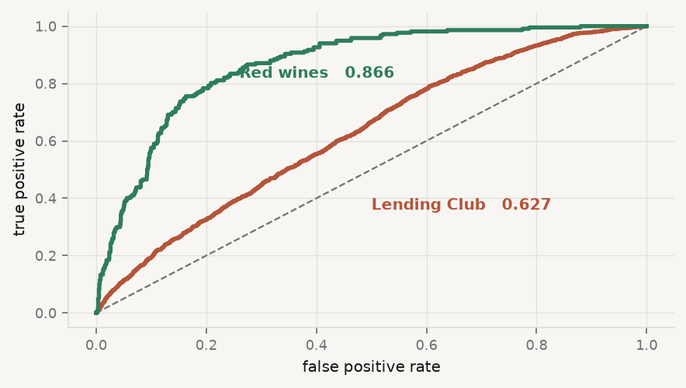
Same method, very different signal

Slide 45
Why the difference is not the method
 | Lending Club | Red wines
$n$ | 9,578 | 1,599
Base rate | 0.160 | 0.136
ROC AUC | 0.627 | 0.866

Slide 46
Same estimator, both imbalanced. The predictors differ in how much they know. Chemistry measures the thing being judged; a credit file measures a person’s past, not their next three years.
When a model performs badly, ask what the features could possibly contain before reaching for a fancier algorithm.

Slide 47
9 · Key takeaways

Slide 48
What to carry out of this session
A model gives a probability; a decision needs a threshold. Separate acts, separate evidence.
Report the base rate first. Accuracy cannot be read without it.
Report an odds ratio or an average marginal effect, with its units.
Derive the threshold from a stated cost ratio — and show how the answer moves if it is wrong.
Check calibration before any probability enters a cost calculation.
A weak model may be a weak feature set. Look there before changing algorithm.

Slide 49
What loses marks reliably
Accuracy on an imbalanced problem | It measures the base rate
Threshold silently left at 0.5 | An economic assumption, unstated
ROC AUC alone under imbalance | Hides the false positives
Random K-fold on a panel | Optimistic, for Session 04’s reason
“The model found the drivers of default” | It found predictors

Slide 50
In the practice session
Fit penalised logistic on your project, grouped CV, base rate reported first
Produce a reliability diagram — is $\hat{p}$ usable as a probability?
State a cost ratio, derive $τ^{⋆}$, report precision and recall there
Bootstrap the selection; report frequencies, not one list
Derivations, penalised logistic and IRLS: 01-lecture/README.md §6.1–6.9 · brief: 02-practice/README.md

