Slide 1
Trees, Forests, and Gradient Boosting
Session 07 · Lecture, first half Thierry Warin

Slide 2
If we abandon linearity, what do we lose — and can we get the interpretation back?

Slide 3
Outline
1 | Where we are, and what this adds
2 | One tree: how a split is chosen
3 | Pruning — the same dial again
4 | Why averaging works, and when it stops
5 | Boosting: gradient descent in function space
6 | Getting the interpretation back
7 | Key takeaways

Slide 4
Learning objectives
Write the greedy splitting objective and say why the global problem is infeasible
Explain why misclassification error is a poor growing criterion but the right pruning one
Derive the bagging variance formula and read off why random forests subsample features
Describe boosting as gradient descent on a loss, in function space
Choose an interpretation tool, and state precisely what it does not tell you

Slide 5
1 · What this adds

Slide 6
Everything so far has been one straight line
Session | What it assumed
02–03 | $E\left[y∣x\right]=x^{⊤}β$ — additive, linear, no interactions
05 | Still linear. The penalty changed which $β$, not the functional form
06 | Still linear — in the log-odds

Slide 7
Every interaction and every non-linearity so far had to be typed by hand: a squared term, a product, a spline. You had to know it was there.

Slide 8
What today adds
A model class that finds the non-linearity and the interactions for you, from the data.
Trees: no functional form at all, just a partition of the predictor space
Forests: a variance-reduction device with a formula that tells you exactly when it stops working
Boosting: the same idea run sequentially, which turns out to be gradient descent
And what it costs: no coefficients, no standard errors, no $t$-statistics. Section 6 is about how much of that we can recover — and it is less than the software suggests.

Slide 9
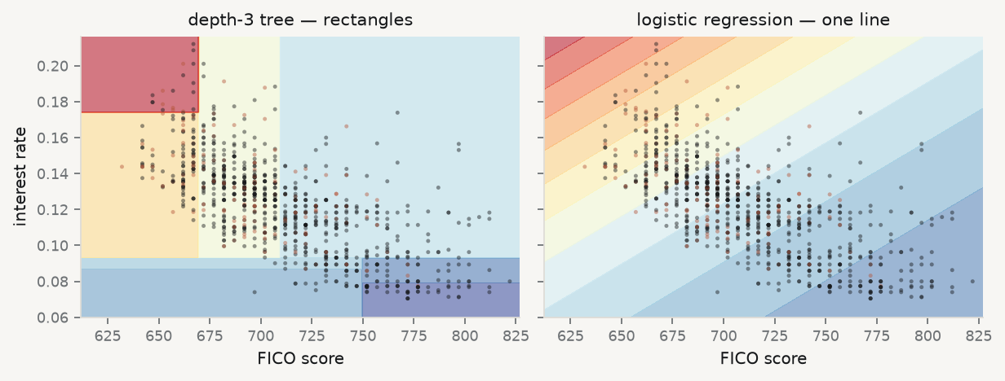
A tree is a partition, not a curve

Slide 10
Same two predictors, same data. Colour is the fitted default probability. The tree can only produce axis-aligned blocks; the logistic model can only produce parallel bands.

Slide 11
Which of those is right?
Neither, always. The tree captures a threshold — “below 660 FICO everything changes” — that the line cannot. The line captures a smooth gradient that the tree can only approximate in steps.
So the question is never “are trees better than regression”. It is: is the relationship I am modelling more like a threshold, or more like a gradient? Draw the picture before you choose.

Slide 12
2 · One tree

Slide 13
The model
Partition the predictor space into $M$ regions and predict a constant in each:
$$\hat{f}\left(x\right)=\sum_{m=1}^{M}{c_{m}} 1\{x∈R_{m}\}$$
Under squared loss the optimal constant is just the region mean, ${\hat{c}}_{m}=ave\left(y_{i}∣x_{i}∈R_{m}\right)$. So the whole problem is choosing the regions.
And that is where it gets hard: the number of partitions is astronomically large. Finding the best one is infeasible.

Slide 14
So we are greedy
At each node, search over splitting variable $j$ and split point $s$:
minj,sminc1​​xi∈R1j,s​​​yi−c12+minc2​​xi∈R2j,s​​​yi−c22
with $R_{1}=\{x:x_{j}≤s\}$ and $R_{2}=\{x:x_{j}>s\}$.
The inner minimisations are means, so one sorted scan per feature suffices. Cost per node: $O\left(p nlogn\right)$ — cheap, which is why trees scale.

Slide 15
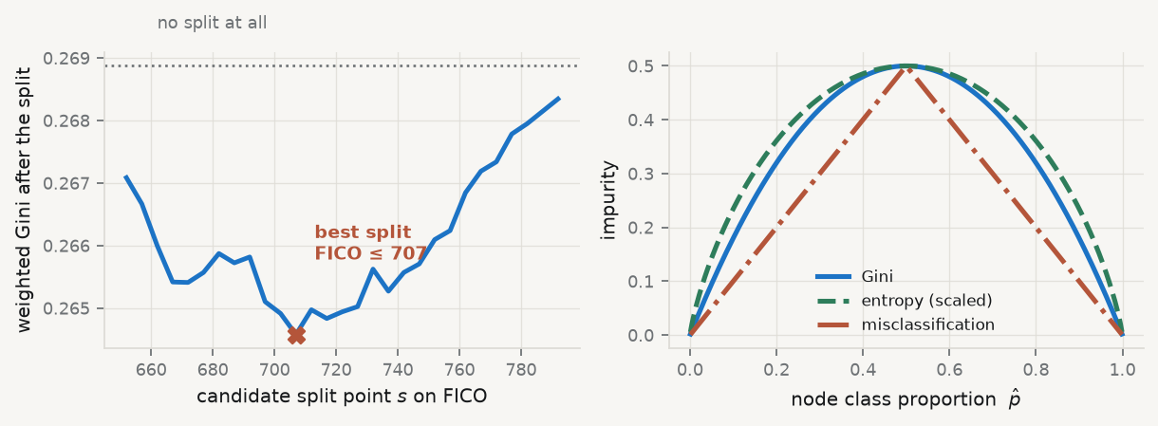
Watch the scan happen

Slide 16
Left: the actual scan on our data — one number per candidate cut. Right: the three impurity measures.

Slide 17
Why the right-hand panel matters
Gini=k​pmk1−pmk, Entropy=−k​pmklogpmk, Miscl.=1−maxkpmk
Gini and entropy are strictly concave: they reward a split that makes a node purer even when the majority class does not change. Misclassification is piecewise linear — it registers nothing.
So: grow with Gini or entropy, prune with misclassification (or whatever loss you will actually be judged on). Different jobs, different criteria.

Slide 18
3 · Pruning

Slide 19
Cost-complexity
Grow a large tree $T_{0}$, then choose the subtree minimising
CγT=m=1Txi∈Rm​yi−cm2+γ T
Weakest-link pruning: as $γ$ rises from 0, the optimal subtrees are nested — obtained by repeatedly collapsing the internal node with the smallest per-leaf increase in error.
That nesting is what makes it tractable: a one-dimensional family indexed by $γ$, which you then select by cross-validation — exactly as you selected $λ$ last week.

Slide 20
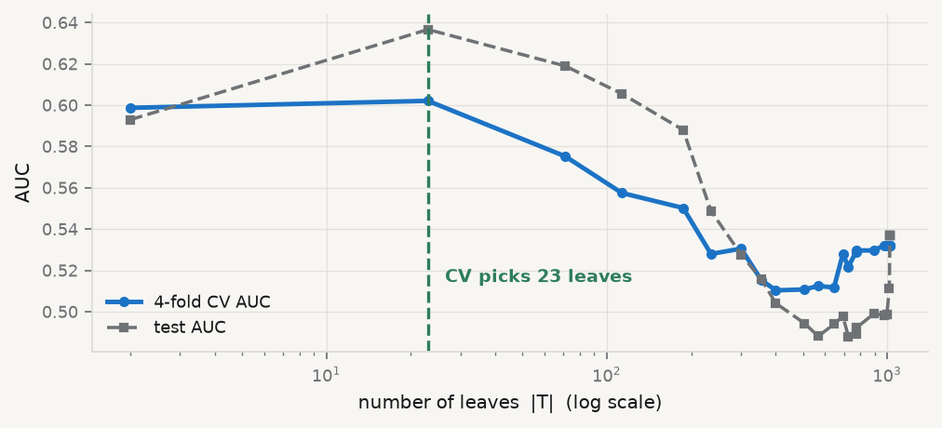
The same picture as Session 05

Slide 21
An interior optimum, found by CV, on a one-dimensional complexity family. Session 04’s figure with different axis labels.

Slide 22
The structural point
$λ$ in ridge. $λ$ in lasso. $γ$ here. Tree depth. Number of components in Session 08. Number of clusters in Session 09.
Every method in this course has a complexity dial and a cross-validation procedure for setting it. Once you see that, a new method is only ever two questions: what is the dial, and what is the loss?

Slide 23
4 · Why averaging works

Slide 24
A single tree is a high-variance estimator
Change 5% of the rows and the first split can change
Change the first split and every region below it changes
So the whole partition is unstable — low bias, very high variance
Session 04’s decomposition says: average many high-variance, low-bias estimators and the variance term falls while the bias term does not. That is bagging — fit $B$ trees on bootstrap resamples and average.

Slide 25
But how far does that go? Do the algebra
If each tree has variance $σ^{2}$ and any two have correlation $ρ$:
Var1Bb​fb=ρσ2+1−ρBσ2 →​B→∞ ρσ2
Increasing $B$ kills the second term only. The first term does not move. Buying more trees past a point buys nothing at all.

Slide 26
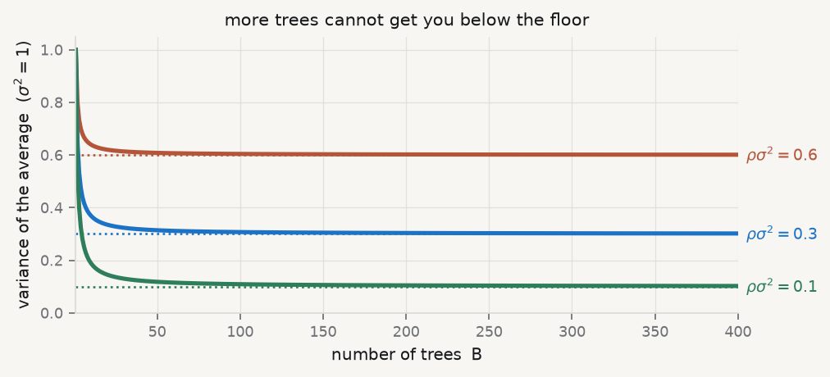
Read it off the graph

Slide 27
$ρ=0.6$, $B=100$ gives $0.604$; $B=∞$ gives $0.600$. The whole gain is in lowering $ρ$, not in raising $B$.

Slide 28
So lower $ρ$: that is a random forest
Restrict each split to a random subset of $m$ features. Defaults: $m=⌊\sqrt{p}⌋$ for classification, $⌊p/3⌋$ for regression.
Lower $m$ → lower $ρ$ → lower ensemble variance
Lower $m$ → higher bias in each individual tree
So $m$ is itself a bias–variance dial, tuned by CV
One free bonus: each row is out-of-bag for about ${\left(1−1/n\right)}^{n}→e^{−1}≈36.8\%$ of trees, so the OOB error approximates CV error at no extra cost.

Slide 29
Does it actually happen? Measure $ρ$
def fit_and_measure(max_features, depth=4, B=200): """Fit an ensemble, then measure how correlated its trees' predictions are.""" m = RandomForestClassifier(n_estimators=B, max_depth=depth, max_features=max_features, random_state=0, n_jobs=-1).fit(Xtr, ytr) # each tree's predicted probability on the test rows, stacked into a matrix P = np.array([t.predict_proba(Xte.to_numpy())[:, 1] for t in m.estimators_[:80]]) C = np.corrcoef(P) rho = C[np.triu_indices(len(C), 1)].mean() root = pd.Series([FEAT[t.tree_.feature[0]] for t in m.estimators_]).value_counts(normalize=True) return m, rho, root bag_m, rho_bag, root_bag = fit_and_measure(None) # all features at every split = bagging rf_m, rho_rf, root_rf = fit_and_measure("sqrt") # sqrt(p) features = random forest
max_features=None means consider every feature at every split — that is plain bagging. "sqrt" is the forest. Everything else about the two fits is identical.

Slide 30
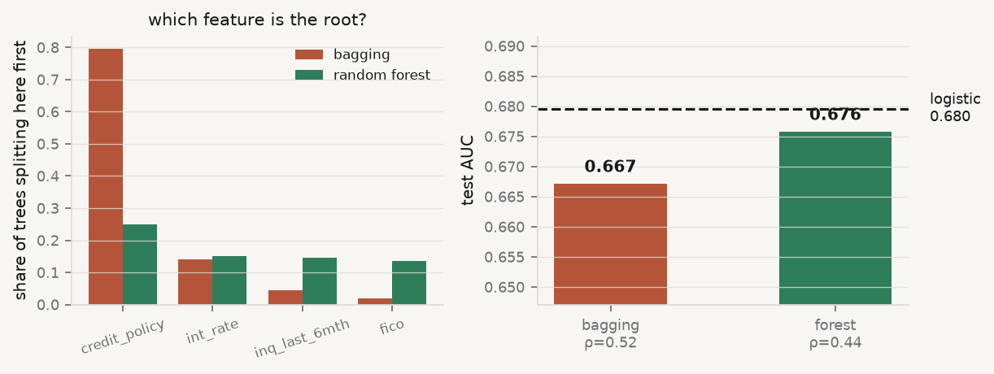
The mechanism, and the payoff

Slide 31
Bagging puts the same feature at the root of 80% of its trees. The forest, forbidden from seeing it most of the time, uses it in a quarter. $ρ$ falls, and the AUC rises.

Slide 32
The honest scoreboard
tuned = RandomForestClassifier(n_estimators=500, min_samples_leaf=40, random_state=0, n_jobs=-1).fit(Xtr, ytr) print(f"logistic regression (Session 06) {AUC_LOGIT:.4f}") print(f"bagging, depth 4 {auc(bag_m):.4f}") print(f"random forest, depth 4 {auc(rf_m):.4f}") print(f"random forest, tuned {auc(tuned):.4f}")
logistic regression (Session 06) 0.6796 bagging, depth 4 0.6671 random forest, depth 4 0.6757 random forest, tuned 0.6813
A tuned forest, on 9,578 loans and 19 features, beats a linear model in the log-odds by 0.002 AUC. Report that honestly. Flexibility is not a free win.

Slide 33
5 · Boosting

Slide 34
A different idea entirely
Bagging fits $B$ trees independently and averages. Boosting fits them sequentially, each one correcting what its predecessors got wrong.
Think of minimising i​Lyi,Fxi by gradient descent — not over parameters, but over the function $F$ itself.
That reframing is the whole derivation. Everything below follows from taking it literally.

Slide 35
Gradient descent in function space
Loss | $r_{im}$ becomes
squared error | $y_{i}−F_{m−1}\left(x_{i}\right)$ — literally the residual
logistic | $y_{i}−p_{m−1}\left(x_{i}\right)$ — the probability residual from Session 06
At stage $m$, the negative gradient at the current fit is the pseudo-residual:
$$r_{im}=−{\left[\frac{∂L\left(y_{i},F\left(x_{i}\right)\right)}{∂F\left(x_{i}\right)}\right]}_{F=F_{m−1}}$$

Slide 36
Fit a small tree $h_{m}$ to those pseudo-residuals, then step: $F_{m}=F_{m−1}+ν γ_{m}h_{m}$.

Slide 37
Shrinkage is not optional
$$F_{m}\left(x\right)=F_{m−1}\left(x\right)+ν γ_{m}h_{m}\left(x\right), 0<ν≤1$$
Small $ν$ (0.01–0.1) with many trees generalises far better than large $ν$ with few
Halving $ν$ roughly doubles the $M$ you need
Three dials interact: $ν$, $M$, and depth $d$ — where $d$ caps the interaction order ($d=1$ is additive, $d=2$ allows two-way interactions)

Slide 38
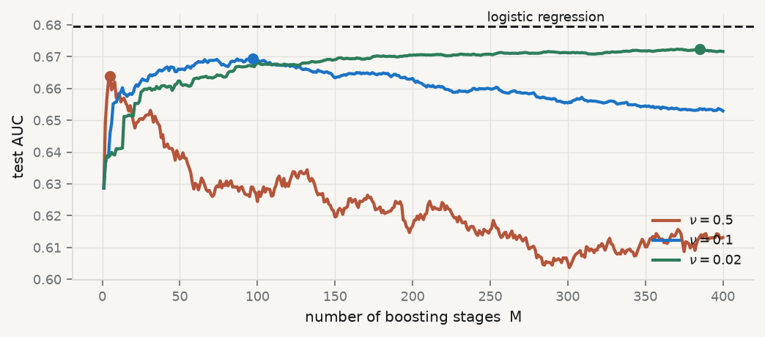
The learning-rate picture

Slide 39
Dots mark each curve’s peak. The fast learner ($ν=0.5$) peaks early and then decays — it is overfitting one stage at a time.

Slide 40
What the modern libraries add
XGBoost and LightGBM expand the loss to second order and penalise the tree explicitly:
Lm≈i​gihmxi+12hihmxi2+Ωhm, Ωh=γT+12λ∥w∥2
Solving for the optimal leaf weight:
$$w_{j}^{⋆}=−\frac{G_{j}}{H_{j}+λ}$$
Look at that denominator. That is ridge, in a third guise — the same $+λ$ that made $X^{⊤}X$ invertible in Session 05, now stabilising a leaf.

Slide 41
6 · Recovering interpretation

Slide 42
Five tools, and what each is for
Tool | What it answers | The caveat
Impurity importance | how often, and how usefully, a feature was split on | biased toward high-cardinality features; in-sample
Permutation importance | how much test error rises when it is scrambled | breaks under correlated features
Partial dependence | the average marginal relationship | assumes $x_{S}⟂x_{C}$; hides heterogeneity
ICE curves | the per-observation version | reveals what PDP averages away
SHAP | additive attribution, per prediction | axiomatically unique, costly, still a model summary

Slide 43
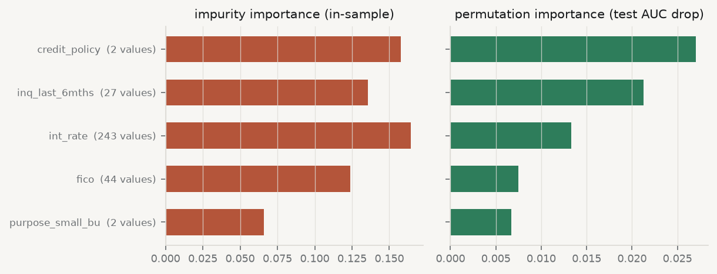
The impurity bias is not theoretical

Slide 44
Impurity importance rewards features with thousands of candidate split points. Permutation importance, scored out of sample, puts FICO first — which is what a credit analyst would have told you before you started.

Slide 45
Why that happens
A continuous feature with 7,000 distinct values offers 7,000 chances to reduce impurity by noise. A binary flag offers one. Impurity importance never corrects for that.
Never report impurity importance as “which variables matter”
Report permutation importance, computed on held-out rows
And state which features are correlated, because permutation breaks there too

Slide 46
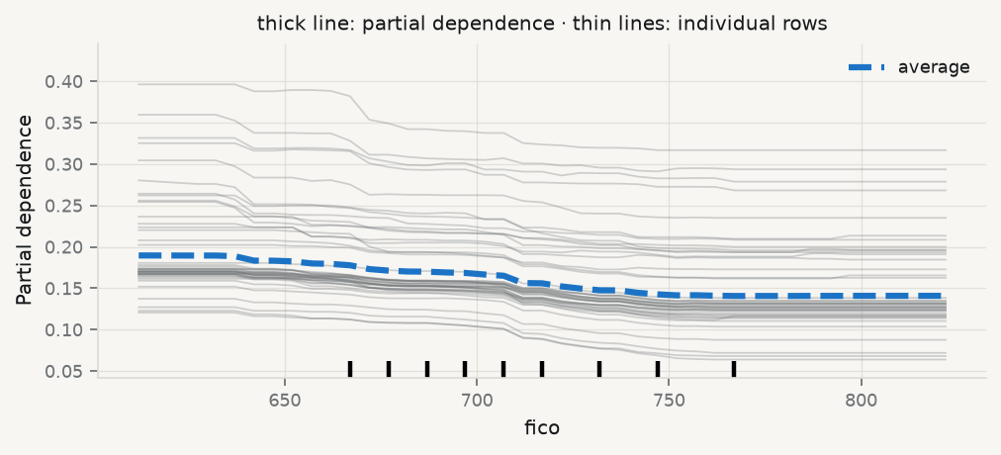
The relationship itself: PDP and ICE

Slide 47
The thick line is the average. The thin lines are individual borrowers — and they are not parallel. A single PDP curve would have hidden that.

Slide 48
The sentence to remember
These tools describe the model, not the world. A large SHAP value means the model relies on that feature. It does not mean the feature causes the outcome.
Your model learned that low FICO predicts default. It did not learn that raising someone’s FICO score would lower their default probability. Those are different claims requiring different evidence.
That distinction is the entire subject of Session 10. Notice how uncomfortable it is now.

Slide 49
7 · Takeaways

Slide 50
Key takeaways
A tree is a partition, not a curve — good for thresholds, clumsy for gradients
Grow with Gini or entropy; prune with the loss you will be judged on
$ρσ^{2}+\frac{1−ρ}{B}σ^{2}$: more trees hit a floor, so decorrelate instead
Boosting is gradient descent in function space; small $ν$ and many trees
Regularisation reappears inside every leaf: $w^{⋆}=−G/\left(H+λ\right)$
Interpretation tools describe the model. Causality is Session 10

Slide 51
What loses marks
Reporting impurity importance as evidence about the world
Reporting importances computed in sample
A partial-dependence plot with no note on whether the features are independent
Tuning $ν$, $M$ and depth one at a time, as if they did not interact
Claiming the ensemble “beat the linear model” without showing both numbers
On this dataset the tuned forest beats logistic regression by roughly 0.002 AUC. Flexibility is not a free win, and saying so is a sign of judgment, not weakness.

Slide 52
Now, the practice
Ninety minutes, in your groups. You will fit a tree, a forest and a boosted ensemble on the same target, tune each honestly, and — the part that carries the marks — say what the importances do and do not license you to claim.
Notes: 01-lecture/README.md · practice brief: 02-practice/README.md

