Slide 1
PCA, the SVD, and Factor Models
Session 08 · Lecture, first half Thierry Warin

Slide 2
Two hundred macro series move together. How many things are actually happening?

Slide 3
Outline
1 | Where we are, and what this adds
2 | PCA as variance maximisation
3 | The SVD, and the best low-rank approximation
4 | Why more series helps
5 | How many factors?
6 | Diffusion-index forecasting
7 | Key takeaways

Slide 4
Learning objectives
Derive PCA from a constrained maximisation and see why the answer is an eigenvector
State Eckart–Young and say exactly what you lose by truncating
Explain why extra series help factor estimation and hurt regression
Report a factor count from several criteria, and say what to do when they disagree
Apply Session 04’s rolling-origin discipline to the unsupervised step

Slide 5
1 · What this adds

Slide 6
Every session so far had a $y$
Session | The question
02–03 | given $y$ and $X$, what is $\hat{β}$, and how sure are we?
04–05 | given $y$, how well can we predict it, and how do we tune?
06–07 | given a binary $y$, where do we set the threshold?

Slide 7
All of it was supervised. There was always an outcome telling you what to look for.

Slide 8
Today there is no $y$
The question is about the structure of $X$ itself.
You have 200 macro series. They visibly move together
Nobody labelled which of them matter, because there is nothing yet to matter for
The question is: how many distinct things are being measured?
This is not a detour. Once you can compress 200 series into 3 factors, you can put those 3 factors into any of the supervised methods from Sessions 03–07 — and that is what a diffusion index is.

Slide 9
The connection you should be looking for
Session 05 shrank coefficients along the SVD basis of $X$, damping small-$d_{j}$ directions smoothly.
Today we truncate exactly those directions — keep the first $k$, discard the rest.
Principal components regression is, in this light, a hard-thresholded ridge. Same basis, different rule. Keep that sentence for the end of Section 3.

Slide 10
2 · PCA as maximisation

Slide 11
The problem
Let $X$ be $n×p$, columns centred and standardised. Find the unit vector maximising the variance of the projection:
$$v_{1}=arg\max_{∥v∥=1}v^{⊤}\hat{Σ}v, \hat{Σ}=1/nX^{⊤}X$$
Standardisation is not optional. Without it, whichever series is measured in the largest units becomes “the first factor”. PCA has no idea what a euro is.

Slide 12
Solve it: two lines of Lagrangian
$$L=v^{⊤}\hat{Σ}v−ϕ\left(v^{⊤}v−1\right) ⇒ \hat{Σ}v=ϕv$$
So $v$ must be an eigenvector of $\hat{Σ}$. And the objective evaluated at an eigenvector is its own eigenvalue — so take the largest one.
Subsequent components solve the same problem subject to orthogonality to those already found. You get the eigenvectors in decreasing eigenvalue order.
PCA is not an algorithm someone invented. It is the solution to a one-line optimisation problem.

Slide 13
Do it by hand, once
$$\hat{Σ}=\left(\begin{matrix}2 & 1 \\ 1 & 2\end{matrix}\right) ⇒ ϕ_{1}=3, v_{1}=1/{\sqrt{2}}\left({1 \atop 1}\right); ϕ_{2}=1, v_{2}=1/{\sqrt{2}}\left({1 \atop −1}\right)$$
First component explains $3/\left(3+1\right)=75\%$ of the variance. Its loading is $\left(1,1\right)$: the average of the two series. The second is their difference.
Thirty seconds of arithmetic, and PCA stops being magic. This is a midterm question.

Slide 14
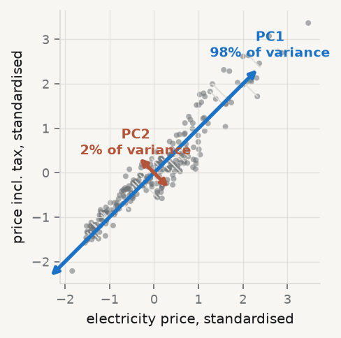
What that looks like on real series

Slide 15
Thin grey lines are what PC1 throws away. Two series, one thing happening: the level of energy prices in that country-year.

Slide 16
3 · The SVD

Slide 17
What software actually computes
With $X=UDV^{⊤}$:
Σ=1nVD2V⊤, V⏟loadings, Z=XV=UD⏟scores, dj2k​dk2⏟variance share
No covariance matrix is ever formed. Forming $X^{⊤}X$ squares the condition number — Session 02’s warning, and the reason numpy.linalg.svd is the right entry point.

Slide 18
Eckart–Young
Theorem. Among all matrices of rank $≤k$, the one minimising $∥X−\tilde{X}∥_{F}$ is the truncated SVD ${\tilde{X}}_{k}=U_{k}D_{k}V_{k}^{⊤}$, and
minrankX≤k∥X−X∥F=(j>k​dj2)1/2
This is the precise sense in which “the first $k$ components capture the most information”. And it tells you exactly what you lost: the discarded singular values.

Slide 19
Check it on our panel
def reconstruct(k): """The rank-k truncated SVD of the standardised panel.""" return (U[:, :k] * D[:k]) @ Vt[:k] for k in (1, 2, 3, 5): actual = np.linalg.norm(Z - reconstruct(k)) theory = np.sqrt((D[k:]**2).sum()) print(f"k={k}: ||X - Xk||_F = {actual:7.3f} sqrt(sum d_j^2, j>k) = {theory:7.3f}")
k=1: ||X - Xk||_F = 40.246 sqrt(sum d_j^2, j>k) = 40.246 k=2: ||X - Xk||_F = 28.492 sqrt(sum d_j^2, j>k) = 28.492 k=3: ||X - Xk||_F = 22.630 sqrt(sum d_j^2, j>k) = 22.630 k=5: ||X - Xk||_F = 10.588 sqrt(sum d_j^2, j>k) = 10.588
Identical to three decimals, as the theorem requires. When a formula and a computation agree to machine precision, you have understood both.

Slide 20
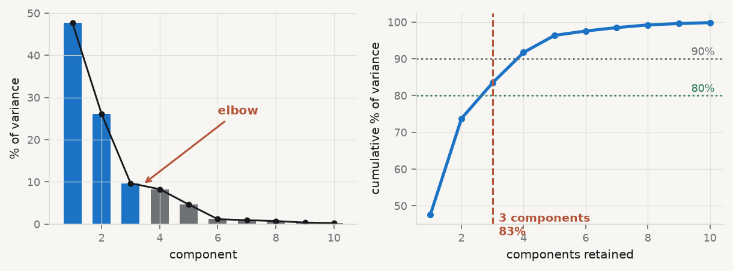
The scree plot, and its elbow

Slide 21
Thirteen standardised indicators. Three components carry 83% of the total variance; the fourth adds eight more, and everything after it is under five.

Slide 22
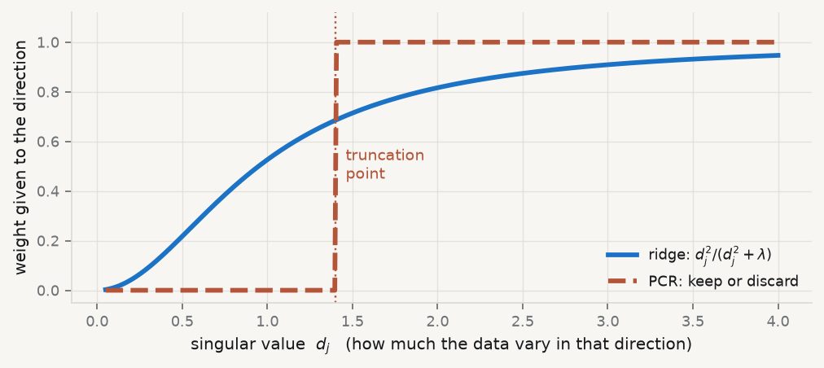
Ridge damps; PCA truncates

Slide 23
Same basis, different rule. Ridge applies a smooth weight; principal components regression applies a step function. Principal components regression is a hard-thresholded ridge.

Slide 24
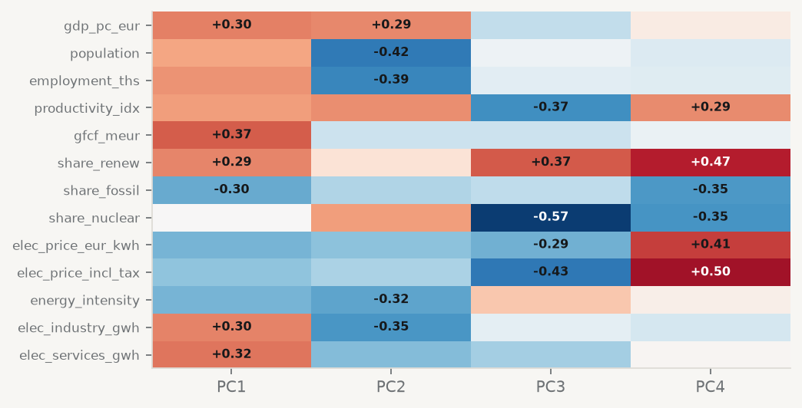
The loadings tell you what a factor is

Slide 25
Read down a column: which series move together. That is all a factor is — a weighted average of series that happen to co-move.

Slide 26
4 · Why more series helps

Slide 27
The approximate factor model
Stock and Watson: a large macro panel is a few common shocks plus idiosyncratic noise.
$$X_{it}=λ_{i}^{⊤}F_{t}+e_{it}, i=1,…,N; t=1,…,T$$
$F_{t}∈R^{r}$ are the common factors; $λ_{i}$ the loadings. The approximate version (Chamberlain–Rothschild) allows weak cross-sectional and serial correlation in $e_{it}$ — which is what makes it usable on real data.

Slide 28
The result that should surprise you
The principal-component estimator ${\hat{F}}_{t}$ is consistent for the space spanned by $F_{t}$ as both $N→∞$ and $T→∞$, at rate $min\left(\sqrt{N},\sqrt{T}\right)$.
And if $\sqrt{T}/N→0$, the estimated factors can be treated as known in a second-stage regression. The generated-regressor problem simply vanishes.
More series genuinely helps. That is the opposite of everything Sessions 05 and 06 taught you. Why?

Slide 29
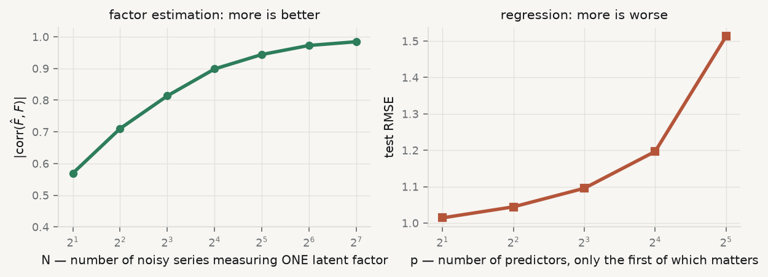
Both effects, side by side

Slide 30
Left: each extra series is another measurement of the same thing, so its noise averages away. Right: each extra predictor is another free parameter, so its noise is fitted.

Slide 31
Say the distinction out loud
Sessions 05–06: an extra column is an extra coefficient to estimate. Variance goes up.
Session 08: an extra column is an extra noisy reading of a latent quantity. Averaging drives its noise down like $1/\sqrt{N}$.
Same table, opposite conclusion — because the object being estimated is different. This is the best question of the semester, and the answer is “what are you estimating?”

Slide 32
Normalisation is a choice, not a discovery
To pin down the rotation we impose $F^{⊤}F/T=I_{r}$ and $Λ^{⊤}Λ$ diagonal.
Factors are identified only up to rotation. So “Factor 1 is the business cycle” is an interpretation you are offering, never an estimate you have produced.
Write that caveat into your paper before you write the interpretation. A referee who finds the interpretation without the caveat will not read further.

Slide 33
5 · How many factors?

Slide 34
Four answers, and they will disagree
Scree plot — look for the elbow. Informal, often ambiguous
Cumulative variance — retain 80–90%. Arbitrary but transparent
Bai–Ng information criteria — $IC_{p1},IC_{p2},IC_{p3}$, with penalties that must vanish slower than $min{\left(N,T\right)}^{−1}$
Ahn–Horenstein eigenvalue ratio — $\hat{r}=arg\max_{k}d_{k}/d_{k+1}$
$$IC_{p1}\left(k\right)=logV\left(k,{\hat{F}}^{k}\right)+k\left(\frac{N+T}{NT}\right)log\left(\frac{NT}{N+T}\right)$$

Slide 35
Compute all of them and look
N_, T_p = NIND, NOBS # N series, T observations def V(k): """Average residual sum of squares from a k-factor fit.""" return ((Z - reconstruct(k))**2).mean() c = (N_ + T_p) / (N_ * T_p) ks = np.arange(1, 9) ic1 = [np.log(V(k)) + k * c * np.log(1 / c) for k in ks] ic2 = [np.log(V(k)) + k * c * np.log(min(N_, T_p)) for k in ks] ic3 = [np.log(V(k)) + k * np.log(min(N_, T_p)) / min(N_, T_p) for k in ks] ahr = [D[k - 1] / D[k] for k in ks] print(f"N = {N_} series, T = {T_p} observations") print(f"Bai-Ng IC_p1 minimised at k = {ks[int(np.argmin(ic1))]}" f" Ahn-Horenstein argmax at k = {ks[int(np.argmax(ahr))]}") print(f"cumulative variance: 3 components = {np.cumsum(VAR)[2]:.1%}")
N = 13 series, T = 239 observations Bai-Ng IC_p1 minimised at k = 8 Ahn-Horenstein argmax at k = 5 cumulative variance: 3 components = 83.4%

Slide 36
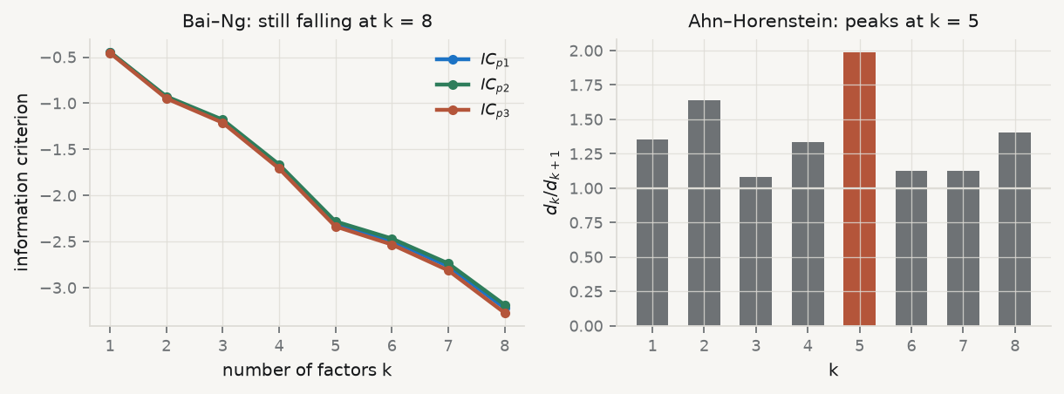
Look at what happened

Slide 37
Scree says 3. Cumulative variance says 3. Ahn–Horenstein says 5. Bai–Ng is still falling at 8.

Slide 38
Why Bai–Ng failed here, and what to do
Bai–Ng is consistent as both $N$ and $T$ grow. We have $T=239$ observations but only $N=13$ series. The penalty $\frac{N+T}{NT}log\frac{NT}{N+T}$ is tiny when $N$ is small, so it never bites.
Which is not a failure of the criterion. It is the criterion telling you your panel is not wide enough for it. Report all four numbers, say they disagree, and say which one your $N$ and $T$ support.
What loses marks: reporting one criterion, the one that gave the number you wanted.

Slide 39
6 · Diffusion-index forecasting

Slide 40
Two stages
1. Extract ${\hat{F}}_{t}$ by PCA from the standardised, stationary panel of $N$ series.
2. Forecast the target with a small regression on the factors and a few own lags:
$${\hat{y}}_{t+h}=\hat{α}+\sum_{j=1}^{r}{{\hat{β}}_{j}}{\hat{F}}_{jt}+\sum_{ℓ=0}^{L}{{\hat{γ}}_{ℓ}} y_{t−ℓ}$$
Two hundred series enter stage 1. Three numbers leave it. Stage 2 is an ordinary regression you already know how to diagnose.

Slide 41
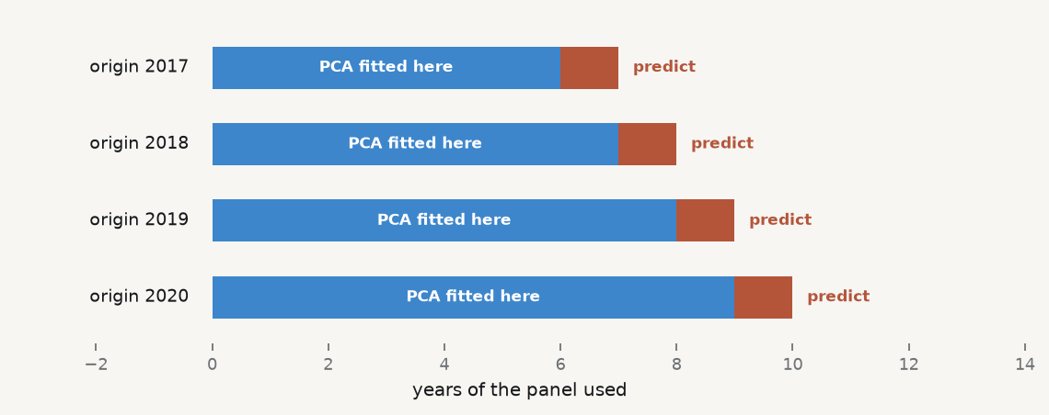
The rule you must not break

Slide 42
Factors must be re-estimated at every forecast origin, from data available at that time. Extracting from the full sample and then backtesting is look-ahead bias, and it is the single most common flaw in student factor-model projects.

Slide 43
Measure the leak on our panel
def diffusion_rmse(target, R=3, leaky=False, first=6): dd = panel.copy() dd["yn"] = dd.groupby("geo")[target].shift(-1) dd = dd.dropna(subset=["yn"]) if leaky: # WRONG: PCA sees the whole sample Zf = (dd[IND] - dd[IND].mean()) / dd[IND].std() Fall = PCA(n_components=R).fit_transform(Zf) num = den = 0 for t in sorted(dd.time.unique())[first:]: tr, te = (dd.time < t).to_numpy(), (dd.time == t).to_numpy() if leaky: Ftr, Fte = Fall[tr], Fall[te] else: # RIGHT: refit PCA on the past only mu, sd = dd.loc[tr, IND].mean(), dd.loc[tr, IND].std() p = PCA(n_components=R).fit((dd.loc[tr, IND] - mu) / sd) Ftr = p.transform((dd.loc[tr, IND] - mu) / sd) Fte = p.transform((dd.loc[te, IND] - mu) / sd) b = LinearRegression().fit(Ftr, dd.loc[tr, "yn"]) num += ((dd.loc[te, "yn"] - b.predict(Fte))**2).sum(); den += te.sum() return np.sqrt(num / den) lk = diffusion_rmse("elec_price_eur_kwh", leaky=True) hn = diffusion_rmse("elec_price_eur_kwh", leaky=False) print(f"factors from the full sample : RMSE {lk:.4f}") print(f"factors refitted each origin : RMSE {hn:.4f} ratio {lk/hn:.3f}")
factors from the full sample : RMSE 0.0290 factors refitted each origin : RMSE 0.0285 ratio 1.019

Slide 44
Be honest about that number
On this panel the leak buys about 2%. The factor space is stable across thirteen years, so knowing the future rotation tells you almost nothing.
That is not a licence. You cannot know in advance whether the leak is worth 2% or 40% — and it is 40% exactly when the factor structure shifts, which is the case you most want to forecast.
The discipline is justified by the fact that you cannot audit it after the fact, not by the size of the measured gap on one dataset.

Slide 45
7 · Takeaways

Slide 46
Key takeaways
PCA is the solution to a constrained maximisation — hence eigenvectors, hence the SVD
Eckart–Young says truncation is optimal, and names what you discarded
Ridge damps the small-$d_{j}$ directions; PCR truncates them. Same basis
More series help factor estimation because each is another reading of one object
Factors are identified only up to rotation — interpretation is a claim, not an estimate
Re-estimate factors at every forecast origin. Every time

Slide 47
What loses marks
Running PCA on unstandardised columns
Naming a factor (“this is the business cycle”) without the rotation caveat
Reporting one factor-count criterion out of four
Extracting factors once on the full sample, then backtesting
Reporting “80% of variance explained” as if 80% were a rule rather than a choice

Slide 48
Now, the practice
Ninety minutes, in your groups. You will extract factors from a wide panel, defend the number you retained against at least three criteria, and build a diffusion-index forecast whose factors are re-estimated at every origin.
Notes: 01-lecture/README.md · practice brief: 02-practice/README.md

