Slide 1
Clustering, Embeddings, and Text as Data
Session 09 · Lecture, first half Thierry Warin

Slide 2
How do you measure something that only exists as words?

Slide 3
Outline
1 | The warning that comes first
2 | k-means: the objective and the algorithm
3 | What the algorithm assumes
4 | Hierarchical clustering
5 | Choosing $k$
6 | Representing text
7 | Validity — the part that is actually hard

Slide 4
Learning objectives
State the k-means objective and prove that Lloyd’s algorithm converges — and to what
Draw the Voronoi tessellation and say which cluster shapes it cannot find
Compute a silhouette by hand and read its sign
Build a TF-IDF matrix and say what word order costs you
Apply four validity criteria to a text-derived index, and actually read the documents

Slide 5
1 · Start with the warning

Slide 6
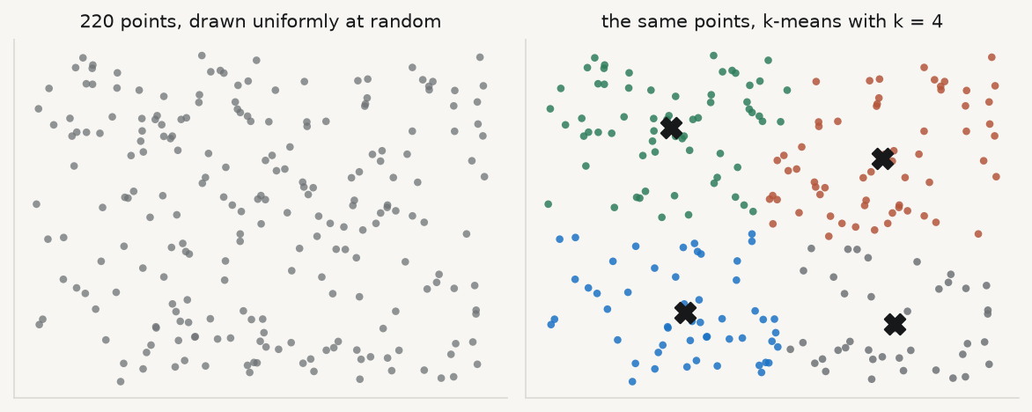
Four clusters. What do they mean?

Slide 7
There is no structure in that data. There cannot be — it is uniform noise. Every clustering algorithm returns clusters, including on noise.

Slide 8
So the burden of proof is yours
A supervised model can be wrong in a way the test set exposes. An unsupervised model cannot. There is no held-out label to contradict you.
The algorithm will always return an answer
The answer will always look convincing when plotted
Nothing in the output tells you whether the structure exists
Everything in this session is therefore about evidence, not about algorithms. The algorithms are twenty lines each.

Slide 9
2 · k-means

Slide 10
The objective
minC1,…,Ck j=1ki∈Cj​∥xi−μj∥2, μj=1Cji∈Cj​xi
This problem is NP-hard. You are not going to solve it. You are going to find a local minimum and be honest about that.

Slide 11
Lloyd’s algorithm
1 · Assign. $c_{i}←arg\min_{j}∥x_{i}−μ_{j}∥^{2}$ — each point to its nearest centroid.
2 · Update. $μ_{j}←$ the mean of the points now assigned to $j$.
Step 2 is optimal given the assignments (differentiate the objective in $μ_{j}$, set to zero — the answer is the mean). Step 1 is optimal given the centroids. So the objective decreases monotonically, and there are finitely many partitions. Hence it terminates.

Slide 12
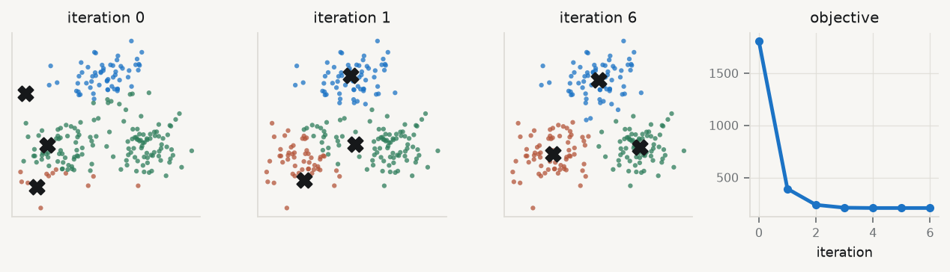
Watch it converge

Slide 13
Monotone decrease, then a flat line. The flat line is convergence; it is not optimality.

Slide 14
Local minima are the normal case
Different starts give different answers. Not slightly different — structurally different, with different cluster counts in each group.
Run it many times from different starts: n_init=20, not the default
Or use k-means++, which seeds centroids with probability proportional to squared distance from the nearest existing centroid
k-means++ is $O\left(logk\right)$-competitive in expectation — a guarantee about the average, not about your run
Report the number of restarts. A clustering from one restart is not a result.

Slide 15
3 · What the algorithm assumes

Slide 16
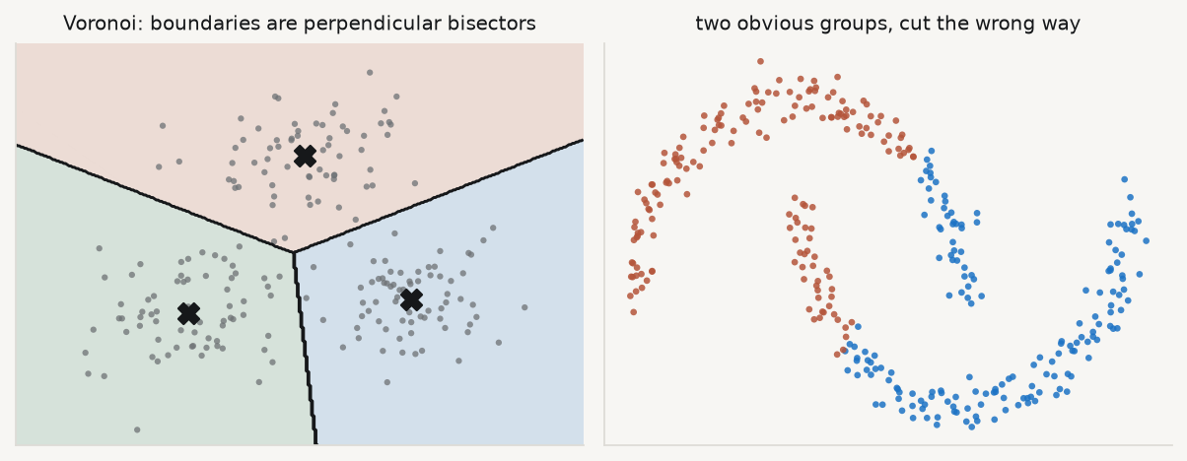
Nearest-centroid means straight boundaries

Slide 17
The right-hand panel is not a tuning failure. No value of n_init fixes it. The objective itself forbids the correct answer.

Slide 18
Say precisely what is assumed
Because clusters are defined by nearest centroid, the boundaries are perpendicular bisectors — a Voronoi tessellation. That forces clusters that are convex, roughly spherical, and of similar size.
Elongated or nested structures will be cut incorrectly no matter how well you optimise
Gaussian mixture (EM): allows covariance structure, gives soft assignments
DBSCAN / spectral clustering: for non-convex shapes
Those shapes are forced by the algorithm, not discovered in the data. Say which you are doing.

Slide 19
4 · Hierarchical clustering

Slide 20
Merge upward instead of partitioning
Linkage | $d\left(A,B\right)$ | Behaviour
Single | $\min_{a,b}∥a−b∥$ | chaining; elongated shapes; unstable
Complete | $\max_{a,b}∥a−b∥$ | compact, similar-diameter clusters
Average | mean pairwise distance | compromise; not transform-invariant
Ward | increase in within-cluster SS | minimises the k-means criterion — try this first
Start with every point its own cluster; repeatedly merge the two closest. The linkage function defines “closest”:

Slide 21
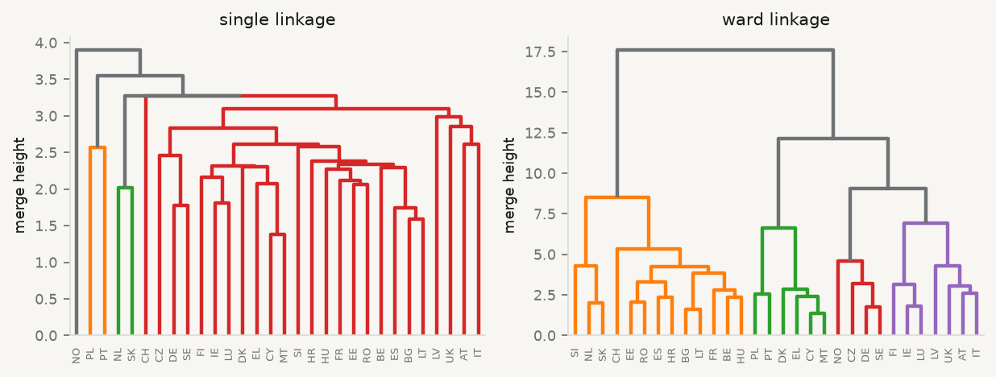
Linkage is not a detail

Slide 22
Thirty European countries, same 13 standardised indicators. Single linkage chains them into one long ladder; Ward produces balanced groups.

Slide 23
What you gain and what it costs
Gain: you need not fix $k$ in advance. The dendrogram shows structure at every resolution, and you cut it where the merge heights jump.
Cost: $O\left(n^{2}\right)$ memory. Thirty countries is free; three hundred thousand documents is not.
Ward minimises the same within-cluster sum of squares as k-means — so a Ward dendrogram cut at $k$ and a k-means run with $k$ usually agree. When they do not, look at your data, not your code.

Slide 24
5 · Choosing $k$

Slide 25
Three criteria
Elbow — plot within-cluster SS against $k$. It always decreases, so you are looking for a kink. Often no kink exists
Silhouette — $s_{i}=\frac{b_{i}−a_{i}}{max\left(a_{i},b_{i}\right)}$, with $a_{i}$ the mean distance to its own cluster and $b_{i}$ to the nearest other. Average over $i$, maximise over $k$
Gap statistic — compare $logW_{k}$ to its expectation under a null. It can return $k=1$, i.e. no cluster structure — which is why it is worth the extra effort

Slide 26
Silhouette, by hand
 | $a_{i}$ | $b_{i}$ | $s_{i}$ | reading
point A | $1.2$ | $2.0$ | $\left(2.0−1.2\right)/2.0=+0.40$ | comfortably in its cluster
point B | $2.0$ | $1.2$ | $\left(1.2−2.0\right)/2.0=−0.40$ | probably misassigned

Slide 27
Near $1$: well clustered. Near $0$: on a boundary. Negative: it belongs somewhere else. A clustering with many negative silhouettes is a clustering you should not report.

Slide 28
Both criteria, on our 30 countries
ks = range(2, 9) inertia, sils = [], [] for k in ks: km = KMeans(n_clusters=k, n_init=20, random_state=0).fit(ZP) inertia.append(km.inertia_) sils.append(silhouette_score(ZP, km.labels_)) print(f"elbow: within-cluster SS falls smoothly {inertia[0]:.0f} -> {inertia[-1]:.0f}, no kink") print(f"silhouette is maximised at k = {list(ks)[int(np.argmax(sils))]}" f" (score {max(sils):.3f})")
elbow: within-cluster SS falls smoothly 298 -> 98, no kink silhouette is maximised at k = 2 (score 0.287)
n_init=20 because a single restart is not a result. Every number here is the best of 20 runs.

Slide 29
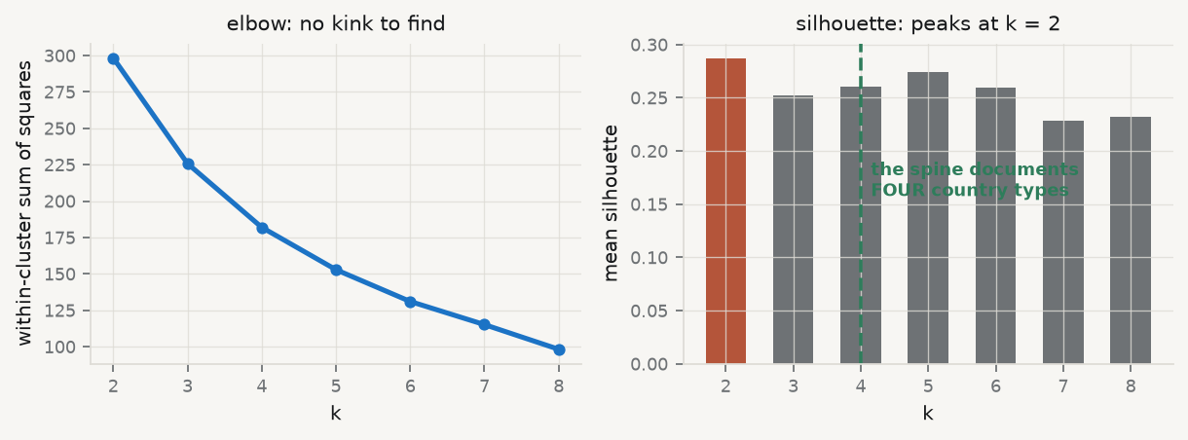
And they do not agree with the truth

Slide 30
The data-generating process has four country types. The elbow shows nothing and the silhouette prefers two. Neither criterion is an oracle.

Slide 31
What to do about that
Report at least two criteria, and report the disagreement. A single elbow plot is not evidence — it is a plot.
Say how many restarts you ran
Say which criteria you computed, including the ones that disagreed with your choice
If the gap statistic returns $k=1$, say so and stop
“We chose $k=4$ because it was interpretable” is an acceptable sentence, provided you write it. What is not acceptable is presenting it as what the data said.

Slide 32
6 · Representing text

Slide 33
Bag of words, and TF-IDF
$$tf\text{-}idf\left(t,d\right)=\underset{\text{how often }t\text{ is in }d}{\underset{⏟}{f_{t,d}}}×\underset{\text{how rare }t\text{ is overall}}{\underset{⏟}{log\frac{N}{1+n_{t}}}}$$
The idf factor downweights ubiquitous terms. A word appearing in every document carries no information about which document you are looking at.
And the cost: bag-of-words discards word order entirely. “Inflation is not a concern” and “a concern is not inflation” are the same vector.

Slide 34
Build one, on 1,980 central-bank documents
vec = TfidfVectorizer(stop_words="english", min_df=5, max_df=0.9) Xt = vec.fit_transform(docs["text"]) terms = np.array(vec.get_feature_names_out()) print(f"{Xt.shape[0]} documents x {Xt.shape[1]} terms") print(f"density: {Xt.nnz / (Xt.shape[0] * Xt.shape[1]):.1%} of cells non-zero")
1980 documents x 45 terms density: 62.4% of cells non-zero
Read that vocabulary size. Forty-five terms, and most cells filled. This corpus is synthetic. A real central-bank corpus has 10,000+ terms and is over 99% sparse — which is the $p≫n$ setting of Session 05, so penalised regression is the natural supervised tool on top of it.

Slide 35
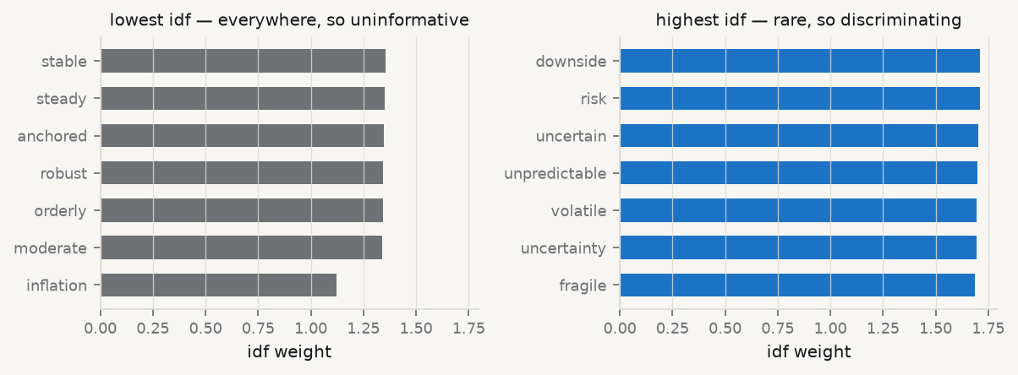
What the idf weights are doing

Slide 36
The rare words in this corpus are the anxious ones. That is a fact about the corpus, and it is about to become a finding.

Slide 37
Cluster the documents and read the result
kmt = KMeans(n_clusters=3, n_init=20, random_state=0).fit(Xt) for c in range(3): top = terms[np.argsort(kmt.cluster_centers_[c])[::-1][:7]] print(f"cluster {c} (n={(kmt.labels_ == c).sum():4d}): {', '.join(top)}") print(f"\nadjusted Rand vs document type : {adjusted_rand_score(docs.doc_type, kmt.labels_):+.3f}") print(f"adjusted Rand vs institution : {adjusted_rand_score(docs.institution, kmt.labels_):+.3f}")
cluster 0 (n= 753): inflation, robust, balanced, anchored, confidence, orderly, sustained cluster 1 (n= 826): inflation, volatile, unpredictable, tension, unclear, fragile, risks cluster 2 (n= 401): artificial, intelligence, inflation, robust, anchored, moderate, resilient adjusted Rand vs document type : -0.001 adjusted Rand vs institution : +0.000
The clusters recover tone — calm, anxious, and an AI-themed group. They recover the metadata not at all. The algorithm answered a question you did not ask.

Slide 38
Dense embeddings, and cosine
A model maps each document to $v_{d}∈R^{m}$ ($m$ typically 384–1024), trained so that semantically similar texts have similar vectors:
$$cos\left(v_{a},v_{b}\right)=\frac{v_{a}^{⊤}v_{b}}{∥v_{a}∥ ∥v_{b}∥}∈\left[−1,1\right]$$
Cosine ignores magnitude, which is what you want when documents differ in length. A 300-word speech and a 30-word release about the same thing should be close.
In the practice you generate embeddings locally. The corpus never leaves your machine — a methodological point and a governance one.

Slide 39
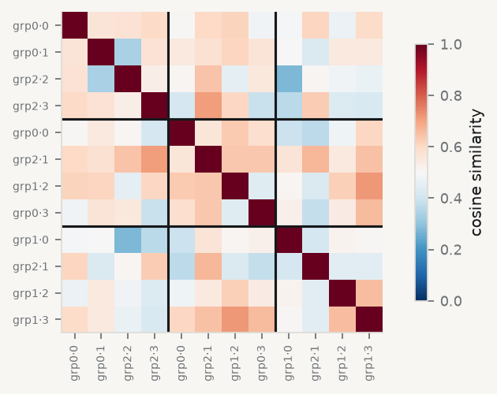
Similarity is a matrix you can look at

Slide 40
Blocks along the diagonal are documents from the same tone group. The block structure is the clustering, seen from the other side.

Slide 41
Do not assume sophistication wins
Dictionary methods — count terms from a pre-specified list — remain widely used in economics precisely because they are transparent and auditable.
An embedding-based index that nobody can interrogate may be less useful for policy than a word count anyone can check. A central banker can argue with a word list. They cannot argue with a 1,024-dimensional vector.

Slide 42
7 · Validity

Slide 43
Four questions about any text-derived measure
Face validity — read a random sample of high- and low-scoring documents. Do they look like what you claim? Do this. Actually read them.
Convergent validity — does it correlate with independent measures of the same construct?
Predictive validity — does it forecast something it should?
Robustness — does it survive changes in preprocessing, vocabulary, and model?
If your finding depends on a stemming choice, you do not have a finding.

Slide 44
Build a dictionary index, then test it
POS = {"robust", "balanced", "anchored", "confidence", "orderly", "sustained", "steady", "resilient", "stable"} NEG = {"volatile", "unpredictable", "tension", "unclear", "fragile", "risks", "risk", "uncertain", "uncertainty", "downside", "concerns", "concern"} def tone(text): """Net share of tone words, in percentage points of the document.""" w = re.findall(r"[a-z]+", text.lower()) return 100 * (sum(x in POS for x in w) - sum(x in NEG for x in w)) / max(len(w), 1) docs["tone"] = docs["text"].map(tone) by_year = docs.groupby("year")["tone"].mean() print(f"most positive year: {by_year.idxmax()} ({by_year.max():+.2f})") print(f"most negative year: {by_year.idxmin()} ({by_year.min():+.2f})")
most positive year: 2014 (+6.38) most negative year: 2022 (-3.15)
Twelve lines, no model, and every step is legible to someone who has never opened a Python file.

Slide 45
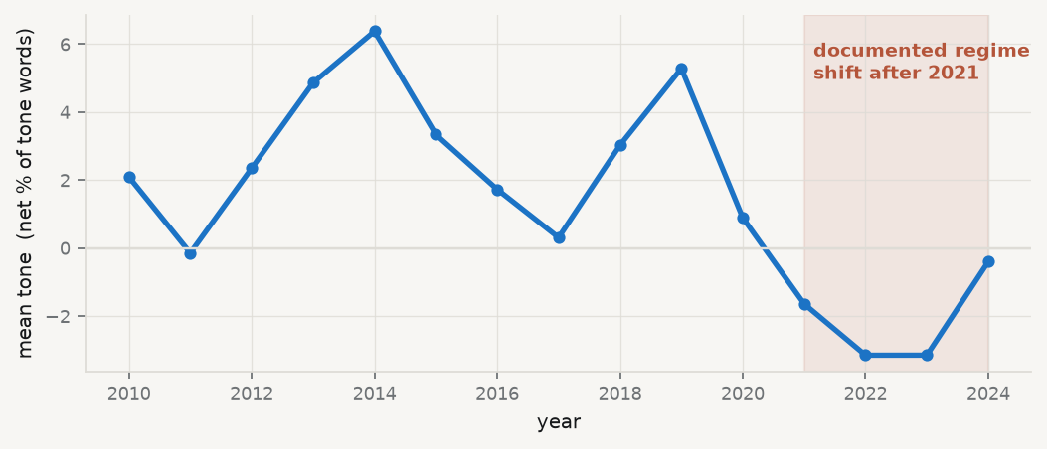
Does it behave?

Slide 46
The index turns negative exactly where the spine documents a structural break. That is predictive validity — one of four boxes, and the only one this slide ticks.

Slide 47
The three boxes still open
Face validity: nobody has read a single document. Do that before the next slide is written
Convergent validity: only 15 country-years merge onto the macro panel. A correlation on $n=15$ is not evidence, and reporting it as such is worse than reporting nothing
Robustness: swap stable out of the positive list and rerun. If the story moves, the story was the word list
The seductive part of text-as-data is that you always get a number. The number is the easy part.

Slide 48
Takeaways

Slide 49
Key takeaways
Every clustering algorithm returns clusters, including on noise
Lloyd’s algorithm converges — to a local minimum. Report your restarts
k-means forces convex, similar-sized clusters. That is an assumption, not a finding
Ward linkage minimises the k-means criterion, without fixing $k$ in advance
Report at least two criteria for $k$, and report the disagreement
TF-IDF is the $p≫n$ setting again. Word order is gone
Validity is four questions, and the first one is read the documents

Slide 50
What loses marks
One restart, one elbow plot, one $k$
Naming clusters (“this is the periphery”) without showing what distinguishes them
Reporting a clustering without saying whether the shapes were plausible
A text index with no face-validity check
A correlation on 15 observations, offered as convergent validity

Slide 51
Now, the practice
Ninety minutes, in your groups. You will cluster a corpus, defend your $k$ against at least two criteria, build a text-derived index — and then spend the last half hour trying to break it.
Notes: 01-lecture/README.md · practice brief: 02-practice/README.md

