Slide 1
Causal Machine Learning: Double/Debiased ML
Session 10 · Lecture, first half Thierry Warin

Slide 2
You have a superb predictive model. Why can you still not use it to choose a policy?

Slide 3
Outline
1 | Where we are, and what this adds
2 | The setup, and what identification requires
3 | Why the naive plug-in fails
4 | Fix 1 — Neyman orthogonality
5 | Fix 2 — cross-fitting
6 | Heterogeneous effects
7 | What this does not fix

Slide 4
Learning objectives
State the partially linear model and name the nuisance functions
Decompose the naive estimator’s error into regularisation and overfitting bias
Explain why an orthogonal score turns two slow rates into one fast enough one
Implement cross-fitting, and say precisely which bias it removes
Report a heterogeneous effect without doing undisclosed multiple testing

Slide 5
1 · What this adds

Slide 6
Sessions 05–09 gave you prediction
Session | What you can now do
05 | fit well with more predictors than rows
06–07 | classify, and fit arbitrary non-linear surfaces
08–09 | compress and cluster without an outcome at all

Slide 7
And none of it answers the only question a minister ever asks: if we do this, what happens?

Slide 8
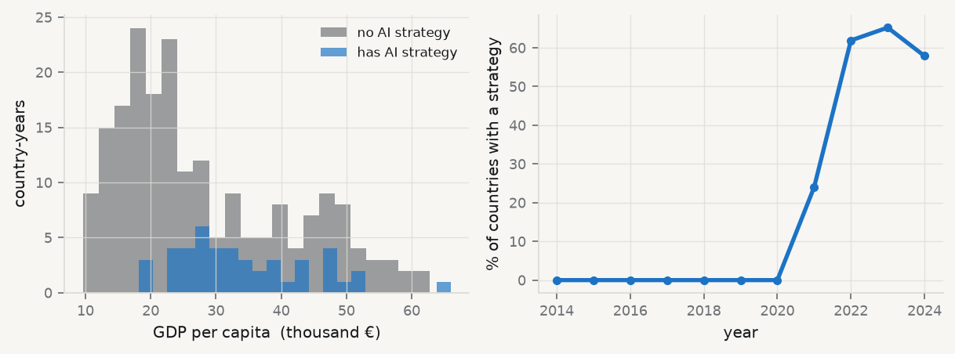
The gap, made concrete

Slide 9
Countries that adopt AI strategies are richer, and they adopt later. Treatment is not random, and no amount of predictive accuracy repairs that.

Slide 10
The number this produces
print(f"mean digital intensity, has strategy : {Yr[Dr==1].mean():6.2f}") print(f"mean digital intensity, no strategy : {Yr[Dr==0].mean():6.2f}") print(f"naive difference in means : {NAIVE:+6.2f} points")
mean digital intensity, has strategy : 56.07 mean digital intensity, no strategy : 45.62 naive difference in means : +10.45 points
Ten points. If you publish that as the effect of adopting a national AI strategy, you have published the difference between rich and poor countries wearing a policy label.

Slide 11
What today adds
A way to use the flexible learners of Sessions 05–07 for the nuisance parts of a causal question, while keeping the valid confidence interval of Session 03.
This is the reconciliation of the two halves of the course. Everything before Session 05 had honest inference and rigid functional form; everything after had flexible fit and no inference. Today they meet.

Slide 12
2 · The setup

Slide 13
The partially linear model
$$Y=θ_{0}D+g_{0}\left(X\right)+U, E\left[U∣X,D\right]=0$$
$$D=m_{0}\left(X\right)+V, E\left[V∣X\right]=0$$
$θ_{0}$ is what you want. $g_{0}$ and $m_{0}$ are nuisance functions — you do not care about them, but you cannot avoid them.
Classical econometrics assumes $g_{0}$ is linear. DML’s premise is that you would rather estimate it flexibly — because functional-form error in $g_{0}$ contaminates $θ_{0}$.

Slide 14
Identification requires three things
Conditional ignorability — $\{Y\left(1\right),Y\left(0\right)\}⟂D∣X$
Overlap — $0<P\left(D=1∣X\right)<1$ almost surely
SUTVA — no interference between units, one version of treatment
No amount of machine learning substitutes for these. They are assumptions about the world, defended with institutional knowledge — not with cross-validation.

Slide 15
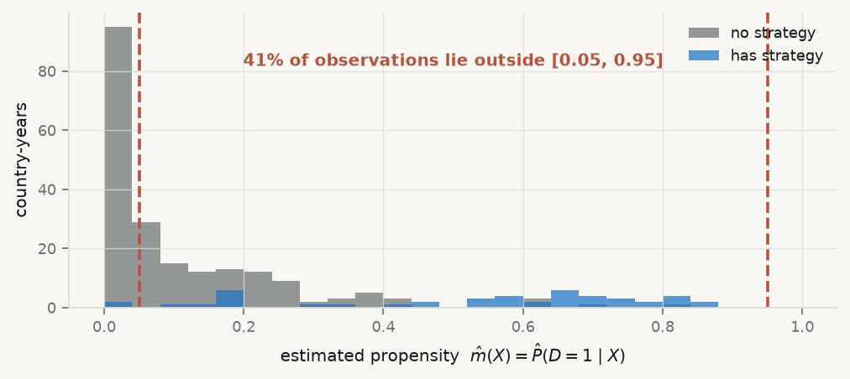
Check overlap before anything else

Slide 16
Two in five observations have almost no counterpart in the other arm. For those countries the data contain no comparison, and any estimate is extrapolation.

Slide 17
3 · Why the naive plug-in fails

Slide 18
The obvious thing to do, and why it breaks
Estimate ${\hat{g}}_{0}$ with a lasso or a forest on the full sample, then regress $Y−{\hat{g}}_{0}\left(X\right)$ on $D$. Decomposing the error:
$$\sqrt{n}\left(\hat{θ}−θ_{0}\right)=\underset{→ N\left(0,Σ\right)}{\underset{⏟}{a}}+\underset{\text{regularisation bias}}{\underset{⏟}{b}}+\underset{\text{overfitting bias}}{\underset{⏟}{c}}$$
$b$ scales like $\sqrt{n}×∥{\hat{g}}_{0}−g_{0}∥$. ML estimators converge slower than $n^{−1/2}$ — that is the price of flexibility — so $b$ diverges
$c$ arises because ${\hat{g}}_{0}$ was fitted on the same observations where it is evaluated
Two distinct problems. Two distinct fixes.

Slide 19
Watch it happen, with $θ_{0}$ known
THETA = 0.5 def simulate(n=300, p=20, seed=0): """Partially linear model with a genuinely non-linear g0 and m0.""" rng = np.random.default_rng(seed) X = rng.normal(size=(n, p)) g = np.exp(X[:, 0]) / (1 + np.exp(X[:, 0])) + 0.25 * np.cos(X[:, 1]) * X[:, 2] m = 0.8 * X[:, 0] + 0.25 * np.sin(X[:, 1]) D = m + rng.normal(0, 1, n) Y = THETA * D + g + rng.normal(0, 1, n) return X, D, Y def forest(): return RandomForestRegressor(60, min_samples_leaf=2, random_state=0, n_jobs=-1) def estimate(X, D, Y, mode): n = len(Y) if mode == "naive": # regress Y - ghat(X) on D return (D @ (Y - forest().fit(X, Y).predict(X))) / (D @ D) if mode == "orthogonal": # residualise BOTH, same sample ty = Y - forest().fit(X, Y).predict(X) td = D - forest().fit(X, D).predict(X) else: # residualise BOTH, cross-fitted ty, td = np.zeros(n), np.zeros(n) for tr, te in KFold(5, shuffle=True, random_state=1).split(X): ty[te] = Y[te] - forest().fit(X[tr], Y[tr]).predict(X[te]) td[te] = D[te] - forest().fit(X[tr], D[tr]).predict(X[te]) return (td @ ty) / (td @ td)

Slide 20
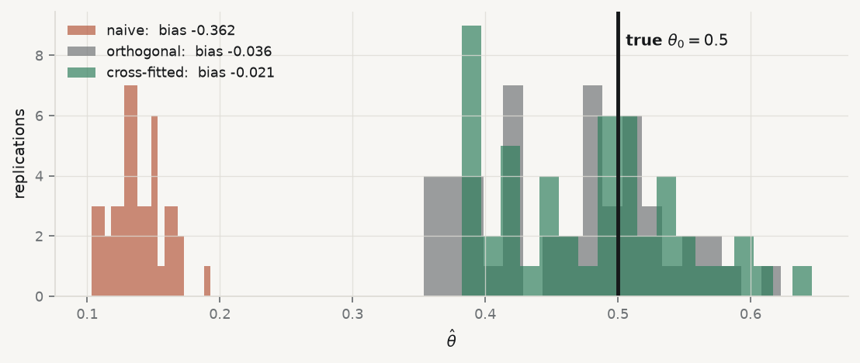
Fifty replications, three estimators

Slide 21
The naive estimator misses by more than half the true effect, and its spread is narrow — it is confidently wrong. A tight confidence interval around it would be worse than no estimate.

Slide 22
4 · Fix 1 — orthogonality

Slide 23
Use a different score
$$ψ\left(W;θ,η\right)=\left(Y−ℓ_{0}\left(X\right)−θ\left(D−m_{0}\left(X\right)\right)\right)\left(D−m_{0}\left(X\right)\right)$$
with $η=\left(ℓ_{0},m_{0}\right)$, $ℓ_{0}\left(X\right)=E\left[Y∣X\right]$, $m_{0}\left(X\right)=E\left[D∣X\right]$. Solving $E\left[ψ\right]=0$:
$$θ_{0}=\frac{E\left[\left(Y−ℓ_{0}\left(X\right)\right)\left(D−m_{0}\left(X\right)\right)\right]}{E\left[{\left(D−m_{0}\left(X\right)\right)}^{2}\right]}=\frac{Cov\left(\tilde{Y},\tilde{D}\right)}{Var\left(\tilde{D}\right)}$$
That is exactly Frisch–Waugh–Lovell from Session 02: regress residualised $Y$ on residualised $D$. The only change is that the residualising is done by a forest instead of a projection matrix.

Slide 24
What “orthogonal” means
The directional derivative of $E\left[ψ\right]$ with respect to the nuisance, at the truth, is zero:
$$∂_{η} E\left[ψ\left(W;θ_{0},η_{0}\right)\right]\left[η−η_{0}\right]=0$$
So a small error in $\hat{η}$ has only a second-order effect on $\hat{θ}$. The bias term becomes
$$\sqrt{n}×∥\hat{ℓ}−ℓ_{0}∥×∥\hat{m}−m_{0}∥$$

Slide 25
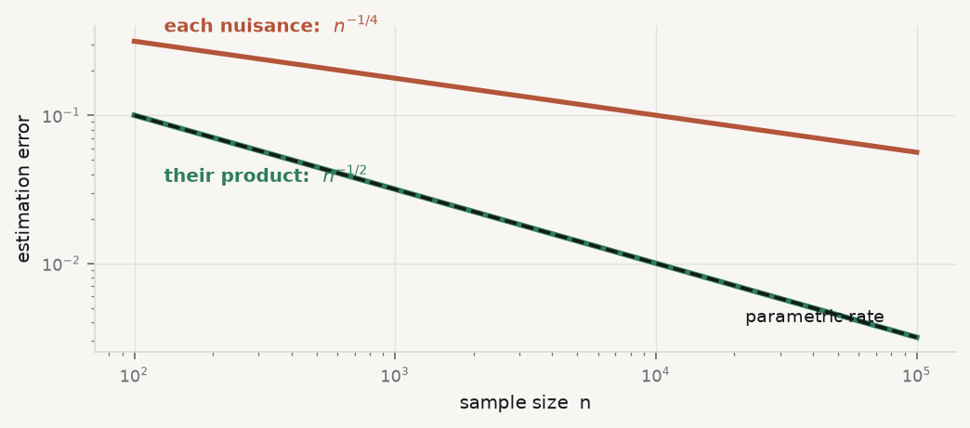
Two slow rates multiply into a fast one

Slide 26
Neither nuisance need converge at $n^{−1/2}$. Each need only beat $n^{−1/4}$ — a rate lasso, forests and boosting achieve under reasonable conditions. Two slow rates multiply into one fast enough rate. That is why it is called double.

Slide 27
5 · Fix 2 — cross-fitting

Slide 28
The remaining bias, and the split that removes it
Term $c$ exists because $\hat{ℓ}$ and $\hat{m}$ were fitted using the very observations at which they are then evaluated. That correlates the estimated nuisance with the residual.
The fix is the one you already know from Session 04: never evaluate a fit on data it was fitted on. Here it is applied to the nuisance step.

Slide 29
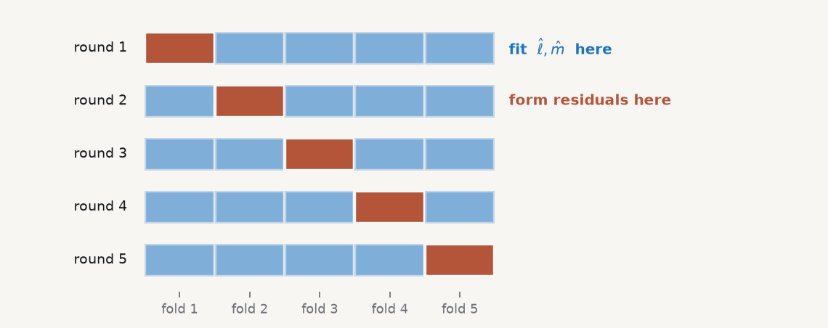
The procedure, drawn

Slide 30
Every observation gets a residual, and no observation’s residual used a nuisance fitted on itself.

Slide 31
Then pool, and get a standard error
θ=i​YiDii​Di2, σ2=1ni​Di2Yi−θDi2(1ni​Di2)2
Result: $\sqrt{n}\left(\hat{θ}−θ_{0}\right)→N\left(0,σ^{2}\right)$. Ordinary confidence intervals are valid — despite black-box learners in the nuisance step. That is the whole point of the session.
Repeat over several random splits and take the median of $\hat{θ}$, to remove split sensitivity.

Slide 32
Now do it on the real question
def dml_real(seed, K=5): n = len(Yr); ty, td = np.zeros(n), np.zeros(n) for tr, te in KFold(K, shuffle=True, random_state=seed).split(Xr): ty[te] = Yr[te] - RandomForestRegressor(300, min_samples_leaf=5, random_state=0, n_jobs=-1).fit(Xr[tr], Yr[tr]).predict(Xr[te]) td[te] = Dr[te] - RandomForestClassifier(300, min_samples_leaf=5, random_state=0, n_jobs=-1).fit(Xr[tr], Dr[tr]).predict_proba(Xr[te])[:, 1] th = (td @ ty) / (td @ td) se = np.sqrt(np.mean(td**2 * (ty - th * td)**2)) / (np.mean(td**2) * np.sqrt(n)) return th, se, ty, td runs = [dml_real(s) for s in (1, 2, 3, 4, 5)] TH = float(np.median([r[0] for r in runs])) SE = float(np.median([r[1] for r in runs])) ols = sm.OLS(Yr, sm.add_constant(np.c_[Dr, Xr])).fit() print(f"naive difference in means : {NAIVE:+6.2f}") print(f"OLS, linear controls : {ols.params[1]:+6.2f} (se {ols.bse[1]:.2f})") print(f"DML, cross-fitted forests : {TH:+6.2f} (se {SE:.2f})" f" 95% CI [{TH-1.96*SE:+.2f}, {TH+1.96*SE:+.2f}]")
naive difference in means : +10.45 OLS, linear controls : -0.10 (se 1.27) DML, cross-fitted forests : -0.61 (se 1.49) 95% CI [-3.54, +2.31]

Slide 33
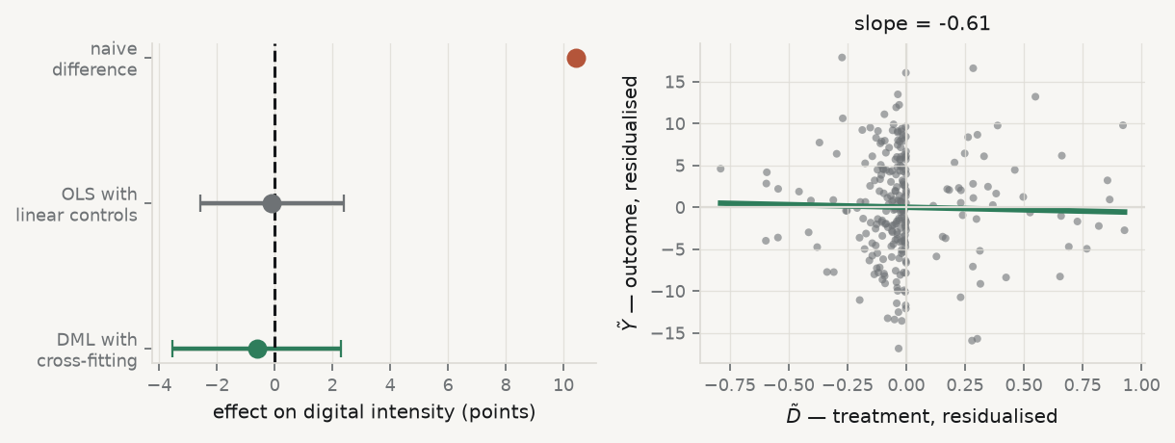
The three answers, side by side

Slide 34
Ten points becomes indistinguishable from zero. The right-hand panel is the whole estimate: one slope, through residualised data — Session 02’s FWL picture, with forests doing the residualising.

Slide 35
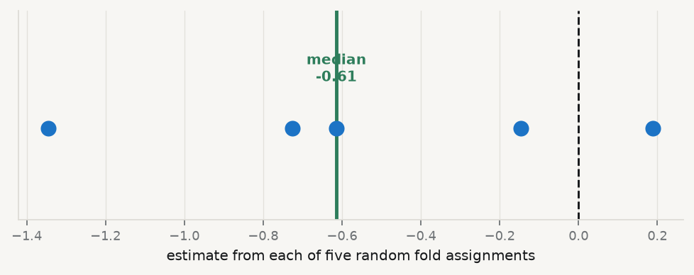
Why the median over splits

Slide 36
The same data, the same code, five different random fold assignments — and estimates that differ by more than a point. Report the median across splits, and report the spread.

Slide 37
6 · Heterogeneous effects

Slide 38
The question is often for whom
$$τ\left(x\right)=E\left[Y\left(1\right)−Y\left(0\right)∣X=x\right]$$
Causal forests (Wager & Athey) adapt random forests in three ways:
Splits maximise heterogeneity in the treatment effect, not in the outcome
Honesty — the observations that choose the splits are disjoint from those that estimate the leaf effects
The estimator is asymptotically normal and pointwise consistent, so confidence intervals exist
Point 2 is Session 04’s discipline again, moved inside the tree.

Slide 39
The discipline that must come with it
Searching over subgroups for large effects is multiple testing, and it will find something. With twenty subgroups and a 5% test, one significant result is the expected outcome under no effect at all.
Pre-specify subgroups wherever possible
Otherwise report the best linear projection of $\hat{τ}\left(X\right)$ on a small covariate set
Or use a calibration test — the GATES / CLAN procedures of Chernozhukov et al.
And label the whole section exploratory

Slide 40
7 · What this does not fix

Slide 41
Read this slide twice
DML delivers valid inference conditional on the identifying assumptions. If treatment is confounded by something not in $X$, DML estimates a precisely-quantified wrong number — and its narrow confidence interval will make the wrong number look authoritative.
Flexible nuisance estimation removes functional-form error. It does not remove omitted-variable bias. Session 03’s OVB formula still governs everything:
$${\hat{β}}_{\text{short}}→β_{\text{long}}+γ δ$$

Slide 42
Which means the hard part is not the code
The code is thirty lines and you have just read all of them
The argument — why $X$ contains everything that drives both $D$ and $Y$ — is the paper
That argument is made with institutional knowledge, not with cross-validation
On our own example, 41% of observations failed the overlap check. That fact belongs in the abstract, not in a footnote.

Slide 43
Takeaways

Slide 44
Key takeaways
Prediction accuracy and causal validity are different properties. One does not imply the other
The naive plug-in has two biases: regularisation ($b$) and overfitting ($c$)
An orthogonal score kills $b$ — errors in the nuisance become second-order
Cross-fitting kills $c$ — never evaluate a fit on its own training rows
Two $n^{−1/4}$ rates multiply into $n^{−1/2}$. Hence double
Heterogeneity searching is multiple testing. Pre-specify or label it exploratory
None of this identifies anything. The assumptions do that

Slide 45
What loses marks
Reporting a DML estimate with no overlap diagnostic
Fitting nuisances on the full sample (that is the naive plug-in, with extra steps)
Reporting one fold assignment instead of the median over several
Presenting a subgroup effect found by searching, without saying you searched
Any sentence of the form “the model shows that $X$ causes $Y$”

Slide 46
Now, the practice
Ninety minutes, in your groups. You will estimate one treatment effect three ways — naive, linear controls, and cross-fitted DML — check overlap first, and write the paragraph defending conditional ignorability. That paragraph carries the marks.
Notes: 01-lecture/README.md · practice brief: 02-practice/README.md

