Slide 1
Forecasting, Distribution Shift, and Model Governance
Session 11 · Lecture, first half Thierry Warin

Slide 2
What are you responsible for when someone acts on your model?

Slide 3
Outline
1 | Backtesting when time matters
2 | Comparing forecasts honestly
3 | Distribution shift
4 | Goodhart’s law, stated precisely
5 | Model governance
6 | The arc of the course
7 | Back to Europe 2031

Slide 4
Learning objectives
Choose among expanding, fixed-window and purged blocked designs, and say why
Compare against a benchmark with a Diebold–Mariano statistic, not an eyeball
Detect covariate shift with a classifier — and interpret the number against a placebo
Distinguish covariate shift, label shift, concept drift and feedback
Write a governance file a competent successor could act on

Slide 5
1 · Backtesting

Slide 6
Random K-fold is invalid here, and you know why
Session 04 established it: when observations are ordered in time, a random fold puts the future in the training set. The error you measure is not the error you will get.
Three valid designs, each answering a different question:
Expanding window — train on $1..t$, predict $t+h$. Uses all history; training size grows, so early and late errors are not comparable
Fixed window — train on $t−w..t$. Constant size; adapts to structural change; discards old information
Blocked, with purge and embargo — leave a gap of at least $h$ between train and test

Slide 7
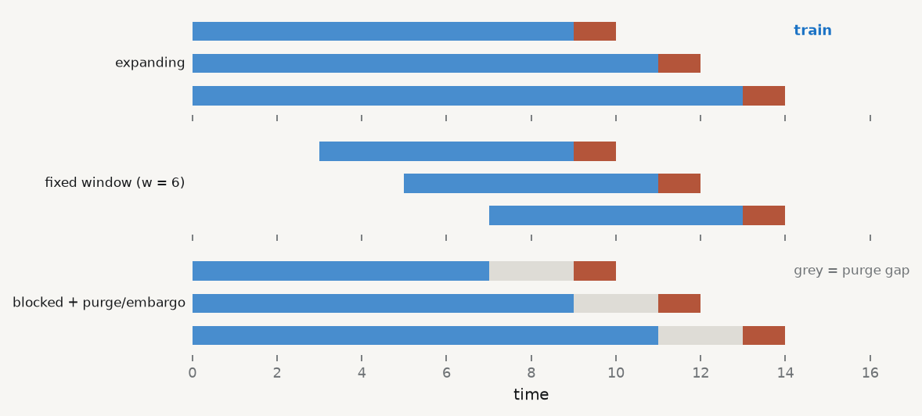
The three designs, drawn

Slide 8
Blue: training. Red: the origin being predicted. Grey: the purge gap — essential whenever features are built from rolling windows, because those windows straddle the boundary.

Slide 9
Two rules that are violated constantly
1 · Point-in-time data. Macroeconomic series are revised. A backtest using today’s vintage of GDP gives your model information no forecaster had at the time.
Use real-time vintages — ALFRED, the Philadelphia Fed real-time dataset — or state clearly that you have not.
2 · Everything inside the loop. Standardisation, factor extraction (Session 08), feature selection, hyperparameter choice. Every one of them. Every origin.

Slide 10
Run it, three ways
def backtest(window=None, first=6): """One row per predicted country-year, with the model's error and the benchmark's.""" out = [] for t in YEARS[first:]: tr = (d.time < t) if window is None else ((d.time < t) & (d.time >= t - window)) te = (d.time == t) if tr.sum() < 30 or te.sum() == 0: continue f = (RandomForestRegressor(200, min_samples_leaf=3, random_state=0, n_jobs=-1) .fit(d.loc[tr, FEAT], d.loc[tr, "y_next"]).predict(d.loc[te, FEAT])) truth = d.loc[te, "y_next"].to_numpy() out.append(pd.DataFrame({"time": t, "e_model": truth - f, "e_rw": truth - d.loc[te, TGT].to_numpy()})) # random walk return pd.concat(out, ignore_index=True) rmse = lambda e: np.sqrt((e ** 2).mean()) for name, w in [("expanding", None), ("fixed 5y", 5), ("fixed 8y", 8)]: r = backtest(w) print(f"{name:10s} model RMSE {rmse(r.e_model):.4f} random walk {rmse(r.e_rw):.4f}")
expanding model RMSE 0.0287 random walk 0.0283 fixed 5y model RMSE 0.0285 random walk 0.0283 fixed 8y model RMSE 0.0290 random walk 0.0283
Read the second column. The random walk wins. Thirteen features, two hundred trees, and a rule that says “next year looks like this year” is better.

Slide 11
2 · Comparing honestly

Slide 12
Pick a benchmark that is hard to beat
A random walk — for anything close to a unit root, this is brutal
An AR($p$) — cheap, and it uses the persistence you were going to claim credit for
The consensus forecast — if you cannot beat the professionals, say so
A lower RMSE without a significance statement is an anecdote. The difference between 0.0287 and 0.0283 is not a finding until you have tested it.

Slide 13
Diebold–Mariano
With $e_{1t},e_{2t}$ the two models’ errors and $d_{t}=L\left(e_{1t}\right)−L\left(e_{2t}\right)$:
$$DM=\frac{\overset{‾}{d}}{\sqrt{\hat{Var}\left(\overset{‾}{d}\right)}} \overset{d}{→} N\left(0,1\right)$$
The variance must use a HAC (Newey–West) estimator, because $d_{t}$ is serially correlated at multi-step horizons. Lag truncation of at least $h−1$.
Two cautions: not valid for nested models on the same sample (use Clark–West), and with small samples apply the Harvey–Leybourne–Newbold correction.

Slide 14
Compute it
r = backtest(None) def dm_stat(dt, lag=1): """Diebold-Mariano with a Newey-West variance.""" n = len(dt); dbar = dt.mean() v = ((dt - dbar) ** 2).mean() for l in range(1, lag + 1): gl = ((dt[l:] - dbar) * (dt[:-l] - dbar)).mean() v += 2 * (1 - l / (lag + 1)) * gl return dbar / np.sqrt(v / n) diff = (r.e_model ** 2 - r.e_rw ** 2).to_numpy() print(f"mean loss differential : {diff.mean():+.6f} (positive = model is worse)") print(f"DM statistic : {dm_stat(diff):+.3f} |DM| < 1.96, so no detectable difference")
mean loss differential : +0.000021 (positive = model is worse) DM statistic : +0.265 |DM| < 1.96, so no detectable difference
The honest sentence is: “the forest neither beats nor is beaten by a random walk on this panel.” That is a result, and it is what most forecasting comparisons actually find.

Slide 15
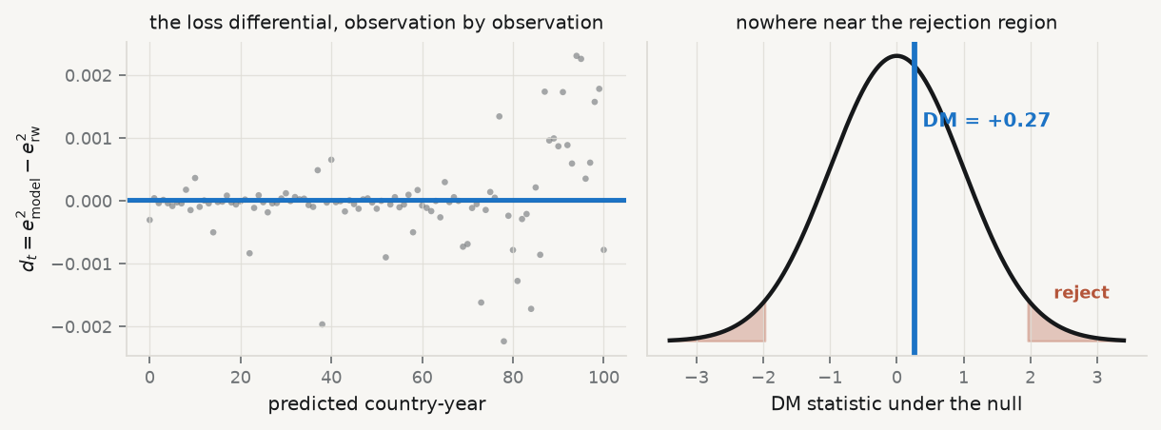
The test, drawn

Slide 16
Left: a cloud centred on nothing. Right: where that cloud’s mean lands on the null distribution.

Slide 17
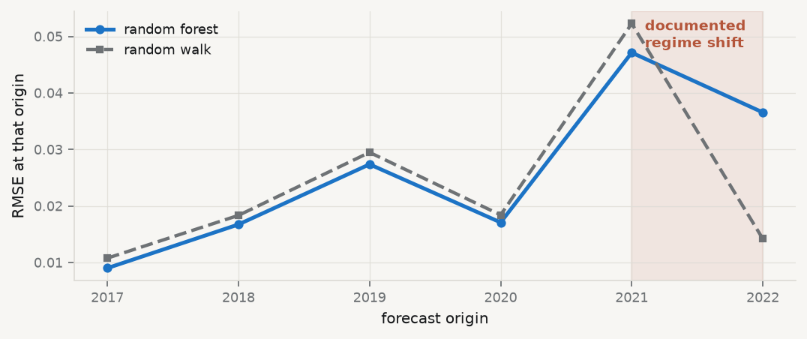
Where the errors actually are

Slide 18
An average hides this. Both models get worse at the same moment — which is the signature of something changing in the world, not in the model.

Slide 19
3 · Distribution shift

Slide 20
Four kinds, and they need different answers
Type | What changes | Detection | Fix
Covariate shift | $P\left(X\right)$; $P\left(Y∣X\right)$ stable | classifier: train vs deploy | reweight, or retrain
Label shift | $P\left(Y\right)$; $P\left(X∣Y\right)$ stable | predicted vs observed marginal | reweight; correct the intercept (S06)
Concept drift | $P\left(Y∣X\right)$ | only once outcomes arrive | retrain — necessary, not sufficient
Feedback | your model changes the world | causal reasoning, not monitoring | redesign

Slide 21
Only the first is detectable before the damage. The last is not a monitoring problem at all.

Slide 22
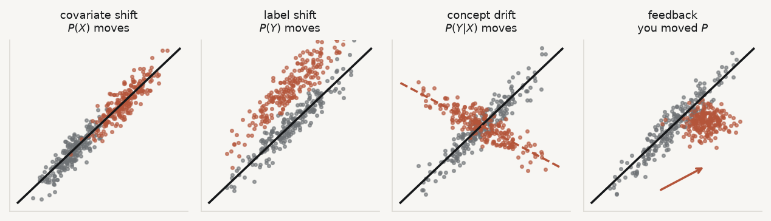
What each one looks like

Slide 23
Grey: training. Red: deployment. The black line is the model you fitted; only the third panel makes it wrong, and only the fourth is your fault.

Slide 24
The classifier diagnostic
Pool the training and deployment features, label each row by period, and try to predict the label.
If a classifier can tell your two periods apart, so can your model’s errors. AUC near 0.5 is reassuring. Near 1.0 is an alarm.
It costs four lines and it is the single highest-value monitoring check you can run.

Slide 25
Run it — and run a placebo
X_lev = m[FEAT].to_numpy(float) chg = m.groupby("geo")[FEAT].pct_change().replace([np.inf, -np.inf], np.nan) ok = chg.notna().all(axis=1) X_chg, t_chg = chg[ok].to_numpy(float), m.loc[ok, "time"].to_numpy() def drift_auc(X, times, cut): lab = (times >= cut).astype(int) p = cross_val_predict( RandomForestClassifier(400, min_samples_leaf=3, random_state=0, n_jobs=-1), X, lab, cv=StratifiedKFold(5, shuffle=True, random_state=0), method="predict_proba")[:, 1] return roc_auc_score(lab, p) CUTS = [2015, 2017, 2019, 2021] lev = [drift_auc(X_lev, m["time"].to_numpy(), c) for c in CUTS] chgs = [drift_auc(X_chg, t_chg, c) for c in CUTS] print("cut year :", " ".join(f"{c}" for c in CUTS)) print("levels :", " ".join(f"{v:.2f}" for v in lev)) print("changes :", " ".join(f"{v:.2f}" for v in chgs))
cut year : 2015 2017 2019 2021 levels : 0.82 0.85 0.84 0.87 changes : 0.65 0.63 0.65 0.68

Slide 26
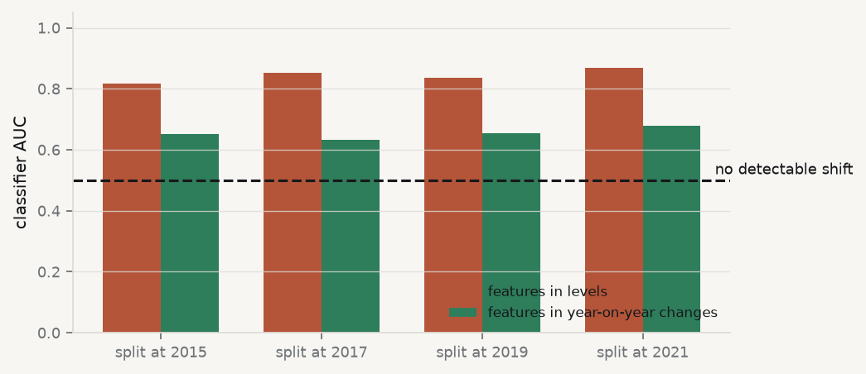
Read that carefully

Slide 27
In levels, the classifier separates every split at AUC 0.82–0.87 — including years with no documented break. It is detecting the trend, not the regime change.

Slide 28
The lesson about diagnostics
A drift AUC of 0.87 means nothing on its own. It means something compared with the AUC at a date where you believe nothing happened.
Always run placebo cuts
Detrend or difference before asking about a regime change
Report the whole profile, not the one number that supported your story
This is the same discipline as Session 03’s diagnostics and Session 09’s second criterion for $k$. By now it should feel like a habit.

Slide 29
4 · Goodhart

Slide 30
Stated precisely for this course
When a measure becomes a target, the relationship the model learned between measure and outcome is exactly the relationship agents have an incentive to break.
A credit-scoring feature that predicts default only until applicants learn it is used is not a stable feature. It was never a feature of the world; it was a feature of the world before your model existed in it.
This is a causal problem (Session 10), not a monitoring problem. No amount of retraining solves it, because every retrain teaches the agents faster.

Slide 31
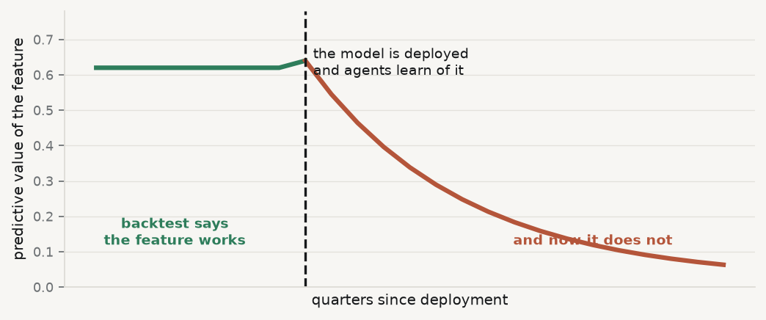
The shape of a feature that stops working

Slide 32
Every retraining fits the decayed relationship and pushes agents to break it further. The monitoring plan will faithfully report the decline it cannot fix.

Slide 33
5 · Governance

Slide 34
What a deployable model comes with
Intended use, and out-of-scope uses — what decision, and what it must not be used for
Data lineage — sources, vintages, collection dates, licences, quality issues, checksums
Preprocessing — every transformation, in order, with the code
Validation — the design, why it matches deployment, metrics, benchmark, subgroup performance
Limitations — where it performs worst, who is under-represented, what is load-bearing
Monitoring plan — which quantities, at what frequency, and what triggers review
Ownership — who is accountable, and the retirement criterion

Slide 35
This is not bureaucracy
Sections 5 and 6 are where the intellectual content of this entire course finally has to be written down for somebody else.
Section 5 is Sessions 03, 06 and 10: what is load-bearing, and where does it fail
Section 6 is Sessions 04, 08 and 11: what would tell you it has stopped working
If you cannot fill in sections 5 and 6, you do not understand your own model well enough to deploy it. Template: 02-practice/governance-file-template.md.

Slide 36
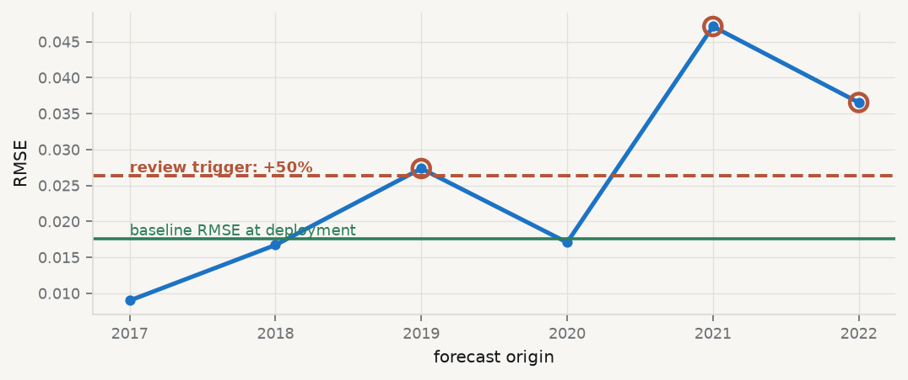
A monitoring plan is a threshold, not a hope

Slide 37
Write the threshold before deployment, while you still have no stake in the answer. A threshold chosen after the model degrades is not a threshold; it is a negotiation.

Slide 38
6 · The arc

Slide 39
Every session, one dial and one self-deception
Session | The dial | The self-deception it prevents
02–03 | which variables enter, how errors are modelled | “my standard errors are right because the software printed them”
04 | complexity, via CV | “it fits the data well”
05 | $λ$ and $α$ | “the model identified the true drivers”
06 | the decision threshold | “it is 97% accurate”
07 | depth, learning rate, $m$ | “the important feature is the cause”

Slide 40
…continued
Session | The dial | The self-deception it prevents
08 | the number of factors | “I extracted factors, then backtested”
09 | $k$, and the text representation | “the algorithm found clusters, so clusters exist”
10 | nothing — identification is not a dial | “a better predictor is a better policy guide”
11 | the monitoring threshold | “it worked last year”

Slide 41
Session 10 is the exception that defines the course: no tuning parameter buys you identification.

Slide 42
7 · Back to Europe 2031

Slide 43
The same numbers, sharper questions
In Session 01 the scenario’s figures — a US:EU compute ratio near 12.2 in 2031, a buildout ratio near 15.7 — were parameters of a narrative. Now ask:
What would a factor model (S08) say about how many independent dimensions “technological capacity” has? Is compute one factor, or a proxy for several?
Is the labour-displacement mechanism a prediction or a causal claim (S10)? Which one does the policy menu require?
The policy menu implies decisions under cost asymmetry. What are $c_{FP}$ and $c_{FN}$, and where does that put $τ^{⋆}$ (S06)?
europe2031.ai

Slide 44
What has changed since Session 01
Nothing about the scenario. Everything about what you are able to ask of it.
That is the deliverable of this course: not a list of methods, but the reflex of asking what would have to be true — and knowing which of Sessions 02 to 11 answers it.

Slide 45
Takeaways

Slide 46
Key takeaways
Match the backtest design to the deployment: expanding, fixed, or blocked with a purge
Everything inside the loop. Including the unsupervised steps
Benchmark against something hard, and test the difference with Diebold–Mariano
Four kinds of shift, four different responses. Only one is detectable in advance
A drift diagnostic needs a placebo to be interpretable
Goodhart is causal, not statistical. Retraining makes it worse
If you cannot write the limitations and the monitoring plan, do not deploy

Slide 47
What loses marks
Random K-fold on time-ordered data — after eleven weeks, there is no excuse
Standardising or extracting factors outside the backtest loop
“Our model beats the benchmark” with no DM statistic
A drift AUC with no placebo cut
A governance file whose limitations section says “none identified”

Slide 48
Now, the practice
Ninety minutes, in your groups. You will backtest one forecast properly, test it against a hard benchmark, run a drift diagnostic with a placebo — and write the governance file. The governance file is the deliverable.
Notes: 01-lecture/README.md · practice brief: 02-practice/README.md

