Slide 1
The Supervised Learning Problem
Session 01 pre-session · what Session 02 assumes you have Thierry Warin

Slide 2
When can a number about the past be used to make a claim about the future?

Slide 3
Read this before Session 02
Session 01 spends both halves on the syllabus and on Europe 2031. So the mathematics of the course starts here, at your desk, before the first class.
Four ideas, forty minutes
Everything from Session 02 to Session 11 is built on them
Part A of the midterm examines this page directly
These slides follow the reading the-supervised-learning-problem.md section by section. Same numbering, same notation.

Slide 4
Outline
0.1 | The problem, stated once
0.2 | Loss and risk
0.3 | The best predictor there is
0.4 | The irreducible error
0.5 | Why prediction and inference pull apart

Slide 5
0.1 · The problem

Slide 6
Stated once
$f$ | the systematic part | fixed, unknown — the thing you want
$ε$ | the noise | everything driving $Y$ that $X$ does not observe
$\hat{f}$ | your estimate | built from data, and therefore random
You observe pairs $\left(x_{i},y_{i}\right)$. You believe they were produced by
$$Y=f\left(X\right)+ε, E\left[ε∣X\right]=0, Var\left(ε\right)=σ^{2}$$

Slide 7
The distinction that trips people up
$f$ is fixed and unknown. $\hat{f}$ is known and random.
Every confidence interval in this course is a statement about the second, made in order to say something about the first.
If that sentence feels like a technicality now, it will not by Session 03.

Slide 8
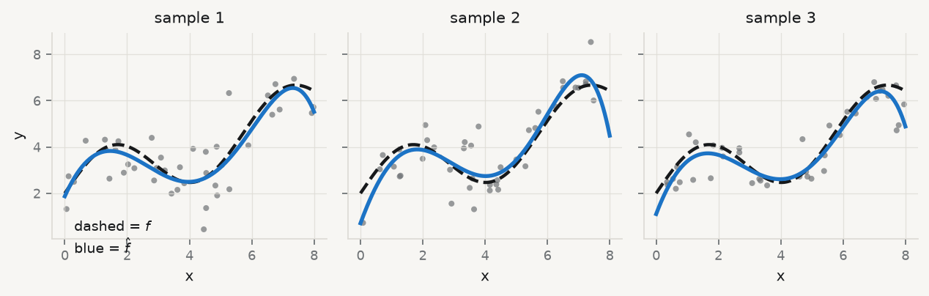
Three samples, three different $\hat{f}$

Slide 9
The dashed line is the same in all three panels — that is $f$. The blue line changes every time — that is $\hat{f}$. Nothing about the world changed; only the sample did.

Slide 10
Two reasons to want $\hat{f}$
 | Prediction | Inference
You want | $\hat{f}\left(x\right)$ close to $y$ for new $x$ | to know how $Y$ depends on $X$
A black box is | a success, if it predicts | a failure, even if it predicts

Slide 11
Sessions 02–03 are inference. Sessions 04–09 are prediction. Session 10 is what happens when you need a third thing — causation — and find that neither of the first two supplies it.

Slide 12
0.2 · Loss and risk

Slide 13
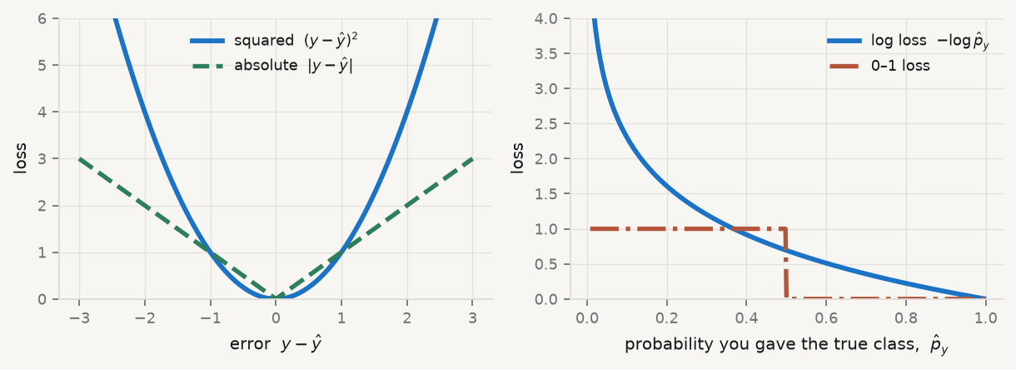
First say what a mistake costs
A loss function $L\left(y,\hat{y}\right)$ prices a single mistake.

Slide 14
Squared loss punishes one big error more than several small ones. Log loss punishes confident and wrong without limit — which is why it, not accuracy, trains a classifier.

Slide 15
Risk is loss over the population
$$R\left(g\right)=E\left[L\left(Y,g\left(X\right)\right)\right]$$
Read the expectation carefully. It averages over new draws of $\left(X,Y\right)$ — including draws you have never seen and never will.
That is what makes risk the quantity you care about and the sample average the quantity you can compute. The gap between them is the entire subject of Session 04.

Slide 16
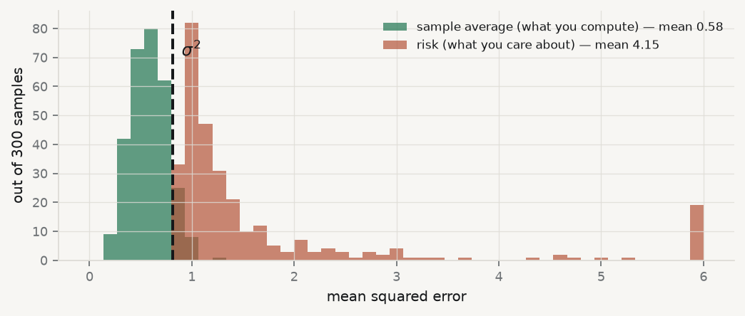
Watch the gap

Slide 17
The green histogram sits below $σ^{2}$. The red one sits far above it. They are the same models, scored two different ways.

Slide 18
0.3 · The best predictor

Slide 19
Suppose you knew everything
Suppose you knew the entire joint distribution of $\left(X,Y\right)$ — no estimation, no sample, perfect knowledge. What would you predict?
Under squared-error loss, the conditional expectation:
$$f^{⋆}\left(x\right)=E\left[Y∣X=x\right]$$
Not a convention, not a convenience. It falls out of three lines of algebra.

Slide 20
The derivation
Take any competing predictor $g$, and add and subtract $E\left[Y∣X\right]$ inside the square:
$$R\left(g\right)=E\left[(\underset{\text{noise}}{\underset{⏟}{Y−E\left[Y∣X\right]}}+\underset{\text{your error}}{\underset{⏟}{E\left[Y∣X\right]−g\left(X\right)}})^{2}\right]$$
The cross term vanishes by the tower property — condition on $X$ first, and $E\left[Y∣X\right]−g\left(X\right)$ passes outside the inner expectation:
$$E\left[\left(E\left[Y∣X\right]−g\left(X\right)\right)\underset{= 0}{\underset{⏟}{E[Y−E\left[Y∣X\right] \left| X\right]}}\right]=0$$
Also called the law of iterated expectations: $E\left[Z\right]=E\left[E\left[Z∣X\right]\right]$. You will be asked to name it.

Slide 21
What is left
$$R\left(g\right)=σ^{2}+E\left[{\left(E\left[Y∣X\right]−g\left(X\right)\right)}^{2}\right]$$
The first term does not depend on $g$ at all
The second is a squared quantity, so it is $≥0$
It is zero exactly when $g\left(x\right)=E\left[Y∣X=x\right]$
Therefore no predictor — however clever, however flexible, however much data it saw — can achieve a squared-error risk below $σ^{2}$. And the conditional expectation achieves it.

Slide 22
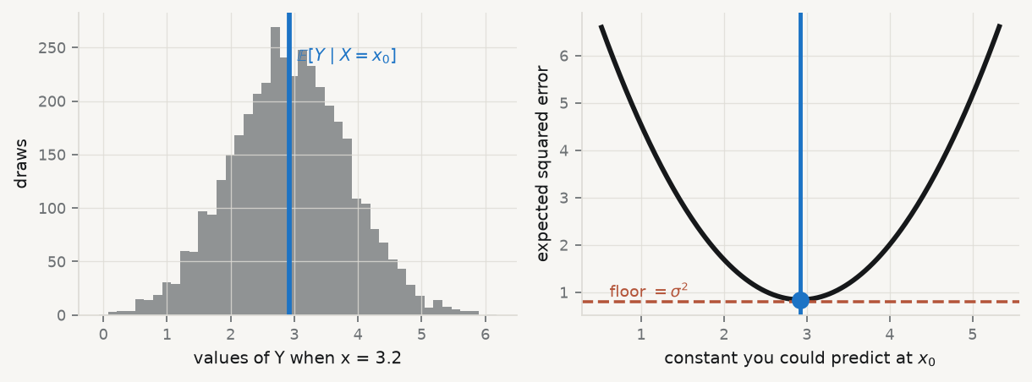
See it at a single $x$

Slide 23
A parabola with its minimum at the conditional mean, and a floor it never touches. That floor is $σ^{2}$, and the right-hand panel is the whole of §0.3 in one picture.

Slide 24
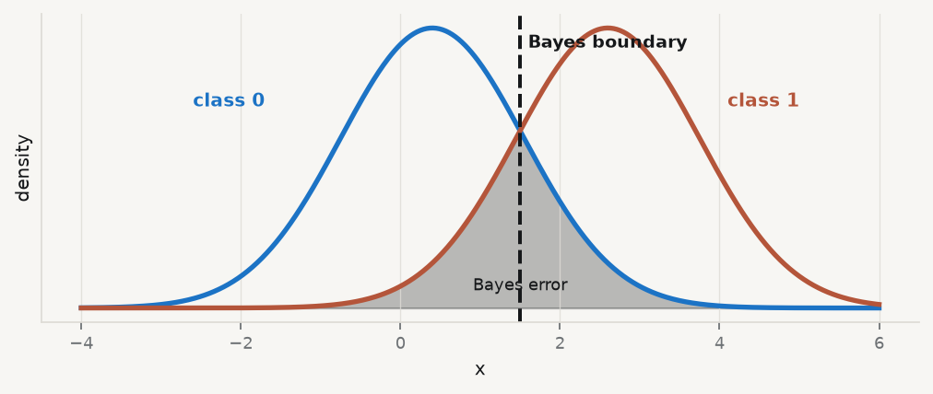
For classification: the Bayes rule
Under 0–1 loss the same argument gives: predict the most probable class.
$$g^{⋆}\left(x\right)=arg\max_{k} P\left(Y=k∣X=x\right), \text{Bayes error}=1−E\left[\max_{k}P\left(Y=k∣X\right)\right]$$

Slide 25
The shaded overlap is irreducible: where the two classes genuinely coincide, no rule separates them. Session 06 is about where to put that line when the two errors cost different amounts.

Slide 26
So what is every method in this course?
Session | How it approximates $E\left[Y∣X\right]$
02–03 | assume it is linear in $X$, estimate the coefficients
05 | assume it is linear and sparse, and penalise
06 | model $P\left(Y=1∣X\right)$ through a logistic link
07 | approximate it by a piecewise constant function on a learned partition
08 | approximate $X$ itself first, by a few factors

Slide 27
Eleven weeks, one target. The methods differ only in what they are willing to assume about its shape.

Slide 28
0.4 · The irreducible error

Slide 29
What $σ^{2}$ is, and is not
It survives the optimal predictor with perfect knowledge of the distribution. So it is not a defect of your method — it is a statement about your variables.
unmeasured determinants of $Y$
genuine randomness
measurement error in $Y$
Irreducible means irreducible by any method. It does not mean irreducible by any dataset.

Slide 30
Three consequences you will use all term
There is a ceiling, and you do not know where it is. An $R^{2}$ of 0.30 may be excellent or dreadful; nothing in the output tells you which
You lower $σ^{2}$ only by measuring more things — better data, not better algorithms. This is why Session 08’s answer to “more series” is the opposite of Session 05’s
A validation error below $σ^{2}$ is impossible. If you see one you have not discovered something; you have leaked
Consequence 3 is the most useful thing on this page. It is a free correctness check you can run on any result, including your own.

Slide 31
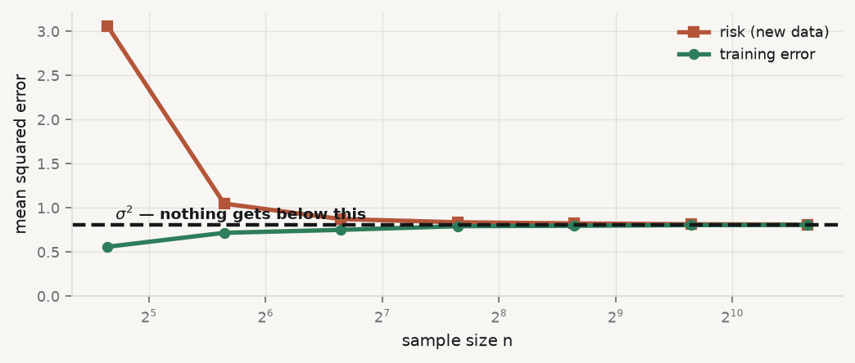
The floor, drawn

Slide 32
More data closes the gap between the two curves. It does not move the dashed line. Only new variables do that.

Slide 33
0.5 · Prediction vs inference

Slide 34
They are served by the same $\hat{f}$, and they pull apart
 | Prediction asks | Inference asks
Target | $\hat{f}\left(x\right)$ close to $y$ | ${\hat{β}}_{j}$ close to $β_{j}$, honestly
Judged by | error on data never seen | coverage of the interval
Flexibility is | a resource | a hazard
Correlated predictors | mostly harmless | fatal (Session 03)
Fails when | the future differs (S11) | misspecified, or a confounder is missing

Slide 35
Prove the fourth row
rng = np.random.default_rng(3) BETA, RHO = np.array([1.0, 1.0]), 0.985 def experiment(correlated, reps=400, n=60): """Same truth, same sample size. Only the correlation between x1 and x2 changes.""" coef, err = [], [] for _ in range(reps): z = rng.normal(size=(n, 2)) X = np.c_[z[:, 0], RHO * z[:, 0] + np.sqrt(1 - RHO**2) * z[:, 1]] if correlated else z y = X @ BETA + rng.normal(0, 1, n) fit = sm.OLS(y, sm.add_constant(X)).fit() coef.append(fit.params[1]) zt = rng.normal(size=(2000, 2)) Xt = np.c_[zt[:, 0], RHO * zt[:, 0] + np.sqrt(1 - RHO**2) * zt[:, 1]] if correlated else zt yt = Xt @ BETA + rng.normal(0, 1, 2000) err.append(np.sqrt(mean_squared_error(yt, fit.predict(sm.add_constant(Xt))))) return np.array(coef), np.array(err) c_cor, e_cor = experiment(True) c_ind, e_ind = experiment(False) print(f"correlated : beta1 sd {c_cor.std():.2f} wrong sign in {(c_cor<0).mean():.0%}" f" test RMSE {e_cor.mean():.3f}") print(f"independent : beta1 sd {c_ind.std():.2f} wrong sign in {(c_ind<0).mean():.0%}" f" test RMSE {e_ind.mean():.3f}")
correlated : beta1 sd 0.75 wrong sign in 11% test RMSE 1.026 independent : beta1 sd 0.13 wrong sign in 0% test RMSE 1.028

Slide 36
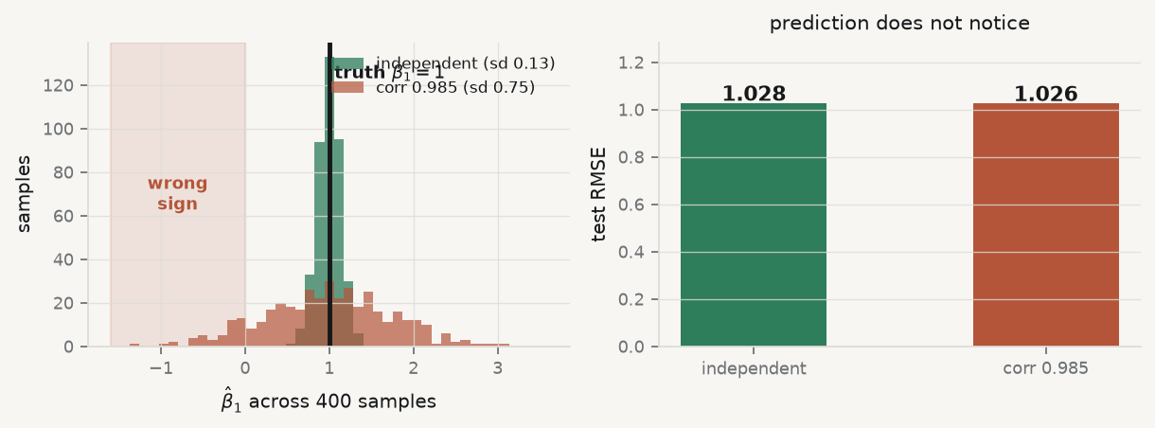
Look at what that means

Slide 37
Same truth, same $n$. The coefficient’s spread grows almost sixfold and it comes out with the wrong sign in 11% of samples — while the prediction error is identical to three decimals.

Slide 38
And a third question, which looks like the second
Causation. If we changed $X$, what would happen to $Y$?
Nothing in $Y=f\left(X\right)+ε$ answers that. The model describes an association in the population that generated your data. It says nothing about a population in which somebody intervened.
A model can predict perfectly, carry tight standard errors, and still be a completely wrong guide to policy. Session 10 is where that is confronted, and it is meant to be uncomfortable.

Slide 39
Before Session 01

Slide 40
Answer these on paper
State the difference between $f$, $\hat{f}$ and $E\left[Y∣X\right]$ in one sentence each
Show that the cross term in §0.3 vanishes. Which property of conditional expectation did you use?
A colleague reports a cross-validated $R^{2}$ of $0.98$ where every published model reaches $0.4$. Give two explanations, and say which you would check first
Give a variable that is an excellent predictor and a useless policy lever. Say why they can differ
Under 0–1 loss, what does the Bayes error rate measure, and why can no classifier beat it?
If you cannot answer one, re-read that section — not the whole page.

Slide 41
What to carry into Session 02
$f$ is fixed and unknown; $\hat{f}$ is known and random
Risk is over draws you have never seen; the sample average is not
$E\left[Y∣X\right]$ is the best predictor under squared loss, and $R\left(g\right)=σ^{2}+…$
$σ^{2}$ is a fact about your variables, not about your method
Prediction, inference and causation are three different questions
Reading: the-supervised-learning-problem.md · Setup: setup-vscodium-local-llm.md · Then: Session 02

