Slide 1
Exploratory Data Analysis: Centre, Spread, and Shape
Session 02 · Lecture, first half Thierry Warin

Slide 2
Before you model anything, what does the data actually look like?

Slide 3
Quote of the day
“It’s tough to make predictions, especially about the future.”
— Yogi Berra
Funny, and exactly the course’s thesis. Everything we do is an attempt to say something about data we have not seen, using data we have.

Slide 4
Outline
1 | Why this comes first
2 | Measuring the centre
3 | Measuring the spread
4 | Measuring the shape
5 | What it buys you later

Slide 5
Learning objectives
Compute the mean, median and trimmed mean, and say which question each answers
Explain why the sample variance divides by $n−1$
Apply the empirical rule, and state the precondition that makes it valid
Compute skewness and excess kurtosis, and test each against its threshold
Show that the two are independent — symmetry is not normality

Slide 6
1 · Why this comes first

Slide 7
Let’s start with an example
core = pd.read_parquet("../data/spine/core.parquet") gdp = core["gdp_pc_eur"].dropna() print(f"n = {len(gdp)}") print(f"mean = {gdp.mean():,.0f} EUR") print(f"median = {gdp.median():,.0f} EUR")
n = 437 mean = 30,373 EUR median = 25,733 EUR
Both of these are “the average European country”. They differ by €4,640. Which one goes in the press release?

Slide 8
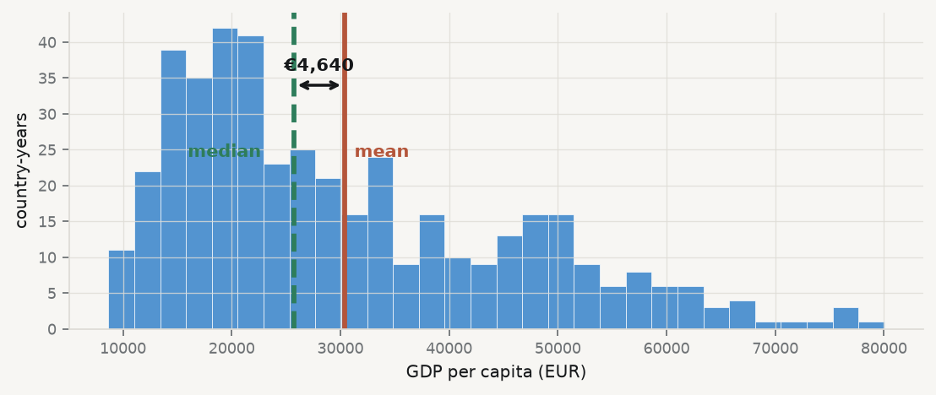
That gap is the whole session

Slide 9
The bulk of the data sits on the left. A handful of rich country-years on the right pull the mean — and only the mean — toward them.

Slide 10
Three questions, asked of every new column
 | Question
Centre | where does the distribution sit? | §2.1
Spread | how far from there does it reach? | §2.2
Shape | is it symmetric, and how heavy are the tails? | §2.3

Slide 11
Summarising is already modelling. Each of these choices throws information away, and which information you throw away decides what you can claim later.

Slide 12
2 · The centre

Slide 13
The sample mean
$$μ=\sum_{i=1}^{k}{x_{i}} p\left(x_{i}\right) → \overset{‾}{x}=\frac{1}{n}\sum_{i=1}^{n}{x_{i}}$$
Natural, easy, and the least-squares minimiser — the fact Session 03 is built on.
Its weakness is written into the formula: every observation enters with weight $1/n$, so one extreme value moves it without limit.

Slide 14
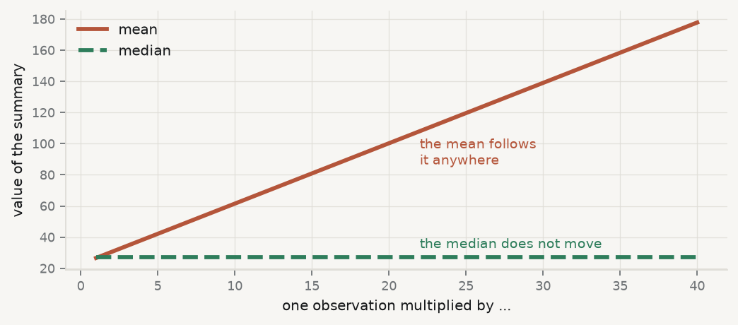
The median, and what “resistant” means

Slide 15
Take eight numbers and drag one of them out. To move the median you must move the middle of the data; to move the mean you need only move one point, as far as you like.

Slide 16
Extensions: the trimmed mean
from scipy import stats print(f"mean = {gdp.mean():,.0f}") print(f"5% trimmed mean = {stats.trim_mean(gdp, 0.05):,.0f}") print(f"median = {gdp.median():,.0f}")
mean = 30,373 5% trimmed mean = 29,419 median = 25,733
Remove a proportion from each end, average the rest: resistant like the median, but still using most of the data.
Read the ladder. Trimming just 5% pulls the average down by nearly a thousand euros. The three summaries disagree, and the direction of the disagreement is the finding.

Slide 17
Quantiles and percentiles
The quantile ${\tilde{q}}_{p}$ is the value below which about $100p\%$ of the data falls
The percentile is the same idea read backwards — given a value, what fraction lies below it
print(gdp.quantile([0, 0.25, 0.50, 0.75, 1.0]).round(0).to_string())
0.00 8663.0 0.25 18289.0 0.50 25733.0 0.75 40505.0 1.00 80039.0

Slide 18
3 · The spread

Slide 19
Variance and standard deviation
$$s^{2}=\frac{1}{n−1}\sum_{i=1}^{n}{{\left(x_{i}−\overset{‾}{x}\right)}^{2}}, s=\sqrt{s^{2}}$$
The $n−1$ is not a convention. Dividing by $n$ gives an estimator that is biased downward — because the deviations are taken from $\overset{‾}{x}$, and $\overset{‾}{x}$ is by construction the point that makes $∑{\left(x_{i}−⋅\right)}^{2}$ smallest.

Slide 20
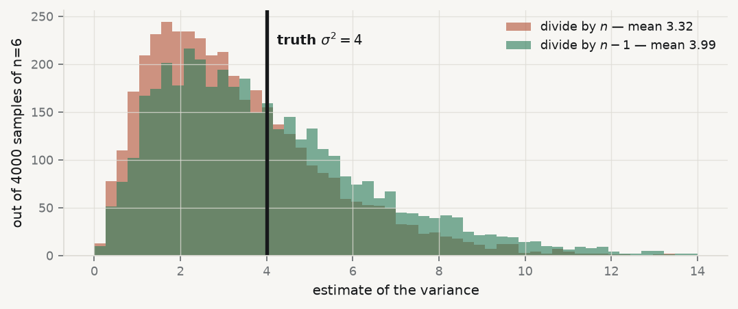
See the bias

Slide 21
Four thousand samples of six observations from a distribution with $σ^{2}=4$. Dividing by $n$ lands low on average; dividing by $n−1$ lands on the truth.

Slide 22
The empirical rule
Within | Contains about
$\overset{‾}{x}±1s$ | 68%
$\overset{‾}{x}±2s$ | 95%
$\overset{‾}{x}±3s$ | 99.7%

Slide 23
SAT scores with mean 1500 and $s=300$: about 68% score 1200–1800, about 95% score 900–2100.
The rule has a precondition. It holds for nearly normal data. Section 4 is how you check.

Slide 24
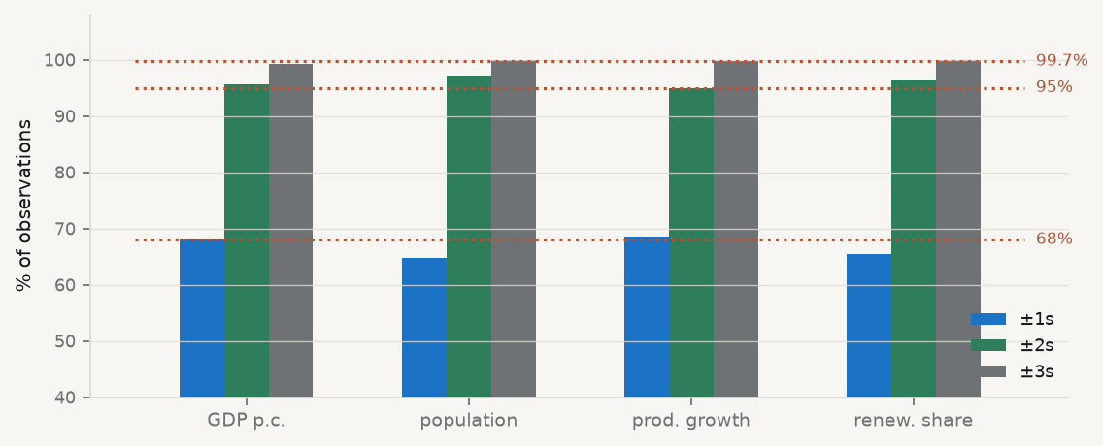
Does it hold on our data?

Slide 25
Dotted lines are what the rule promises. Where a bar misses its line, the variable is telling you something about its shape.

Slide 26
The interquartile range
$$IQR={\tilde{q}}_{0.75}−{\tilde{q}}_{0.25}$$
q1, q3 = gdp.quantile(0.25), gdp.quantile(0.75) print(f"sd = {gdp.std(ddof=1):,.0f}") print(f"IQR = {q3 - q1:,.0f}")
sd = 15,420 IQR = 22,215
Resistant, because it is built from two order statistics. The cost: it sees only the middle 50% and is blind to everything in the tails — which is sometimes exactly what you wanted to know about.

Slide 27
4 · The shape

Slide 28
Centre and spread do not determine a distribution
Two variables can share a mean and a standard deviation and look nothing alike. Two more numbers are needed.
g1=1ni​xi−x3s3 g2=1ni​xi−x4s4−3
The cube keeps the sign — so $g_{1}$ has a direction. The fourth power does not — so $g_{2}$ is about magnitude, and the $−3$ puts the normal distribution at zero.

Slide 29
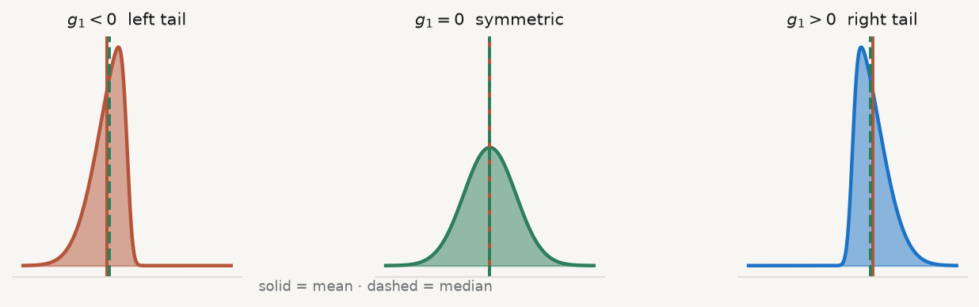
Skewness: sign and direction

Slide 30
A right tail pulls the mean past the median. That is precisely the €4,640 we opened with.

Slide 31
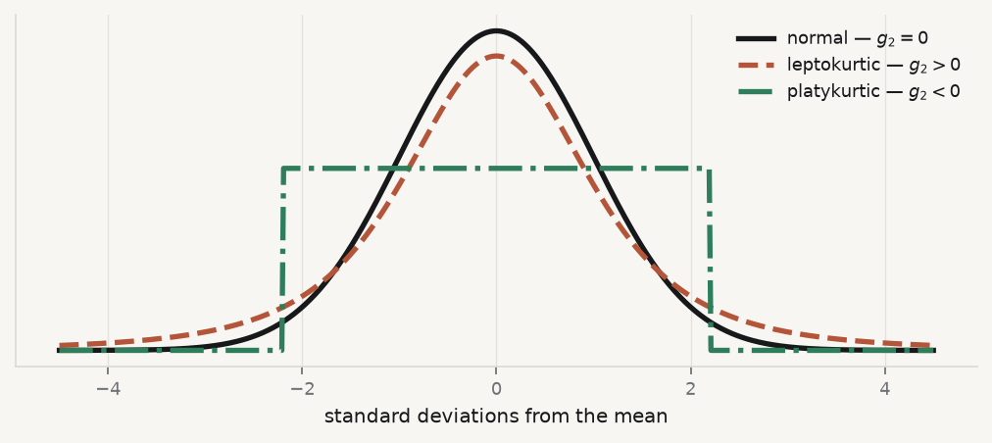
Kurtosis: how heavy are the tails

Slide 32
Leptokurtic: sharper peak and heavier tails — extreme values are more common than normal. Platykurtic: flatter, with the mass spread evenly and thin tails.

Slide 33
When is it “substantial”?
$$\left|g_{1}\right|>2\sqrt{6/n} \left|g_{2}\right|>4\sqrt{6/n}$$
def shape(x): x = np.asarray(pd.Series(x).dropna(), float) n = len(x); xbar, s = x.mean(), x.std(ddof=1) g1 = ((x - xbar) ** 3).mean() / s ** 3 g2 = ((x - xbar) ** 4).mean() / s ** 4 - 3 return n, g1, g2, 2 * np.sqrt(6 / n), 4 * np.sqrt(6 / n) n, g1, g2, t1, t2 = shape(gdp) print(f"n = {n}") print(f"g1 = {g1:+.3f} threshold {t1:.3f} skewed: {abs(g1) > t1}") print(f"g2 = {g2:+.3f} threshold {t2:.3f} kurtic: {abs(g2) > t2}")
n = 437 g1 = +0.881 threshold 0.234 skewed: True g2 = -0.013 threshold 0.469 kurtic: False
Skewed by nearly four times its threshold; kurtosis nowhere near. Asymmetric, not heavy-tailed — different defects.

Slide 34
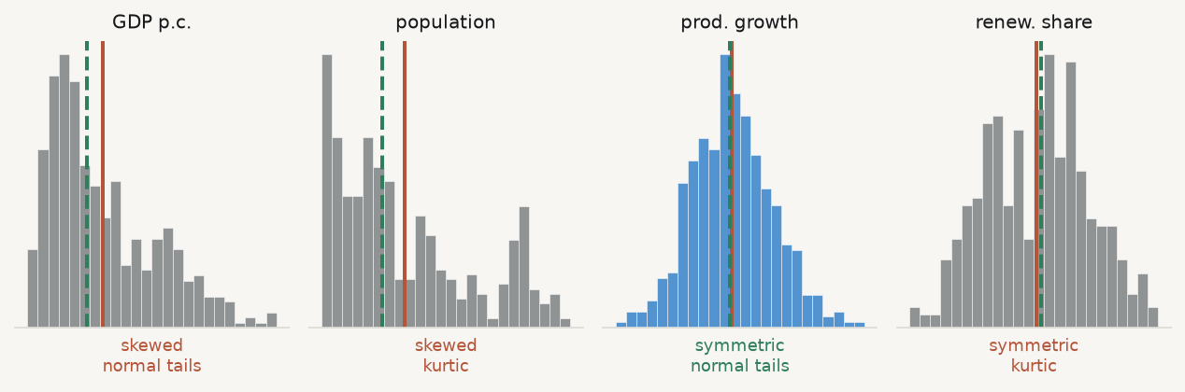
The two are independent

Slide 35
share_renew is perfectly symmetric ($g_{1}=+0.012$) and still badly non-normal ($g_{2}=−0.656$ against a threshold of $0.479$). Symmetry is not normality.

Slide 36
5 · What it buys you later

Slide 37
Every later session assumes you did this
Session 03 fits a mean function by least squares — its standard errors lean on the spread, and its diagnostics are residual shape by another name
Session 04 asks whether a model generalises — a heavy right tail is why a model looks excellent on average and fails on the cases that matter
Sessions 10–11 compare treated and untreated groups — a difference in means between two skewed distributions can be produced entirely by their tails
The mean, the standard deviation and the empirical rule are not neutral defaults. They are assumptions about shape, and this is the session where you check them.

Slide 38
Key takeaways
Mean, trimmed mean and median answer different questions; when they disagree, that is data
The $n−1$ is a correction for estimating the deviations from $\overset{‾}{x}$ rather than $μ$
The empirical rule needs near-normality — check before you use it
$g_{1}$ has a direction; $g_{2}$ has a magnitude. Both need their threshold
Skewness and kurtosis are independent. Symmetry is not normality

Slide 39
What loses marks
df.describe() pasted with no interpretation
A skewness reported without its threshold — $0.4$ is substantial at $n=437$, negligible at $n=40$
Calling a variable “normal” because it is symmetric
Applying the empirical rule to a variable you have just shown to be skewed
Dropping outliers before saying what they are

Slide 40
Now, the practice
Ninety minutes, in your groups. You will profile the three variables your research question depends on — centre, spread and shape, thresholds tested — and decide which summary you would defend in print.
Notes: 01-lecture/README.md · practice brief: 02-practice/README.md

