Slide 1
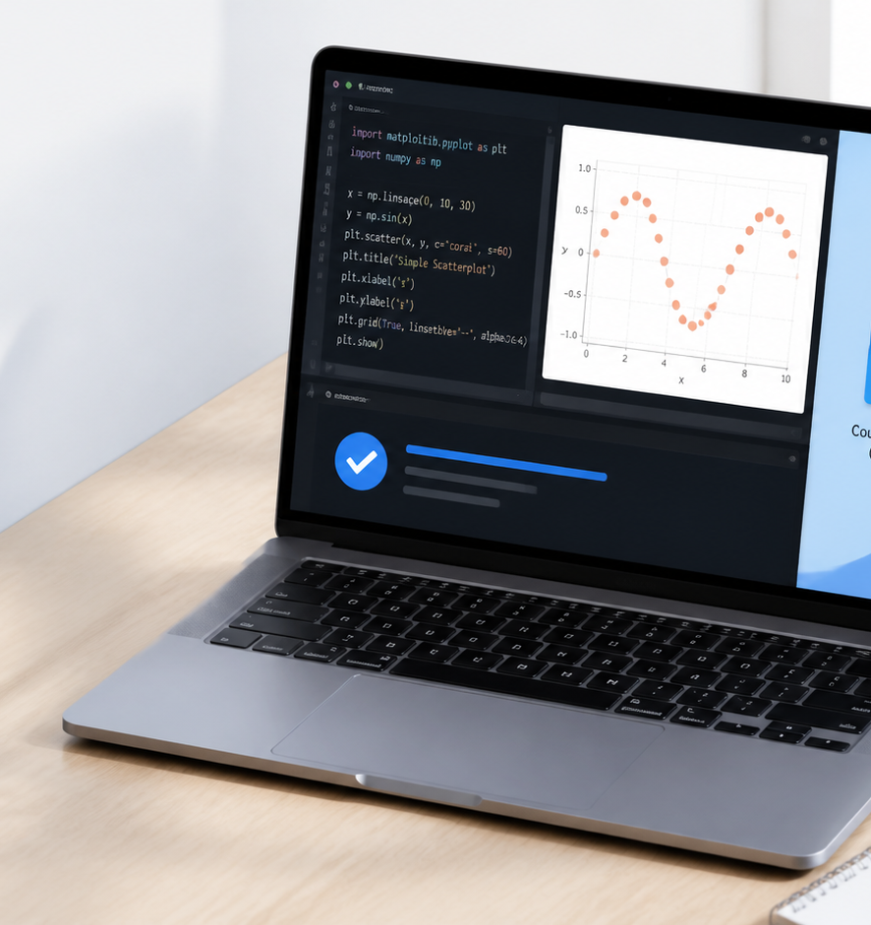
MATH60033A · SESSION 01 · PRE-SESSION
Welcome: build your quantitative workstation
Put the repository directly on your Desktop. Then make every check turn green.
Thierry Warin
MATH60033A · Thierry Warin · Session 01
Setup · 1
Notes:
Open with the question: Put the repository directly on your Desktop. Then make every check turn green.
[Sources]
- Course source: 01-foundations-scenarios-and-tools/00-pre-session/README.md
- Europe 2031 — https://europe2031.ai
- Critical reading brief — local:01-foundations-scenarios-and-tools/00-pre-session/reading-europe-2031.md
- ISLR, Chapter 2 — https://www.statlearning.com/
- Original AI-generated illustration: Original editorial laptop setup on a tidy desk; generic code editor, terminal checkmark, Desktop repository folder; no real logos.

Slide 2
SETUP · LOCATION
One folder anchors the whole course
Desktop/quantitative-methods
Desktop
Folder
VS Codium
Open this folder—not the ZIP, not Downloads, and not the level above it—in VS Codium.
MATH60033A · Thierry Warin · Session 01
Pre-session · 2
Notes:
Check the Explorer shows README.md, requirements.txt, data, and the numbered session folders.
[Sources]
- Course source: 01-foundations-scenarios-and-tools/00-pre-session/setup-vscodium-local-llm.md

Slide 3
What you are walking into
This course asks one question in ten different ways:
When can a number about the past be used to make a claim about the future?
The methods are standard: least squares, penalisation, trees, factors, causal ML.
The data are European, international, and messy on purpose.
The discipline is knowing what your estimate does not entitle you to say.
Ten sessions of method. One question throughout.

Slide 4
Three distinctions we will not let go of
A scenario is not a forecast. Europe 2031 is a conditional narrative — a stress test, not a prediction. You will read it as a set of assumptions you can measure.
Prediction is not inference. “How well does this predict?” and “what is the effect of X?” are different questions, answered by different estimators, with different guarantees.
A construct is not a measurement. An “AI exposure index” is something we built. Session 09 is about being honest about that.

Slide 5
What this session’s pre-work is
# | Task | Time
0 | Build your workstation — these slides | 60–90 min
1 | Read Europe 2031 | 30 min
2 | Review three concepts | 15 min
3 | Run the verification script | 5 min
Four things, before you arrive:

Slide 6
Session 1 does not include installation time. Arriving without a working environment means you cannot take part in the practice session.

Slide 7
The stack

Slide 8
What we install, and why
Tool | What it is | Why this one
VS Codium | VS Code with telemetry removed | Your work touches confidential and licensed data. The editor should not phone home.
Python 3.10+ | The analysis language | Everything in the course runs here.
Ollama | Runs LLMs on your machine | No API key, no per-token cost, no data leaving your laptop.
Qwen 2.5 Coder | The model Ollama serves | Small enough for a laptop, strong at code.
aider | An AI agent in your terminal | Reads and edits your files, and commits.

Slide 9
The principle behind the stack
Every piece runs locally.
The test that matters. When your environment is finished, turn off your wifi and ask the model a question. If it still answers, your setup is genuinely local — and your data never left the room.
This is not ideology. In Session 09 you work with licensed text, and in the group project you may work with data you are not permitted to upload anywhere.

Slide 10
Where do I type this?
Read this slide before you type anything. It is the single most common source of lost time.
Two kinds of instruction appear in these slides, and they are always labelled:
download
Go to a website in your browser and run an installer. No typing.
VS Codium terminal
Type it in the terminal inside VS Codium — never the macOS Terminal app, never PowerShell on its own.

Slide 11
Why always the VS Codium terminal
It opens in your project folder, so git and python act on the right files
It sees the .venv you activate; a separate Terminal window does not
It is the same on macOS, Windows and Linux, so these slides work for everyone
Open it now: View → Terminal, or Ctrl+` (the backtick key, above Tab). A panel appears at the bottom. That panel is where every command below goes.
If a command fails, check where you typed it before you check anything else.

Slide 12
Before you start
You need:
A laptop with 8 GB RAM minimum (16 GB is much more comfortable)
A browser — you will download the course folder, no account needed
Administrator rights to install software
About 10 GB free disk space — the model files are large
60–90 minutes, uninterrupted
Do this on the machine you will actually bring to class. A working setup on a desktop at home is of no use in the practice session.

Slide 13
Step 1 — VS Codium

Slide 14
Install VS Codium
download
Go to vscodium.com and download the build for your operating system.
This is the one step that cannot use the VS Codium terminal — you are installing the thing that provides it.
macOS
Download the .dmg, open it, drag VSCodium to Applications.
If macOS refuses to open it: right-click the app → Open → Open.
Windows
Download the User Installer .exe and run it.
Tick “Add to PATH” when the installer offers it.
Linux: use your package manager, or the .deb / .rpm from the same page.
Check. VS Codium opens and shows the Welcome tab.

Slide 15
Meet the two panels you will live in
[ VS Codium window ]
Left: Explorer (your files) · Bottom: Terminal · Right: Continue (chat)
Two things to find right now:
The Explorer — View → Explorer, or Ctrl/Cmd+Shift+E
The integrated Terminal — View → Terminal, or Ctrl+` (backtick)
The Terminal is where most of this course happens. If you have never used a command line, that is fine — every command you need is on these slides.

Slide 16
Step 2 — Extensions
Extension | Search for | What it does
Python | ms-python.python | Syntax, linting, environment selection
Jupyter | ms-toolsai.jupyter | Run notebooks inside the editor
Continue | Continue.continue | The chat sidebar, wired to your local model
Open the Extensions panel: Ctrl/Cmd+Shift+X. Install three:

Slide 17
VS Codium uses the Open VSX registry, not Microsoft’s Marketplace. Most extensions are there. If one is missing, the course does not depend on it.

Slide 18
Step 3 — The course materials

Slide 19
Get the course folder
Everything from here on runs inside the course folder, so you need it on your machine before anything else works.
download
Go to github.com/warint/quantitative-methods
Click the green Code button
Choose Download ZIP
Unzip it somewhere you will find again — Documents, not Downloads
No account needed. You are just downloading a folder.

Slide 20
Open it in VS Codium
File → Open Folder… and choose the unzipped folder.
The Explorer on the left should show README.md, requirements.txt, a data/ folder and the numbered session folders. If it shows a single folder you have to click into, you picked the level above — go one deeper.
Keep it there. Every command in these slides is relative to this folder, and the terminal you opened is already sitting in it.

Slide 21
In Session 2 you will do this properly
Downloading a ZIP gets you a snapshot. It cannot receive corrections, and it has no history.
Before Session 2 you install git and clone the repository instead
That version updates with git pull when I fix something
It is also where your group’s own work will live
For today the snapshot is enough, and it saves you creating an account before you have seen the course.

Slide 22
Step 4 — Python

Slide 23
Install Python
download
Go to python.org/downloads and install Python 3.11 or 3.12.
Windows: tick “Add python.exe to PATH” on the first installer screen. It is easy to miss, and without it nothing below works.
macOS ships an old Python that is not suitable. Install a current one anyway.

Slide 24
Check Python is there
VS Codium terminal
python3 --version
Prints Python 3.11.x or 3.12.x.
On Windows, if python3 is not found, try python --version.
If it says command not found, the PATH box was not ticked. Re-run the installer — do not try to work around it.

Slide 25
Create the environment
VS Codium terminal
With the course folder open (Step 3), run:
python3 -m venv .venv
This makes a private package folder for this course, so it cannot break your other work.

Slide 26
Activate it
VS Codium terminal
# macOS / Linux source .venv/bin/activate # Windows (PowerShell) .venv\Scripts\Activate.ps1
Your prompt now starts with (.venv). Every command from here on assumes you see that.

Slide 27
Install the packages
VS Codium terminal · with (.venv) showing
pip install -r requirements.txt
numpy, pandas, scikit-learn, statsmodels, matplotlib and the rest. A few minutes.
python -c "import numpy, pandas, sklearn; print('ok')"
prints ok.

Slide 28
Step 5 — Ollama and Qwen

Slide 29
Install Ollama
download
Go to ollama.com/download, choose your operating system, and run the installer. This works on macOS, Windows and Linux.
You may see a one-line curl … | sh command on the web. Ignore it — the installer does the same thing and there is nothing to mistype.
On macOS, open the app once after installing. It puts the ollama command in place and starts the background service.

Slide 30
Check Ollama is there
VS Codium terminal
ollama --version
Prints a version number.
Command not found? Close the terminal panel and open a new one — a new terminal picks up the changed PATH. On Windows, restart VS Codium.

Slide 31
Pull Qwen 2.5 Coder
Your machine | Model | Command
8 GB RAM | qwen2.5-coder:3b | ollama pull qwen2.5-coder:3b
16 GB RAM | qwen2.5-coder:7b | ollama pull qwen2.5-coder:7b
32 GB+ / Apple Silicon | qwen2.5-coder:14b | ollama pull qwen2.5-coder:14b
VS Codium terminal
Choose by the RAM in your machine. Rough rule: model size + 2 GB free.

Slide 32
You also need the embedding model for Session 10:
ollama pull nomic-embed-text
This downloads several gigabytes. Do it on a good connection, not ten minutes before class.

Slide 33
Verify the model
VS Codium terminal
ollama list
You should see your model listed. Now talk to it:
ollama run qwen2.5-coder:7b "Explain the bias-variance tradeoff in three sentences."
Type /bye to leave the chat.
The real check. Turn off your wifi and run that command again. It should still answer. That is what “local” means.

Slide 34
Step 6 — The CLI agent

Slide 35
Talking to Qwen from the terminal
The Continue sidebar is useful for questions about a selected block of code.
But the way this course actually works — and the way I work in front of you — is an agent in the terminal: something that reads your files, edits them, and commits, while you steer it in prose.
That tool is aider, and it runs against your local Qwen.
The same shape as the workflow you have seen me use in class — and it is running on your laptop, on a model you downloaded.

Slide 36
Install aider
VS Codium terminal · with (.venv) showing
python -m pip install aider-install aider-install

Slide 37
Point aider at Ollama
VS Codium terminal
# macOS / Linux export OLLAMA_API_BASE=http://127.0.0.1:11434 # Windows (PowerShell) — then open a new terminal setx OLLAMA_API_BASE http://127.0.0.1:11434

Slide 38
Give Ollama a real context window
This step is not optional. Ollama defaults to a 2k context window and then silently discards whatever does not fit. Your agent will appear to “forget” the file you just gave it.
Start the server with a larger window:
VS Codium terminal 1
OLLAMA_CONTEXT_LENGTH=8192 ollama serve
Leave that terminal running. Open a second terminal for aider.
In VS Codium: the + icon in the terminal panel splits off a new shell.

Slide 39
Run the agent
VS Codium terminal 2
cd /path/to/your/repo aider --model ollama_chat/qwen2.5-coder:7b
Note the prefix: ollama_chat/, not ollama/. The second one exists and behaves worse.

Slide 40
Ask it for something
You are now at a prompt. Ask in plain language:
> add a function that loads data/spine/core.parquet and prints the number of rows per country
aider writes the code, shows you a diff, and asks to apply it.
Read the diff before you accept. That habit is the whole skill.

Slide 41
The worked example

Slide 42
Two terminals
Terminal 1 — the model server, left running:
VS Codium terminal 1
OLLAMA_CONTEXT_LENGTH=8192 ollama serve
Terminal 2 — inside your course folder:
VS Codium terminal 2
source .venv/bin/activate aider --model ollama_chat/qwen2.5-coder:7b

Slide 43
Ask for something real
At the aider prompt
> create explore.py that loads data/spine/core.parquet, prints the shape, and shows mean gdp_pc_eur by year
aider proposes a diff. You read it. You accept it.
python explore.py

Slide 44
What just happened
You ran a model on your own hardware, had it write code against real data, reviewed the change, and accepted it — without sending one byte to anyone’s API.
Every practice session this term is a variation on those two terminals.

Slide 45
Why we do it this way
The data stay put. Some of what you use this term cannot legally be uploaded.
The cost is zero. No key, no quota, no bill at the end of the month.
The record is honest. The diff shows exactly what changed, and why.
The skill transfers. This is how the work is actually done now.
The model is a junior collaborator with no accountability. It will produce confident, wrong code. Every line you accept is a line you are claiming as correct. Read the diff.

Slide 46
If it breaks

Slide 47
Troubleshooting
Symptom | Fix
ollama: command not found | Reopen the terminal; on Windows, restart VS Codium
Model answers very slowly | Use a smaller model (:3b); close other applications
aider “forgets” your file | You skipped OLLAMA_CONTEXT_LENGTH=8192 ollama serve
connection refused from aider | The ollama serve terminal is not running
pip fails on install | Check (.venv) is in your prompt
python3 not found on Windows | Try python; if still missing, PATH was not ticked

Slide 48
Still stuck? Ask Qwen — that is itself a test of whether your setup works.

Slide 49
The last check
VS Codium terminal · with (.venv) showing
python 01-foundations-scenarios-and-tools/00-pre-session/verify_environment.py
You should see five checks pass.
Bring the output to class — a screenshot or a paste into your notes.

Slide 50
PRE-SESSION · REQUIRED BEFORE CLASS
Arrive ready to use the reading
REQUIRED READING
Europe 2031
Annotate four things
Required scenario for the Session 01 conversation
1
The research question
https://europe2031.ai
2
The method or design
3
The strongest evidence
BRING TO CLASS
4
One limitation or doubt
One annotated page · one unresolved question · your self-check answers
MATH60033A · Thierry Warin · Session 01
Pre-session · 11
Notes:
This work is completed before class. Begin the lecture by asking for the unresolved questions students brought.
[Sources]
- Course source: 01-foundations-scenarios-and-tools/00-pre-session/README.md
- Europe 2031 — https://europe2031.ai
- Critical reading brief — local:01-foundations-scenarios-and-tools/00-pre-session/reading-europe-2031.md
- ISLR, Chapter 2 — https://www.statlearning.com/

Slide 51
PRE-SESSION · READING GUIDE
Read for the argument, not for coverage
REQUIRED ARTICLE
Europe 2031
Required scenario for the Session 01 conversation
https://europe2031.ai
READING GUIDE
Critical reading brief
Questions that separate observed evidence from the constructed scenario
local:01-foundations-scenarios-and-tools/00-pre-session/reading-europe-2031.md
OPTIONAL · ISLR
ISLR, Chapter 2
Optional preview of supervised-learning vocabulary
https://www.statlearning.com/
MATH60033A · Thierry Warin · Session 01
Pre-session · 12
Notes:
The academic article and Dataverse package are required before class. ISLR is optional background.
[Sources]
- Course source: 01-foundations-scenarios-and-tools/00-pre-session/README.md
- Europe 2031 — https://europe2031.ai
- Critical reading brief — local:01-foundations-scenarios-and-tools/00-pre-session/reading-europe-2031.md
- ISLR, Chapter 2 — https://www.statlearning.com/

Slide 52
PRE-SESSION · READY CHECK
Ready for Session 01?
Repository on the Desktop
Before we model the future, what are we claiming to know?
Python .venv selected
Qwen answers with Wi-Fi off
Europe 2031 annotated
One question ready
MATH60033A · Thierry Warin · Session 01
Pre-session · 14
Notes:
The goal is readiness, not completion theatre. Invite students to bring one unresolved question.
[Sources]
- Course source: 01-foundations-scenarios-and-tools/00-pre-session/README.md
- Europe 2031 — https://europe2031.ai
- Critical reading brief — local:01-foundations-scenarios-and-tools/00-pre-session/reading-europe-2031.md
- ISLR, Chapter 2 — https://www.statlearning.com/

