Slide 1

Version Control and Git:
A Brief Introduction
Daniele Capocefalo, GT Lab, 2019

Slide 2

Version Control: a (real) story of Pain and Suffering
Congratulations Daniele, you just completed your first bioinfo tool/pipeline/project!
Most importantly, your code works! And is useful!
You publish your code online, or you redistribute it to your lab
It is your code and your code only, and you know every detail of it.
Notes:
you often need to experiment with
new ideas, such as adding new features to a script or increasing the speed of a slow step, but
you do not want to risk breaking the currently working code. One often-utilized solution is to
make a copy of the script before making new edits
A version control system (VCS) allows you to track the iterative changes you make to your code. Thus, you can experiment with new ideas but always have the option to revert to a specific past version of the code you used to generate particular results.

Slide 3


Slide 4

You did some changes to your code to make it faster in the meanwhile, but kept for yourself.
You did bugfixes as well
Somebody added new functions to the code because “it was so useful”!
Underlying libraries were significantly updated/new libraries took place of old ones. Initial results cannot be replicated anymore
You still need to keep track of all this!
Yeah, good luck with that

Slide 5
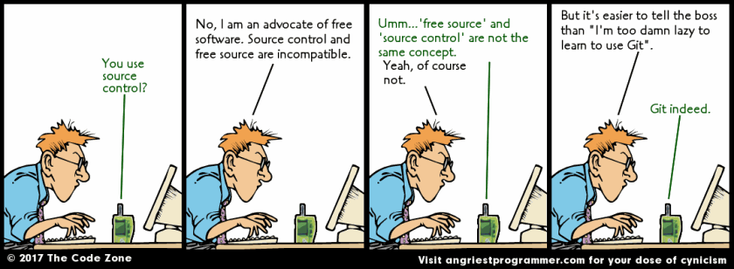
Fighting against yourself: The virtue of ignorance

Slide 6
Why use Version Control?
(and why should I care?)
Pros
Collaborations made easier
Useful Track Record of all chanes
Free Backup
Allows Parallel updates without «breaking» the tools
can be used for everything “text based” (LateX docs, lab notes, these slides!)
Cons
Steep Learning Curve
Not suitable for all workflows!
VC philosophy does not fit well with other, despicable, tools
(Yes, I’m talking to you Jupyter)

Slide 7

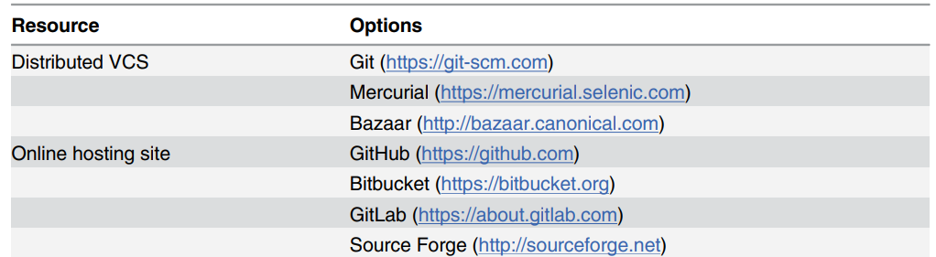

Version Control Systems and Platforms

Slide 8
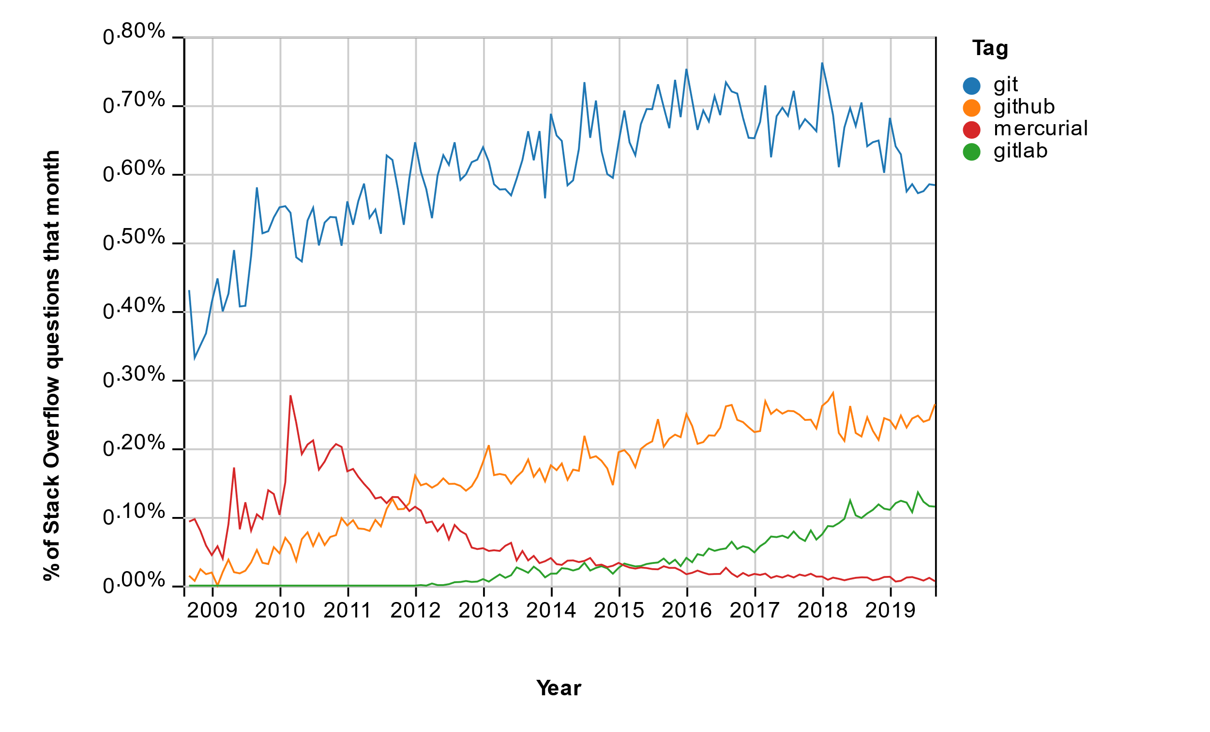

Slide 9

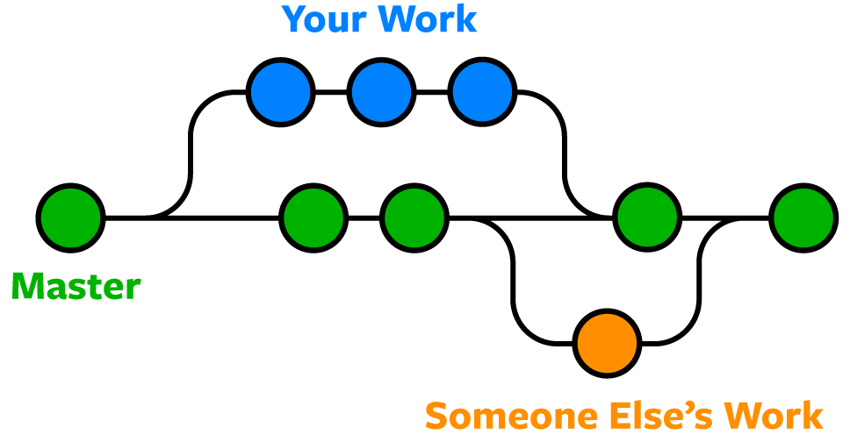
Git Workflow

Slide 10
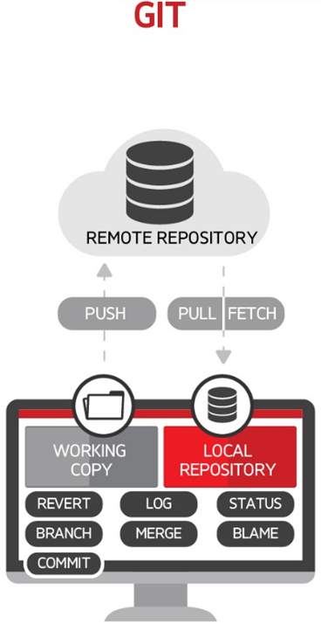
README.nd: your best buddy

Slide 11
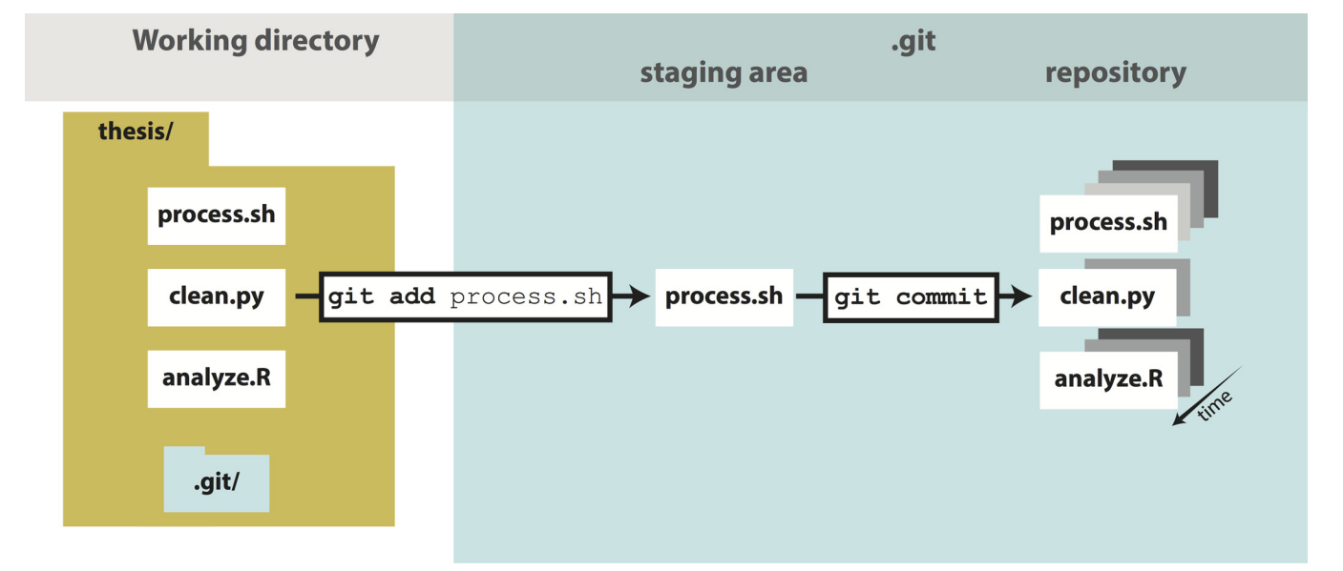

Slide 12


a strict 100MB limit

Slide 13
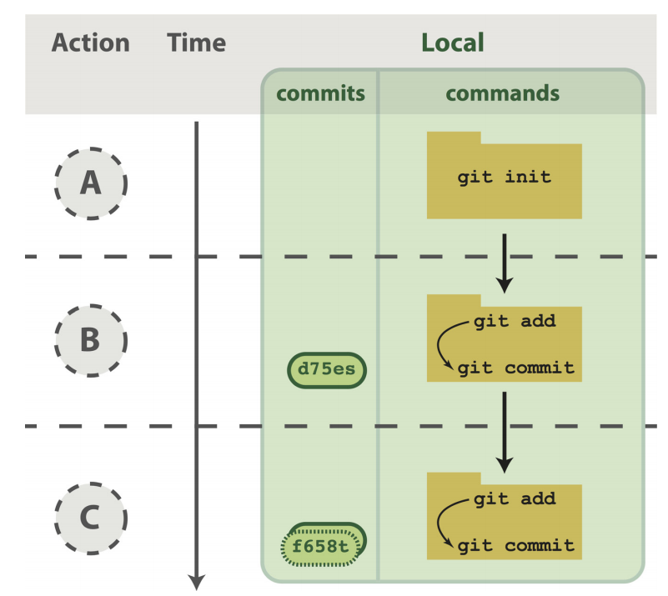
The init-(add)-commit cycle

Slide 14
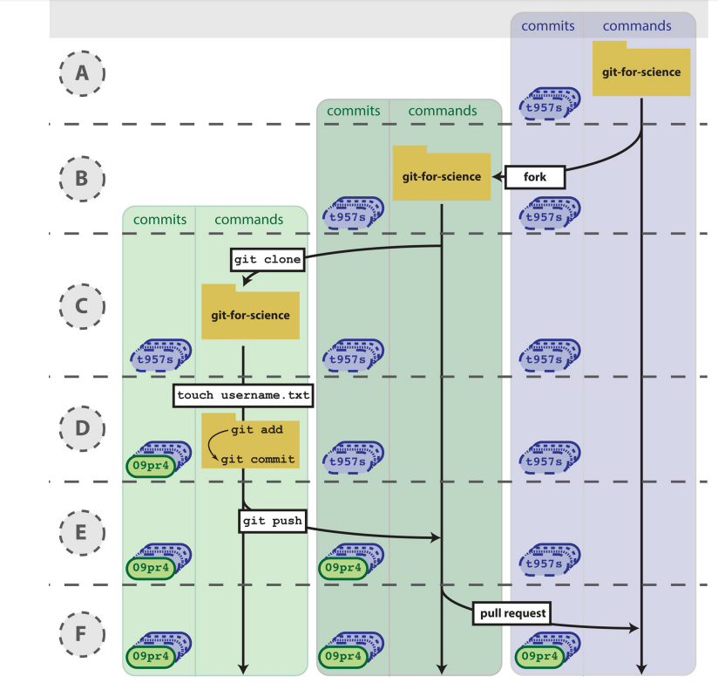
Your First Commit!
(and push)

Slide 15
Pull: the moment of truth

Slide 16
Branching and Merging

Slide 17
Request from external users

Slide 18
Command | Meaning
git init / git clone | initialize a new or existent repository locally
git status | Repo resum (untracked files, commits, etc.)
git commit (–m) | commit changes to your local repo (save local)
git add | add files to git tracking system
git push | push to remote branch (save remote)
git pull | sync and apply last remote version if possible (WILL NOT WORK IF AHEAD)
git fetch | sync local with remote repo (update branches)
git diff | differences among working and committed files
git checkout | reverse untracked changes to previous versions
(Most text editors have these commands in a GUI i.e. PyCharm, Sublime…)

Slide 19
What a Git Repo MUST Contain and Whatnot
Yes
Code, text, scripts
Informative README.md
«Good» commits (see next)
Documentation (comments, vignettes)
Informative branch names
No
Temporary file, logs (use .gitgnore!)
Big (and immutable) Files (use Git LFS for that)
Inintelligibles branch names (no pippo allowed)

Slide 20
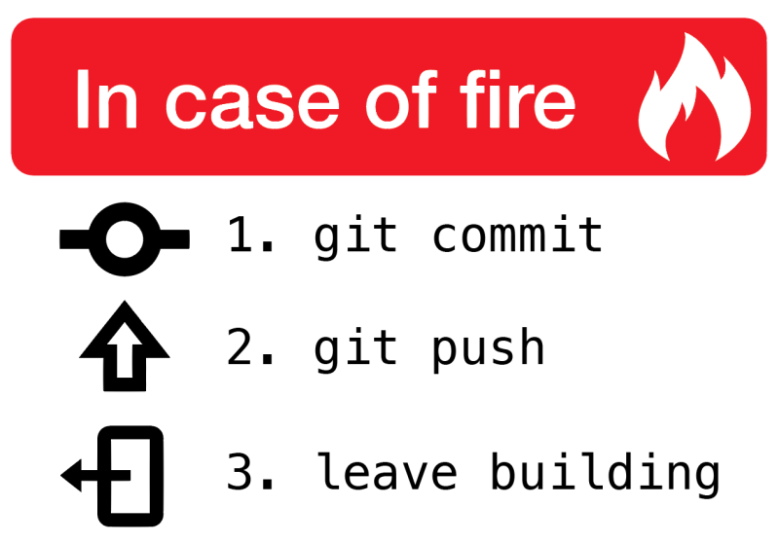
Good Practices
git pull before morning coffee
git commit && git push before leaving the office
Fork every substantial change (even minor)
master branch should always work and be separated from your dev branch

Slide 21
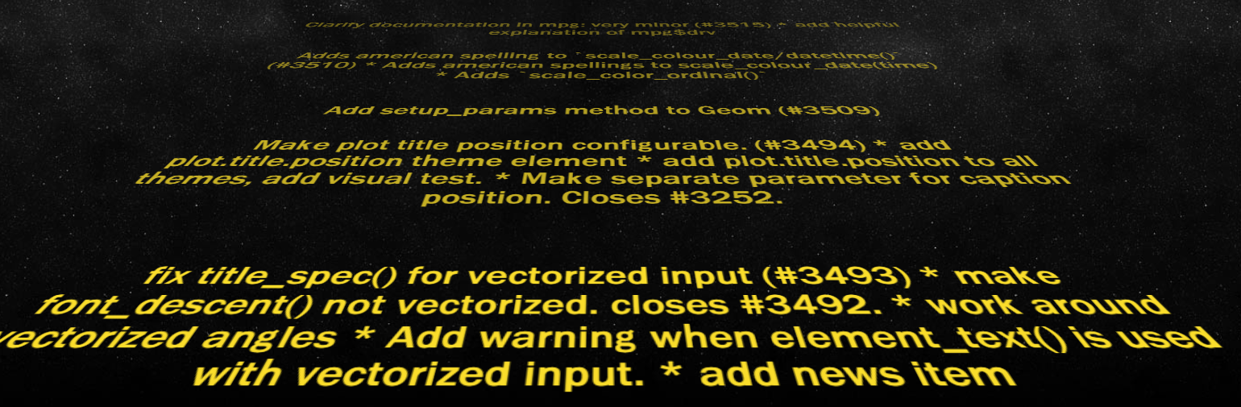
Git Commit Practices
http://starlogs.net/#tidyverse/ggplot2

Slide 22
Good To Know
Management
Wiki

Slide 23
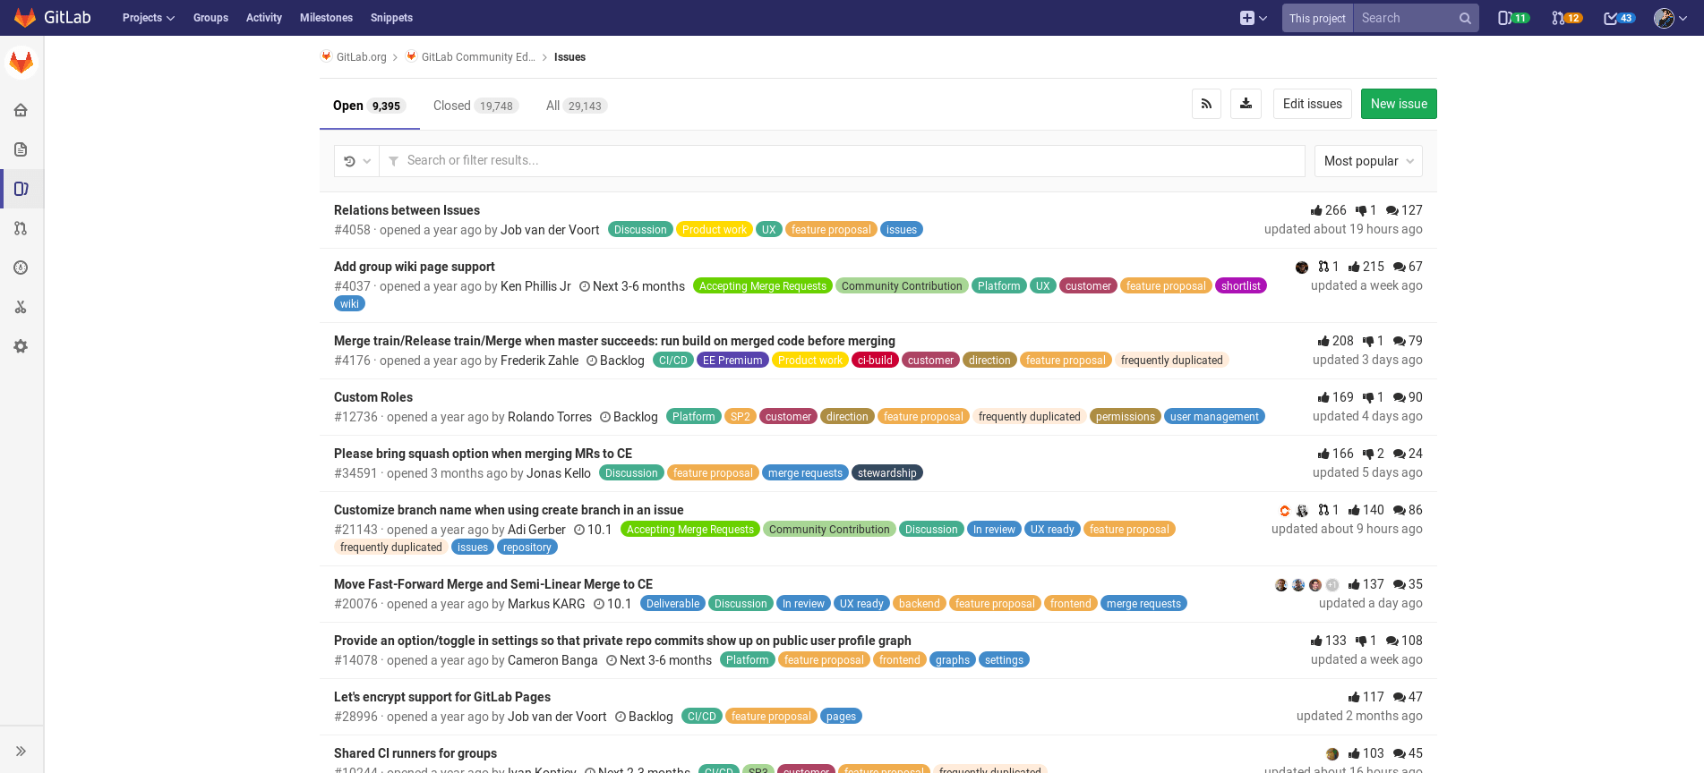
#issues: your best worst nightmare

Slide 24
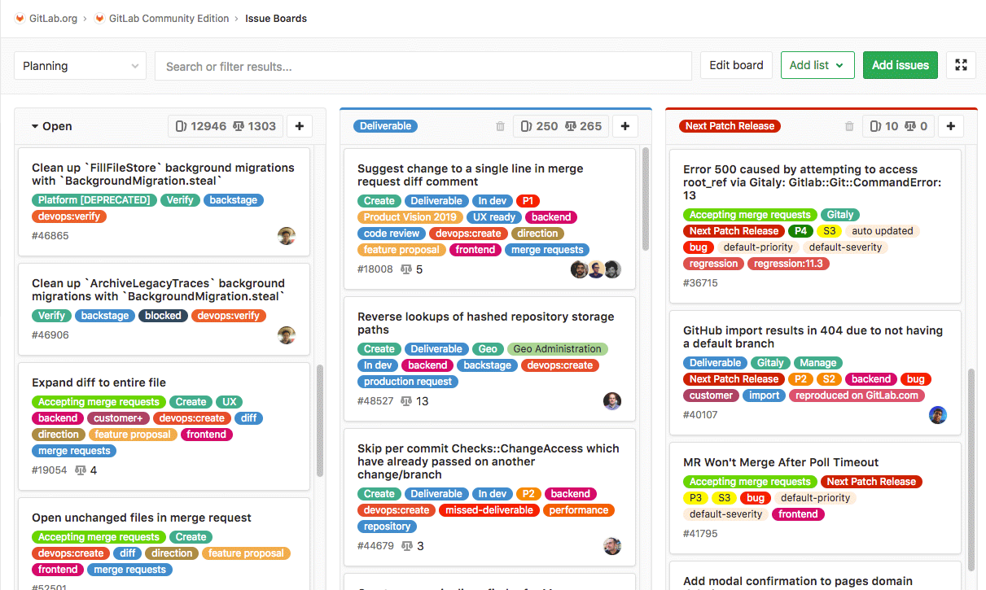
#issues Rules
Informative Title
Informative content
Example behavior (w. Code snippets)
Informative Tags
Use Markdown
Add all the people that can help you
Associate commits to fix

Slide 25
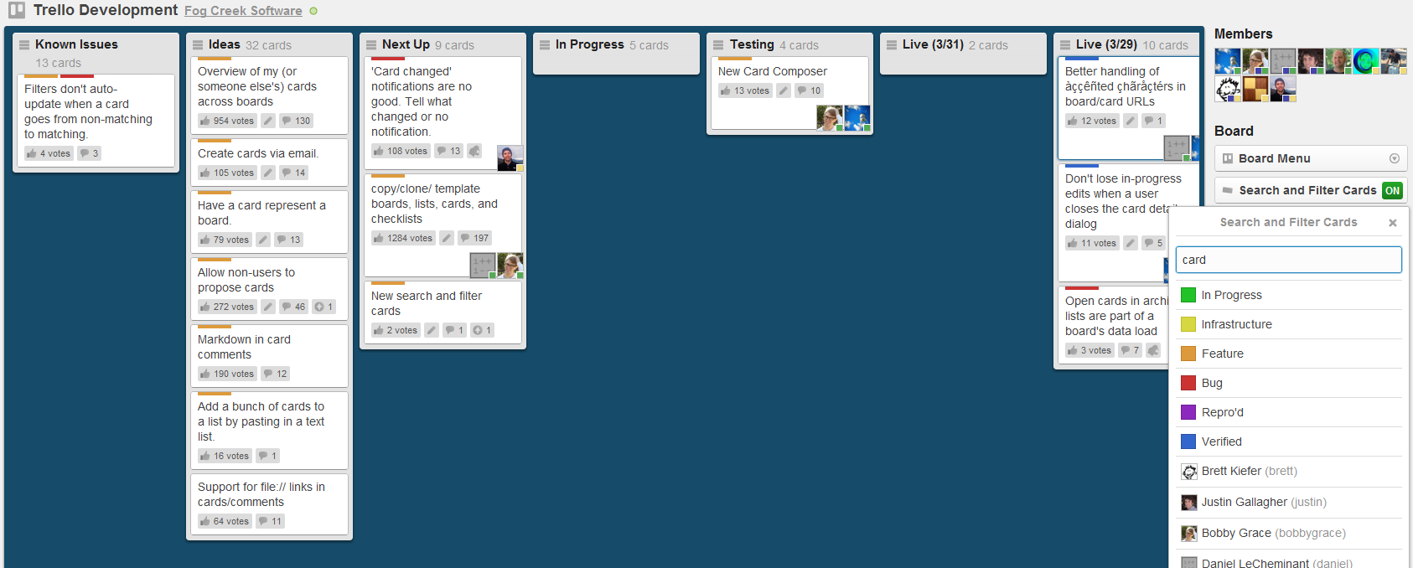
Project Managment and Tracking with Trello / Slack / Microsoft Teams

Slide 26
Useful Resources
Blischak JD, Davenport ER, Wilson G (2016) A Quick Introduction to Version Control with Git and GitHub. PLoS Comput Biol 12(1): e1004668. https://doi.org/10.1371/journal.pcbi.1004668
Git tutorial (Udemy video lectures):
https://www.youtube.com/watch?v=9GKpbI1siow
Good commit practices:
https://github.com/trein/dev-best-practices/wiki/Git-Commit-Best-Practices
Git for beginners: the definitive practical guide: https://stackoverflow.com/questions/315911/git-for-beginners-the-definitive-practical-guide
Git Large File Storage (LFS)
https://git-lfs.github.com/
Using Git with Rstudio:
https://cfss.uchicago.edu/setup/git-with-rstudio/

