Slide 1
Interatomic potentials for oxide glasses
Warisa Roongaraya
Yiyang Zhu
Andres Ramos

Slide 2
Available interatomic models with charges:
Rigid ionic models:
Born-Mayer-Huggins (BMH)
TTAM Tsuneyuki
Pedone Potential (PMMCS)
Polarizable interatomic models :
BMP-FF
Polarizable Ionic Model (PIM)
Reactive Force-Fields:
ReaxFF model

Slide 3
Characteristics of Rigid Ionic Models:
Ions are treated as fixed in space.
Assume spherically symmetric electronic charge distribution.
Ions interact through Coulomb potential.
Commonly used to describe ionic solids.

Slide 4
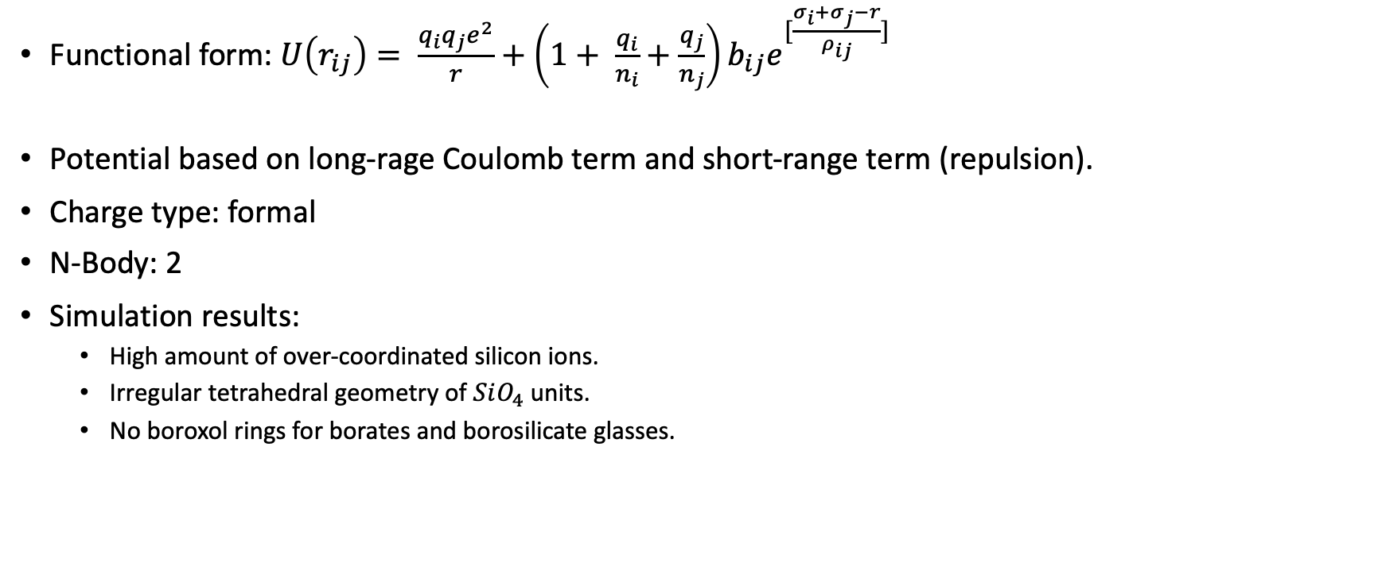
Born-Mayer-Huggins (1976 - 1985)
Functional form: $U\left(r_{ij}\right)= \frac{q_{i}q_{j}e^{2}}{r}+\left(1+ \frac{q_{i}}{n_{i}}+\frac{q_{j}}{n_{j}}\right)b_{ij}e^{[\frac{σ_{i}+σ_{j}−r}{ρ_{ij}}]}$
Potential based on long-rage Coulomb term and short-range term (repulsion).
Charge type: formal
N-Body: 2
Simulation results:
High amount of over-coordinated silicon ions.
Irregular tetrahedral geometry of $SiO_{4}$ units.
No boroxol rings for borates and borosilicate glasses.

Slide 5
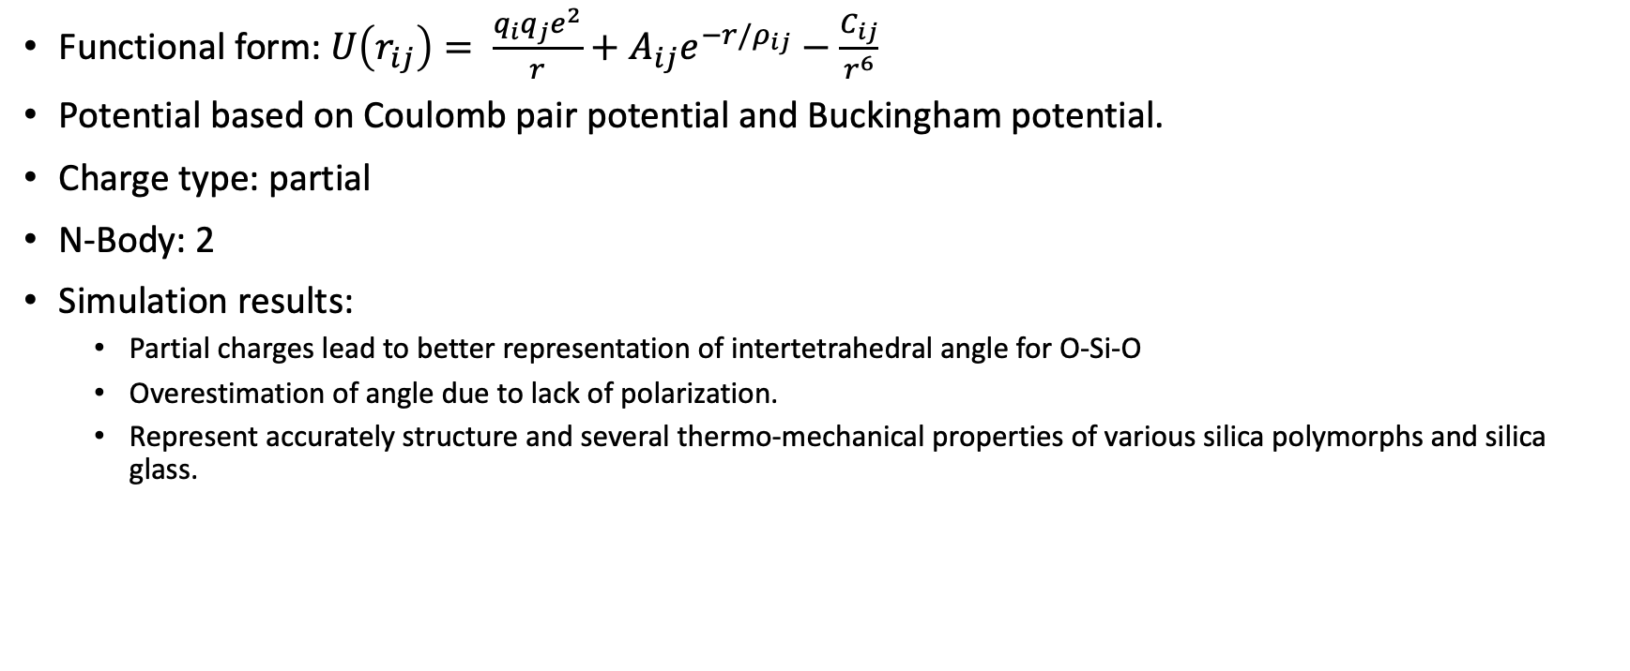
TTAM - Tsuneyuki
Functional form:$U\left(r_{ij}\right)= \frac{q_{i}q_{j}e^{2}}{r}+A_{ij}e^{−r/ρ_{ij}}−\frac{C_{ij}}{r^{6}}$
Potential based on Coulomb pair potential and Buckingham potential.
Charge type: partial
N-Body: 2
Simulation results:
Partial charges lead to better representation of intertetrahedral angle for O-Si-O
Overestimation of angle due to lack of polarization.
Represent accurately structure and several thermo-mechanical properties of various silica polymorphs and silica glass.

Slide 6
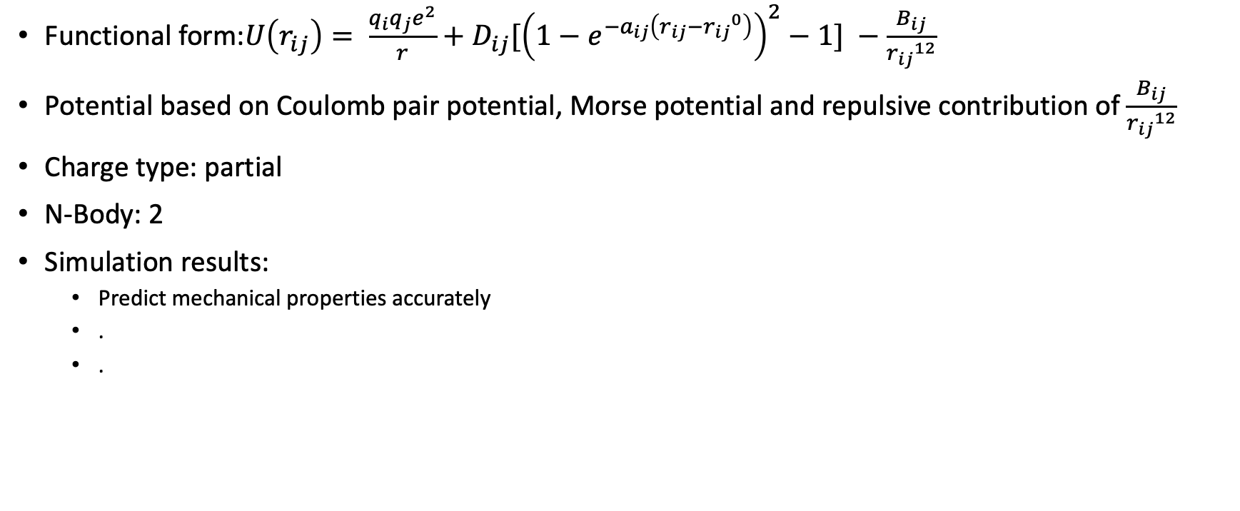
Pedone Potential (PMMCS)
Functional form:$U\left(r_{ij}\right)= \frac{q_{i}q_{j}e^{2}}{r}+D_{ij}[{\left(1−e^{−a_{ij}\left(r_{ij}−{r_{ij}}^{0}\right)}\right)}^{2}−1] −\frac{B_{ij}}{{r_{ij}}^{12}}$
Potential based on Coulomb pair potential, Morse potential and repulsive contribution of $\frac{B_{ij}}{{r_{ij}}^{12}}$
Charge type: partial
N-Body: 2
Simulation results:
Predict mechanical properties accurately
.
.

Slide 7
Available interatomic models with charges:
Rigid ionic models:
Born-Mayer-Huggins (BMH)
TTAM Tsuneyuki
Pedone Potential (PMMCS)
Polarizable interatomic models:
BMP-FF
Polarizable Ionic Model (PIM)
Reactive Force-Fields:
ReaxFF model

Slide 8
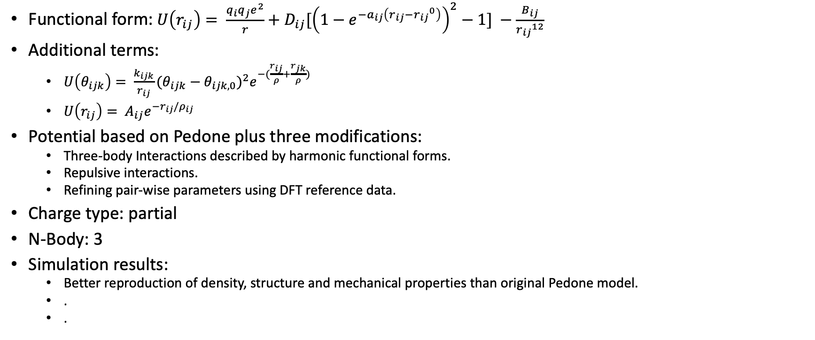
Bertani-Menziani-Pedone (BMP-FF)
Functional form:$U\left(r_{ij}\right)= \frac{q_{i}q_{j}e^{2}}{r}+D_{ij}[{\left(1−e^{−a_{ij}\left(r_{ij}−{r_{ij}}^{0}\right)}\right)}^{2}−1] −\frac{B_{ij}}{{r_{ij}}^{12}}$
Additional terms:
$U\left(θ_{ijk}\right)= \frac{k_{ijk}}{r_{ij}}{(θ_{ijk}−θ_{ijk,0})}^{2}e^{−(\frac{r_{ij}}{ρ}+\frac{r_{jk}}{ρ})}$
$U\left(r_{ij}\right)= A_{ij}e^{−r_{ij}/ρ_{ij}}$
Potential based on Pedone plus three modifications:
Three-body Interactions described by harmonic functional forms.
Repulsive interactions.
Refining pair-wise parameters using DFT reference data.
Charge type: partial
N-Body: 3
Simulation results:
Better reproduction of density, structure and mechanical properties than original Pedone model.
.
.

Slide 9
Polarizable Ionic Model (PIM)
Functional form: https://link.springer.com/article/10.1007/s00214-012-1143-9
Potential based on four components:
Charge-Charge
Dispersion
Overlap repulsion
Polarization
Charge Type: formal
N-Body: 3
Characteristics / Simulation results:
Not widely applied due to complexity and lack of transferability.

Slide 10
Available interatomic models with charges:
Rigid ionic models:
Born-Mayer-Huggins (BMH)
TTAM Tsuneyuki
Pedone Potential (PMMCS)
Polarizable interatomic models:
BMP-FF
Polarizable Ionic Model (PIM)
Reactive Force-Fields:
ReaxFF model

Slide 11
Reactive Force Fields

Slide 12
Models available on LAMMPS

Slide 13
Table comparing available models on LAMMPS

Slide 14
Conclusions

Slide 15
Thank you for your attention.

