Slide 1
Preliminary Design Presentation
Group 23 - Angad, Annie, Francisco, Larry, Waris
Notes:
Fran

Slide 2
NEEDS ANALYSIS
Needs Statement: ​
Industrial and building systems require a safe, cost-effective and reliable method to remove mineral scale build-up from ⌀100-150mm pipes, where existing solutions such as chemical cleaning, pigging, and jetting are either hazardous, resource intensive or ineffective at hard deposits.
Problem Definition: ​
Design a low-cost robotic system that can navigate ⌀100-150mm pipe, mechanically remove scale and improve flow performance while being able to adapt to varying pipe sizes and geometries.
​
Notes:
Fran

Slide 3
DESIGN SPECS: Objectives
Criteria | Objectives​ | Unit of Measurement | Notes
Pipe diameter compatibility | ≤⌀90 | mm
Water sealed electronic enclosure | IP54 | - | Solids (5): Dust protection Liquids (4): splashing water
Navigation of bends | 90 | Degrees
T-Junction entry | ≥80% success | %Trials | Ability to enter branch on demand
Scale removal effectiveness | ≥50 | % | Removal of CaCO₃/rust deposits
Cost | ≤750 | $ | University allocated budget
Traction/adhesion force | ≥5 | N | Maintain grip while engaged
Movement speed | ≥0.1 | m/s | Continuous travel without stalling
Mass | <20 | kg | Lightweight for retrieval and mobility
Live video transmission | 480p, 10fps | pixels, fps | Assists in operator navigation of pipe system
Notes:
Fran (3'27)

Slide 4
DESIGN SPECS: Constraints
Criteria | Constraint
Size/Operation | The system must fit within ⌀100mm inner pipe diameter The system must operate reliably in wet conditions
Cleaning Performance | The system must mechanically remove >50% of simulated mineral scale The system must complete one cleaning cycle without permanent pipe damage
Safety & Reliability | The system must be retrievable via tether in the event of power loss or failure
Monitoring & Feedback | The system must transmit live video
Notes:
Waris

Slide 5
DESIGN SPECS: Criteria
Criteria | Reason
Size | Size of robot must be small enough to fit comfortably in ⌀90mm pipes
Mass | Light weight robot allows for easy transport
Speed | Move as efficient as a water jetting machine
Cost | Overall cost of the solution must be within budget
Manufacturability | Minimal number of parts and simple mechanism
Waterproofing | Work in damp/water splashing conditions
Mobility | Ability to move smoothly within pipes, including bends and junctions
Durability | Resistance to abrasion, chemicals, moisture
Precision | Ability to clean without damaging pipe walls
Notes:
Waris(4'30)

Slide 6
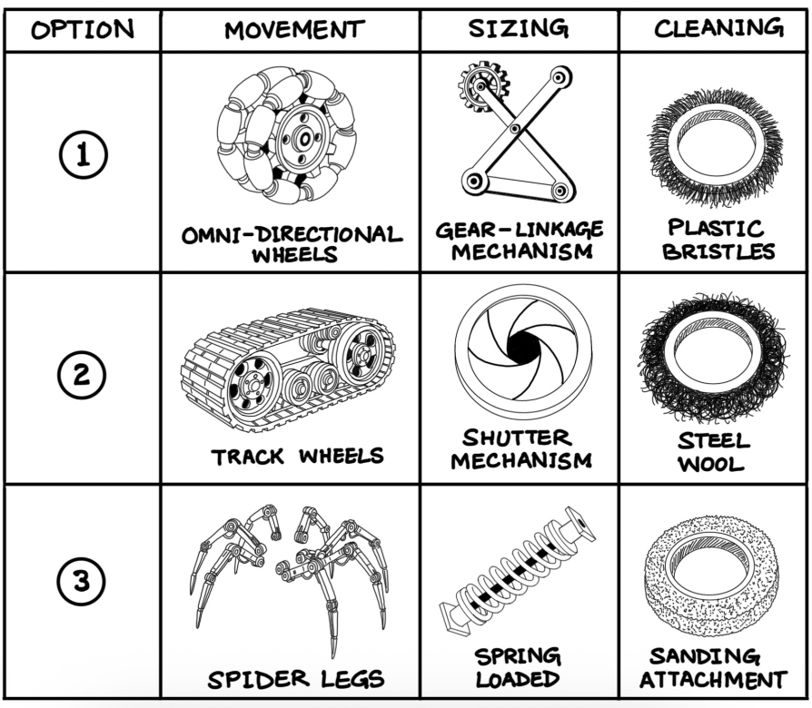
Morphological
chart
Notes:
Angad

Slide 7
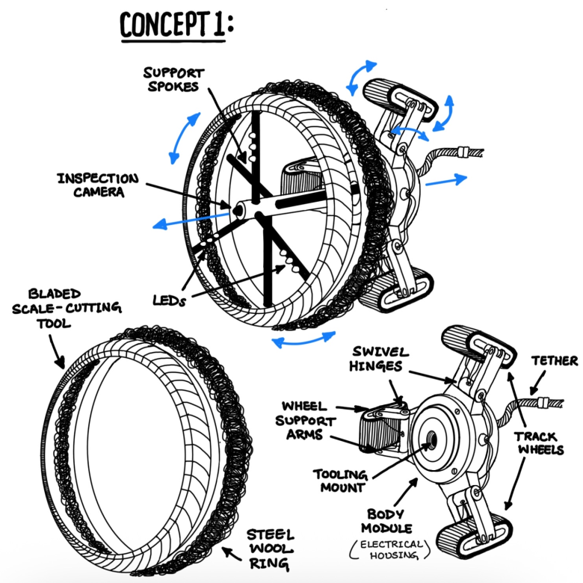
Four-bar linkage tank drive
Notes:
Angad

Slide 8
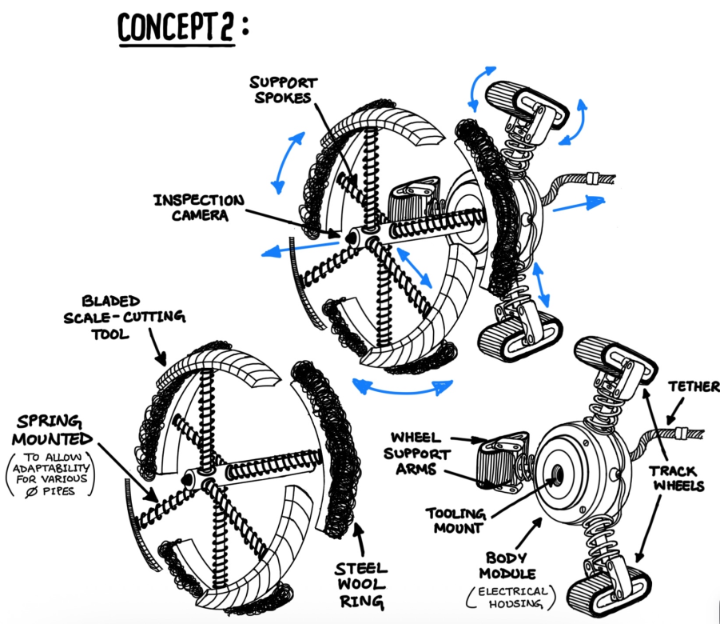
Spring loaded tank drive
Notes:
Angad

Slide 9
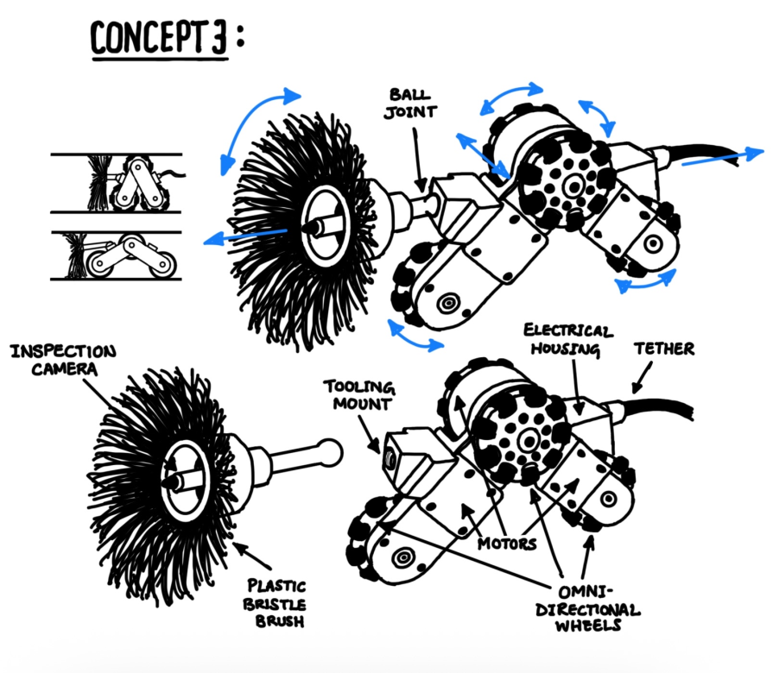
V-splay drive
Notes:
Angad

Slide 10
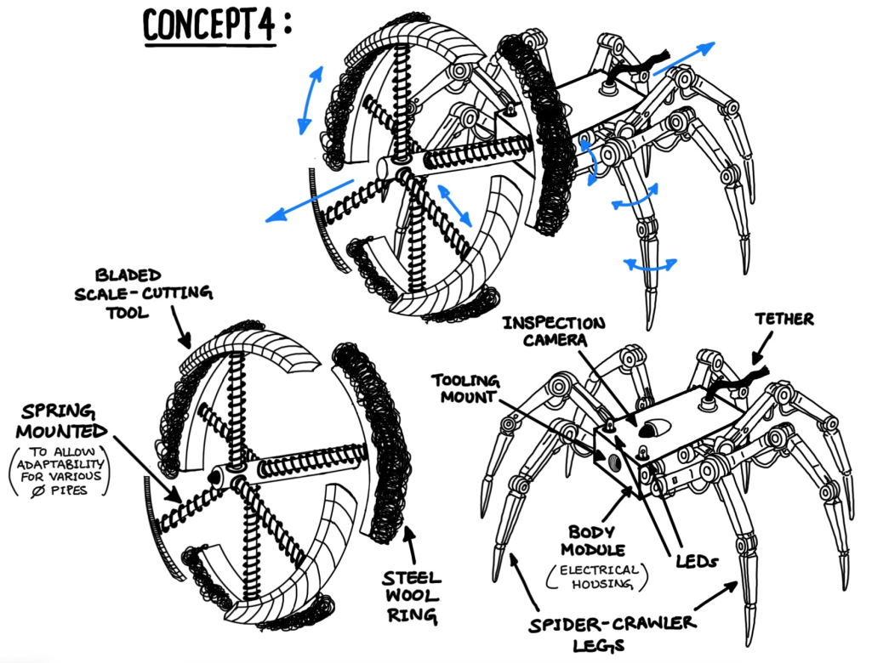
Spider
Notes:
Angad (8'50)

Slide 11
Design Matrix
 |  | Linkage Tank Tread |  | Spring Tank Tread |  | V-Splader |  | Spider
Criteria​ | Priority | Rating | Weighted Score | Rating | Weighted Score | Rating | Weighted Score | Rating | Weighted Score
Size | 1 (x11) | 3 | 33 | 1 | 11 | 2 | 22 | 4 | 44
Mobility | 2 (x9) | 4 | 36 | 2 | 18 | 3 | 27 | 1 | 9
Waterproofing | 3 (x7) | 3 | 21 | 2 | 14 | 4 | 28 | 1 | 7
Durability | 4 (x6) | 4 | 24 | 3 | 18 | 2 | 12 | 1 | 6
Cost | 5 (x5) | 3 | 15 | 4 | 20 | 1 | 5 | 2 | 10
Speed | 6 (x4) | 2 | 8 | 1 | 4 | 4 | 16 | 3 | 12
Manufacturability | 7 (x3) | 2 | 6 | 4 | 12 | 3 | 9 | 1 | 3
Mass | 8 (x2) | 1 | 2 | 3 | 6 | 2 | 4 | 4 | 8
Precision | 9 (x1) | 4 | 4 | 3 | 3 | 1 | 1 | 2 | 2
TOTAL |  |  | 149 |  | 106 |  | 124 |  | 101
Notes:
Waris (9'25)

Slide 12
Design Matrix
 |  | Linkage Tank Tread |  | Spring Tank Tread |  | V-Splader |  | Spider
Criteria​ | Priority | Rating | Weighted Score | Rating | Weighted Score | Rating | Weighted Score | Rating | Weighted Score
Size | 1 | 3 | 15 | 1 | 5 | 2 | 10 | 4 | 20
Manufacturability | 6 | 2 | 10 | 4 | 20 | 3 | 15 | 1 | 5
Mobility | 2 | 4 | 16 | 2 | 8 | 3 | 12 | 1 | 4
Cost | 8 | 3 | 12 | 4 | 16 | 1 | 4 | 2 | 8
Waterproofing | 3 | 3 | 9 | 2 | 6 | 4 | 12 | 1 | 3
Mass | 7 | 1 | 3 | 3 | 9 | 2 | 6 | 4 | 12
Speed | 5 | 2 | 6 | 1 | 3 | 4 | 12 | 3 | 9
Durability | 4 | 4 | 8 | 3 | 6 | 2 | 4 | 1 | 2
Precision | 9 | 4 | 8 | 3 | 6 | 1 | 2 | 2 | 4
TOTAL |  |  | 87 |  | 79 |  | 77 |  | 67

Slide 13
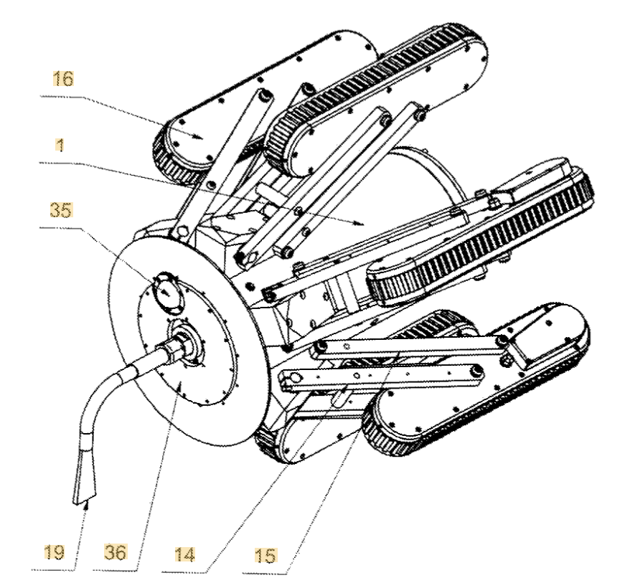
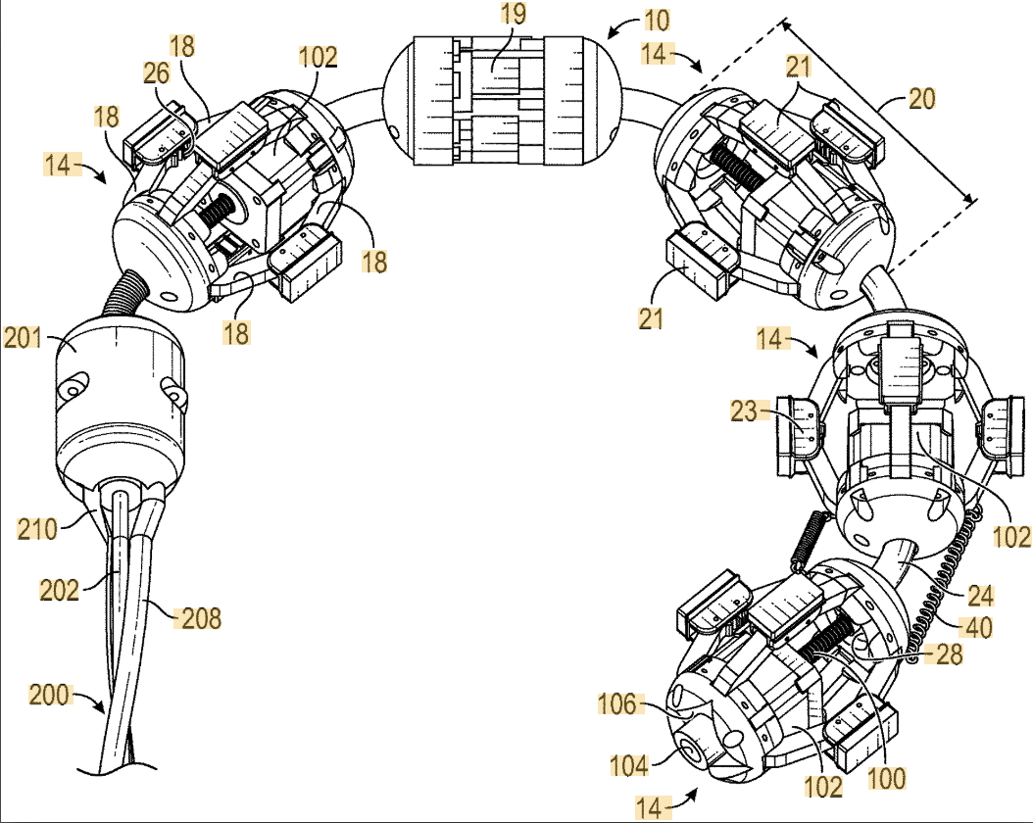
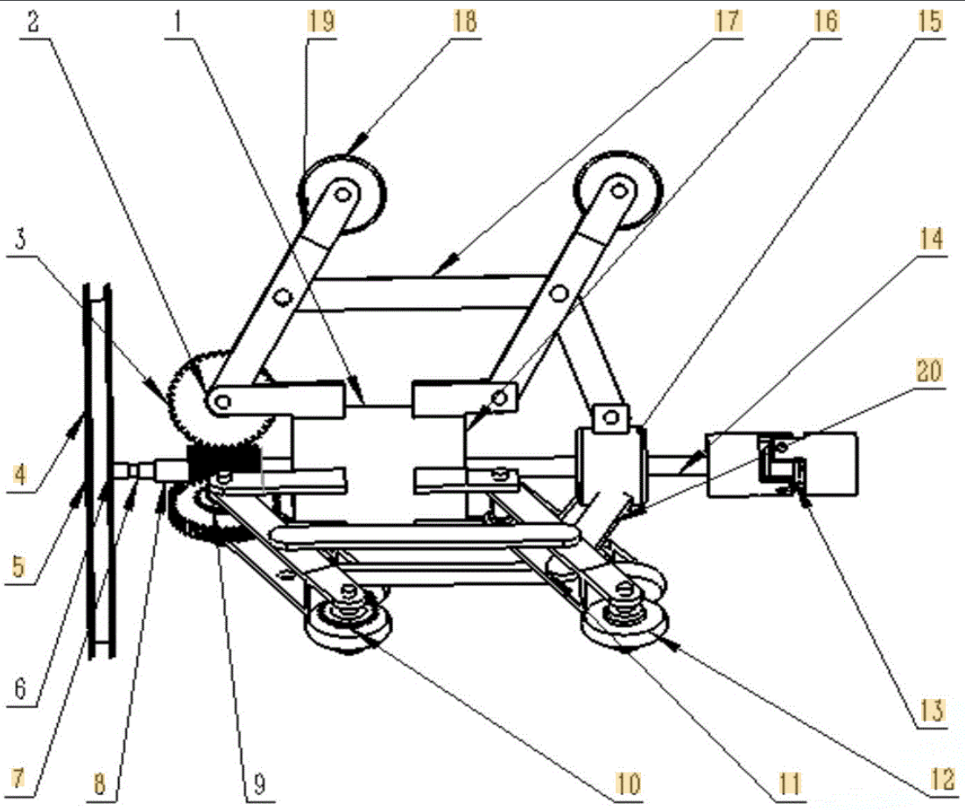
PATENT RESERACH
Adaptable Pipe Cleaning Robot
[CN107649470B]
Jetty Robot 6
[US9101967B2]
Modular Robotic Crawler
[US11781698B2]
Self-centering
Constant-force expansion
Operator-guided bend control
Auto-reverse
Unique radial drive system
Hybrid extension mechanism
Multi-segment architecture
Designed for small diameter pipes
Synchronized radial actuation
Modularity/Hot-swap features
Sensor feedback loop
Notes:
Larry

Slide 14
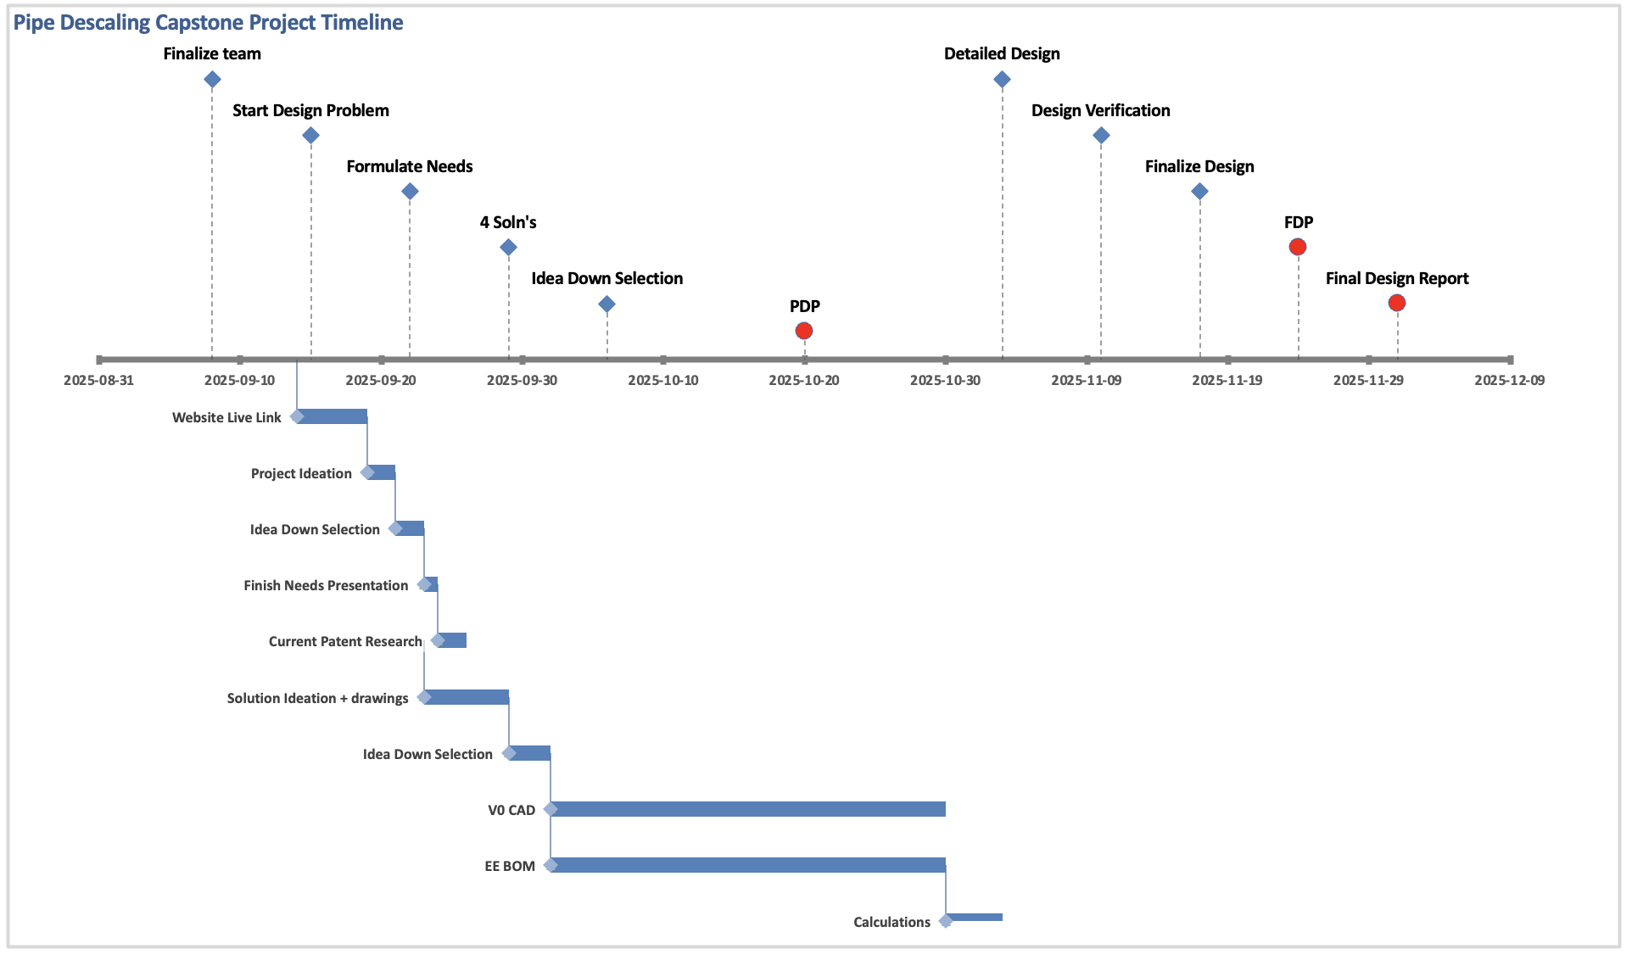
PROJECT TIMELINE
Notes:
Larry

Slide 15

Questions?
Notes:
Larry(10'34)

