Slide 1
This is a title slide

Slide 2
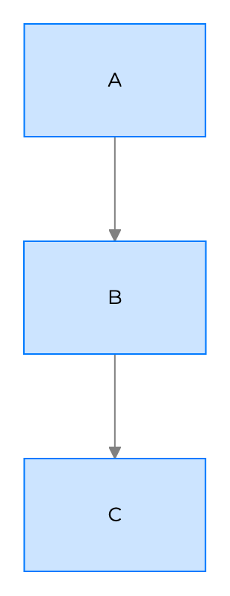
Monday, June 29, 2026

Slide 3
Your name here

Slide 4
Section title slide

Slide 5
Title & body slide
This is the slide body.
Text can be styled for:
emphasis
strong emphasis
strikethrough
fixed width code fonts
Slides :heart: links too!

Slide 6
Section title & body slide
This is a subtitle
This is the body

Slide 7
This is the main point

Slide 8
100%
This is the body

Slide 9
Two column layout
This is the left column
{.column}
This is the right column

Slide 10

Columns can have images
This is the left column
{.column}

Slide 11
Slides can have background images

Slide 12

Slides can have an inline image

Slide 13
Slides can have inline images with custom parameters

Slide 14
Slides can have videos
@youtube

Slide 15
Slides can have code
// Print hello function hello() { console.log('Hello world'); }

Slide 16
Code can be big…
// Print hello function hello() { console.log('Hello big world'); }

Slide 17
… or small
// Print hello function hello() { console.log('Hello little world'); }

Slide 18
Slides can have tables
Animal | Number
Fish | 142 million
Cats | 88 million
Dogs | 75 million
Birds | 16 million

Slide 19
Some inline HTML and CSS is supported
Use span to color text.
Use superscript and subscript, strikethrough or underline, even small caps.

Slide 20
Slides can use custom master slides
Custom master slides can be selected by adding the attribute {layout="Title and body"}, rather than auto detect the layout the slide layout will be chosen from the available master slides by the name.
This can be used with the flag --copy=[presentation id] to copy and use an existing presentation as the source rather than a blank slide.

Slide 21
Slides can have background images
Hello, is it me you’re looking for?

Slide 22
Slides can have an inline image

Slide 23
Slides can have inline images with custom parameters

Slide 24

Slides can have many images

Slide 25


Slide 26


Slide 27


Slide 28


