Slide 1
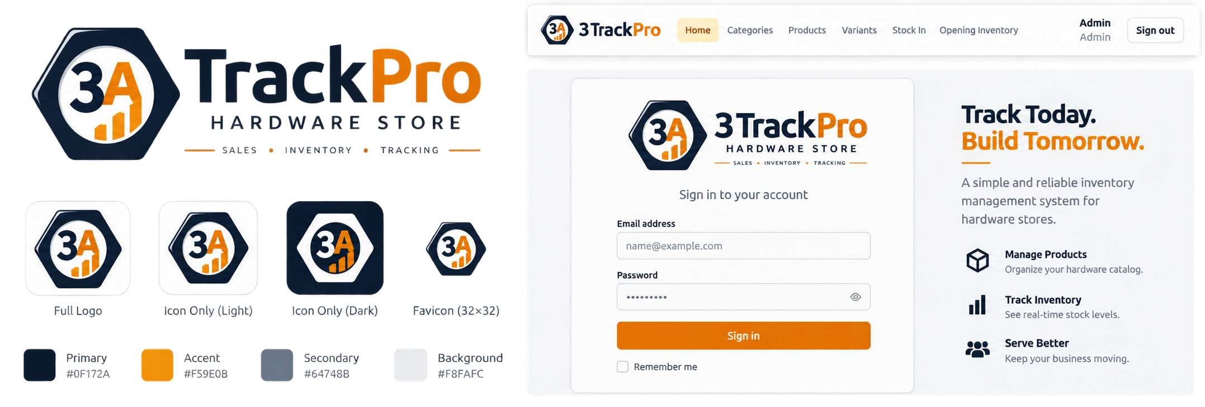
3A TrackPro
Hardware Store Sales and Inventory Management System
Track Today.
Build Tomorrow.
Final presentation deck • The Visionaries
Layupan · Wariza · Largo · Amores · Casipong
Feature-frozen release candidate
Notes:
Layupan opens the presentation and introduces the team.

Slide 2
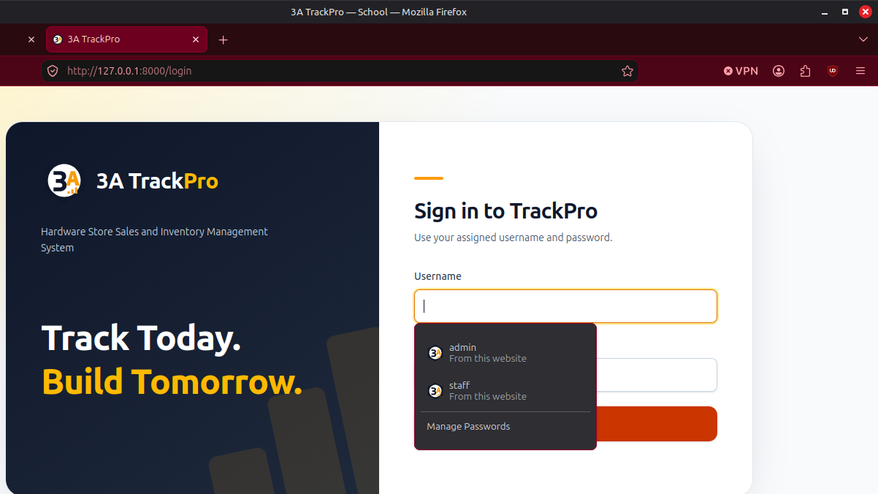
Problem & Purpose
Layupan
Hardware inventory needs traceability, not scattered notes.
TrackPro connects stock, purchases, sales, damage evidence, and reports in one role-controlled system.
• Manual tracking makes stock levels and purchase needs hard to verify.
• Cash sales need receipts, register context, and preserved history.
• Receiving must separate accepted stock from damaged evidence.
• Admins need reports; Staff need safe daily operations.
2
5
8
roles
movement types
reports
Audience cue: show the real login screen, not a mockup.
3A TrackPro • The Visionaries
02
Notes:
Layupan explains the practical problem and why a controlled system matters.

Slide 3
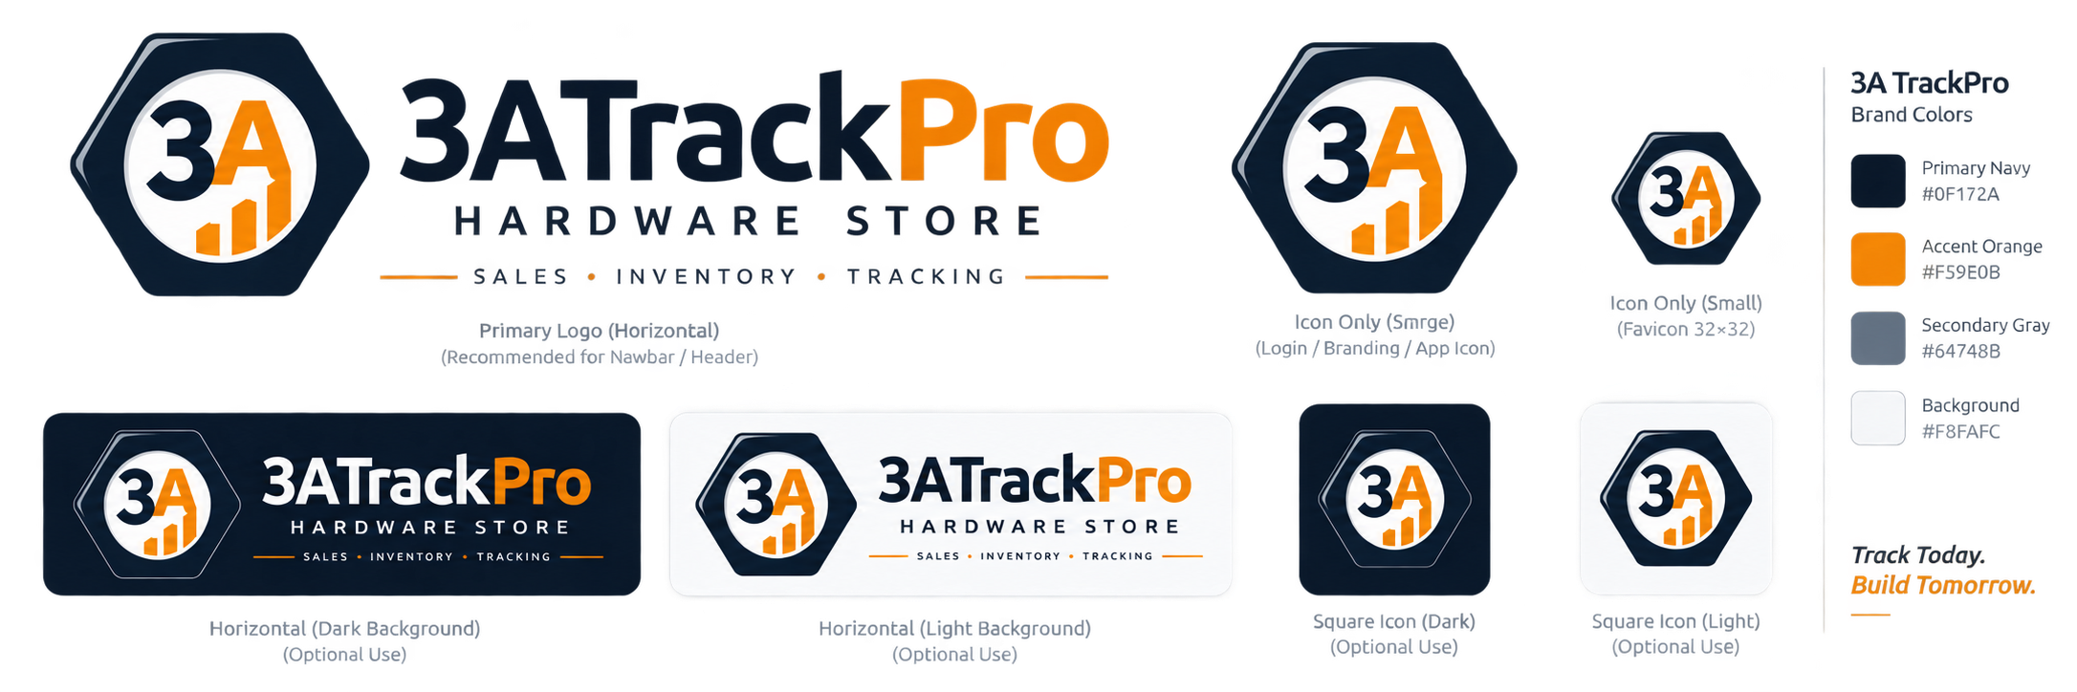
Project Objectives
Layupan
The system was built around four goals.
01
Track inventory per Variant
02
Support cash POS
Stock, unit, threshold, and movement history stay at Variant level.
Register state, receipt, Sales History, and stock deduction stay consistent.
03
Manage procurement evidence
04
Protect roles and history
Low-stock demand, POs, receiving, damage, and follow-up POs remain traceable.
Admin/Staff boundaries, Audit Logs, and immutable evidence support accountability.
3A TrackPro • The Visionaries
03
Notes:
Layupan connects these objectives to the modules that will be shown live.

Slide 4
Users & Role Boundaries
Layupan
Two roles keep daily work simple and sensitive actions protected.
Admin / Owner
Staff / Cashier
• Catalog and user management
• Purchase Orders and follow-ups
• Reports and Audit Logs
• Full Sale Void with evidence
• POS and Sales History
• Stock In and PO receiving
• Movement History
• Daily dashboard views
Server-side authorization is the security boundary
3A TrackPro • The Visionaries
04
Notes:
Layupan explains that access is enforced on the server, not just hidden in navigation.

Slide 5
System Overview
Layupan → Wariza
A browser-based Laravel system centered on inventory evidence.
1
Browser UI
(Admin / Staff)
2
Laravel app
Auth + rules
3
MySQL data
ledger evidence
4
Reports &
traceable evidence
Built for local demonstration
Evidence-first workflow
Feature-frozen scope
PHP/Laravel + MySQL + browser UI; prepared data stored in trackpro_demo.
Movements, reports, receipts, and Audit Logs preserve what happened.
Core functions are complete; remaining work is demo, rehearsal, and presentation.
3A TrackPro • The Visionaries
05
Notes:
Layupan transitions to Wariza. Use this slide to explain the system at a high level only.

Slide 6
Inventory & Low-Stock Story
Wariza
Low stock does not always mean “create another PO.”
Prepared demo evidence
Plywood
2 / 5 sheets
LOW · UNCOVERED
TrackPro separates current stock, thresholds, and open procurement coverage.
G.I. Pipe
4.500 / 5.000 m
LOW · COVERED
Common Nail
15 / 4 kg
HEALTHY
• Variant-level stock keeps units separate.
• Thresholds identify demand.
• Open POs explain whether that demand is already covered.
Claw Hammer
9 / 3 pieces
HEALTHY
3A TrackPro • The Visionaries
06
Notes:
Wariza explains Plywood versus G.I. Pipe. This sets up procurement and reports.

Slide 7
Purchase Order / Receiving / Follow-up
Wariza
Procurement keeps demand, receiving, damage, and follow-up lineage connected.
1
Low-stock demand
G.I. Pipe
2
Parent PO #1
10.000 m ordered
3
Receiving
3.000 accepted
2.000 damaged
4
Follow-up PO #2
7.000 m outstanding
Important distinction
Teacher-scope evidence
Plywood stays low and uncovered; G.I. Pipe is low but already covered by open procurement. They demonstrate different decisions.
Partial receiving, damage-only evidence, transferred demand, and follow-up lineage are shown from prepared records.
3A TrackPro • The Visionaries
07
Notes:
Wariza should be precise: Plywood is the uncovered low-stock example. The PO evidence is for G.I. Pipe.

Slide 8
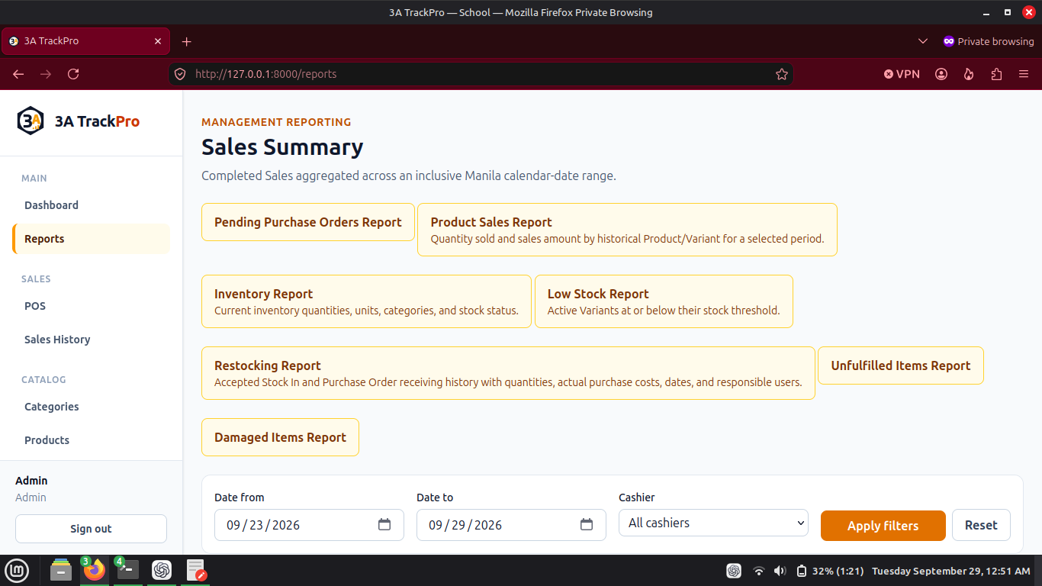
Damage Evidence & Procurement Reports
Wariza
Accepted stock and damaged items are recorded separately.
Accepted receiving
Damage-only receipt
Increases sellable stock and creates Stock In evidence.
Keeps damage evidence without increasing sellable stock.
Pending PO Report
Damaged Items Report
Shows open procurement demand and supplier context.
Preserves damaged quantity, note, PO and receipt context.
3A TrackPro • The Visionaries
08
Notes:
Wariza uses this as a bridge from PO records to reports.

Slide 9
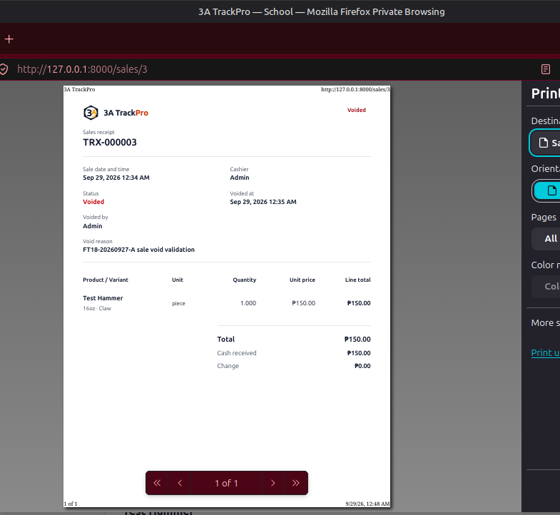
POS, Opening Cash & Completed Sale
Largo
POS flow preserves cash context and stock movement.
• Opening cash is register state — not sales revenue.
• Prepared demo state: register is Closed.
• TRX-000001 is the completed ₱500.00 demo sale.
• Insufficient-stock checkout rejects the sale and deducts no stock.
₱500
0
Closed
completed sale
extra live sales
register state
3A TrackPro • The Visionaries
09
Notes:
Largo should use existing records rather than creating a new sale. Explain that opening cash is not revenue.

Slide 10
Sale Void & Transaction History
Largo
A voided sale remains visible; the system records the restoration.
1
TRX-000002
originally completed
2
Admin void
reason required
3
Stock restored
movement written
4
History retained
no repeat void
Demo reason
Presenter cue
“Transaction entered twice during demonstration.”
Do not perform another live void; show the prepared voided record and explain preserved evidence.
3A TrackPro • The Visionaries
10
Notes:
Largo explains that the status is now Voided, but the original sale evidence remains.

Slide 11
Staff Daily Operations & Movement History
Amores
Staff sees daily tools without Admin-only controls.
Staff Dashboard
Stock In form
Recent activity and daily context.
Record non-PO stock entries through controlled forms.
PO receiving access
Movement History
Staff can receive against POs where allowed.
Opening Inventory, Stock In, Sale, Correction, and Sale Void.
Role story: Staff can perform daily operations, but Admin-only navigation and controls remain absent.
3A TrackPro • The Visionaries
11
Notes:
Amores should sign in as Staff during the live demo and show the role difference.

Slide 12
Reports & Management Controls
Casipong
Reports organize evidence for decisions and defense.
• Sales: summary, Product Sales, completed-sale totals.
• Inventory: current stock, Low Stock, Movement History.
• Procurement: Pending PO, Unfulfilled Items, Damaged Items, Restocking.
• Control: User Management and Audit Logs support accountability.
8
Admin
Read-only
report pages
report access
evidence
3A TrackPro • The Visionaries
12
Notes:
Casipong summarizes reports and management controls. Keep this concise before testing evidence.

Slide 13
Testing & Quality Evidence
Casipong
Quality evidence is reported without combining unrelated totals.
FT18
19 / 19 Pass
SQLite
558 tests / 6,112 assertions
current-scope browser validation
ordinary full suite evidence
PO edit race
3 / 3 focused repeats
Reports
52 tests / 752 assertions
same-revision guarded MySQL verification
polish + build + browser visual check
Historical FT17 evidence remains preserved separately; current-scope FT18 closed 19/19.
3A TrackPro • The Visionaries
13
Notes:
Casipong should keep testing evidence concise. Do not invent a grand total.

Slide 14
Final Scope & Live Demo
Core features are feature-frozen. The live demo shows prepared evidence first, with role-based handoffs.
Layupan
Opening / overview
Wariza
Inventory & procurement + Q&A backup
Largo
POS / Sales / Sale Void
Amores
Staff workflow / Movement History
Casipong
Reports / testing / closing
Presentation allowance communicated to the group: no fixed cutoff; explain the system fully.
Next: live demo and questions.
3A TrackPro • The Visionaries
14
Notes:
Casipong closes and invites questions. Wariza supports deeper cross-module technical questions.

