Slide 1
Netbeans: The best Ruby IDE
That's what I think; so there!

Slide 2
Mainly because the underlying NetBeans IDE works so well
Indents logically (most of the time)
Recognises end of next line
Tracks external file change
Very flexible window control
Good performance
  8 is new – 7.3 is a little faster at the moment
Good support for plugins
Cross platform – works well on Linux, Windows, and Macs

Slide 3
Installation on Linux
Download main app from:
  https://netbeans.org/downloads/
  Change the .sh file permission to executable and run it.
Download Ruby on Rails plugin from:
  http://plugins.netbeans.org/plugin/38549/ruby-and-rails
  Extract files

Slide 4
Installing the plugin
Open Netbeans and select Tools > Plugins
Select the Downloaded tab
Click on Add Plugins …
Change 'Files of Type' to 'All files'
Navigate to extracted plugin files
Click on Open
Follow the menus through, accepting the prompts

Slide 5
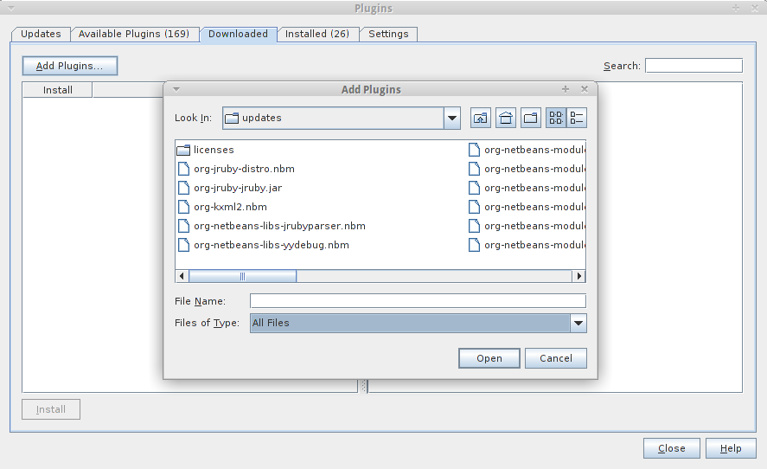
The plugin GUI

Slide 6
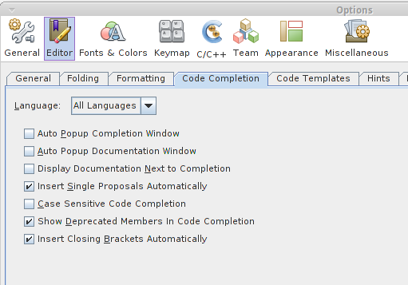
Autocomplete Popup
Turn it off via Tools > Options

Slide 7
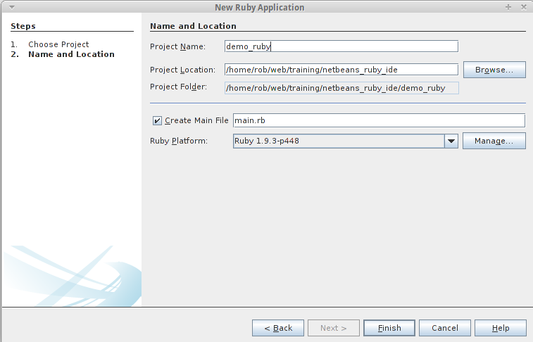
Create a new ruby app

Slide 8
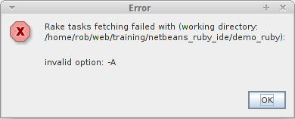
Ignore Rake error

Slide 9
New project
The project will be created with:
  Folders: lib, spec, test, nbproject
  Files: lib/main.rb, LICENSE, README, Rakefile
    Rakefile has some useful defaults

Slide 10
Git: ignore all of nbproject
Netbeans will modify an existing .gitignore to exclude some nbproject files.
However, I'd recommend adding a .gitignore file as nbproject/.gitignore with this content:
  *.*
  */**/*.*

Slide 11
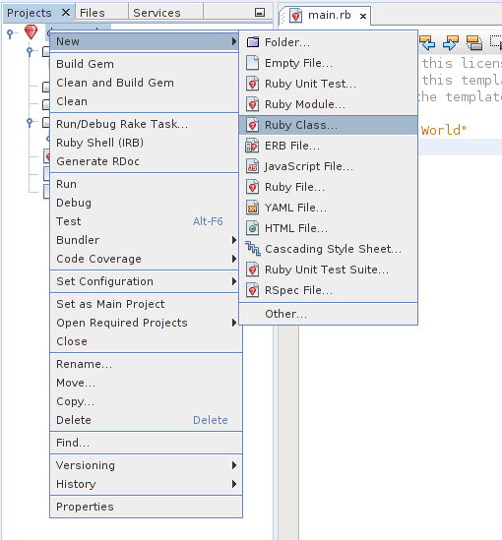
Create new class
Use menu via right click on location in project

Slide 12
New class
Method initialize automatically created
Create a setter
  def colour=(new_colour)
On hitting return, end is created and cursor is placed in right place to start entering content
Variable new_colour has wavy underlining until it is used – when it also changes colour
Selecting the def highlights the matching end
Selecting the ( highlights the matching )

Slide 13
Use with an existing rails app
Select new project
Choose option 'Ruby on Rails Application with Existing Sources'
Navigate to root of existing app
Ignore the rake error again
Create a nbproject/.gitigignore file as before

Slide 14

Block changes
Highlight a block of code
  Tabbing insets text two spaces
    Shift-tab reverses the insets
    Go to Tool > Options > Editor > Formatting to alter tab spacing
  Use file tool bar comment buttons to comment out block of code

Slide 15
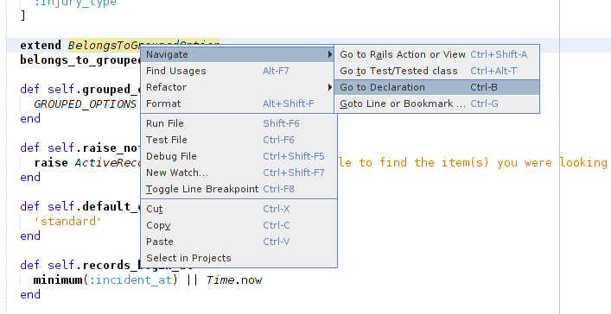
Go to declaration
Right click on a class or method and select Navigate > Go to Declaration
Doesn't work within erb view files

Slide 16
Find in project
Use find in project in Edit menu to search all project files for text.
There is also a replace in project option

Slide 17
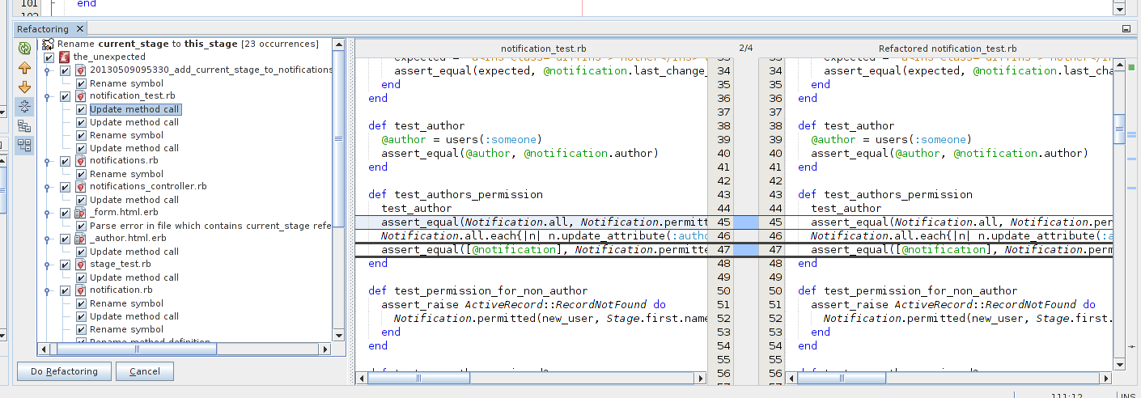
Refactor
Right click on an object or method you want to rename. Select refactor and then rename
Avoid running from declaration

Slide 18
Right margin indicators and errors
Select a method or variable and the location of other instances within the file will be shown as brown bars
The location of errors will be show as red bars
If you save a file with an error, the file will get a warning icon.

Slide 19
Git integration
Modified files and tree get an extra icon
Left margin highlight changes:
  Red margin signifies where lines removed
  New lines indicated by green margin
  Blue margin signifies where lines changed
Hover over margin to view change
Click on margin for options (including rollback)
File names will also change colour to reflect status

Slide 20
History
On right click menu
Allows you to restore deleted files even if they are not version controlled!

Slide 21
Other file support include
HTML
  On create – creates HTML structure
JavaScript
  Highlights errors/issues such as lack of trailing semicolon
CSS and SASS
  SASS support in version 8 (was a plugin before)
YML
  Avoids inserting tabs
  Colour highlight help identify valid structure
Erb

Slide 22
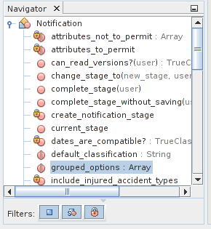
Method Navigator
Window showing methods within page. Makes finding and locating methods in large files easy.
Also shows YML file structure

Slide 23
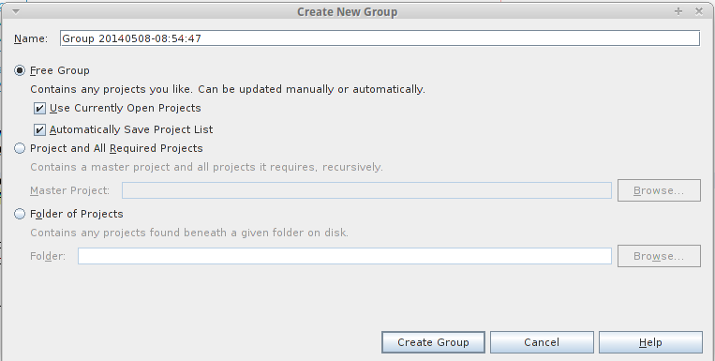
Grouping
Makes it easy to swap between projects
System remembers which files where open and restore them (but not windowing)

Slide 24
Multi-pane / split screen
Drag a window to where you want it
Very useful for comparing files. For example, a test with the class being tested.

Slide 25
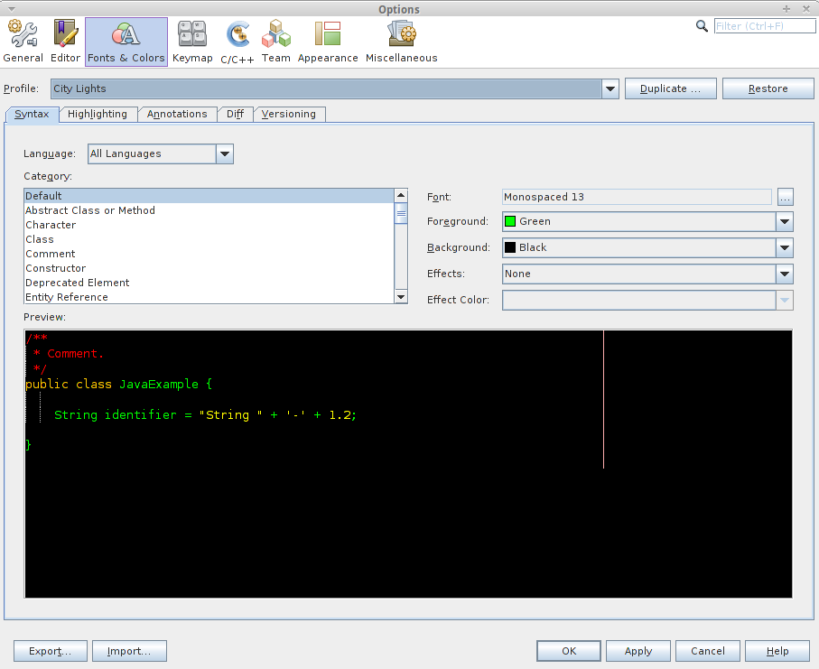
Other colour scheme
http://netbeansthemes.com/

Slide 26
What doesn't work
Rake tasks
Running and testing files within the IDE
Console (unless you open from within folder)
All of these can be done at the console instead
More things work if you launch netbeans from project folder – but I'd rather have project grouping goodness.

Slide 27
What other IDEs do better
Aptana
  Nothing
RubyMine
  Language file support
  Avoidance of the rest of the world. If you want an IDE that does everything for you – this is the one for you!
Sublime
  Multi-line editting
All
  Avoid being owned by Oracle

