Slide 1
内核漏洞

Slide 2
Paths of getting root
Patch setresuid(setresduid(0,0,0)) —> root
commit_creds(prepare_kernel_cred(0)) —> root
Patch sys_call_table —> root
Patch ptmx_fops —> root
DKOM task_struct ->cred —> root
Patch return address(stack overflow) —> root
Patch dynamic allocated data(heap overflow) —> root
SUID(owner)/SGID(owner group)

Slide 3
Paths of getting root
close selinux
modify addr_limit
modify cred
Uid/gid/suid/sgid/euid/egid/fsuid/fsgid
capabilities
security
u:r:init:s0

Slide 4
实施攻击
任意地址写
Credential
任意函数执行
Kernel obj(selinux)
覆盖函数指针
addrlimit
syscall
执行内核指定函数
覆盖sp
Hijack控制流
KSMA
Close selinux
Set memory
Set page
Commit_cred
覆盖一些数据实现功能
Rop
userland
Ptmx->fops
Funtions

Slide 5
攻击屏障
smep
smap
vendor
exploits
Get root
ooB
Impro lock
cfi
Close selinux
Modify addr_limit
Mod cred
Uid,gid,Suid
Capabilities
Security
u:r:init:s0
Suid
uaf
Race condi
/dev
Interger
Impro inpu
uaf
Double fre
Sys call
permission
Uninit data
Info Disclo
other
selinux
text
alsr

Slide 6
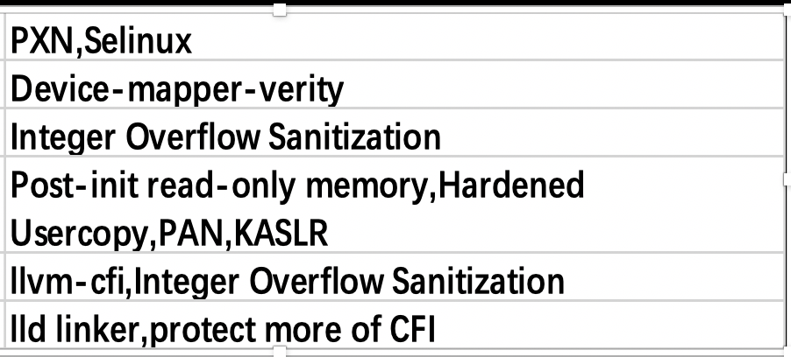
Mitigation

Slide 7
Bypass Mitigation
How to check?
PAN->ttrb0,cpsr寄存器
KASLR->信息泄露，slide
Ret2dir
Vdso
Selinux
Setenforce
Patch kernel space
Call reset_secure_ops
sepolicy
Think
Rop
Mod cp15
Set_fs
Ret2dir
vdso
Root Defense
Execve-fork
XPFO
Trustboot,TIMA
FBLOCKS
………
pxn

Slide 8
用户态调用：
/* 往寄存器0x01写入数据0xef */
fd = open("/dev/ioctl-test", O_RDWR);
memset(&my_msg, 0, sizeof(my_msg));
my_msg.addr = 0x01;
my_msg.data = 0xef;
my_msg.offset = 0x1;
ret = ioctl(fd, IOCWREG, &my_msg);
Demo
地址增长方向
user
0XFFFFFF8000000000
static long test_ioctl(struct file *file, unsigned int cmd, unsigned int*arg)
{
copy_from_user(&msg, (struct msg __user *)arg, sizeof(my_msg));
write_reg(msg->addr, msg->data);
void* va= getkernelPmap();
int * ch = va + arg->offset;
memset(ch,0,32);
break;
}
..........
}
kernel
kernel

Slide 9
Mmap=vuser_addr
Demo
fffffffffffffff
Vuser_addr=va+offset
fffffffffffffff
000000000
fffffffffffffff
地址增长方向
user
0XFFFFFF8000000000
VA+offset
算出VA,能够调整我们可以控制的offset，能够对(VA+offset）任意空间置0
How to root?
000000000
VA addr =?
000000000
000000000
kernel
kernel

Slide 10
ptmx_fd = open("/dev/ptmx", O_RDONLY);
ret = ioctl(fd, ptmx_fd, &arg);
扩展知识
get_root()
{
commit_creds(prepare_kernel_cred (0));
}
地址增长方向
user
0XFFFFFF8000000000
pxn
struct file_operations
{
-------------------
struct module *owner;
int (*iterate) (struct file *, struct dir_context *);
unsigned int (*poll) (struct file *, struct poll_table_struct *);
long (*unlocked_ioctl) (struct file *, unsigned int, unsigned long);
long (*compat_ioctl) (struct file *, unsigned int, unsigned long);
-------------------
}ptmx_fops
kernel
kernel

Slide 11
Demo
00389FA3
IOCTL
000000000
000000000
ROP_READ
地址增长方向
user
0XFFFFFF8000000000
ffffffc000a7fa48
0000000
FFFFFFC0
LDR X0,[X2]
00389FA3
000000000
0000000000389FA3(ptmx_fops)
Ffffffc000a7fa48(ptmx_cdev)→ FFFFFFC000389FA3(ptmx_fops)
kernel
kernel

