Slide 1
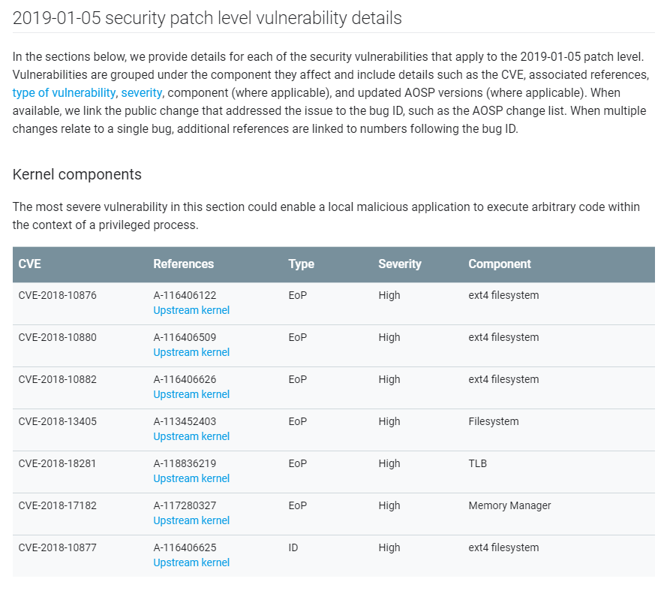
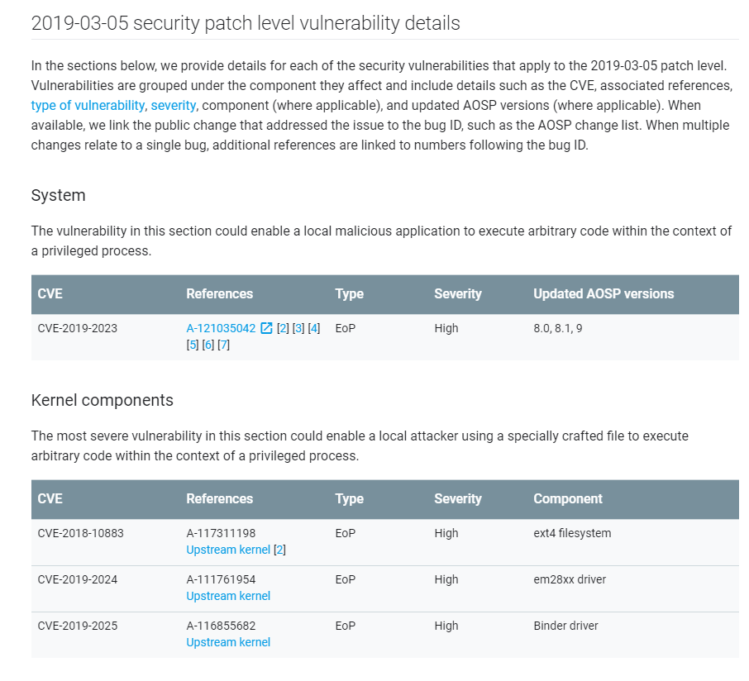
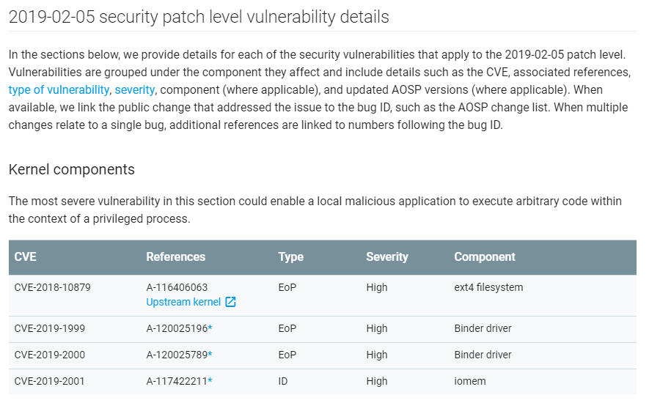
Introduction
Notes:
Ok , now let’s start the topic.
As shown in the above figure, we can see that the Android Security Bulletin disclosed the vulnerabilities from January to March 2019, each of them has a lot of kernel vulnerabilities. And in the vulnerability disclosure in March, CVE-2019-2025 can gain the root access of all the Pixel series mobile phones. Therefore, the research on the android kernel vulnerability is very important.

Slide 2
Passive fuzz architecture
Android kernel passive fuzz
Notes:
Now let’s talk about passive fuzz architecture.

Slide 3
How to achieve passive fuzz
Kernel interceptor
Part of the kernel
Has good stability
Fuzzing trigger
linux system call “kill”
Notes:
So how to achieve passive fuzz? Firstly, we need a kernel interceptor.
The interceptor is built into the kernel as a part of the kernel and has good stability.
When adding the interceptor, you need to pay attention to what considering whether the mobile phone is properly booted, you need to set a start switch for fuzz to avoid this problem after you flashed the kernel with interceptor. So we chooses the linux system call “kill”, although a better method is to add a new system call to do it, but it may damage the stability of the system, so we still uses the kill function that have already in system call. The main advantages are:
1) The owner of this function is the kernel and it has good stability;
2) The function can be called directly in the shell via the kill command, which is easy to use;
3) The function has two parameters, which can provide a variety of usages, such as transferring the filter list to the kernel.

Slide 4
How to transfer the filter list
#include <sys/types.h> #include <signal.h>
int kill(pid_t pid, int sig);
0<=sig<=64
Notes:
But how to transfer the filter list to the kernel?
As we all know, the kill function has two parameters, the one is the process pid and the other one is the signal. After testing we found that the value of the signal is between 0 and 64, but it cannot be a 32-bit or 64-bit address. However, we can use hexadecimal format to transfer data, so we can only use the value of the signal from 0 to 15.

Slide 5
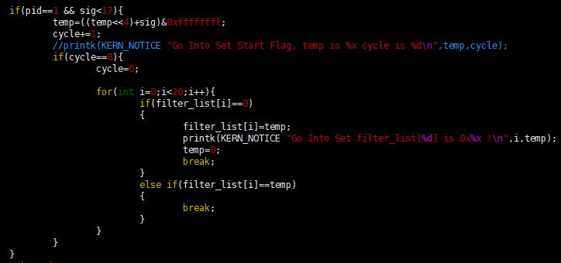
Receive filter list
Notes:
Then the filter list information is received in the kernel. As shown in the figure, since the signal only transmits 4 bits each time, if you want to transfer 32 bits, you need to receive 8 times, so that it can transfer the command code of the ioctl function that you want to filter to the kernel.

Slide 6
Fuzzing strategies
(1) Without changing the length of the parameter;
(2) Modifying the fixed number of bytes;
(3) Only modify one bit or one byte;
(4) Modifying the random number of bytes;
(5) use the for loop to perform multiple fuzz;
(6) Set the fuzz frequency for each target function;
Notes:
After having the kernel interceptor and fuzz trigger, we need the fuzz strategies as follows.
Without changing the length of the parameter；
(2) Modifying the fixed number of bytes in the parameter, for example, modify the length of the parameter by one eighth;
(3) Only modify one bit or one byte in the parameter;
(4) Modifying the random number of bytes in the parameter;
(5) Using the for loop to perform multiple fuzz, in order to reduce the influence of context switching when fuzzing;
(6) Set the fuzz frequency for each target function, such as thousandth.
Because the fuzz frequency will affect the discovery of some vulnerabilities, for example, we found that increasing the fuzz frequency will lead to more OOM-type vulnerabilities when fuzzing.

Slide 7
What do we need to prepare
How to open kasan in the kernel
Kernel panic log
/sys/fs/pstore
console-ramoops-0
dmesg-ramoops-0
pmsg-ramoops-0
Notes:
What do we need to prepare
Firsly, we must know how to open kasan in the kernel, and then if the kernel panicked, we need to know where the panic log is stored.
Collecting the panic log of Android kernel, you need to know first that the panic log of the android kernel is stored in the /sys/fs/pstore directory. There are 3 files in the directory: console-ramoops-0, dmesg-ramoops-0, and pmsg-ramoops-0, the panic log is stored in the dmesg-ramoops-0 file.

Slide 8
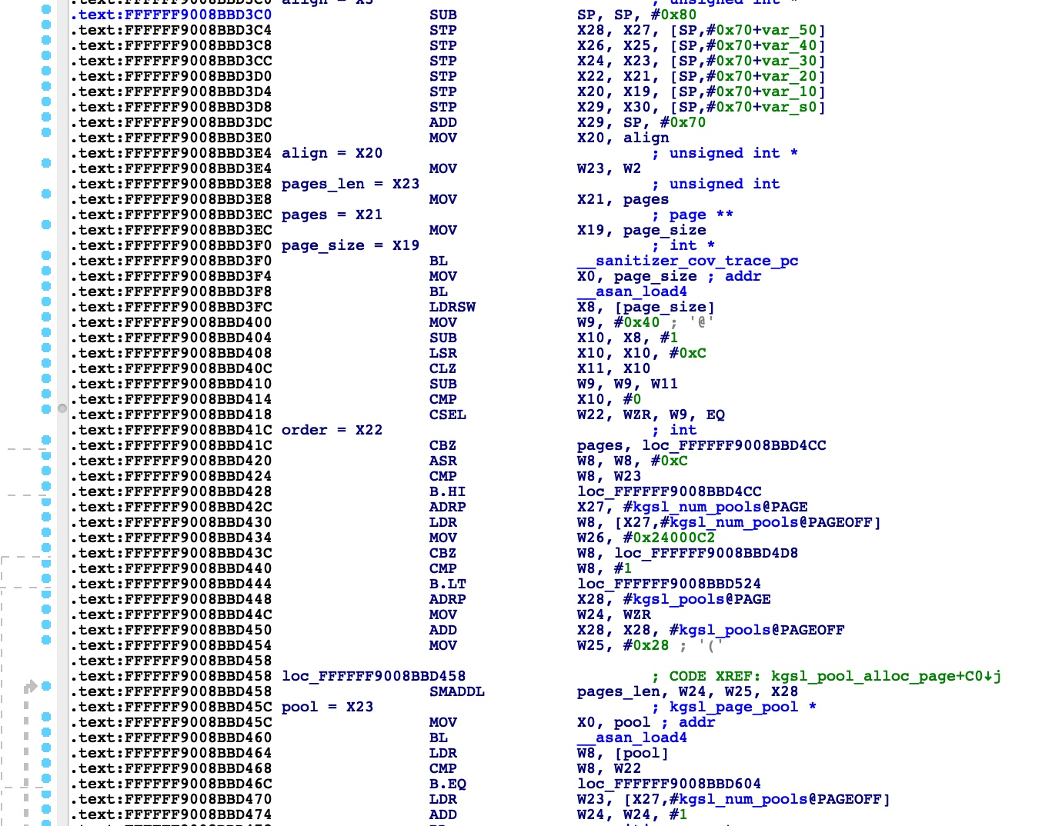
How to open kasan in the kernel
Notes:
Kernel Address Sanitizer (KASAN) is mainly used to detect out-of-bounds memory access and the use of released memory. Google provides kasan configuration file named build.config.kasan in kernel 4.9.96, which can be used directly when we build kernel source code. After building successfully, as shown in the picture.
And kasan will help us find more vulnerabilities.

Slide 9
Build kernel issues
Touch screen cannot work
Required key not available
exec format error
How to deal with?
Remove kernel’s signature authentication
Replace *.ko in the vendor.img
Turn off dm-verity checking
insmod /vendor/lib/modules/*.ko
Notes:
When we have prepared the kernel with interceptor and flash it into pixel 3, the touch screen doesn’t work.
And when compiling Android source code, we found that although all the replaced *.ko files are repackaged into the vendor directory, but no new vendor.img generate, that is to say, AOSP does not generate vendor.img file, but use the default vendor.img provided by Google, so the replaced *.ko file is not packaged into the vendor.img, so the touch screen does not work.
Attempting to use “insmod” command to load the modules in /vendor/lib/modules directory, and find out that why failed. There are two problems, the one is “required key not available”, and the other one is “exec format error”.
But how to deal with it?
The solution is to remove the signature authentication of the kernel, and modify the files in the vendor.img that provided by Google, last but not least, we need to turn off dm-verity checking, otherwise the new vendor.img will fail to load.

Slide 10
Attack interface
Notes:
The kernel attack interface is shown in the figure, all drivers can be used as our attack interface, such as qseecom, v4l2 and kgsl, and so on, you can also choose some memory operation functions, such as copy_from_user, memecpy and mmap.
But here we choose the kgsl driver as the target attack interface.

Slide 11
Why kgsl
User space
OpenGL ES App
EGL wrapper
libEGL.so
Software graphic library
OpenGL ES
Kernel
KGSL
/dev/kgsl-3d0
PMEM
Hardware
Adreno220
Notes:
Why we choose kgsl?
As shown in the figure, kgsl is mainly called by OpenGL ES. It is mainly responsible for the rendering of 3D images in android, and it is mainly used in games, which have many 3D scenes. However, the implementation of kgsl in the kernel is done by OpenGL ES, the OpenGL ES is the HAL layer, which is provided by Qualcomm and has no source code. The next layer is the kgsl-3d0 driver in the kernel, and it has source code, the driver in the phone is /dev/kgsl-3d0.
There are a total of 37 functions in kgsl.

Slide 12
Why kgsl
Notes:
We have statistics on the historical vulnerabilities of kgsl, as shown in the figure.
Through the statistics of historical vulnerabilities of kgsl-3d0 driver, and found that there are a large number of security issues. As can be seen from the above pictures, there are many UAF vulnerabilities in kgsl, which very harmful. Analyzing of these vulnerabilities found that these vulnerabilities were mainly focused on memory allocation and resource race.
Tracing back to KGSL's threat history, there are many security issues. For example, Integer overflow include CVE-2012-4220, CVE-2012-4221, and CVE-2012-4222. There are still many vulnerabilities that can gain the root privileges of the mobile phone without the user's suspicious, and the harm caused by the vulnerabilities is immeasurable. The typically one is QuadRooter.
Therefore, it is necessary to detect the vulnerability of kgsl.

Slide 13
KGSL in detail
Notes:
The above picture shows the whole kgsl passive fuzz framework that include the android kernel startup and device registration process. On the left is the Android system startup process. Firstly, the bootloader will start the kernel and pass the device tree to the kernel. The kernel executes the start_kernel() function to initialize, and a kernel_init() function is responsible for starting the init process to start the Android system. Another important function is called do_initcalls(), which uses some device probes to find and load the drivers that device need when it powers on. As shown in the figure, it’s the driver kgsl initialization process, each driver in the kernel has an initialization function, which is responsible for registering and loading the driver, and the initialization function is called in the do_initcalls() function, so that kgsl-3d0, and the application can use the driver.
Finally, our fuzz idea is fuzzing the content what dst pointer points to after copy_from_user(), and the parameters can be passed in from the user space.

Slide 14
KGSL in detail
kgsl-3d0
Sys_ioctl
kgsl_ioctl
do_vfs_ioctl
kgsl_ioctl_helper
vfs_ioctl
cmds[nr].func
func[1]
func[2]
.
.
.
func[37]
unlocked_ioctl
Notes:
As shown in the figure is the kgsl function call flow chart, kgsl-3d0 is a driver which in /dev directory, when we use it before, we should open it firstly, and then, we will get a handle that can be used by “ioctl” method. In the kernel, it will go into syscall ioctl first, after some simple parameter checking, it will enter do_vfs_ioctl, and in this function, some distribution work will happended. But if there is no matching command code, it will enter the vfs_ioctl function, and there is a very important function here called “unlocked_ioctl”, which is available to other driver developers to implement, and kgsl_ioctl is one of the implementation of this function.
Finally, the function call enters the kgsl-3d0 driver, that including 37 functions, and in kgsl_ioctl_helper method, it will determine which function to call based on the command code. There is a functions structure named kgsl_ioctl_funcs, including function name and command code, that is to say, we can get function name via command code according to this structure. At last, use cmds[nr].func() method to call the target function.

Slide 15
Solution Overview
Notes:
The whole kernel space fuzz framework is shown in the figure, it use the CS mode, and communicating with the android debug bridge. The whole process is divided into four steps:
Firstly, start the fuzz program with the “adb shell kill -17 1” command.
And then, start some 3D games or programs to call the kgsl function
Thirdly, fuzz and crash kernel
Finally, monitor and automatically achieve panic logs

Slide 16
Call stack
EXPORT_METHOD:
EsxContext :
EsxContext::Create3DCmdMgr
…
EglApi :
EglApi::CreateContext
EglApi::SwapBuffers
…
EsxContext :
EsxContext::Init
…
EglManager::initialize
android::egl_display_t::initialize
EglApi::Initialize
EglDisplay::Initialize
EglDisplay::CreateDummyEsxContext
EsxContext::Init
EsxContext::Create3DCmdMgr
EsxCmdMgr::Init
EsxCmdBuf::Create
EsxCmdBuf::CreateMemPool
EsxMemPool::GetMemory
EsxMemPool::AllocateMemory
EsxGfxMem::Create
EsxGfxMem::Init
libhwui.so
libEGL.so
libGLESv2_adreno.so
libgsl.so
libc.so
EXPORT_METHOD:
gsl_memory_alloc_pure
gsl_syncobj_create
gsl_context_create
gsl_memory_map_ext_fd_pure
gsl_memory_free_pure
gsl_command_issueib_sync
gsl_memory_map_ext_fd_pure
gsl_device_getinfo_ext
gsl_device_open
gsl_library_open
…
ioctl
gsl_memory_alloc_pure
ioctl_kgsl_sharedmem_alloc
gsl_ldd_control
copy_from_user()
SyS_ioctl
do_vfs_ioctl
System call
kernel
kgsl_ioctl
kgsl_ioctl_helper
IOCTL_KGSL_GPUOBJ_ALLOC
IOCTL_KGSL_DEVICE_GETPROPERTY
IOCTL_KGSL_SUBMIT_COMMANDS
…
Kgsl-3d0
PMEM
Notes:
As shown in the above picture, it is the system call stack of the kgsl driver, which include user space and kernel space. The right side is the system call stack of the kgsl_ioctl_gpuobj_alloc() function, which is triggered by libhwui.so. The EglManager::initialize() function is called first, then enters libEGL.so, and the android::egl_display_t::initialize() function is called. Then, it will enter libGLESv2_adreno.so that is provided by Qualcomm. There are a lot of export functions for the upper layer to call, and it is also the bridge for the user layer to access the kgsl driver. Finally, it will enters libgsl.so which directly executes the system call ioctl to access the kgsl driver. Through the tracking call process we found that when each application is initialized, the ioctl_kgsl_driver_entry function in this dynamic link library is called firstly to open the kgsl-3d0 driver and get its handle, which can be used to call the functions of kgsl.
Generally, the upper module will call the gsl_* type functions of libgsl.so, but sometimes the ioctl_kgsl_* type functions will also be called directly, such as ioctl_kgsl_sharedmem_free. Finally, the ioctl() function is called by the gsl_ldd_control() function to access kgsl driver in the kernel, so that the user space parameters can pass into the kernel. Before the dispatch function of kgsl, the copy_form_user() function will copy the parameters passed in by users to kernel space, and we can do some fuzz ideas here, causing the kernel panic.

Slide 17
Panic call stack
EglManager::initialize
android::egl_display_t::initialize
libhwui.so
EglApi::Initialize
EglDisplay::Initialize
EglDisplay::CreateDummyEsxContext
EsxContext::Init
EsxContext::Create3DCmdMgr
EsxCmdMgr::Init
EsxCmdBuf::Create
EsxCmdBuf::CreateMemPool
EsxMemPool::GetMemory
EsxMemPool::AllocateMemory
EsxGfxMem::Create
EsxGfxMem::Init
libEGL.so
libGLESv2_adreno.so
libgsl.so
libc.so
SyS_ioctl+0xe4/0x110
do_vfs_ioctl+0x7a0/0xcf8
kgsl_ioctl+0x30/0xe8
kgsl_ioctl_helper+0x188/0x260
kgsl_ioctl_gpuobj_alloc+0x38/0x1b4
gpumem_alloc_entry+0x18c/0x508
kgsl_allocate_user+0x84/0x2c8
kgsl_sharedmem_page_alloc_user+0x2f0/0x704
kgsl_pool_alloc_page+0x48c/0x584
__alloc_pages_nodemask+0xcb8/0x101c
out_of_memory+0x254/0x35c
oom_kill_process+0x134/0x938
dump_header+0xcc/0x1e8
dump_stack+0xa4/0xc0
dump_backtrace+0x0/0x4
ioctl
copy_from_user()
gsl_memory_alloc_pure
ioctl_kgsl_sharedmem_alloc
gsl_ldd_control
System call
kernel
Kgsl-3d0
Notes:
As shown in the figure is a kernel panic call stack, and the crash occurs in the kgsl_ioctl_gpuobj_alloc() function.

Slide 18
Automatic passive fuzz
Android kernel passive fuzz
Notes:
Now let's talk about how to make the kernel passive fuzz automation.

Slide 19
How to make it automatic
console-ramoops-0
dmesg-ramoops-0
pmsg-ramoops-0
Notes:
Fuzz automation server is deployed on the PC, and communicates with the mobile phone through ADB. The main work of the server is shown in the picture:
1) Monitor the status of the mobile phone, mainly to check whether the mobile phone is restarted to determine whether the mobile phone is panic. We can use command “adb devices” to check whether the mobile phone is in the device list, if it is not, it means that the phone is panic or restarting.
2) Since the kill function is selected to trigger fuzz, it is necessary to modify kill function code, and in order to avoid repeating fuzz already panic functions, we need to filter the target functions. So we uses the sig parameter of the kill function to transfer the filtering information to the kernel.
3) In the process of fuzz, the mobile phone is often in a suspended state, so it needs to be monitored. The monitoring method is using the printk to add the kernel log. Since the kernel log has a level limit, the KERN_NOTICE or KERN_INFO is selected for kernel log, otherwise there will be no kernel log output, and the system provides the “dmesg” command to view the kernel log, but it must be use root privileges, so you must first execute “adb root” before. After adding the kernel log, you need to listen to the log. The way to listen is to use dmesg command to view the current last line kernel log, which is recorded as “startline”. After six seconds, check the kernel log again, record it as “endline”, and then compare the two. If it is the same, means that the phone is temporarily suspended, listen after one minute, if it is different, means no hangs, continue to listen. If the number of same times equal 10, it is considered that the mobile phone is hanging and needs to restart, and there is sufficient time for the mobile phone to recover from the suspended state, it can avoid the mobile phone keep in a suspended state.
4) Collecting the panic log of Android kernel, you need to know first that the panic log of the android kernel is stored in the /sys/fs/pstore directory. There are 3 files in the directory: console-ramoops-0, dmesg-ramoops-0, and pmsg-ramoops- 0, the panic log is stored in the dmesg-ramoops-0 file. After the kernel panic, the phone will automatically reboot. After that, the panic log will be generated in the /sys/fs/pstore directory. And the PC detects mobile phone paniced, it will be pull out of the phone and saved by ADB.
5)At the same time, in order to avoid duplication of these panic logs, an md5 value for each panic log will be stored in the MongoDB, if there is a duplicate, the panic log will be detected and will not be stored.

Slide 20
Fuzz status statistics
Notes:
In the kernel fuzz process, we need to know the status of fuzz, for example, you can view the kernel code coverage when fuzzing, and find out the code branch that passive fuzz does not reached, filtering the functions that have been found or no need to fuzz, Because if it is always in the same or often in the same function panic, it will make our passive fuzz unable to continue to find other functions that may appear panic, for example, our mobile phone just panic when restarting, what’s more, it crashes in the same function, in this way, it can't Found problems with other functions. But if filtering these functions that have panicked, we can avoid such problems. so as to improve the performance of kernel passive fuzz. And there are two ways to get the status, the one is to add the log in the source code of kernel for each function; the other one is to open the KCOV of the kernel, use KCOV to record coverage of the kernel that have been reached, and save them into the database, and then develop IDA Plugin to achieve.

Slide 21
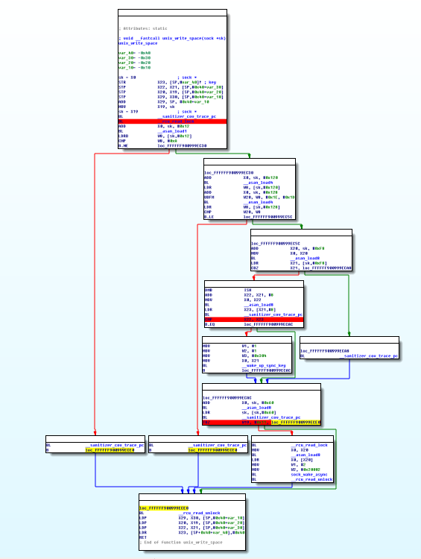
KCOV in IDA
Notes:
It is what kcov looks like in IDA, This is a simple IDA plugin I wrote in python that can mark the reached block and generate a text report file about the function's coverage.
You can also use the lighthouse to show the coverage, it will be more beautiful.

Slide 22
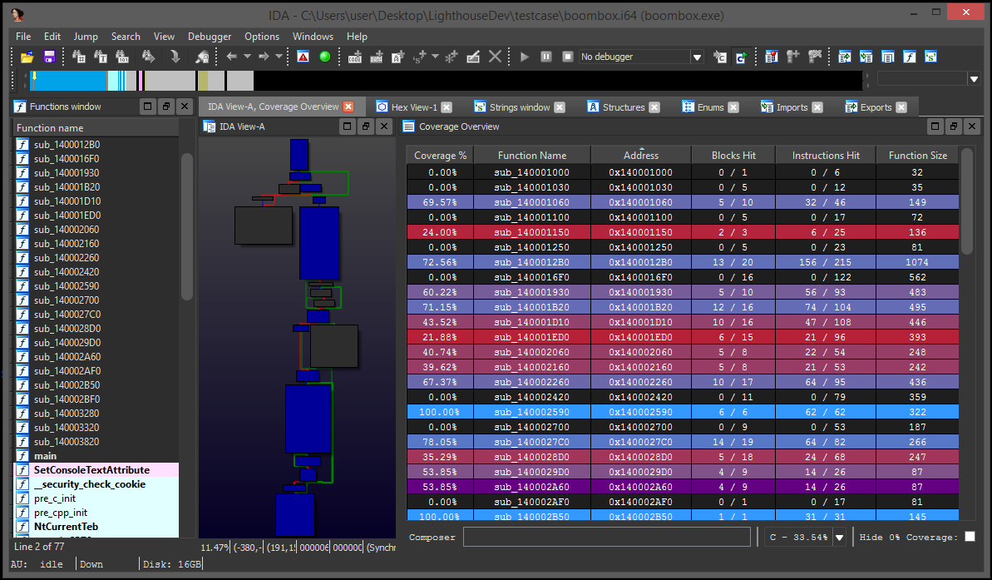
KCOV in IDA
Notes:
It looks like this, it is a sample diagram of the lighthouse, because we don’t used in our fuzz system.

Slide 23
Fuzz status statistics
Notes:
This bar chart shows the fuzz status of kgsl-3d0, the left side indicates the number of crashes, The right side shows the number of each fuzzing function.
It can be clearly seen from the above table that a total of 15 functions are triggered, but there are 37 functions in kgsl-3d0 in kernel 4.9.96, and 22 still not reached. In the process of monitoring, we can filter out the functions that are often crashed at the same place, or the trigger frequency is high but without any crash, add their command code to the filter list. So that you can focus on fuzz other functions that maybe crash, thus it can improve fuzz efficiency.
At the same time, it can be seen that many methods are rarely triggered, and many methods are not triggered at all, and the vulnerability was found by the methods which was most frequently fuzzed. Therefore, in addition to setting the filter list, it is also necessary to solve the problem what methods coverage. Since kgsl is a 3D graphic driver, we can install and run different kinds of 3D games to improve methods coverage. Or add a trigger program, use the command code and recorded parameters of each kgsl method to call the methods actively, so we can improve the fuzz frequency of these methods, after that we can achieve a better fuzz performance.

Slide 24
Install and run different kinds of 3D games
PC
adb shell am start …
Application
Game1
Game2
…
Graphics driver
(OpenGL ES)
Status
record
Kernel
Passive fuzz
kgsl
Notes:
As shown in the figure, it is the strategy 1 that starting different 3D games to improve the code coverage, but there is a disadvantage, the calling frequency of many methods is still not high, which can not achieve a good fuzz performance. However, in the passive fuzz, a high methods trigger rate is required to find out as many panics as possible, so we need to find out some strategies to improve the fuzz frequency of each method. There are two ways to do this. The first method is to add a for loop to each function that fuzz reached, so that you can increase the fuzz frequency by modifying the parameters of the for loop. The second method is to add an active trigger program. We will add the fuzz status record in passive fuzz, whenever a new function is fuzzed, record its command code and parameters, and then use the record data to achieve the purpose of active triggering by writing a trigger program.

Slide 25
add a for loop
int StartFuzz (void *uptr,unsigned int n)
{
……
int i;
for(i=0;i<20;i++)
{
Fuzz_N_bytes(uptr,n);
}
……
}
Notes:
Add a for loop like this, it can ensure that multiple fuzz are performed under the same context, which can reduce the influence of context changes and improve the fuzz frequency of each function.

Slide 26
Add a trigger program
new ioctl
Application
Trigger program
Status
record
Kernel
System ioctl
Passive
fuzz
kgsl
Notes:
However, the active triggering method also has a disadvantage, that is, the fuzz function is single, and cannot associate the context of each function call, so that it can only find the vulnerability in the internal processing of a single function, and cannot associate it with other functions, such as CVE-2016-3842, the vulnerability involves two kgsl functions that need to be used together. So we combine the two ways to achieve better fuzz performance.

Slide 27
CVE-2016-3842
if(pid){
while(1){
arg_free.id = 1;
ioctl(fd,IOCTL_KGSL_GPUMEM_FREE_ID, &arg_free);
}
}
ret = ioctl(fd,IOCTL_KGSL_GPUMEM_ALLOC, &arg);
if(ret){
perror("alloc");
}
Notes:
This is part of CVE-2016-3842's poc. It can be seen that the vulnerability is caused by race condition. It needs to involve two kgsl functions instead of a single one.

