Slide 1
Use Foursquare Data to Enhance Property Valuation Models

Slide 2
Background
Property valuation models are used by many industries and people
Hedonic model, using linear regression, is a popular choice for property valuation models
Traditionally, only characteristics of the property itself are used
Locational data may provide information about neighbourhood amenities for a property, which may improve the quality of property valuation models

Slide 3
Data
Property sales and characteristics data from the Province of Nova Scotia
Locational data (venues) from Foursquare

Slide 4
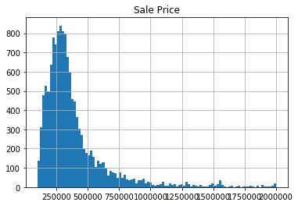
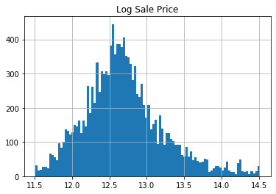
Exploratory data analysis
Property price follows a log-normal distribution

Slide 5
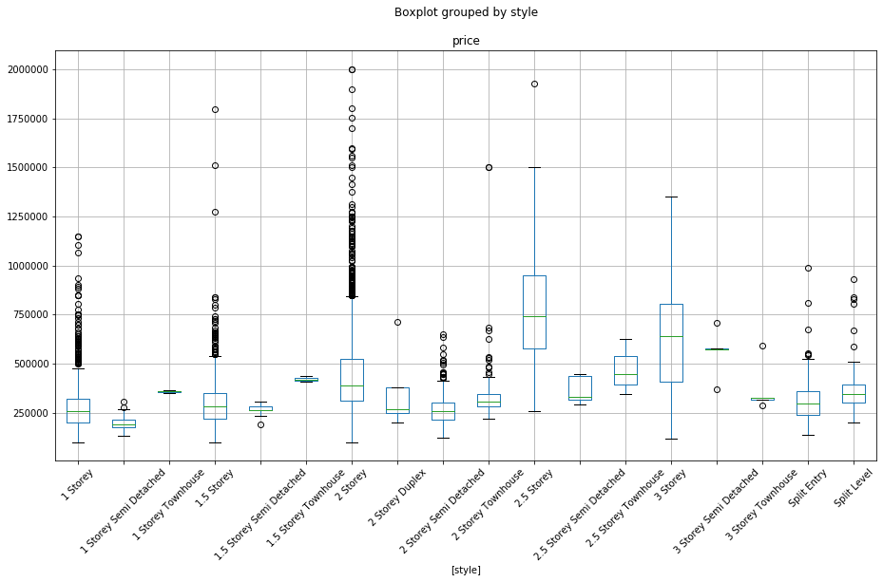
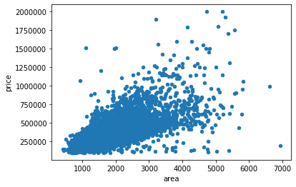
Exploratory data analysis
Property floor area and style are highly influential to price

Slide 6
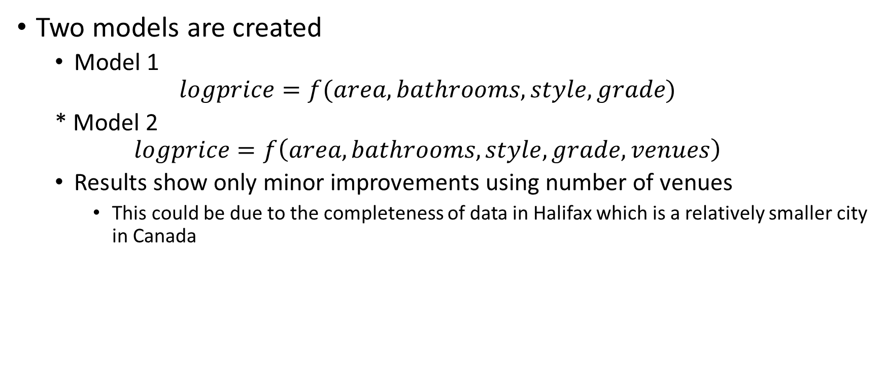
Models and results
Two models are created
Model 1
$$logprice=f(area, bathrooms, style, grade)$$
* Model 2
$$logprice=f\left(area, bathrooms, style, grade, venues\right)$$
Results show only minor improvements using number of venues
This could be due to the completeness of data in Halifax which is a relatively smaller city in Canada

Slide 7
Recommendations
Investigate and choose better predictors for use in the regression model
Choose a larger city such as Toronto where locational data are more complete

