Slide 1
The Battle of the Neighborhoods in Austin, Texas
Applied Data Science Capstone
by IBM/Coursera

Slide 2
Korean Fried Chicken and Bar
Establish a Korean Fried Chicken and Bar business in an Austin, Texas neighborhood
Use the Foursquare API to search for an ideal neighborhood
Search for an Austin neighborhood with high food and bar venue interest, and ideally close to the University of Texas Austin

Slide 3
Data Acquisitiion and Cleaning
20 initial list of neighborhoods around Austin Texas was acquired from wikipedia.
Data cleaning was done and neighborhoods too distant from Austin Downtown neighborhood were dropped.
Neighborhoods with missing latitude or longitude data after processing through geocode/Nominatim were also dropped.
Post data cleaning, 10 neighborhoods were available for Foursquare venues processing

Slide 4
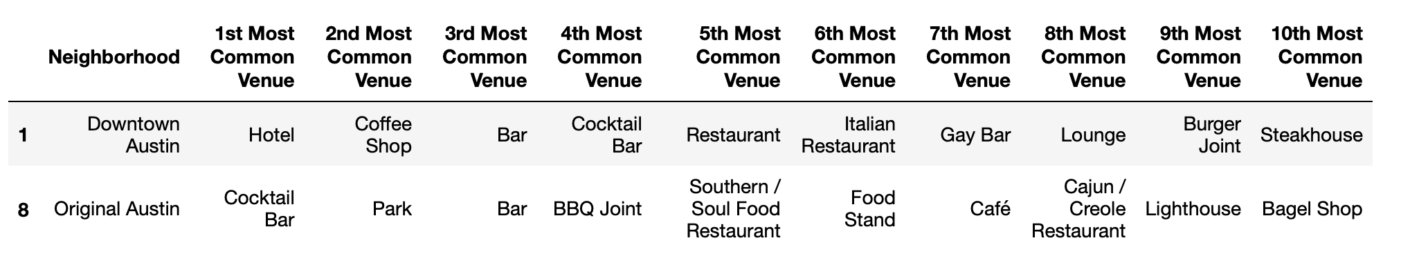
Foursquare Top Results
Total of 6 venue clusters were processed. Cluster 1 neighborhoods showed the highest number of food and bar venues:
Downtown Austin
Original Austin

Slide 5
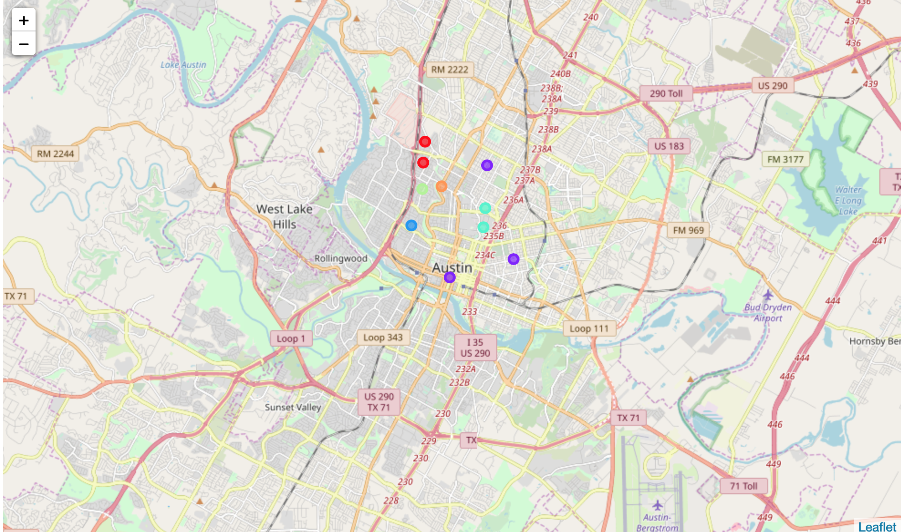
Austin Neighborhoods
Original Austin
Year-round business crowds in the afternoon and evenings and late night crowds _______
Many food and bar establishments in the neighborhood _______
1.1 miles from the University of Texas Austin _______
1.5 miles from Downtown Austin
Hyde Park
Downtown Austin
University of Texas Austin

Slide 6
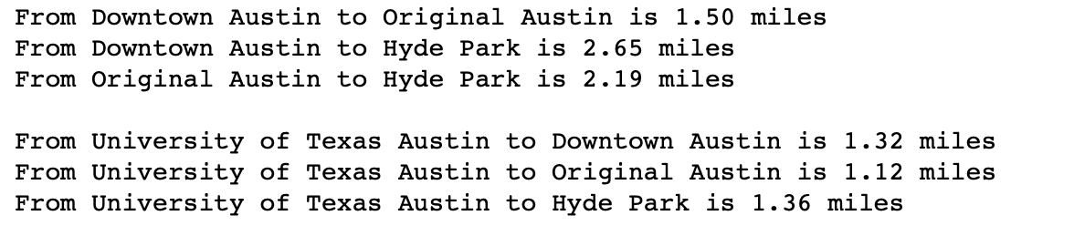
Distances Between Selected Neighborhood
All three neighborhoods look promising but Original Austin seems to be best choice given that it is closest to University of Texas Austin and to Downtown Austin.

Slide 7
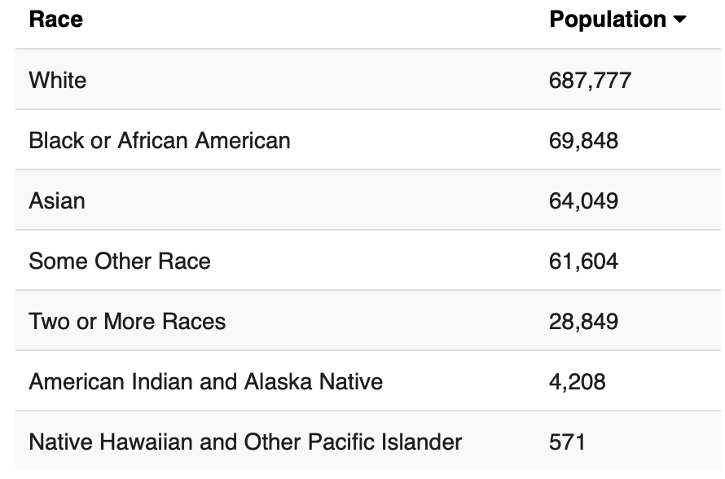
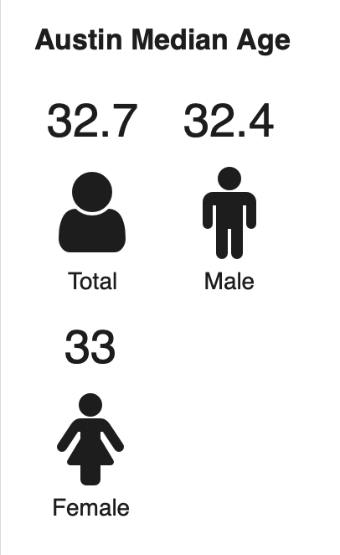
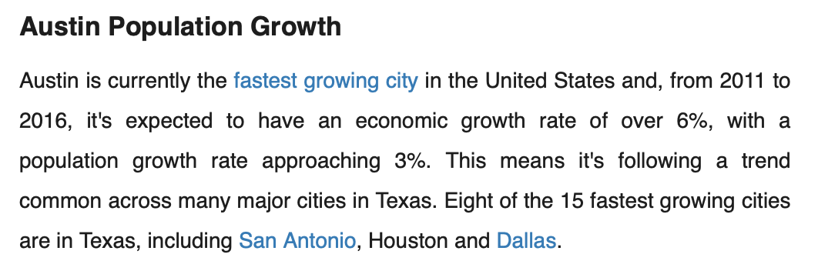
Demographics & age in Austin Data via US Census (2017 ACS 5-Year Survey)
Source: http://worldpopulationreview.com/us-cities/austin-population/

Slide 8
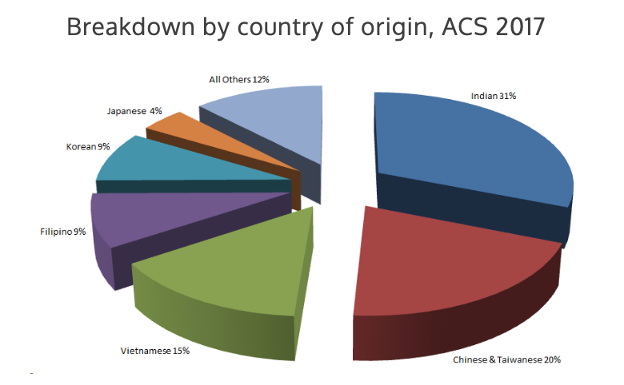
Asian Demographics of Austin, Texas in 2017
Source: http://www.austinasianchamber.org/asian-data

Slide 9
Population & Age In Austin
Austin population is reaching 1.0 million in 2019
Austin population annual growth rate is expected to be 3.0%
Asian population in Austin is about 10% and Korean population of 9% of the total Asian population (or 0.9% of total Austin population, ~ 9K Koreans)
Median age of 33 for both male and female population in Austin

Slide 10
Conclusion
Original Austin seems to be the ideal neighborhood with its high concentration of food and bar businesses already established.
Original Austin is close to Downtown Austin (1.5 miles) and the University of Texas Austin (1.1 mile) to attract crowds from these adjacent neighborhoods.
Austin offers a growing community, with population reaching 1.0 million in 2019, with annual growth rate of 3.0%, and relatively young crowd with median age of 33.
The Korean population in Austin is about 9K which should generate ample demand. Assume, nominally, another 1% conversion of total Austin population and the potential customer base grows to ~20K which is a very sizable opportunity.

Slide 11
Conclusion (CONTINUED)
As mentioned on the onset of this project, Korean fried chicken and bar is very popular in Korea, among all age groups from college students and up. It is also very popular in Los Angeles and San Jose where there are large Korean communities and very diverse ethnicities and we believe it will be very popular in Austin as well.
Combining all the data collected and analyzed, Original Austin neighborhood, Austin population growth and demographics data, all support a good foundation to start the Korean fried chicken and bar business in Austin, Texas.
Next phase of the business case would be to actually build the Korean fried chicken and bar design, style, menu, services, size, financials, etc. All of these are beyond the scope of this project.

