Slide 1
Cloud Overview
Xuan Gao
Associate Solution Engineer, Oracle
Notes:
Let me guide you to the journey of oracle cloud
Introduce yourself – Your Journey, your passion –tech/non-tech
Get into the Role of a Solutions Engineer presenting to customers that are only barely aware of cloud computing
» Oracle offers the most complete portfolio of integrated infrastructure and platform services with depth and breadth of functionality.
» Oracle Cloud offers a hybrid cloud, allowing easy management and monitoring of services from on-premises as well as easy migration of workloads.
» Oracle Cloud solutions were built using standards-based technologies that customers are familiar with.

Slide 2


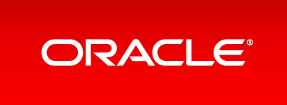
The Most Complete Cloud
DaaS
SaaS
PaaS
CLOUD
IaaS
Copyright © 2017 Oracle and/or its affiliates. All rights reserved. |
Notes:
A complete, open, and secure platform that spans all layers of the cloud
Let’s show you more about oracle cloud from top to bottom which is from Daas to Iaas.
An integrated platform that provides unprecedented ability to take meaningful steps towards genuine business transformation.
Complete importance: A lot of big enterprises want to manage their system outside the company. In the enterprise, one kind is the traditional application, such as finance, HR, CRM, these applications can use Oracle‘s SaaS, but there are some core applications, such as the insurance information system of the insurance company, it is developed by itself. If these core applications are placed on the vendor side, It is IaaS. Imagine that if the insurance core system is placed in a IaaS supplier, ERP, CRM, and HR are placed in another supplier, and the company's core system will be integrated with more than one hundred points in the middle of the general system. By choosing Oracle Cloud, businesses can avoid the fragmented data and business processes that can result from using multiple, solid clouds from different vendors.

Slide 3
Data-as-a-Service
Provides data from a wide variety of Oracle and third-party sources that you can leverage for deeper insights into your clients to enable modern marketing campaigns.
Aggregates, analyzes, and activates data into one unified solution.
The Most Complete Cloud
The Most Complete Cloud
DaaS
DaaS
SaaS
SaaS
PaaS
PaaS
CLOUD
CLOUD
IaaS
IaaS
Copyright © 2017 Oracle and/or its affiliates. All rights reserved. |
Notes:
Oracle data cloud provides data from a wide variety of Oracle and third-party sources, aggregates, analyzes, and activates consumer data into one unified solution.
DaaS is a cost-efficient, agile service that lets you focus on selling your products, rather than sourcing, managing, and activating data.
DaaS is a response to the growing volume and variety of data generated in today’s digital world. Users consume data across a variety of systems and processes—data that can be used to make customer engagements more relevant and impactful. This data-driven insight helps you connect with customers across marketing and sales to virtually all areas of your business.
Informatica

Slide 4
Data-as-a-Service
Oracle ID Graph
5 billion global consumer IDs
Reduce wasted spend
Target right individuals
The Most Complete Cloud
The Most Complete Cloud
DaaS
DaaS
SaaS
SaaS
PaaS
PaaS
CLOUD
CLOUD
IaaS
IaaS
Copyright © 2017 Oracle and/or its affiliates. All rights reserved. |
Notes:
Powered by Oracle ID Graph, this DaaS creates cross-channel consumer understanding, so that you can know more about who your customers are, what they do, where they go, and what they buy.
5 billion global consumer IDs, 115 million US households
Reach individual consumers , deliver relevant, engaging, and connected experiences across all channels
Pandora we deliver target against mobile ad scale their business dramatically
Bringing together data about businesses and consumers to maximize every customer interaction
Data acquisition: it comes from any data source, such as data warehouse, e-mail, portal, third party data source and so on.
Data governance and standardization: manually or automatically collating data standards.
Data aggregation: this very strong service and technology driven quality control mechanism
Data services: through web services, extraction and reporting, enabling end-users to consume data more easily.
Informatica

Slide 5
Software-as-a-Service
Customer experience
Human Capital Management
Enterprise Resource Planning
Supply Chain Management
Enterprise Performance Management
IoT applications
ERP cloud vs Workday & SAP
The Most Complete Cloud
DaaS
DaaS
SaaS
SaaS
PaaS
PaaS
CLOUD
IaaS
IaaS
Copyright © 2017 Oracle and/or its affiliates. All rights reserved. |
Notes:
Oracle provides a comprehensive and integrated modern management suite to manage accounting, financial planning, procurement and projects.
CX: help you effectively engage your customers across physical and digital channels to dramatically improve customer retention, up-sell, and brand advocacy.
Marketing Deliver the best of your brand
Sales Sell more, know more, grow more
Service Delight your customers
Configure, Price, and Quote (CPQ) Increase sales efficiency
Commerce Build inspired commerce experiences
Loyalty Increase customer lifetime value and profitability
Engagement (Sales and Service) Unified Sales and Service
Customer Data Management Create a complete customer view
Sales Performance Management Execute strategies to boost performance
Social Engage on what is important to your consumers
Data Reach the audiences that matter most
CRM Analytics Maximize CRM success
CX Cloud for MidsizeReduce complexity, enable growth, lower IT costs
Oracle HCM Cloud enables modern human resources to find and retain the best talent and increase global agility.
Global Human ResourcesIncrease global agility
Talent Management Find and retain the best talent
Workforce Rewards Differentiate and win the talent war
Workforce Management Optimize time
Work Life Solutions Engage your employees
HCM Analytics Boost HR and workforce effectiveness
HCM Cloud for Midsize Simplify human resources
Streamline your enterprise business processes with Enterprise Resource Planning (ERP) Cloud. You can increase productivity, lower costs, and improve controls.
Financials Empower modern finance
Revenue Management Simplify complex revenue recognition
Accounting Hub Unite disparate accounting systems
Project Financial Management Improve project profitability
Project Management Power your project delivery
Procurement Empower modern procurement
Risk Management Drive financial reporting compliance
ERP Analytics Sustain a thriving business
ERP Cloud for Midsize Reduce complexity, enable growth, lower IT costs
Supply Chain Management
With capabilities that include product innovation, strategic material sourcing, outsourced manufacturing, integrated logistics, omni-channel fulfillment, and integrated demand and supply planning,
Oracle SCM Cloud is the most comprehensive SCM suite in the cloud. Oracle SCM Cloud allows you to deploy functionality incrementally, with minimal risk, lower cost, and maximum flexibility
In-Memory Cost Management CloudMaximize revenue, increase profits, optimize operational costs and working capital
Inventory ManagementGet visibility and management across the supply chain
LogisticsReduce costs, increase efficiency, ensure compliance
MaintenanceEnable efficient and productive maintenance operations
ManufacturingStreamline your manufacturing processes
Order ManagementGet visibility into your orders
ProcurementEmpower modern procurement
Product Lifecycle Management Innovate, develop, and commercialize profitable products
Product Master Data ManagementMaster and commercialize your enterprise product information
Supply Chain Collaboration and VisibilityImprove the performance of your global value network
Supply Chain PlanningStay ahead of challenges and changes in your business
SCM AnalyticsPower a highly efficient supply network
Enterprise Performance Management
Oracle’s market-leading Enterprise Performance Management (EPM) applications combined with the innovation and simplicity of the cloud, enable companies of any size to drive predictable performance, report with confidence, and connect the entire organization.
Account ReconciliationStreamline your account reconciliation process
Enterprise Data ManagementDrive agile business transformation
Enterprise Performance ReportingReinvent your narrative reporting processes
Enterprise PlanningBe in control and keep everything connected
Financial Consolidation and CloseDramatically reduce the time and cost to complete a close
Planning and BudgetingImplement a world-class planning and budgeting solution
Profitability and Cost ManagementDiscover and act on hidden profit and loss
Tax ReportingBringing tax and finance together
Oracle Internet of Things Applications deliver a world-class set of IoT apps for enterprise assets, production lines, transportation fleets, and mobile workers. Get smart with predictive, machine learning algorithms, and quickly extend core SCM, CX, HCM and ERP processes—with real-time IoT data and insights.
Leverage the comprehensive Oracle product portfolio to address distinct industry-specific requirements. With solutions for financial services, communications, consumer goods and more, Oracle enables you to accelerate the delivery of innovation, improve customer experiences, and improve margins to drive competitive advantage.

Slide 6
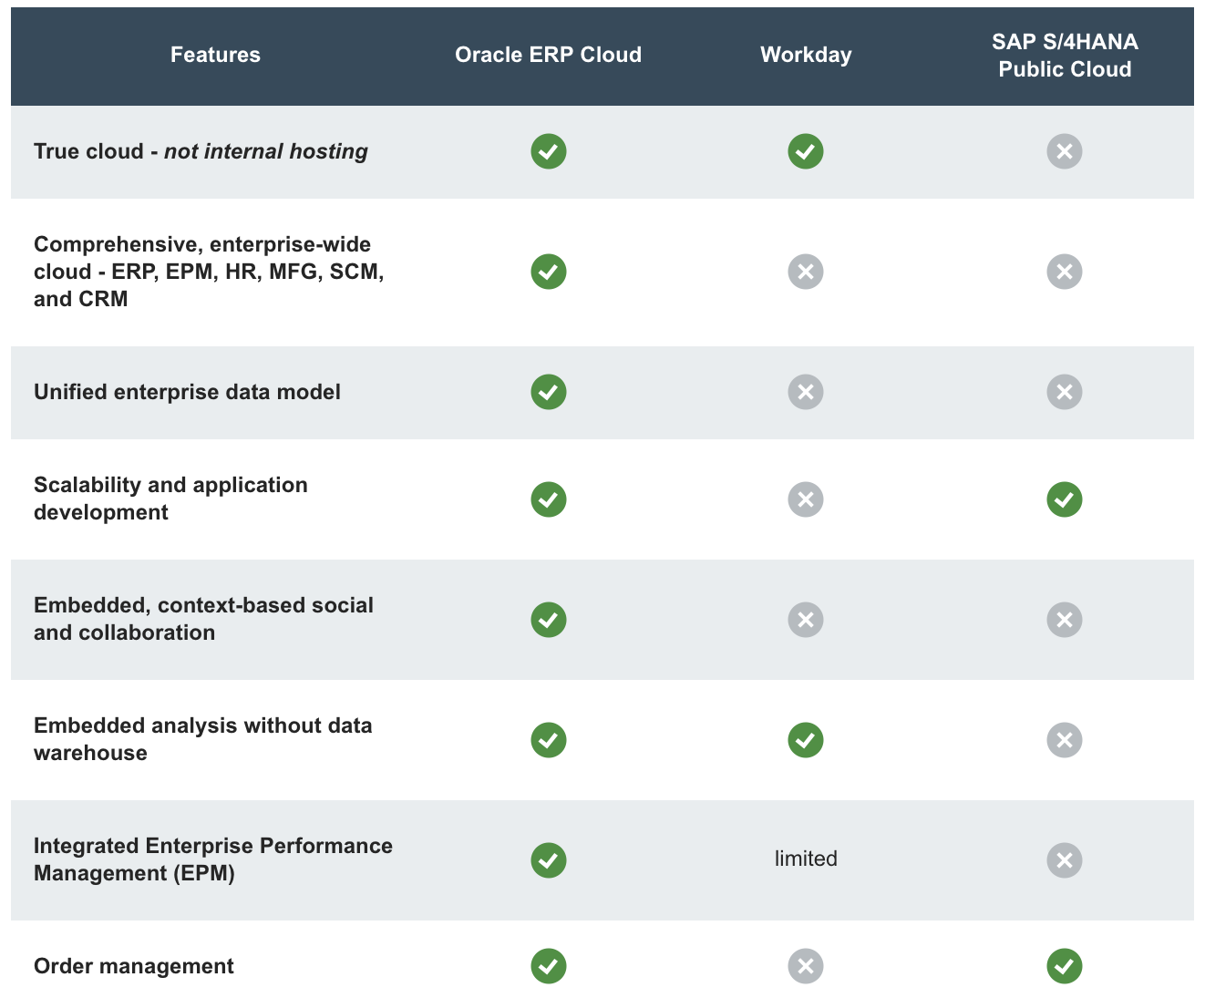
Notes:
https://www.oracle.com/cn/applications/erp/comparison.html

Slide 7
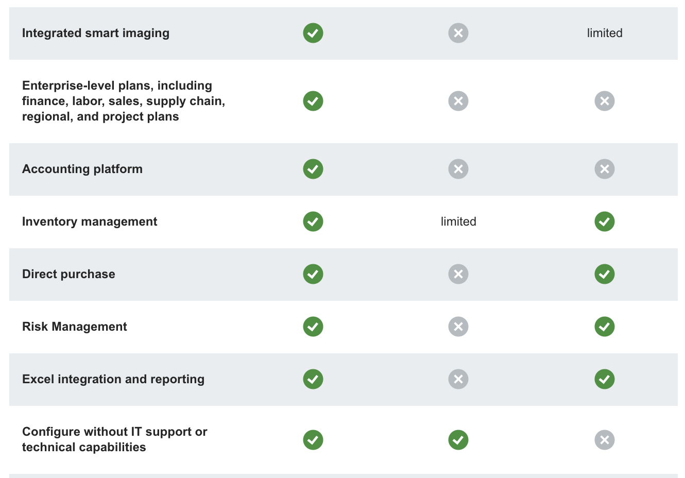
Notes:
We Unlock business value and performance by enabling businesses and people to be more informed, connected, productive, and engaged
NCR increases speed and agility at lower cost with Oracle ERP Cloud and SCM Cloud
Panasonic Computer Products drives customer satisfaction with strategic move to Oracle CX Cloud
CX: help you effectively engage your customers across physical and digital channels to dramatically improve customer retention, up-sell, and brand advocacy.
Marketing Deliver the best of your brand
Sales Sell more, know more, grow more
Service Delight your customers
Configure, Price, and Quote (CPQ) Increase sales efficiency
Commerce Build inspired commerce experiences
Loyalty Increase customer lifetime value and profitability
Engagement (Sales and Service) Unified Sales and Service
Customer Data Management Create a complete customer view
Sales Performance Management Execute strategies to boost performance
Social Engage on what is important to your consumers
Data Reach the audiences that matter most
CRM Analytics Maximize CRM success
CX Cloud for MidsizeReduce complexity, enable growth, lower IT costs

Slide 8
Platform-as-a-Service
Enables developers, IT professionals, and business leaders to develop, extend, and secure applications
Oracle cloud platform services vs Microsoft Azure
Oracle is the only vendor that provides a complete, integrated stack for the cloud
The Most Complete Cloud
DaaS
DaaS
SaaS
SaaS
PaaS
PaaS
CLOUD
IaaS
IaaS
Copyright © 2017 Oracle and/or its affiliates. All rights reserved. |
Notes:
Oracle offers the broadest range of PaaS in the industry that enables developers, IT professionals, and business leaders to develop, extend, and secure applications that leverage advanced analytics.
Innovate, integrate, connect, secure, and discover with an integrated underlying platform for change
“Azure taps out for large implementations, with a maximum 1 terabyte for Azure SQL Database.” That’s just not enough for the volume of data that companies are collecting today. For example, sensors on a single airline engine can generate half a terabyte of data on a cross-country flight.
“Oracle is the only vendor in the market that will deliver cloud on your terms. We want to give you the choice and the confidence to follow your own path. We’re committed to your success, and we understand that you’re betting your business on Oracle technology
Oracle is the only vendor that provides a complete, integrated stack for the cloud

Slide 9
Platform-as-a-Service
Free developers without distraction
Doesn’t simply stop at less money
Ensure that your application is always running on the latest and greatest.
The Most Complete Cloud
DaaS
DaaS
SaaS
SaaS
PaaS
PaaS
CLOUD
IaaS
IaaS
Copyright © 2017 Oracle and/or its affiliates. All rights reserved. |
Notes:
PaaS is a driving force in DevOps, freeing developers to focus on their core mission of creating new, innovative apps, without the distraction of managing infrastructure and middleware
Doesn’t simply stop at less money. You not only get the best possible stack as of the moment you deploy, you also get a stack that keeps up with you over time, ensuring that your application is always running on the latest and greatest.
Levi Strauss uses Oracle Cloud Access security broker and Oracle Identity Management Cloud services to meet their security needs.
Oracle offers the broadest range of PaaS in the industry that enables developers, IT professionals, and business leaders to develop, extend, and secure applications that leverage advanced analytics.
Focusing development resources and spending less headcount on unneeded expertise are both benefits that intuitively translate into reducing costs.
SECURE:
protecting against attacks is best left to specialists. A PaaS offering provides continual security updates for individual stack components as they are issued. At Engine Yard the stack engineering team maintains fully updated Rails and PHP technologies, so security vulnerabilities in core language or framework components are quickly remedied and customers are automatically notified following the patch.
Developer:
https://www.techrepublic.com/blog/the-enterprise-cloud/the-app-developer-top-5-why-paas-is-a-liberating-choice/

Slide 10
Infrastructure-as-a-Service
A comprehensive offering including compute, storage, network, and container services, our enterprise-grade cloud enables organizations to run any workload at any time.
The Most Complete Cloud
DaaS
DaaS
SaaS
SaaS
PaaS
PaaS
CLOUD
IaaS
IaaS
Copyright © 2017 Oracle and/or its affiliates. All rights reserved. |
Notes:
High performance:
Oracle IaaS is equipped with enterprise level network to provide high bandwidth, low latency, non blocking and multi tenant services. This allows network isolation among users, without sharing resources, and ensures user safety and performance.
Safe and reliable:
Oracle IaaS provides unassailable security for users, providing end-to-end security encryption, global disaster recovery infrastructure to ensure security and reliability, and to escort the enterprise's cloud services.
PaaS + IaaS seamless integration
The seamless integration of Oracle IaaS and Oracle PaaS based on Oracle databases provides an integrated solution to the depth tuning of IaaS + PaaS performance, which not only helps enterprises to move into the cloud more quickly and safely, but also is easy to manage.
In addition, through Oracle at customer Cloud, enterprises can choose the deployment mode of public cloud, private cloud or hybrid cloud according to their needs.
Price grounding gas:
Oracle has further reduced the price of cloud services and the total cost of ownership of customers, providing customers with cost-effective services. In addition, Oracle IaaS is the best platform for running Oracle workloads, and running the database on Oracle IaaS is cheaper and faster.

Slide 11
Infrastructure-as-a-Service
Developers control
Cost saving
Scalability and flexibility
High performance
PaaS + IaaS seamless integration
Safe and reliable
Oracle Bare Metal Cloud Service vs AWS
The Most Complete Cloud
DaaS
DaaS
SaaS
SaaS
PaaS
PaaS
CLOUD
IaaS
IaaS
Copyright © 2017 Oracle and/or its affiliates. All rights reserved. |
Notes:
Developers will orchestrate their own execution processes, manage their own data services and maintain the underlying OS. This will mean more flexibility when adding unique features and tweaking apps and services for maximum performance.
Cost saving, scalability and flexibility, high performance, PaaS + IaaS seamless integration, safe and reliable
Cost savings: No longer do organizations have the responsibility of ensuring uptime, maintaining hardware and networking equipment, or replacing old equipment.
Scalability and flexibility: scale up and down quickly in response to an enterprise’s requirements
High performance: Oracle IaaS is equipped with enterprise level network to provide high bandwidth, low latency, non blocking and multi tenant services. This allows network isolation among users, without sharing resources, and ensures user safety and performance.
Safe and reliable:
Oracle IaaS provides unassailable security for users, providing end-to-end security encryption, global disaster recovery infrastructure to ensure security and reliability, and to escort the enterprise's cloud services.

Slide 12
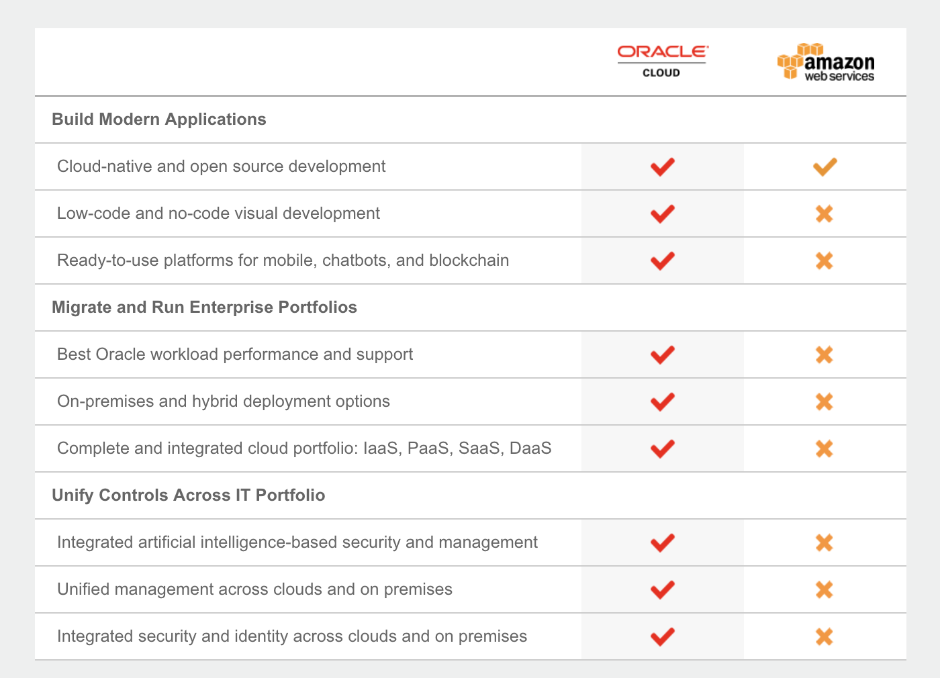
Notes:
Oracle Bare Metal is 11.5 times faster than the AWS solution, and the cost is reduced by 20%, and the database is supported by service (DaaS), network block storage, object storage, and virtual private network connections. It is worth mentioning that Oracle Bare Metal Cloud Servers also supports enterprise local deployment and seamless connection with Oracle Cloud.
Oracle Ravello Cloud Service can support enterprise customers running VMware in public cloud without any modification configuration. Oracle Container Cloud Service provides an Docker compatible way for enterprises to deploy application stack by one click.
Frozen mountain --- Communications software firm doubles compute performance, translating directly into cost savings
We unified controls across cloud and on premises
https://go.oracle.com/comparison-aws
https://blog.csdn.net/xcjing/article/details/63250667

Slide 13
The Most Complete Cloud
DaaS
SaaS
PaaS
CLOUD
IaaS
Copyright © 2017 Oracle and/or its affiliates. All rights reserved. |
Notes:
IBM can only provide PaaS, IaaS, and no SaaS; Amazon is more focus on IaaS, Microsoft's Azure platform provides PaaS, and SaaS is strictly a Office application for Office users, and IaaS is less likely to talk about.
I have to emphasize that AWS is an incomplete cloud. Their main focus is IaaS, like compute, and storage. If you want to store files in the cloud or spin out a new server, you’re good. But most customers want to run applications, and with AWS most of those capabilities come from third parties. So when it comes to integration, you’re on your own.” And if something breaks down, you’d better hope it’s a problem with the infrastructure; otherwise you’ll be calling multiple app vendors to resolve the issue.
In addition to the integrity of cloud services, there are other features of the Oracle cloud service: open, the bottom architecture of the Oracle cloud computing architecture uses open standards such as Java and SOA; for example, Oracle integrates SaaS, PaaS, and IaaS into the same cloud which enabling the Oracle cloud to switch between the public cloud and the private cloud. In addition to these, the Oracle clouds are all made form our own products from bottom to top, including machine, hardware, OFM, middleware and so on, so it can achieve faster response speed, lower cost and lower risk.

Slide 14






Oracle Develops Offerings for Three Deployment Models
On-Premise
Cloud at
Customer
Public Cloud
For All Your Workloads
Copyright © 2017 Oracle and/or its affiliates. All rights reserved. |
Notes:
Oracle develops offerings for three distinct deployment models: Traditional On-Premise, Cloud at Customer, and Public Cloud.
On-premises means clients keep hardware or data on-site, on your data center.
A private cloud is for the exclusive use of one organization. It is most often on-premise in the data center and controlled and managed by IT.
Private clouds are those that are built exclusively for an individual enterprise. They allow the firm to host applications in the cloud, while addressing concerns regarding data security and control, which is often lacking in a public cloud environment.
Called Oracle Cloud at Customer, the new suite lets companies tap the Oracle Cloud as a fully managed service within their data center, giving them full control.
The service provides the same hardware and software platform that Oracle uses in its own cloud data centers and puts them into a “cloud machine” that lives in the customer’s data center. “We are essentially stretching out our public cloud to reach the customer’s data center

Slide 15
On-premise
Advantages:
Trust. When you run it yourself, you have only worry about yourself.
Compliance. You understanding your business better.
Customization. You can do deploy any way you want, customize things, add plug-ins.
Disadvantages:
High costs, not enough expertise.
Limited size and scalability
Notes:
It provides a more standardized process and protection, Trust, Customized, are best used for applications that require complete control and configurability of the infrastructure and security.
but is often limited in size and scalability.
Top talent comes with top costs, and niche skills maybe very expensive to attract and retain. Monitoring systems 24x7 can be very expensive.
80% of all workloads are still deployed on premises.

Slide 16
Public Cloud
Advantages:
Simple and easy
Less cost and time. The IT resources and services are available immediately saving time.
Maintenance. The hardware and networks are maintained by the cloud services provider.
Disadvantages:
Lack proper controls. Want a dedicated infrastructure within their own data center.
Weak on security. Want to keep sensitive data on premises.
Data Latency. Want near-zero latency for connect with back-end mainframes, databases.
Notes:
Public clouds are available as a service in the internet, they are easy to deploy.
The IT resources and services are available immediately saving time for the company.
Internal IT staffs have no responsibility in maintaining the infrastructure.
Lacks proper controls: They must also maintain control of business-critical systems, and often want a dedicated infrastructure within their own data center.
Weak on Security: Companies are required to comply with regulatory, legal, and privacy requirements and keep sensitive data on premises.
Customization: Customization of resources or services is not always possible.
Data Latency: In addition, they need to connect with back-end mainframes, databases, ERPs, and more, with near-zero latency.

Slide 17
Oracle Cloud at Customer
You will be able to access ALL of the capabilities of Oracle Cloud
in your own data centers
with the same user experience, technical architecture, and economics.
You will benefit from:
Tight control over data sovereignty and governance concerns
Full integration with your network security
Low latency interaction with your other on-premises applications and data
All good features in cloud, without risks
Notes:
Customers can get the infrastructure, the database, all the public cloud services, but behind the firewall."
You stay in control of your data. Oracle delivers and manages the services based on how you want to operate, and you subscribe only to the infrastructure, platform, and software services you need.
You will benefit from…
We combine the best of cloud and on-premises applications into a single architecture. This gives you maximum flexibility and leverage with your existing investment, and your gradual adoption of the cloud.
One issue customers have had with public clouds concerns data sovereignty and compliance. They need to address the issue that certain workloads and data must reside within the customer’s country borders, or behind the firewall within their data center.

Slide 18
Move, Connect, Transform Thanks!
Xuan Gao
Notes:
We has 17 data centers around the world, with more than 1000 virtual machines and 205PB storage
Customer trust us. We supporting 21 million users and 19 million day processing.
Welcome to Oracle cloud, and if you have any questions, please let me know. I’m glad to offer you the best solution that fit your company.
Exposes the underlying hardware infrastructure to users.
IaaS users have to devote more energy to the management of the underlying hardware and middleware infrastructure, which is more complex and professional than PaaS, but because of this, it is naturally more flexible and maneuverable, and is more popular with large enterprises.
PaaS is more suitable for small and medium sized companies or companies without too many professional and technical personnel. In most cases, choosing PaaS is more convenient than IaaS. Its drawback lies in the different standards of PaaS providers, which brings higher cost and difficulty risks to future migration.

Slide 19
Which one to choose?
Work on business, instead of wasting time on troubleshooting and managing the IT infrastructure. Just open your browser!
Different departments
need a unified application?
SAAS
Shared platform? (database, API)
developers, IT professionals?
To develop, extend, and secure applications?
You are fully committed to developing applications, and everything else will be handled by the platform.
PAAS
Shared hardware?
Do you need network infrastructure components such as virtual computers, cloud storage, firewalls, and configuration services?
You can choose multiple operating systems, platforms, databases and content distribution networks. Do environment configuration and application development by yourself.
IAAS

Slide 20
PaaS vs IaaS
 | PaaS | IaaS
Development environment | Good | OK
Supported applications | Limit | Wide
Standards | Not optimistic | Better
Scalability | Auto | Manually
Integration | Good | OK
Billing | Accurate | Simple
Difficulty | High | Low
Notes:
1) development environment: PaaS will provide developers with a set of development and test environments, including IDE, and IaaS users are more familiar with the development environment before they are used, but because the previous development environment is less integrated with the cloud, it is not very convenient to use.
2) supported applications: because IaaS is mainly a virtual machine, and the ordinary virtual machine supports a variety of operating systems, the scope of IaaS support applications is very wide. But it is not easy to make an application run on a PaaS platform, because not only needs to ensure that the application is based on the language supported by the platform, but also to ensure that the application can only call the API supported by the platform, if the application calls the API that the platform does not support. The application is modified.
3) open standards: Although many IaaS platforms have a certain private function, but because of the existence of OVF and other protocols, it is a steady step forward for IaaS to cross platform and avoid being locked by suppliers. The situation of PaaS platform is not optimistic, because both Google's App Engine and Salesforce's Force.com have some private API.
4) scalability: the PaaS platform automatically adjusts resources to help applications running on it better cope with bursty traffic. The IaaS platform requires developers to manually adjust resources to cope with them.
Integration rate and economy: PaaS platform integration rate is very high, for example, PaaS's representative Google App Engine can carry thousands of applications on a server, and the integration rate of the ordinary IaaS platform will not exceed 100, and is generally around 10, making the IaaS economy less than PaaS.
Billing and regulation: because the PaaS platform in billing and monitoring these two aspects not only reach the operating system level that the IaaS platform can reach, for example, the use of CPU and memory, and can also be applied, such as the application time (Response Time) or the amount of transaction consumed by the application, etc. This will improve the accuracy of billing and management.
Learning difficulty: since developing and managing applications on IaaS is close to existing ways, and the development of PaaS may need to learn a new language or a new framework, so IaaS is more difficult to learn.
https://dzone.com/articles/developers-perspective-iaas-vs
https://searchmicroservices.techtarget.com/feature/Whats-the-difference-between-IaaS-and-PaaS-to-developers

Slide 21
Security
Oracle Identity and Access Management
Oracle’s complete, integrated, next-generation identity management platform provides breakthrough scalability with an industry-leading suite of identity and access management (IAM) solutions for on-premises or hybrid cloud.
Oracle CASB Cloud Service
Provides threat visibility and ensures compliance of your cloud footprint by combining threat detection, predictive analytics, security configuration management, and automated incident response.
Oracle Security Monitoring and Analytics Cloud Service
Enables rapid detection, investigation, and remediation of the broadest range of security threats across on-premises and cloud IT assets.
Oracle Database Security
Ensure data privacy, protect against insider threats, and enable regulatory compliance with a comprehensive portfolio of security solutions, on premises and in the cloud.
Oracle Configuration and Compliance Cloud Service
Assess both on-premises and cloud infrastructure using industry-standard benchmarks and custom rules to ensure that regulatory compliance goals are being met.
https://cloud.oracle.com/opc/iaas/whitepapers/Oracle_Cloud_Security_Whitepaper.pdf
Notes:
» Design Phase: Security training about guiding security principles and Oracle’s secure coding standards help ensure that our engineers, architects and product managers make the best security decisions possible. Assessing threats during architectural risk analysis meetings help us identify potential security issues as early in the development lifecycle as possible.
» Coding Phase: We address standard vulnerability types through the use of secure coding standards and patterns. In this phase we use static code analysis tools to identify security flaws and fix all significant security findings before our services move to testing phase. » Testing Phase: Our internal security professionals and independent security consultants use Oracle internal tools, third party tools for dynamic analysis and fuzz testing, and manual testing to identify potential security issues.
» Prior to service release: Before we release a cloud service, Oracle validates that the functionality being developed meets Oracle’s cloud security requirements. We use independent security professionals to evaluate and monitor the product for potential security issues.

Slide 22
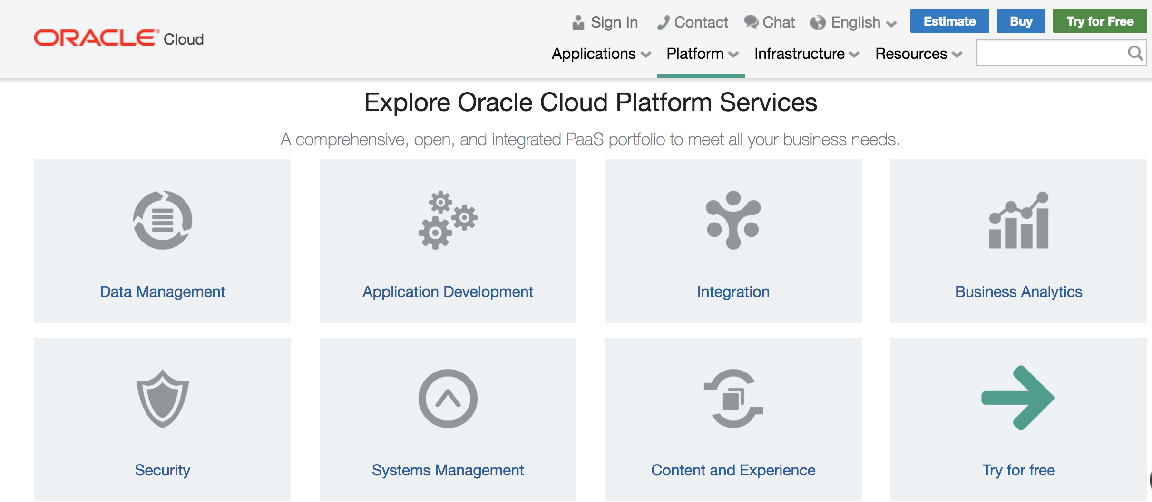
Notes:
CX: help you effectively engage your customers across physical and digital channels to dramatically improve customer retention, up-sell, and brand advocacy.
Marketing Deliver the best of your brand
Sales Sell more, know more, grow more
Service Delight your customers
Configure, Price, and Quote (CPQ) Increase sales efficiency
Commerce Build inspired commerce experiences
Loyalty Increase customer lifetime value and profitability
Engagement (Sales and Service) Unified Sales and Service
Customer Data Management Create a complete customer view
Sales Performance Management Execute strategies to boost performance
Social Engage on what is important to your consumers
Data Reach the audiences that matter most
CRM Analytics Maximize CRM success
CX Cloud for MidsizeReduce complexity, enable growth, lower IT costs
Oracle HCM Cloud enables modern human resources to find and retain the best talent and increase global agility.
Global Human ResourcesIncrease global agility
Talent Management Find and retain the best talent
Workforce Rewards Differentiate and win the talent war
Workforce Management Optimize time
Work Life Solutions Engage your employees
HCM Analytics Boost HR and workforce effectiveness
HCM Cloud for Midsize Simplify human resources
Streamline your enterprise business processes with Enterprise Resource Planning (ERP) Cloud. You can increase productivity, lower costs, and improve controls.
Financials Empower modern finance
Revenue Management Simplify complex revenue recognition
Accounting Hub Unite disparate accounting systems
Project Financial Management Improve project profitability
Project Management Power your project delivery
Procurement Empower modern procurement
Risk Management Drive financial reporting compliance
ERP Analytics Sustain a thriving business
ERP Cloud for Midsize Reduce complexity, enable growth, lower IT costs
Supply Chain Management
With capabilities that include product innovation, strategic material sourcing, outsourced manufacturing, integrated logistics, omni-channel fulfillment, and integrated demand and supply planning,
Oracle SCM Cloud is the most comprehensive SCM suite in the cloud. Oracle SCM Cloud allows you to deploy functionality incrementally, with minimal risk, lower cost, and maximum flexibility
In-Memory Cost Management CloudMaximize revenue, increase profits, optimize operational costs and working capital
Inventory ManagementGet visibility and management across the supply chain
LogisticsReduce costs, increase efficiency, ensure compliance
MaintenanceEnable efficient and productive maintenance operations
ManufacturingStreamline your manufacturing processes
Order ManagementGet visibility into your orders
ProcurementEmpower modern procurement
Product Lifecycle Management Innovate, develop, and commercialize profitable products
Product Master Data ManagementMaster and commercialize your enterprise product information
Supply Chain Collaboration and VisibilityImprove the performance of your global value network
Supply Chain PlanningStay ahead of challenges and changes in your business
SCM AnalyticsPower a highly efficient supply network
Enterprise Performance Management
Oracle’s market-leading Enterprise Performance Management (EPM) applications combined with the innovation and simplicity of the cloud, enable companies of any size to drive predictable performance, report with confidence, and connect the entire organization.
Account ReconciliationStreamline your account reconciliation process
Enterprise Data ManagementDrive agile business transformation
Enterprise Performance ReportingReinvent your narrative reporting processes
Enterprise PlanningBe in control and keep everything connected
Financial Consolidation and CloseDramatically reduce the time and cost to complete a close
Planning and BudgetingImplement a world-class planning and budgeting solution
Profitability and Cost ManagementDiscover and act on hidden profit and loss
Tax ReportingBringing tax and finance together
Oracle Internet of Things Applications deliver a world-class set of IoT apps for enterprise assets, production lines, transportation fleets, and mobile workers. Get smart with predictive, machine learning algorithms, and quickly extend core SCM, CX, HCM and ERP processes—with real-time IoT data and insights.
Leverage the comprehensive Oracle product portfolio to address distinct industry-specific requirements. With solutions for financial services, communications, consumer goods and more, Oracle enables you to accelerate the delivery of innovation, improve customer experiences, and improve margins to drive competitive advantage.

Slide 23
Cost Compare
One Oracle OCPU provides CPU capacity equivalent to one physical core of an Intel Xeon processor with hyper threading enabled.

Slide 24
Reference
https://hub.packtpub.com/what-oracle-public-cloud/
https://www.stratoscale.com/resources/article/iaas-paas-saas-the-good-bad-ugly/
https://www.forbes.com/sites/oracle/2016/10/13/why-oracle-cloud-is-a-better-choice-than-aws-or-azure/#66cc179f2938
https://cloud.oracle.com/opc/iaas/whitepapers/Oracle_Cloud_Security_Whitepaper.pdf

