Slide 1
Project title Team name
List of team members

Slide 2
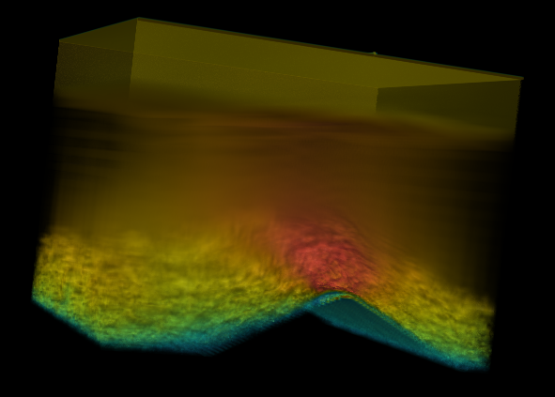
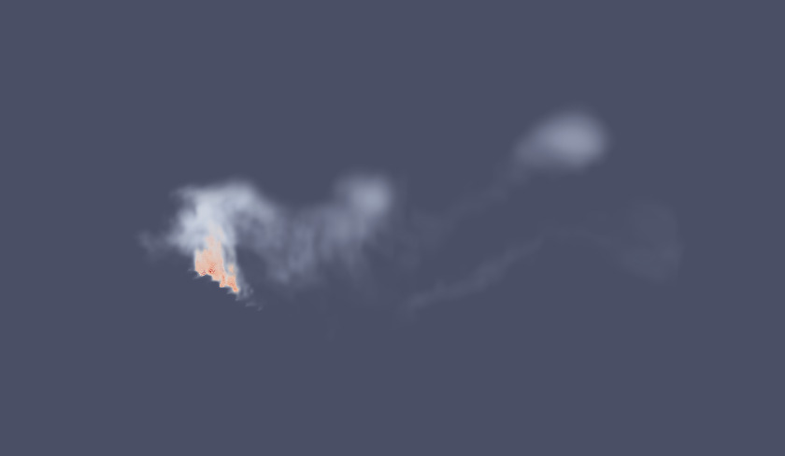
Project Start
What is your data set about?
What has been simulated / measured here?
The result of simulations of wild fire in mountain environments
Add an image of the data on this slide

Slide 3
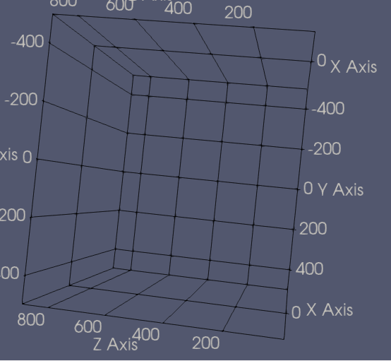
Project Start
What kind of data is given?
What type of grids are given (regular, rectilinear, unstructured, …)
Regular grid (Original data was curvilinear)
Is the data quantitative, nominal, ordinal?
The data quantitative
Will you transform the data onto regular grids? (can be done with ParaView)
Already done for that data set
You can use ParaView to create a visualization of the grid

Slide 4
Project Start
What do you want to visualize?
Which variables of the data set do you want to show?
If you choose a subset, then how did you decide which variables to remove?
Wind, Oxygene levels, Temperature, Fuel density, Moisture level.
Which features or structures of the data set do you want to concentrate on?
Clouds, vortices, plumes, …
Position of the fire, the smoke, direction of the wind, how all of those interact.
Do you derive quantitative information from features of the data set?
Extent of clouds, lifetime of clouds, etc.
Speed of fire spread, Magnetude of wind
What is the story that you want to communicate?
We want to show the evolution of the fire along the mountain slope and the smoke emited by said fire, as it evolves with time.

Slide 5
Project Start
How do you visualize it? More Likely Less Likey
Direct / indirect volume rendering
Particle animation
Visualization of particle trajectories
Filters for brushing and making selections (A bulk of the work as we need to find where the fire actually is)
User can select structures and gets more information presented
Derive additional information first, for example, vortex measures (To analyse how the wind is behaving)
Extract topological information and visualize it (To show how fire react to slopes and the montain environment + the fuel density)
Writing your own shaders

Slide 6
Project Start
Timeline
Make a plan for what you want to have achieved!
How do you distribute the work among team members?
-A bit too early to tell, we‘ll distribute dynamically once we figgure out how hard things are going to be
Until the milestone presentation we have finished:
We want a clear visualition of the smoke and fire extracted from the other parameters (With the mountains slope of course)
We want an animation of it over time.
Maybe a representation of the wind?
Until the final presentation we have finished:
Interaction between the elements.
Deriving additional info, perhaps how the evolution of the water from the plants is correlated with bush density and how it subsequently affect the fire.
Deriving a measure of speed of the fire.

