Slide 1
IAWN/SMPAG:
5.6
Communication Guidelines (in the event of a credible threat per IAWN)
If an object 10-meters or greater in size has a 1% or greater probability of impact, IAWN shall warn of the possibility of impact on the IAWN webpage (http://www.iawn.net ) and JPL sentry page (http://neo.jpl.nasa.gov/risks ). One page description suffices.
For an object is on impact trajectory, NASA’s Center For NEO Studies (CNEOS) and ESA’s Near-Earth Object Dynamic Site (NEODyS) shall independently prepare appropriately relevant maps of the Earth impact sites with time of impact
Content of the page
Designation
Facts (discovery, size estimate, composition)
Impact location
(example – next pages)
IAWN spokesman informs UNOOSA
UNOOSA informs appropriate entities and member states of the credible threat

Slide 2
Example Notification Sheet
A small asteroid, provisionally designated 2017 XYZ) was discovered on 31 Nov 2017 by Pan-STARRS located atop Halekakala (Maui), Hawaii and reported to the Minor Planet Center. Additional follow-up observations by the Catalina Sky Survey, the University of Hawaii 2.2-meter, and the Large Altazimuth Telescope (BTA-6) 6-meter telescopes have confirmed the orbit of 2017 XYZ.
2017 XYZ is observed to be approximately 120 meters in size. Based on current calculations, the asteroid has a 4% probability of impact will be on 31 Sep 2028 in the Eastern Pacific Ocean near the northern coast of Mexico at 13:13 UTC.
Future observations are planned with the planetary radar systems located in Goldstone and Arecibo on 1 April 2018. Further radar observations will precisely determine the orbit of 2017 XYZ.
The International Asteroid Warning Network (IAWN) has informed the Space Mission Planning Advisory Group (SMPAG), currently chaired by the European Space Agency.
Basic facts RE: discovery, follow-up, etc.
Current predicted details
Next Observations
IAWN & SMPAG (trusted sources of information, etc.)

Slide 3
Notification Particulars (to be agreed upon by IAWN members)
Asteroid name/designation
Asteroid characteristics – size (metric and standard), composition (if known), brightness/albedo, etc.
Observational history (discovery information, follow-up)
Prediction of asteroid trajectory including closest distance to Earth (surface, not center) and date and time of close approach.
A colloquial (non-statistical) qualifier of impact risk
Hazard to space assets (if any)
Future observations
Visibility, visual magnitude (i.e., amateur astronomers be able to see the object)
Consistent terms of measurement: “size” rather than “diameter” of object, brightness/albedo of object, etc.
Authoritative source(s) for more information (i.e., IAWN, SMPAG)

Slide 4
CNEOS Relevant Trajectory Plot

Slide 5
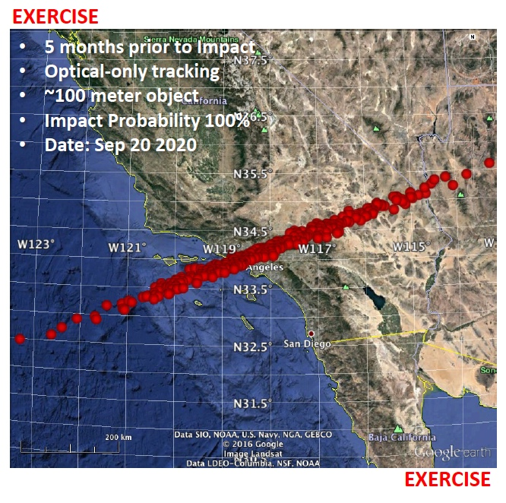
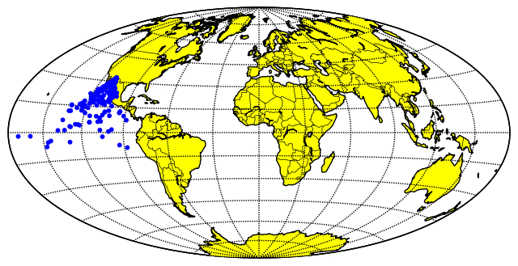
CNEOS Relevant Map
This type of map or what we’ve used in TTX (risk corridor)

Slide 6
NEO Impact Alert Process
Survey,
Detect,
& Report
Publish/
Update
Results
Correlate, Determine
Rough Orbit
Observations and
Update Orbit
Radar
Planetary Defense
Officer (NASA)
Possible
New PHO?
Iterate
No
Routine
Processing
Publish
Results
Resolve
Result
Differences
Publish
Results
Yes
Yes
Alerts to PDCO
MPC - PHO of interest
MPC -possible close approach
CNEOS - reports potential for impact
CNEOS -publishes probability of impact
Potential
Impact?
Impact
Still
Possible?
No
No
Yes
Precision Orbit
and Follow Up
Observations
Survey Systems
Minor Planet Center
Ctr NEO Studies @ JPL *
* In parallel with NEODyS

Slide 7
NEO Impact Alert Process
Planetary Defense
Officer (NASA)
IAWN
SMPAG
(supported by
ESA & NASA)
Notional
SMPAG members
convene to formulate recommendations
UN
Notional
Notional
SMPAG member agencies vet, and agree to, recommendations
UN announcement
(UNCOPUOS, UNOOSA)
SMPAG recommendations briefed to member states
Member states inform
UN of recommended
actions to be taken
YES
Member states agree
to support SMPAG
recommendations
Action
NO

Slide 8
Overview for NEO Threat Response
(very simplified)
United Nations
COPUOS/OOSA
UN Office of Outer Space Affairs
Committee on Peaceful Uses of Outer Space
Inform in case of
credible threat
Parent Government
Delegates
Determine Impact time, location and severity
Potential deflection mission plans
International Asteroid Warning Network (IAWN)
Space Missions Planning Advisory Group (SMPAG)
Observers, analysts, modelers…
Space Agencies and
Offices

