Slide 1
How to lose friends and dominate FIFA – a data sciences approach
Randy Chan, Corey Kretzmer Matthew Warner, Tom Matoushek

Slide 2
Background
During a Saturday afternoon gaming session on FIFA EA sports soccer game, Tom and Randy teamed up to challenge Corey and Matthew. Unfortunately, they were outclassed and lost every single match. With hectic class schedule and weekly homework deadlines, spending additional time practicing is out of the question. An alternate strategic advantage is required to increase their odds of winning…

Slide 3
Motivation
Finding those players with top attributes to fill your roster does not require an extensive knowledge of the international player-base. Using a public database with updated attributes each season, it is possible to select out only top candidates to bring to your team, and crush your competition.

Slide 4
Data/App Architecture
Web App Container
Process Dynamic Content
Flask Server
(app.py running on http://127.0.0.1:5000/)
Github Repository
VSC Terminal
(launch - app.py)
Gunicorn
(WSGI Server)
Static Content (CSS, JavaScript, Images, etc.)
SQL Alchemy
User Request
Heroku
Open HTML Browser
Home Page
Database
HTML Response

Slide 5
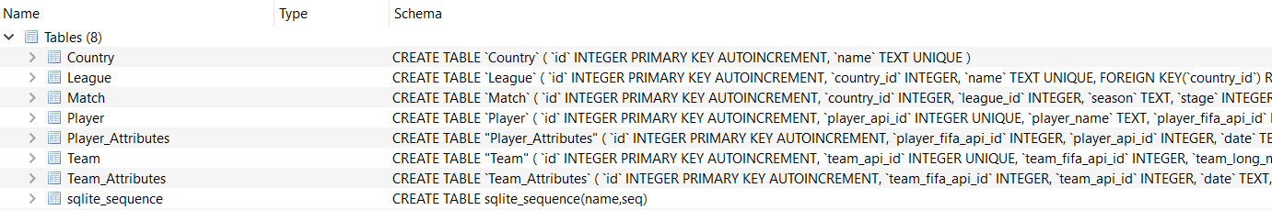
Data search and consolidation
Data was obtained from Kaggle as a SQLite Database
Original database held extraneous data and multiple records for individual players containing attributes for various seasons. For our purposes, we only needed the most recent season’s data covering player profiles and attributes.

Slide 6
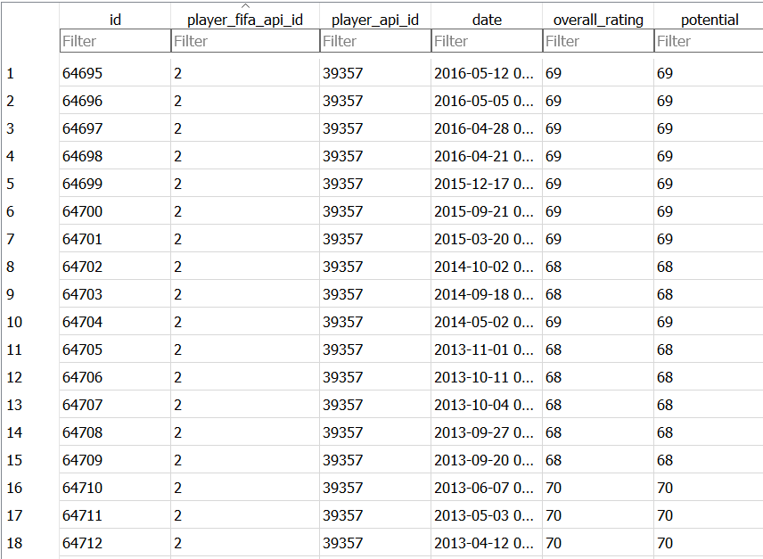
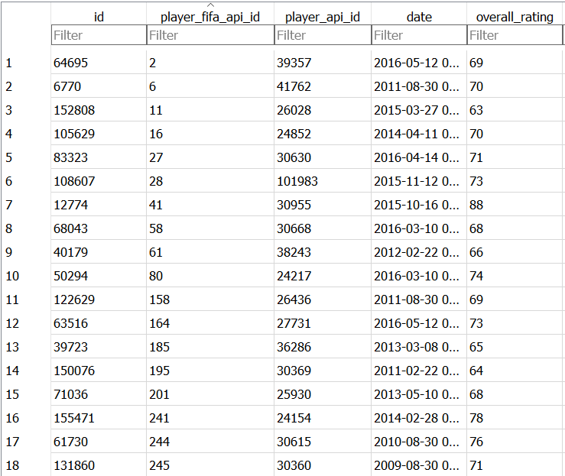
Dropping duplicates in SQL
Github 100MB File Size Limit
300 MB
2.4 MB file

Slide 7


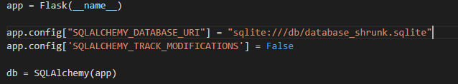






Coding approach
SQL Alchemy – Efficient and high-performing database access
Flask – Lightweight WSGI web application framework
Python – a programming language used to develop software on the web and in app form
HTML and CSS – HTML describes the structure of Web pages using markup, and CSS describes how HTML elements should be displayed.

Slide 8





Coding approach - Continue
D3 – JavaScript library for visualizing data using SVG, Canvas and HTML
Bootstrap – front-end framework for faster and easier web development that includes HTML and CSS base design template
JavaScript – programming language for the Web that can update and change both HTML and CSS
Plotly – an open source JavaScript library for creating graphs and dashboards

Slide 9

Demo

