Slide 1
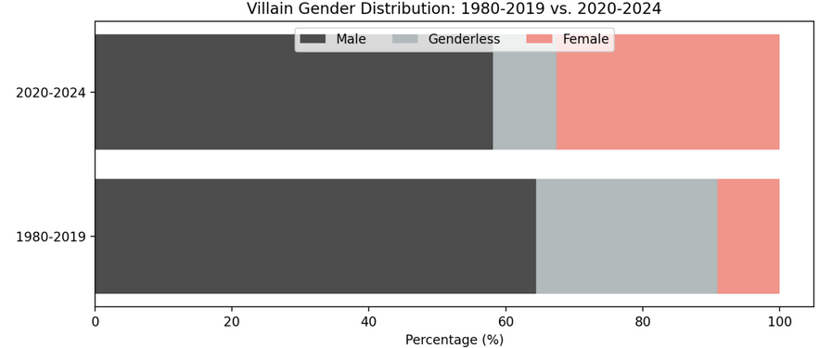
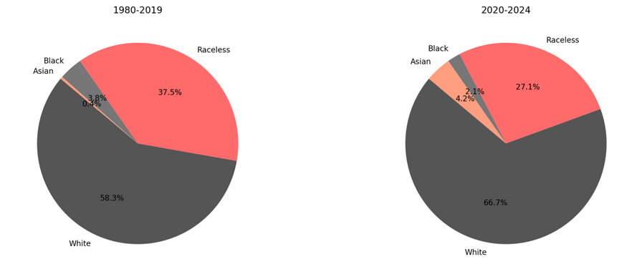
Section 1- The Villanous Landscape
Villain Gender Distribution
Villain Race Distribution

Slide 2
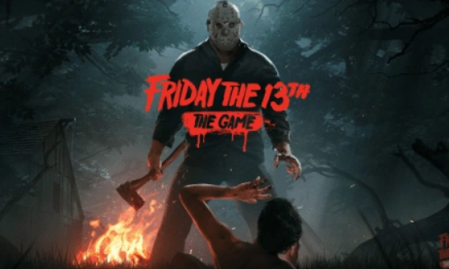
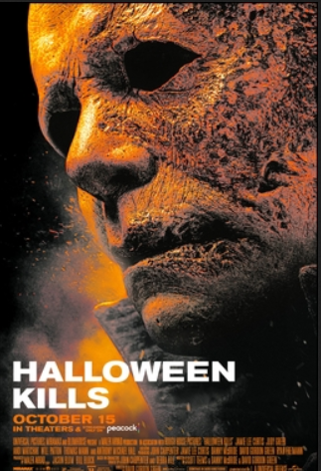
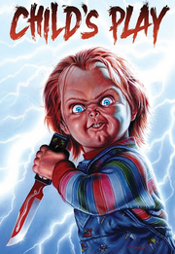

Section 1- The Villanous Landscape
This data isn‘t just telling us who the villain are- it‘s revealing the underlying patterns of exclusion.
After all, you only need to look at the best- selling franchises to see a white male as the villain.

Slide 3
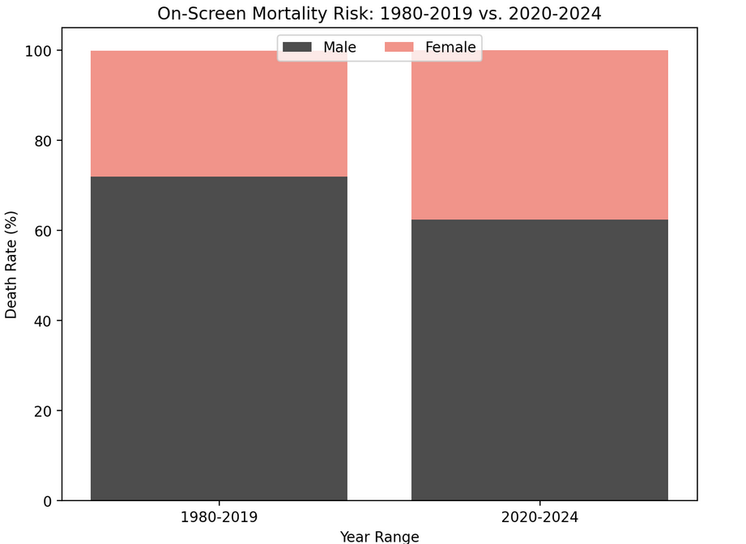
Section 2- The Reaper Has a Soft Spot for Men!

Slide 4


Section 2- The Reaper Has a Soft Spot for Men!
This statistic speaks directly to the Final Girl trope, where the final survivor is often a woman.
The trope highlights women as the emotional backbone of the story, symbolizing purity, endurance, and resilience, while men take the fall, often to serve a narrative purpose.
Scream (2000) Wrong Turn (2021)

