Slide 1

Async vs Sync Programming
Warren
Simpson

Slide 2

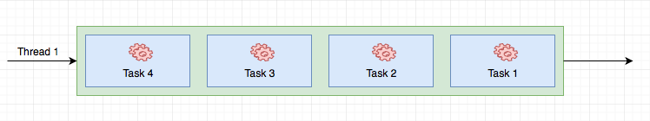
Synchronous Programming
When code is running synchronously, each task is executed one after the other where each task must finish processing before executing the next. For example, in the figure below, task 4 as to finish executing before task 3 can start executing.

Slide 3
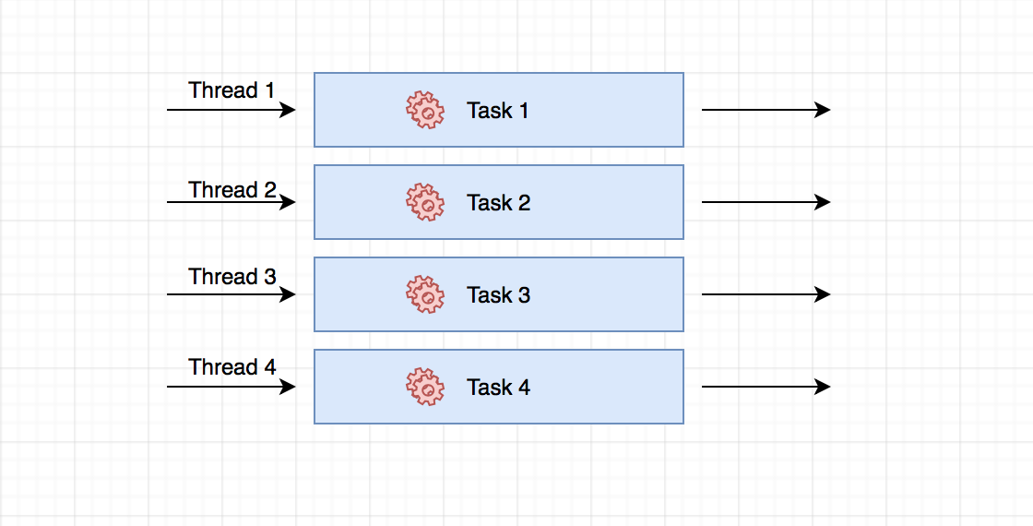
Asynchronous Programming
In Asynchronous programming, your code can take advantage of multiple threads and run different task concurrently. In the figure below, All four task are running on different threads with at the same time.

Slide 4
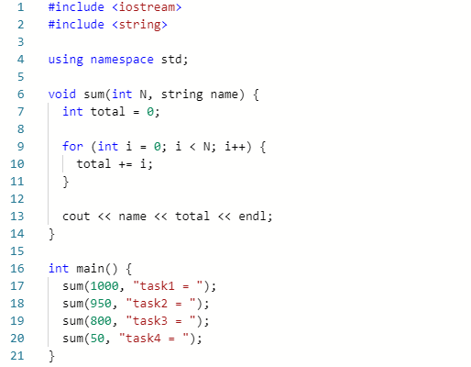

Synchronous Example
Output

Slide 5
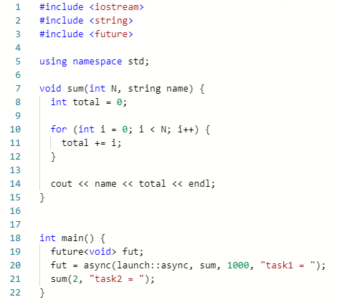

Asynchronous Example 1
Output

Slide 6
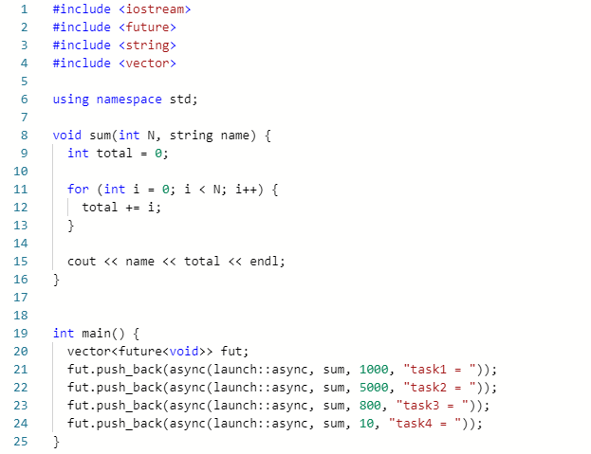



Asynchronous Example 2
Output

Slide 7
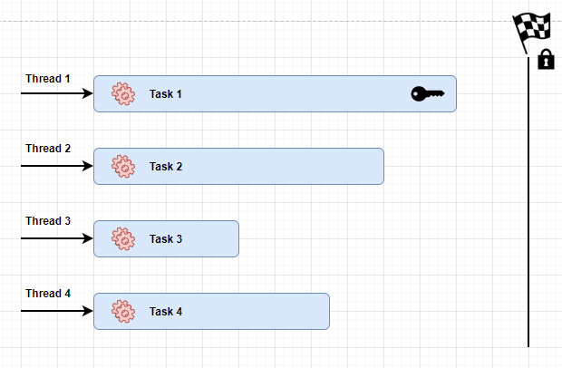
Mutex / Lock
A mutex or lock is a mechanism that locks resources where there are multiple threads trying to use the same resource. Only one thread can use the resource at a time.

Slide 8
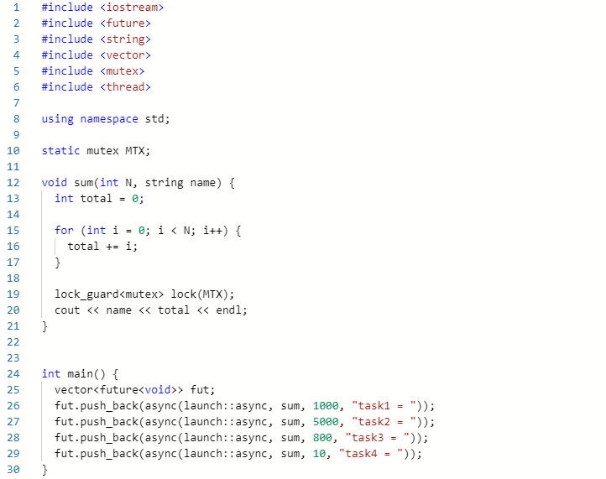

Asynchronous Example 3
Output

Slide 9
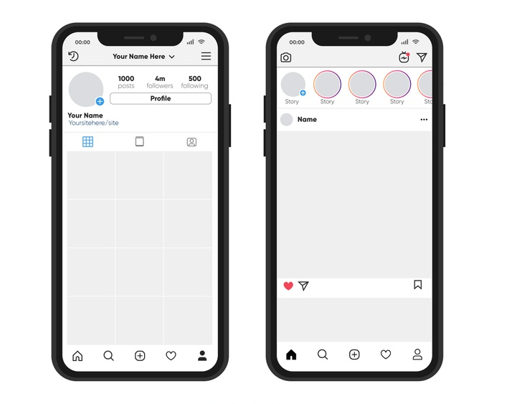
When to use async programing?
Async programming is useful when you need to looping through multiple objects or lengthy complex calculations. For example, when the Instagram application makes a HTTP request to their api, the json data needs to be parsed and rendered into the frames. This code would need to run asynchronously on the background thread to not slow down the app.

Slide 10
Advantages and Disadvantages of Async vs Sync
 | Asynchronous Programming | Synchronous Programming
Advantages | .Can run multiple tasks at the same time. .Executes complex programs with less time. | . Easier to debug because everything is running on a single thread. .Don’t need to worry about problems such as deadlocks.
Disadvantages | .Can be a little challenging to debug sometimes. .Can encounter problems such as locks and deadlocks with multiple threads. | .Can only run one task at a time. .Can make the program run slower with more complex tasks.

Slide 11
References
https://www.rudrakos.com/ios/2017/03/21/exploring-concurrency-in-ios-and-in-general/
https://www.freepik.com/free-vector/realistic-instagram-photo-frame-iphone-collection_4264408.htm#position=40
https://blog.logrocket.com/the-visual-learners-guide-to-async-js-62a0a03d1d57/
https://www.youtube.com/watch?v=5HWCsmE9DrE&t=867s

