Slide 1

霹靂卡霹靂拉拉波波莉娜貝貝魯多
DESIGNED BY NIGHT
Ethical Gaming
BUSINESS
SUMMERISE REPORT
POWERPOINT
林泓諭 施儒宏 陳昱霖

Slide 2

OUTLINE
PART ONE - TARGET
PART FOUR - SIMULATION
PART TWO - ABUSE
PART FIVE - FUTURE
PART THREE - CHEATING

Slide 3

PART ONE
TARGET
Notes:
開始想法介紹: 遊戲種類->鎖定RPG->分析外掛行為

Slide 4
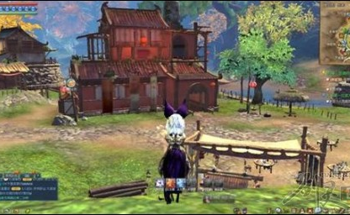
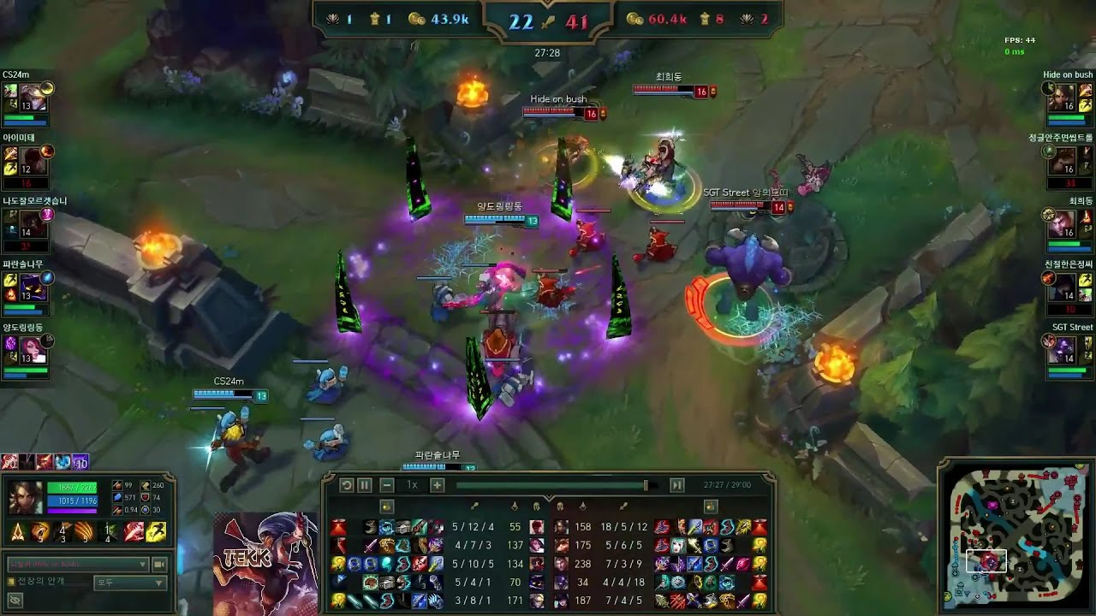
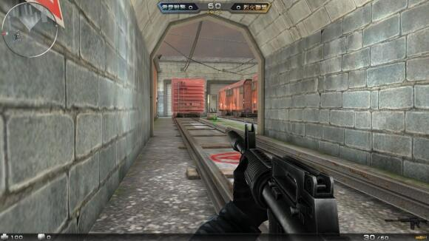
GAME CATEGORIES
1
MMORPG
2
MOBA
3
FPS
Value modification
Auto Script
Transaction Fraud
Value modification
Abusing/Flaming
AFK
Value modification
Auto Aiming

Slide 5

PART TWO
ABUSE

Slide 6
Mechanism
We perform sentiment analysis on the words that players type.
Sentiment analysis is to evaluate the emotion of the words and convert them to value within -1~1 which positive numbers represents positive emotions and vice versa.
There are two mode :
detect per line
detect per dialogue

Slide 7



Detect per Line
Fuck you
You are bull shit
You play badly! trash

Slide 8
Detect per Line
Well played!
Good game
Nice play

Slide 9
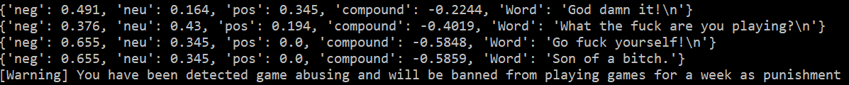
Detect per Dialogue
God damn it!
What the fuck are you playing?
Go fuck yourself!
Son of a bitch.

Slide 10
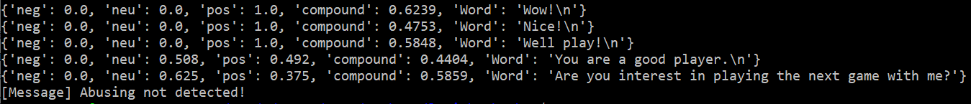
Detect per Dialogue
Wow!
Nice!
Well play!
You are a good player.
Are you interest in playing the next game with me?

Slide 11

PART THREE
CHEATING
Notes:
偵測，加密

Slide 12
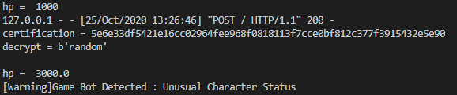
Detection Target
Value modification :
infinite skill cast
unusual character status
Acceleration

Slide 13

PART FOUR
SIMULATION

Slide 14


Encryption
Value modification is one of the main method to attack the local data.
We try to encrypt the local data which prevent the hacker from modifying. We generate a code via RSA encryption and validate the correctness.
For further implementation, one can store the encryption data in non-continuous memory location which makes the attacks even harder.
Notes:
所有物件 data 都經由 RSA 加密過
且所有 Client的DATA 都須經由 local 的解密function進行解碼
(HACKER沒辦法改function, 僅能透過記憶體偏移進行修改某物件的數值)
當HACKER 嘗試修改數值時，回傳Server後會發現 Decryption failed，便可確定是外掛
For further implementation, one can store the encryption data in non-continuous memory location which makes the attacks even harder.

Slide 15

PART FIVE
FUTURE

Slide 16
FUTURE WORK
The future work of our project :
- train the abusing and cheating detection model by machine learning
- simplify the encryption make the detection of server easier and faster
- encrypt the whole attributes that makes attacker harder to modify
We are also looking to seeing the game community to be more friendly and tolerant, ethical gaming world should be maintained by every players in the community.

Slide 17
Thanks

