Slide 1
Time to melt in phase change materials
Genevieve Gaudin and Austin Warren

Slide 2
Outline
Concentrated solar power
Thermal storage via phase change materials
Current research
Our goal
Methodology
Results/ conclusions

Slide 3
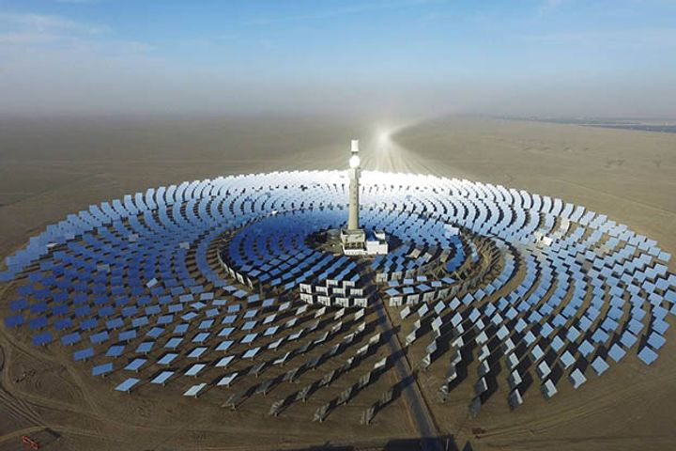
Concentrated solar power
Uses mirrors to heat water and turn a turbine
Can’t run the system at night
[2]

Slide 4
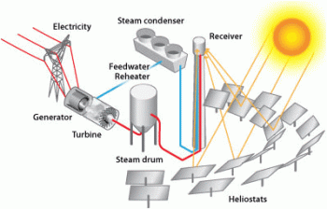
Thermal storage via phase change materials
Store the excess heat during the day
Use the heat at night to extend the hours of power generation
[2]

Slide 5
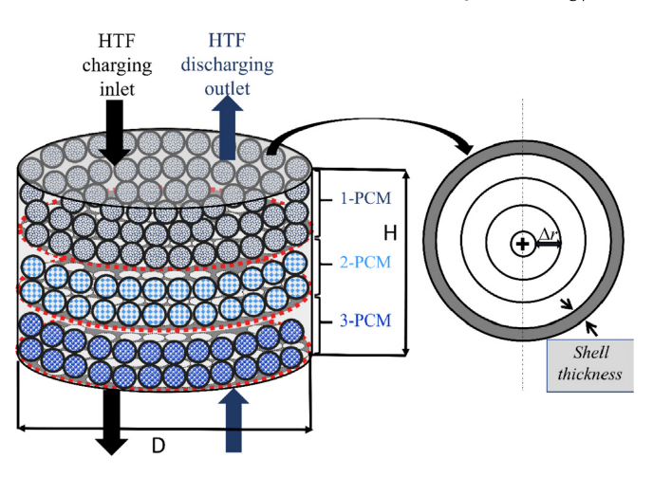
Current research
Packed beds with spherical salts
Different salts have different melting points
[3]

Slide 6
Drawback of current research
Spheres are hard to manufacture
Modeling efforts don’t capture the randomized nature of the packed bed

Slide 7
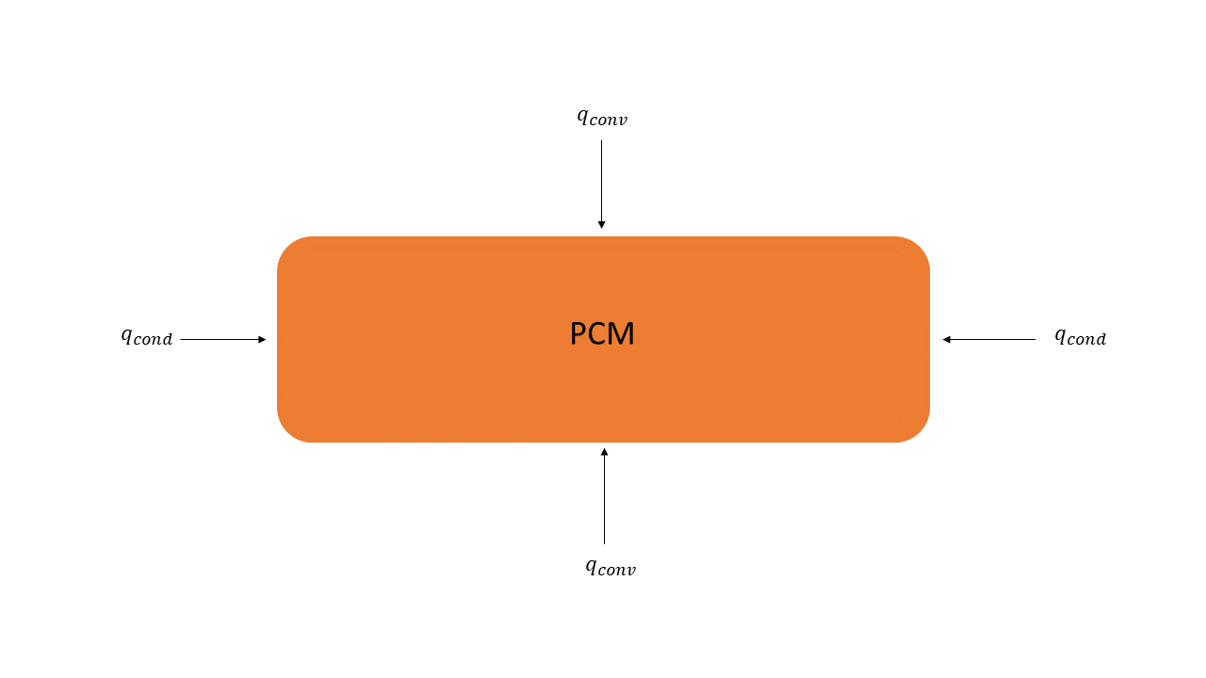
What we are doing different
Take the same salts and change the form factor to a brick
How long will it take the brick to completely change phase?

Slide 8
Methodology
Finite difference analysis
Average thermophysical properties
Stop when all the temperatures are equal to or higher than the melting point

Slide 9
Methodology
Three salts:
Sodium Carbonate-Lithium Carbonate (769 K)
Magnesium Chloride- Sodium Chloride (708 K)
Potassium Hydroxide (653 K)

Slide 10
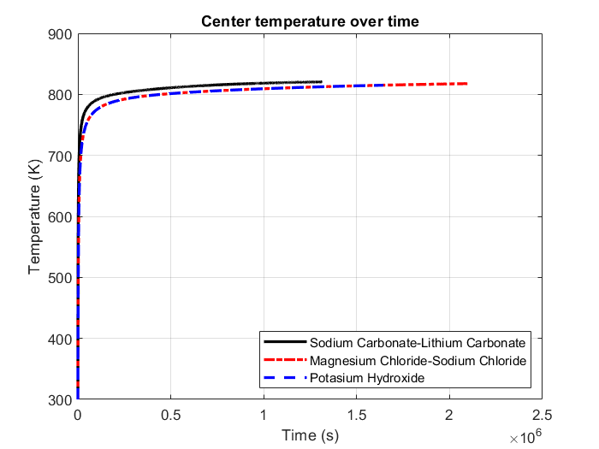
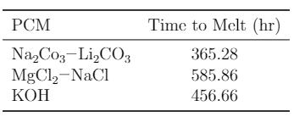
Results

Slide 11
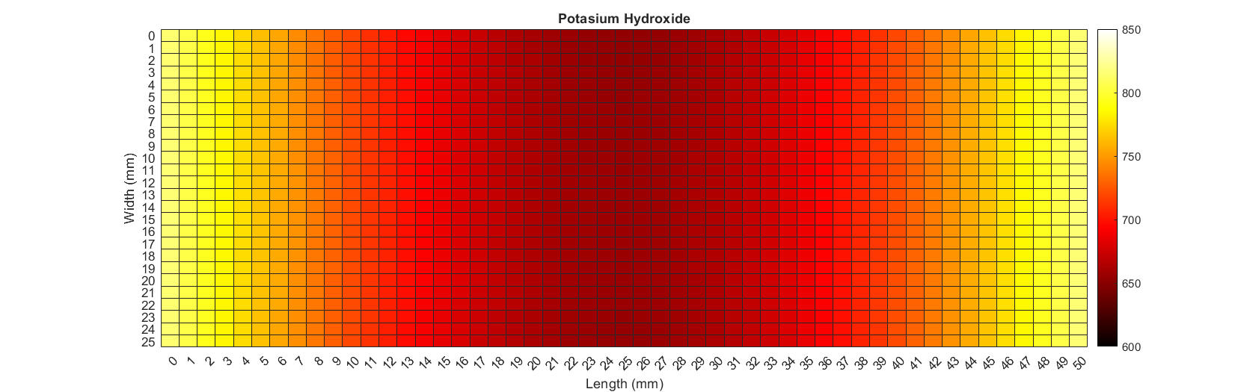
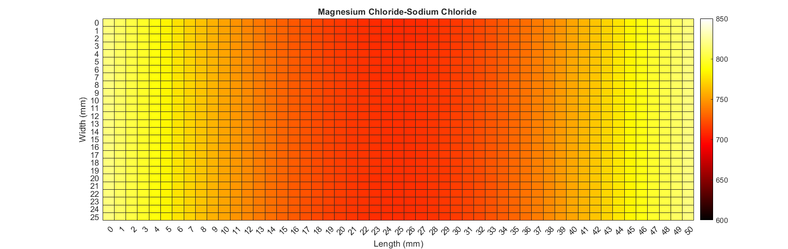
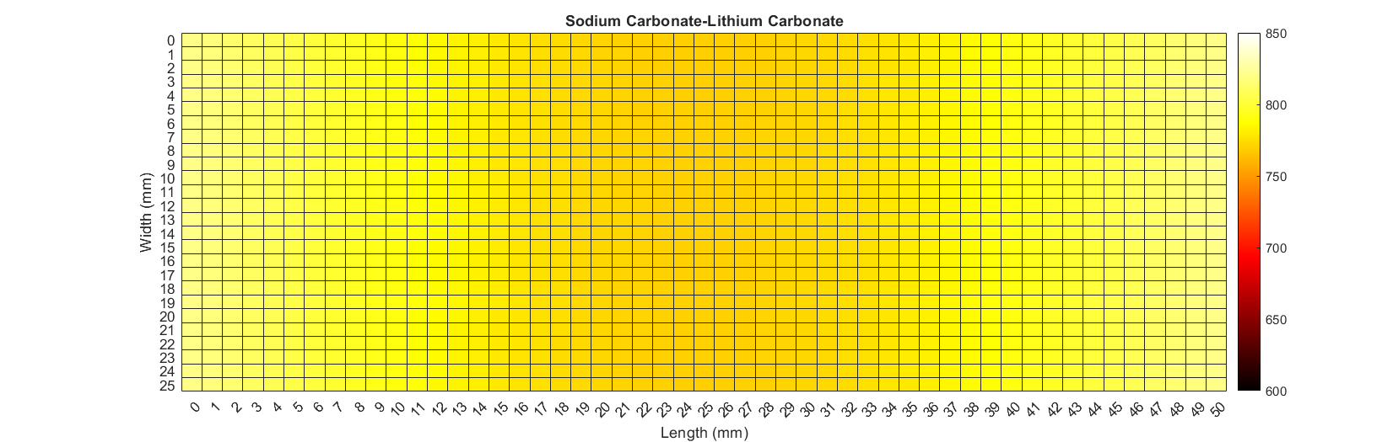
Results

Slide 12
Conclusions
Ease of manufacture does not outweigh the cost of thermal performance

Slide 13
References
[1] https://www.yicaiglobal.com/news/china-puts-200-megawatt-hour-concentrated-solar-power-plant-into-operation
[2] https://www.energy.gov/eere/solar/power-tower-system-concentrating-solar-thermal-power-basics
[3] https://www.sciencedirect.com/science/article/pii/S0960148120300562

