Slide 1
Time to melt in phase change materials
Genevieve Gaudin and Austin Warren

Slide 2
Outline
Concentrated solar power
Thermal storage via phase change materials
Current research
Our goal
Methodology
Results/ conclusions

Slide 3
Concentrated solar power
Uses mirrors to heat water and turn a turbine
Can’t run the system at night

Slide 4
Thermal storage via phase change materials
Store the excess heat during the day
Use the heat at night to extend the hours of power generation

Slide 5
Current research
Packed beds with spherical salts
Different salts have different melting points

Slide 6
Drawback of current research
Spheres are hard to manufacture
Modeling efforts don’t capture the randomized nature of the packed bes

Slide 7
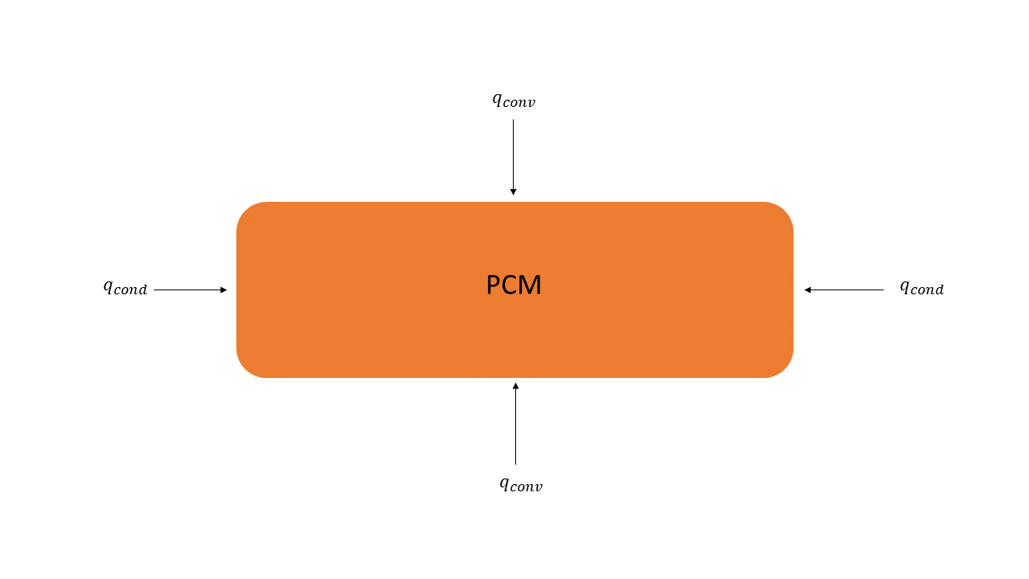
What we are doing different
Take the same salts and change the form factor to a brick
How long will it take the brick to completely change phase?

Slide 8
Methodology
Finite difference analysis
Average thermophysical properties
Stop when all the temperatures are equal to or higher than the melting point

Slide 9
Methodology
Three salts:
Sodium Carbonate-Lithium Carbonate (769 K)
Magnesium Chloride- Sodium Chloride (708 K)
Potassium Hydroxide (653 K)

Slide 10
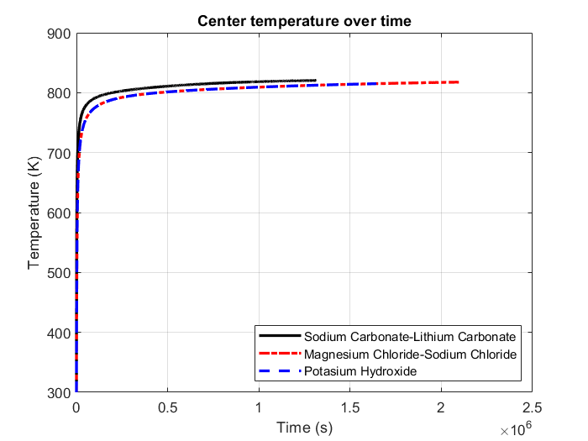
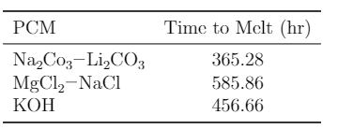
Results

Slide 11
Results

Slide 14
References

