Slide 1

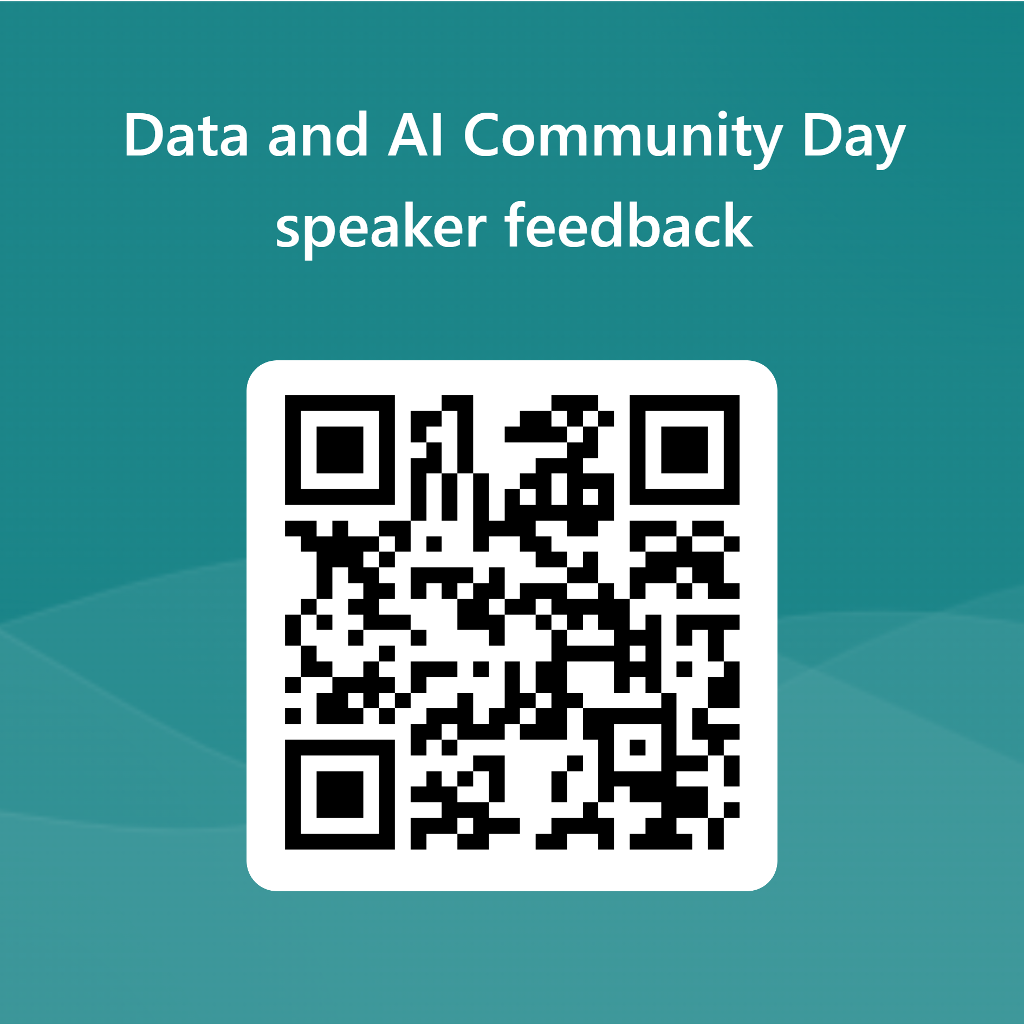

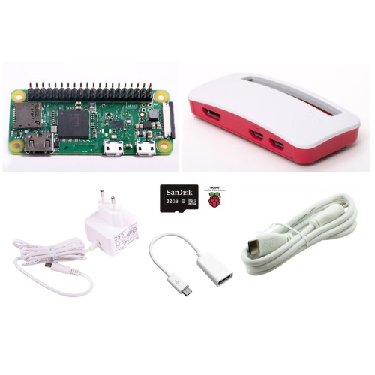
Data and AI community day
Our Sponsors
Each review will be an entry into the draw for one of two Raspberry Pi’s

