Slide 1
Task 2 Bluetooth Low Energy
--Team 12

Slide 2
Index of content
Setup BLE
Scan BLE devices
Device connection
Read temperature / humidity
Characteristic change notification
Write control state to BLE controlled fan

Slide 3
Setup BLE
Permission and features
Bluetooth
BLUETOOTH, BLUETOOTH_ADMIN
Location
ACCESS_FINE_LOCATION, ACCESS_COARSE_LOCATION
Enable Bluetooth service
Check if supported

Slide 4
Scan BLE devices
startLeScan()
Stops scanning after a pre-defined scan period
postDelay()
LeScanCallback
Called when device available
add the found device to the LeDeviceListAdapter
Show on the View

Slide 5
Device connection
BluetoothGatt
Enable communication between bluetooth devices
connectGatt()
Return an instance of bluetoothGatt to setup the connection
GattCallback
Transfer connection status and result

Slide 6
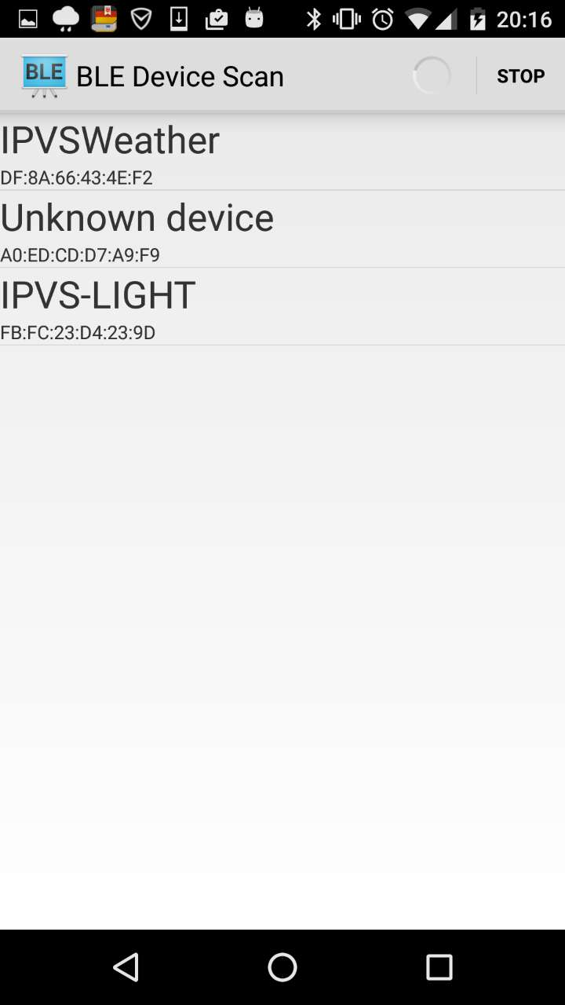
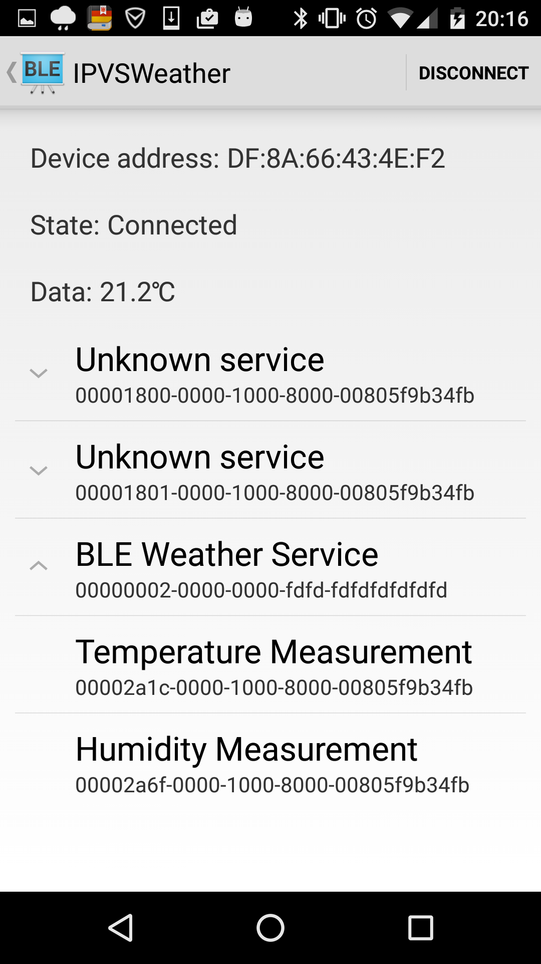

Slide 7
Read temperature / humidity
Achieve and locate services / characteristics
BluetoothGatt.getServices()
BluetoothGattService.getCharacteristics()
Use a 2-level list to store characteristics
ExpandableListView
Group position and child position
Properties
BluetoothGattCharacteristic.getProperties()
PROPERTY_READ (0x00000002)
PROPERTY_WRITE (0x00000008)
PROPERTY_NOTIFY (0x00000010)
bitmask operation to get the properties available
ANDbit (“&”)

Slide 8
Read temperature / humidity
Read characteristics
BluetoothGatt .readCharacteristic()
BluetoothGattCallback.oncharacteristicRead()
Data display
Data display
Format
E.g. FLOAT, UINT16 …
BluetoothGattCharacteristic.getFloatValue()/ getIntValue()

Slide 9
Characteristic Change Notification
Descriptor
Feature / Behavior of characteristics
UUID
00002902-0000-1000-8000-00805f9b34fb
Value
BluetoothGattDescriptor.ENABLE_NOTIFICATION_VALUE
BluetoothGattDescriptor.setValue()
BluetoothGatt.writeDescriptor()
BluetoothGatt.setCharacteristicNotification()
BluetoothGattCallback.onCharacteristicChanged()
Display data again

Slide 10
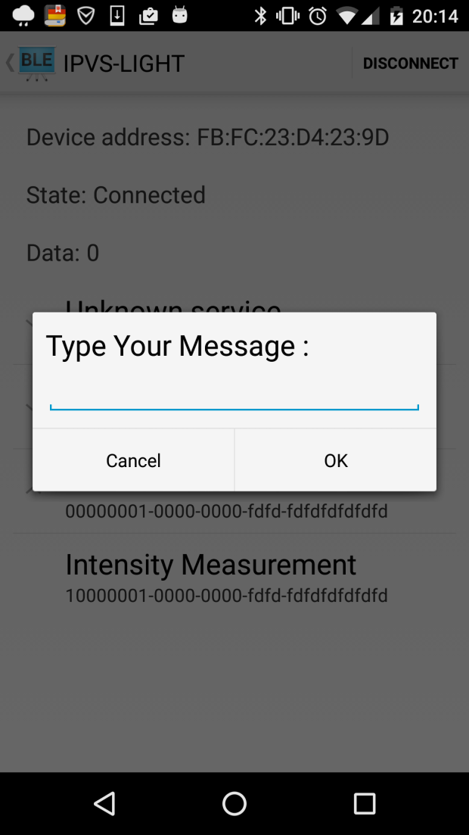
Write control state
In deviceControlActivity
Two conditions
After touch the screen “Intensity measurement”
For characteristics with write properties
setIntensity()
“OK” ->writeCharacteristic
(characteristic,intensity)

Slide 11
Write control state
In BluetoothLeservice
characteristic.setValue(intensity,BluetoothGattCharacteristic.FORMAT_UINT16, 0);
mBluetoothGatt.writeCharacteristic(characteristic);
onCharacteristicWrite()
broadcastUpdate(ACTION_DATA_AVAILABLE, characteristic);

Slide 12
Reference
Program sample
https://developer.android.com/samples/BluetoothLeGatt/index.html

Slide 13
Thanks for listening!

